Slide 2
Windows to the Soul: A Creative Writing Project
ELA 7-12

Slide 3
Guiding Questions
What does a piece of art communicate to us?
How can art inform our writing?

Slide 4
Commit & Toss
Choose a person who you admire.
On each post-it note:
Write your name.
Write one adjective or characteristic that describes this person.
Complete three post-it notes.
This Photo by Unknown Author is licensed under CC BY-SA-NC
Notes:
Image citation: Explain to students that they can choose someone they know personally or from the public. If it is someone from the public, tell students that it should not be someone who is generally

Slide 5
Art project
Draw a pair of eyes that best represents the adjectives or characteristics you chose and the person you admire.
This Photo by Unknown Author is licensed under CC BY-NC-ND

Slide 6
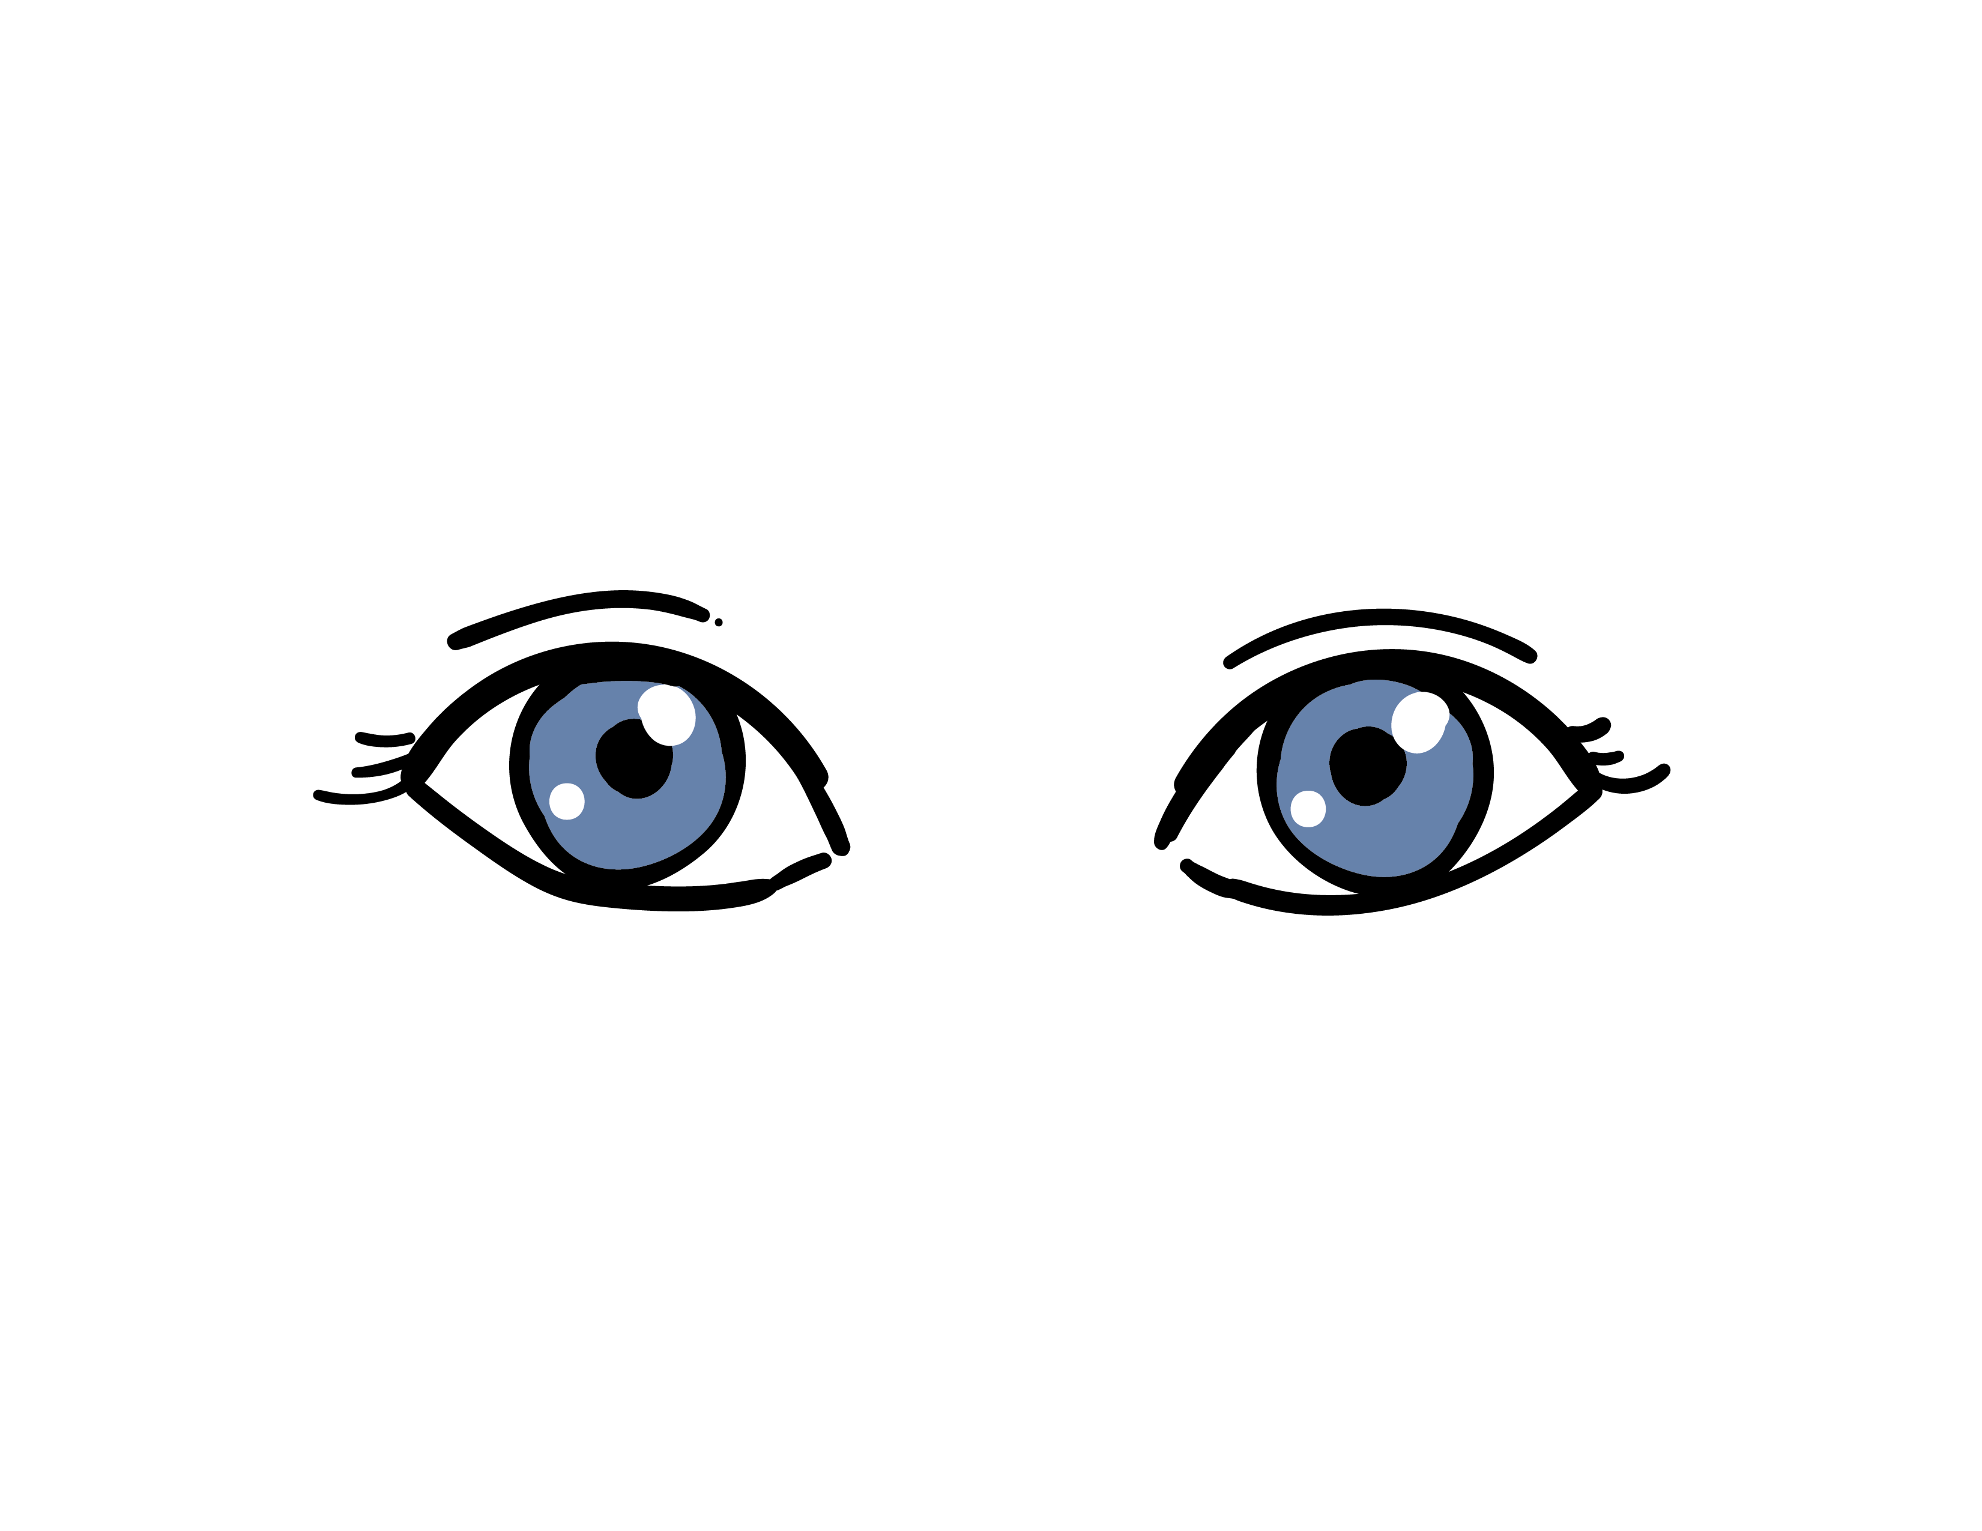
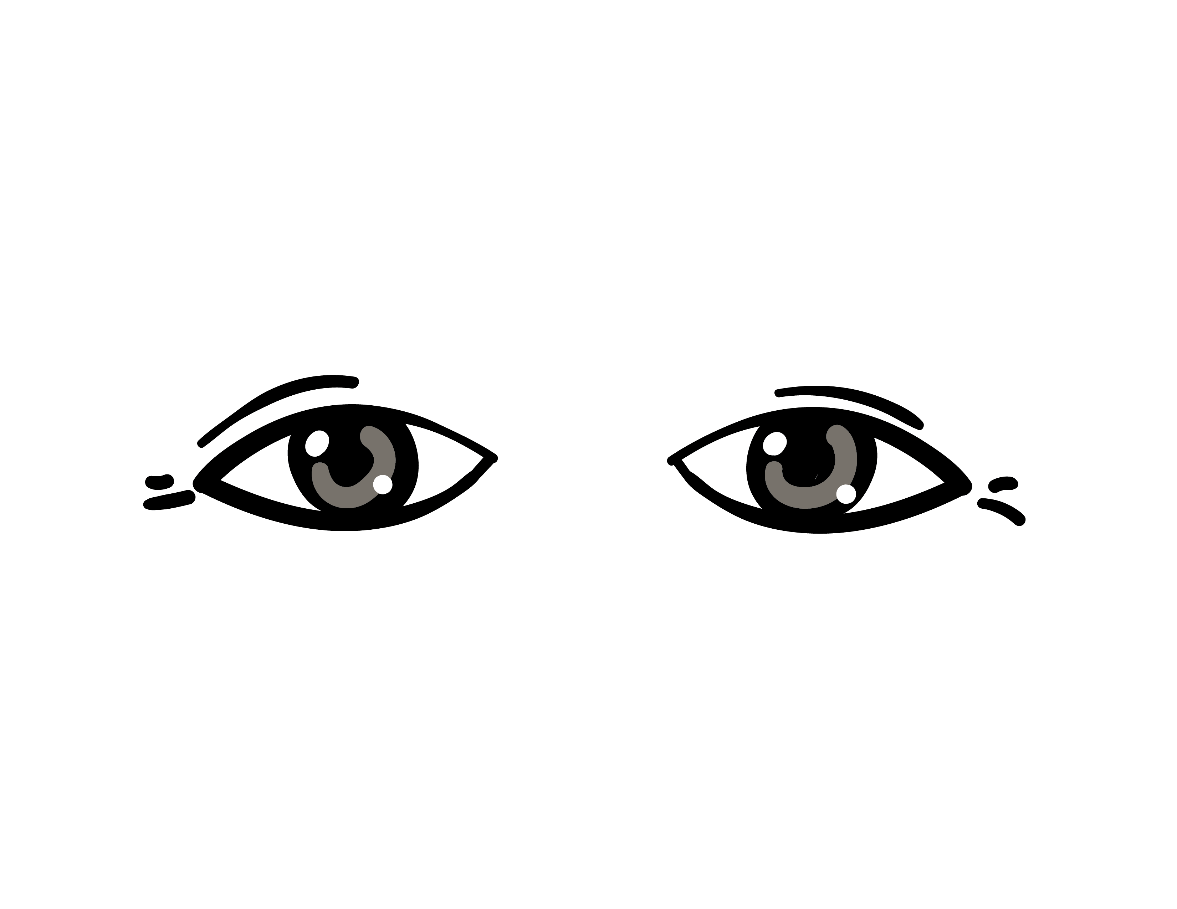
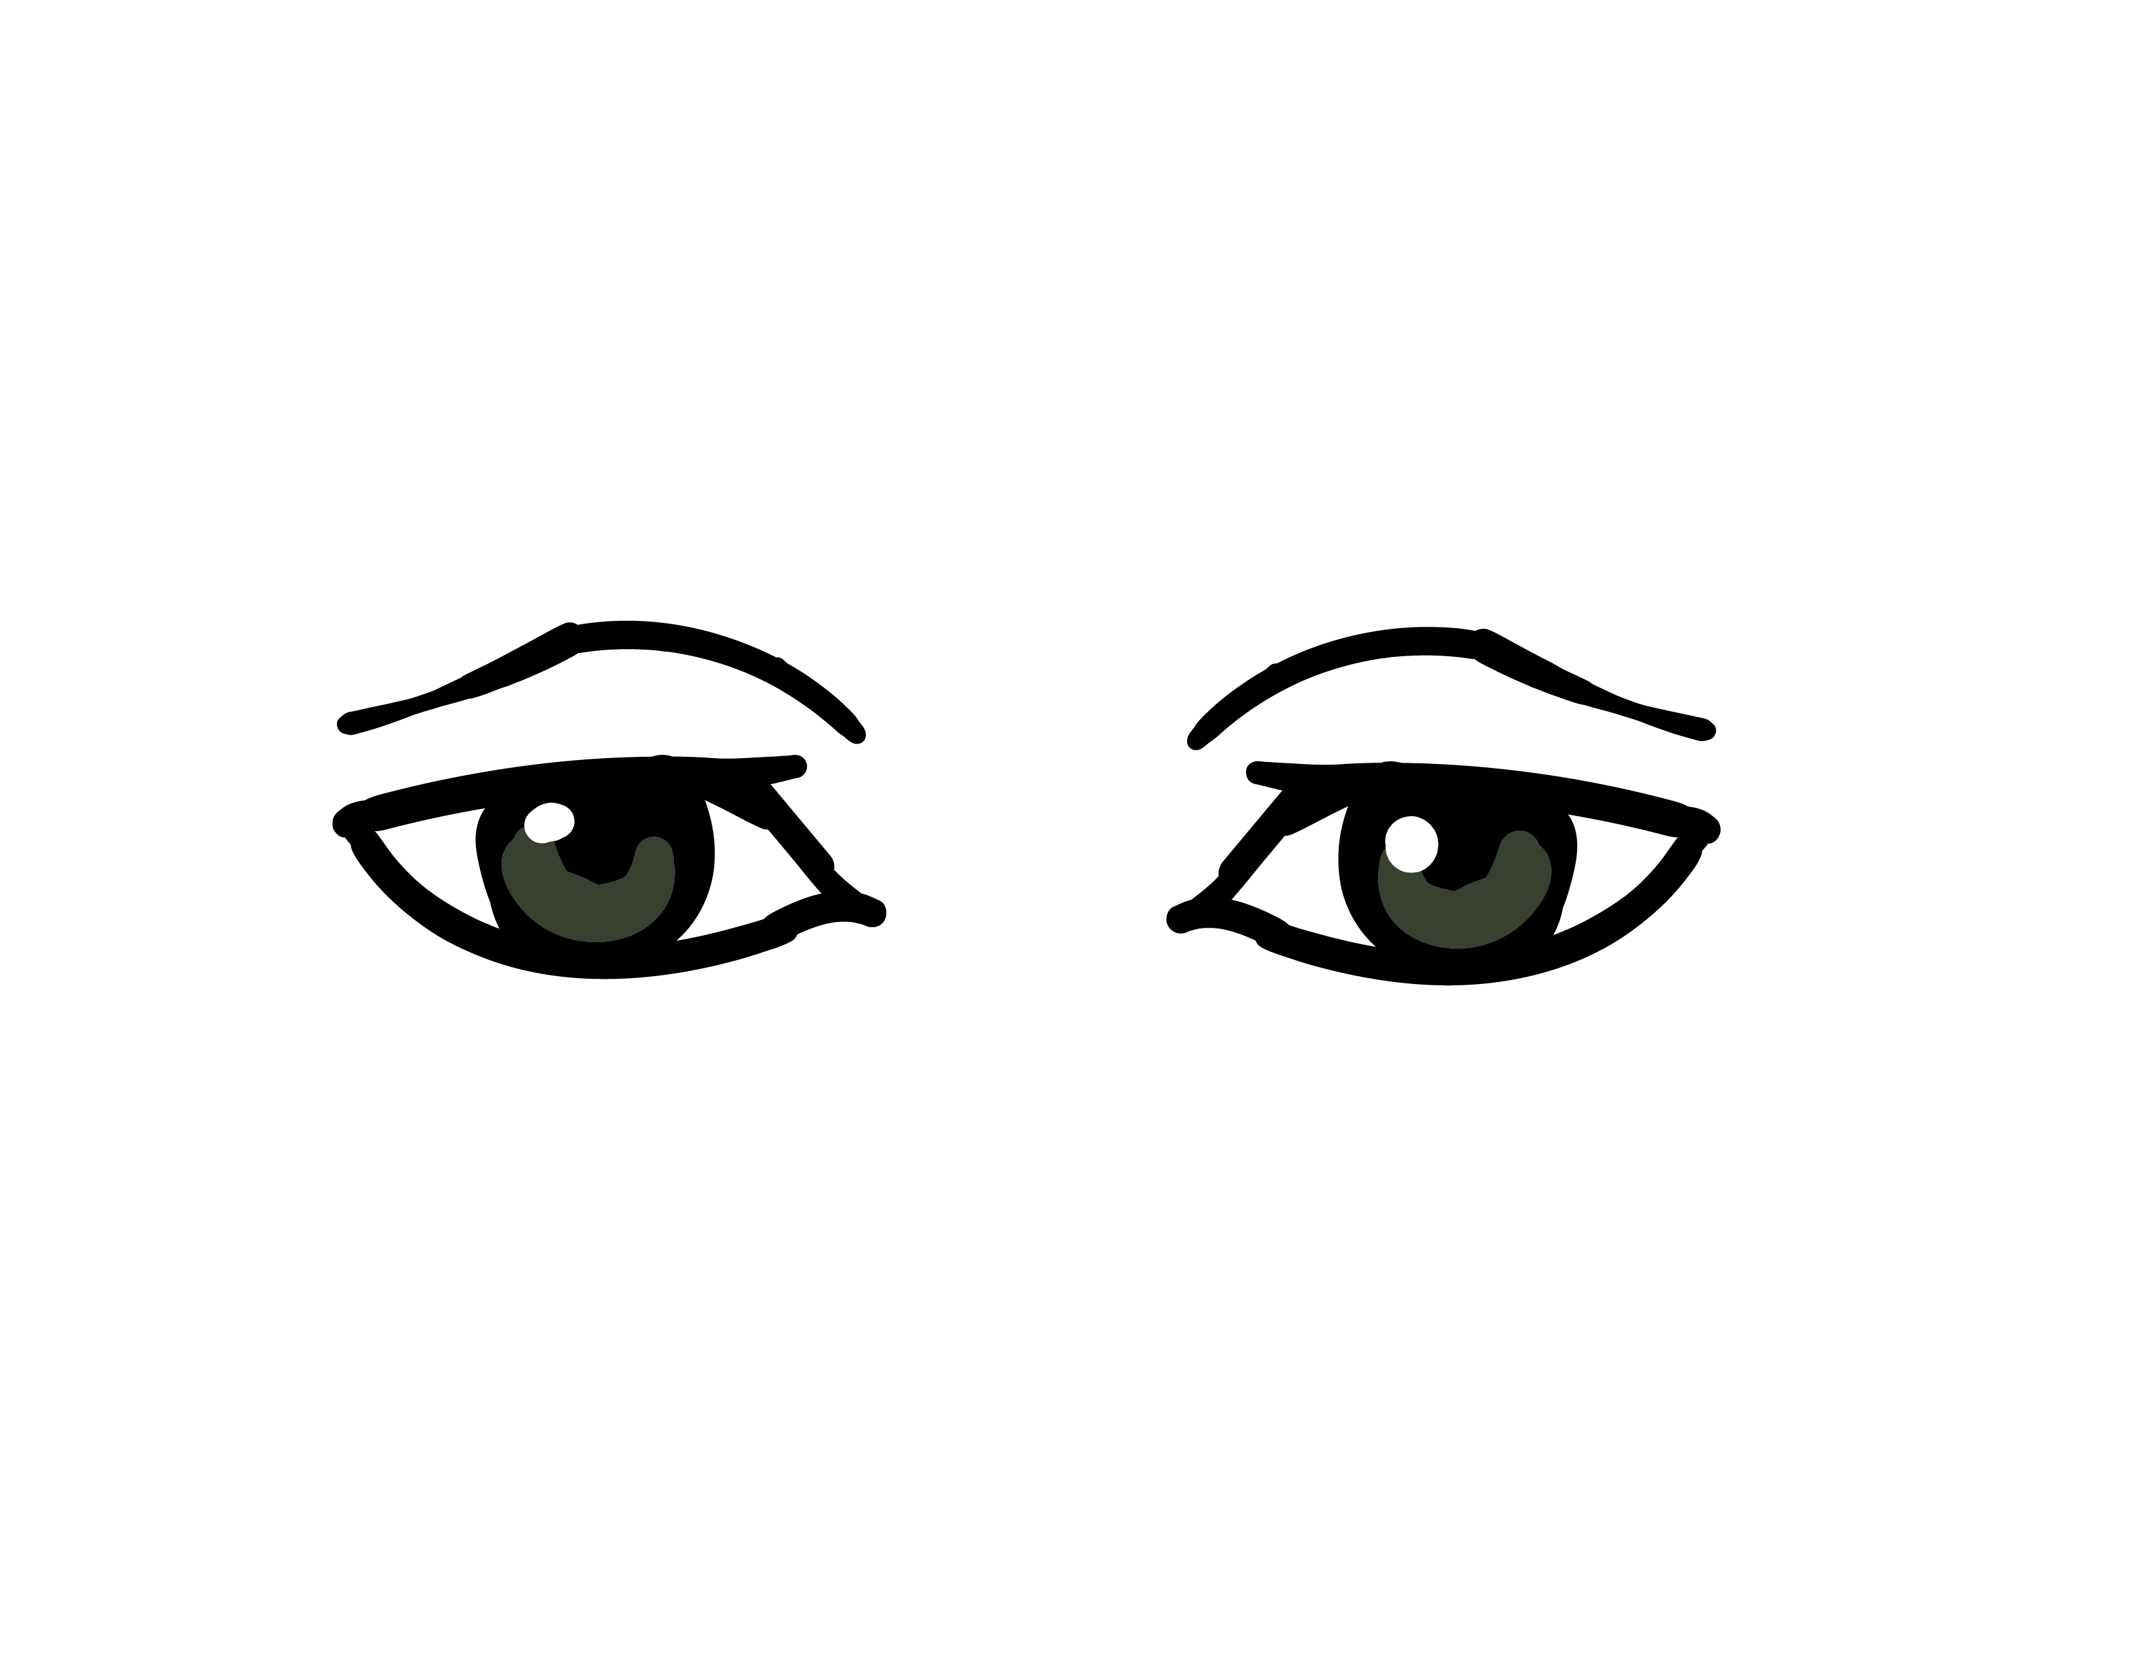
You can judge a person by simply looking into their eyes.

Slide 7
The eyes have a story to tell…
What story would your eyes tell others?
This Photo by Unknown Author is licensed under CC BY-SA

Slide 8
Group Feedback
On your post-it note,
Write a “star” note- something the writer did well from the checklist.
Write a “check” note- something the writer might want to check again or revise before writing the final copy.
This Photo by Unknown Author is licensed under CC BY-SA

