Slide 2
Unitary, Federal, and Confederal Systems of Government

Slide 3
Essential Question
How do governments distribute power?

Slide 4
Lesson Objectives
Compare and contrast systems of government.
Evaluate the advantages and disadvantages of unitary, confederal, and federal systems.

Slide 5
Think, Pair, Share
What is the role of government in people's lives?

Slide 6
T-Chart
As a group, read through the description of the country.
Write down the advantages and disadvantages of the country’s system of government.
Be ready to share something you have written down.

Slide 7
Systems of Government
Read each card and sort into the type of government that is being described.
Unitary
A system in which all or most of the power resides in a single and centralized government. Laws and regulations are the same across a unitary governmental system.
Confederal
A group of states that form a union to coordinate for specific purposes.
Federal
A system in which the power is divided between a strong central government and smaller states.

Slide 8
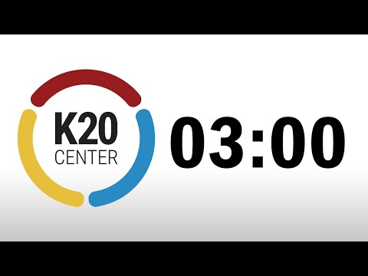
Evaluating Governments
Visit each Chat Station Poster around the room with your group.
Read the prompt and discuss the corresponding questions.
When the timer expires, move to the next poster.
https://www.youtube.com/watch?v=iISP02KPau0
Notes:
https://www.youtube.com/watch?v=iISP02KPau0

Slide 9
Systems Report Card
Give each system of government grades for the categories listed.
Look at your grade for each category and assign an overall grade.
Leave some comments that explain your grade.

