Slide 2
The Great Gatsby and the Sense of Touch
Texture Poetry:
What is the relationship between a character and an object?

Slide 3
In your groups…
Get one “Texture Bag”
Without looking at the contents of the bag, take turns in your group feeling the texture of the contents.
In your comp books, start compiling a list of adjectives that describe the texture of the contents of your bag.
Use the Texture Words handout to help with descriptive words

Slide 4
Two-Minute Paper
In your comp books, answer the following:
Describe, without giving away the name of the object, what you think is in your “Texture Bag”; use the descriptive words from your initial list to help.
After two minutes, one member from each group will share. See if the rest of the class can guess your object based on the texture description!

Slide 5
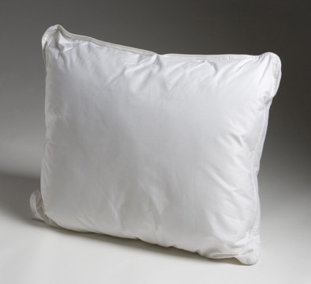

Describe the textures that both objects have in common

Slide 6
What are the differences between how you would hold these objects?

Slide 7
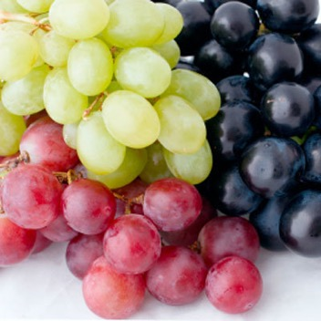
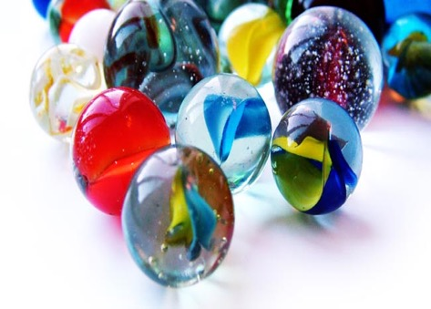
Texture similarities? How would you handle these differently?

Slide 8
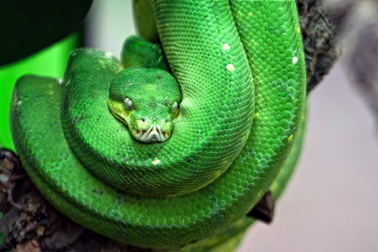
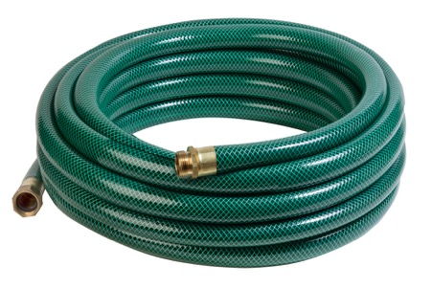
Texture similarities? How would you handle these differently?

Slide 9
Explore
The Great Gatsby and the Sense of Touch
"How can the feeling of a physical object mirror the feelings of a character?"

Slide 10
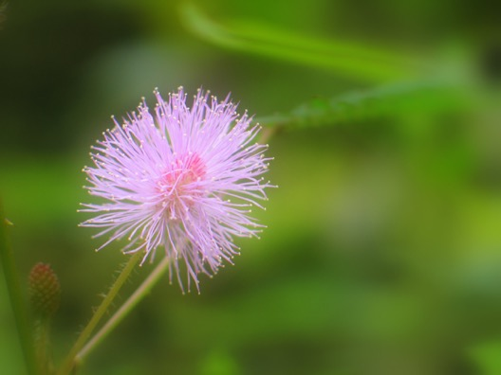
What is the texture of this flower?
How would the characters from Gatsby react differently? Jay Gatsby vs. Tom Buchanan?

Slide 11
Choose ONE character from The Great Gatsby
Without naming the character, write 1)a metaphor and 2)a simile from that character’s point of view describing this flower

Slide 12
Choose ONE character about whom to write.
Next, choose ONE object on which to focus (something that has TEXTURE that can be described)
Without revealing either the character or the object, you will write a poem (using the format on your handout as a starting place) that shows how the feeling of that object reveals aspects and feelings of your character

Slide 13
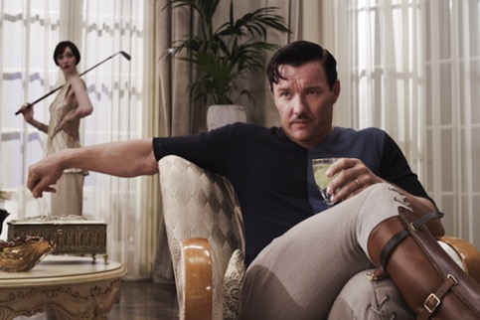
Your final project will include:
  1. Texture Poem on a separate sheet of paper
  2. Rubric

