Slide 1
What is the Green Revolution?
An AP World Geography Lesson

Slide 2
Essential questions of this lesson
Is the world's food supply enough for a growing population?
What was the Green Revolution?
What are the challenges of a Western diet?

Slide 3
The World Population Clock is Ticking!
http://www.worldometers.info/world-population/
How fast is the world’s population growing?

Slide 4
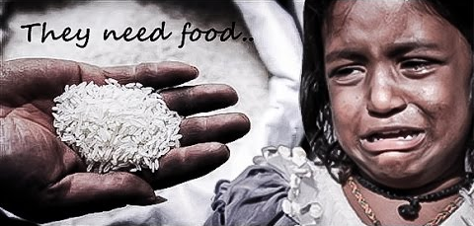
Hunger exists. Where do we look for it in the world?

Slide 5
Two-part brainstorm activity
Reasons for Abundant Food Supply
Reasons for Scarce Food Supply

Slide 6
Two-column notes example 1 & 2
Guiding Questions
Video Notes
1.What was the Green Revolution?
2. How were seeds different in the Green Revolution?

Slide 7
Two Column Notes Example 3 & 4
Guiding Questions
Video Notes
3. How were farming methods different?
4. What countries benefited most by the Green Revolution?

Slide 8
Two-column notes example 5 & 6
Guiding Questions
Video Notes
5. What were some positive results of the Green Revolution?
6. What were some negative consequences of the Green Revolution?

Slide 9
The Green Revolution: Waging a War Against Hunger video
https://www.youtube.com/watch?v=HucSCNQ01X4
Notes:
chocoabuddha. (2010). The Green Revolution: Waging a war against hunger [Video file]. Retrieved from https://www.youtube.com/watch?v=HucSCNQ01X4
Alternative video: Samhita Karnati. (2012). Winner National History Day 2012 – The Green Revolution: Against all odds [Video file]. Retrieved from https://www.youtube.com/watch?v=c6Ids_RK6XM

Slide 10
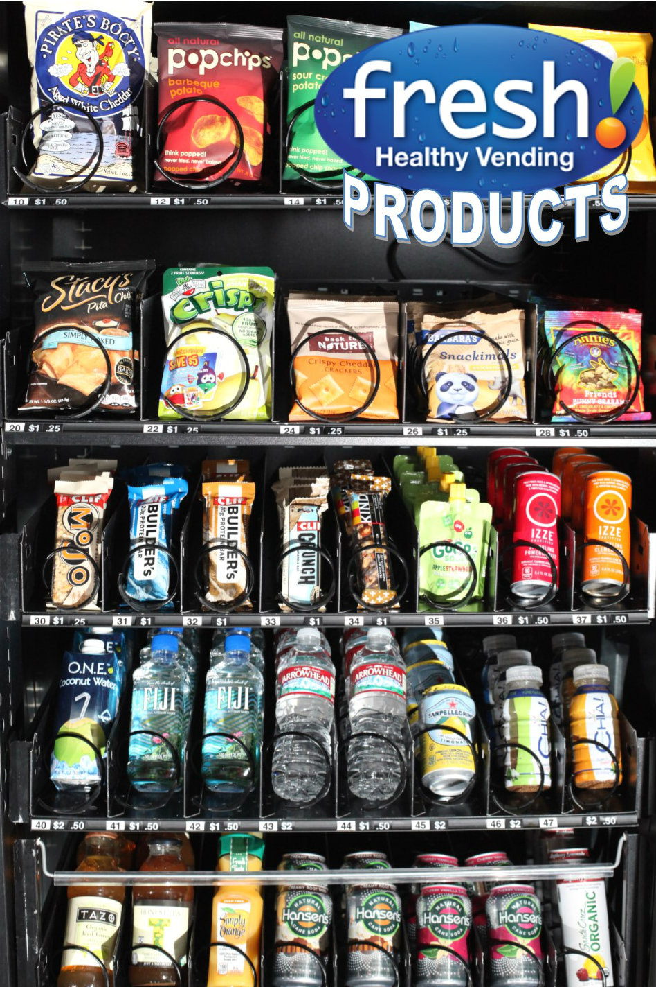
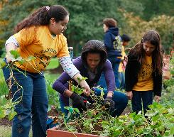
Michelle Obama’s War
Notes:
Jackson, L. (2013, Feb. 28). First Lady Michelle Obama exercises with kids. Official White House Photo. Retrieved from https://letsmove.obamawhitehouse.archives.gov/blog/2013/02/28/new-program-will-help-bring-physical-activity-back-schools
Fresh Healthy Vending. (n.d.). Fresh! Healthy Vending Products. Retrieved from https://www.pinterest.com/pin/438819557412751536/
Newsweek. (2010, March 22). Cover [Image]. Newsweek. Retrieved from https://theobamadiary.com/2017/03/01/celebrating-lets-move/
NPR. (2011). Michelle Obama Gardening [Image]. NPR. Retrieved from https://theobamadiary.com/2017/03/01/celebrating-lets-move/

Slide 11
Stop & Jot
As you read the article, stop after one or two paragraphs.
Write a few main ideas in the margin of your paper.
Continue to “stop and jot” until you finish the reading.

Slide 12
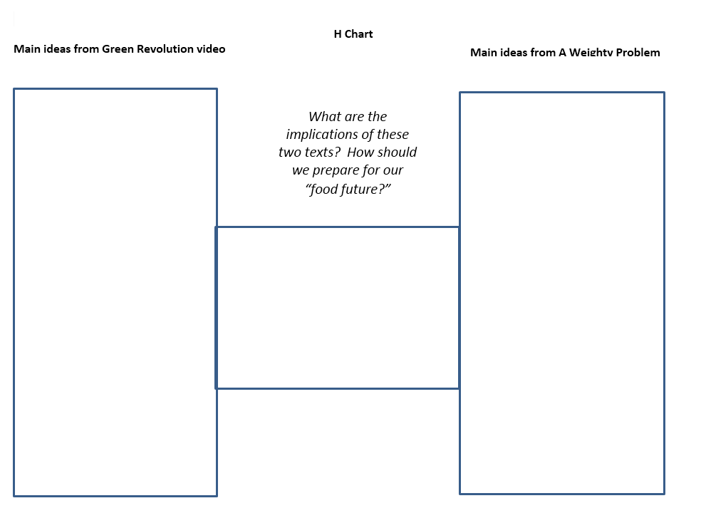
H Chart

Slide 13
A Public Service Announcement (PSA) Poster
Based upon what you have learned, create a PSA poster. It should display ONE of these choices:
A poster that explains the problem of obesity and western diets,
A poster that explains Michelle Obama’s fight for ending childhood obesity, or
A poster that shows healthier alternatives to fast food.

