Slide 1
What is the Price of Freedom?
A U.S. History Lesson

Slide 2
Essential Questions:
Is it worth giving up personal freedoms for greater protection?
How do we define terrorists and terrorism?

Slide 3

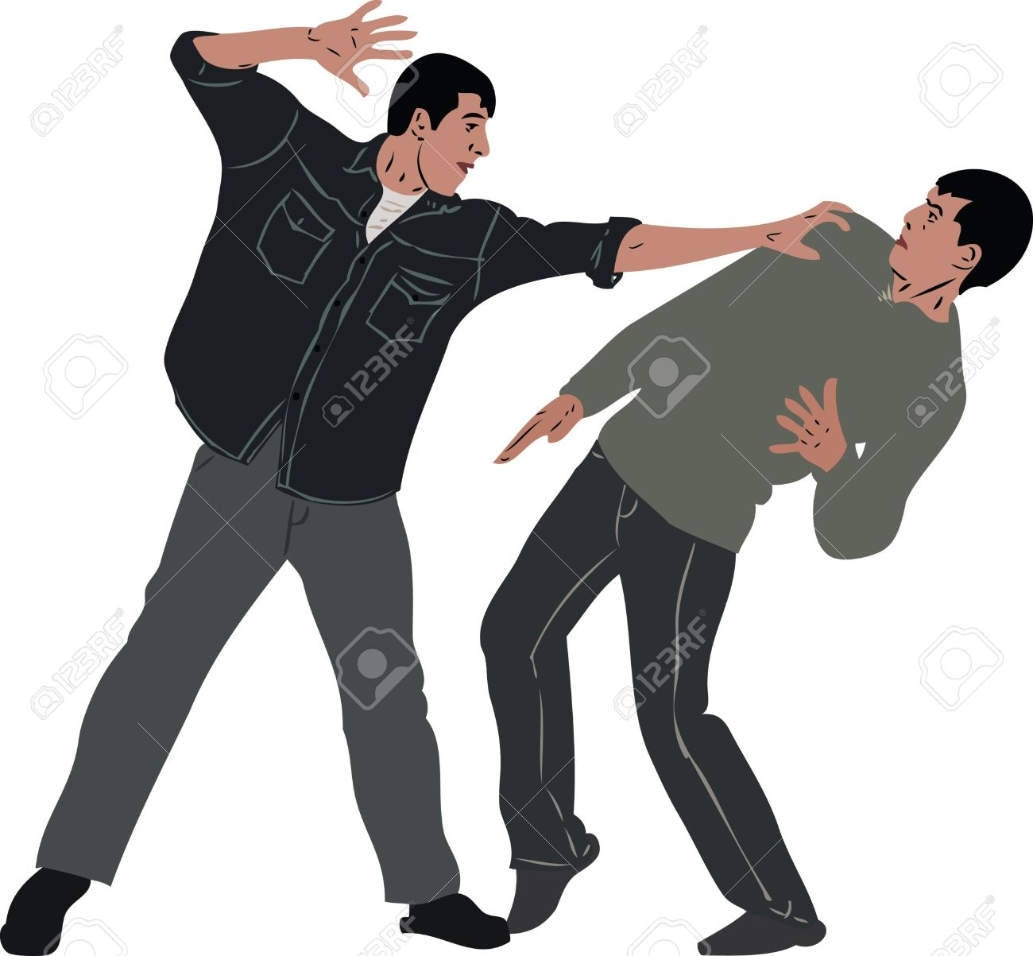
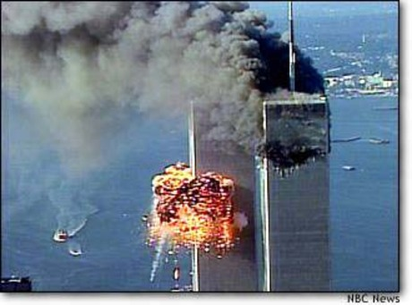
Which of these events is terrorism?
2.
1.
3.

Slide 4
The FBI’s definition of terrorism
The Federal Bureau of Investigation (FBI) defines terrorism as
“the unlawful use of force or violence against persons or property to intimidate or coerce a government, the civilian population, or any segment thereof, in furtherance of political or social objectives.”
Jan 3, 2017
Source: National Institute of Justice
https://www.nij.gov/topics/crime/terrorism/Pages/welcome.aspx

Slide 5
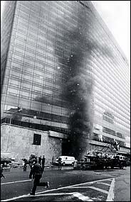
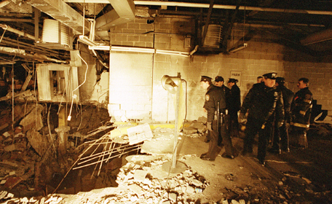
Truck Bombing of World Trade Center, 1993

Slide 6
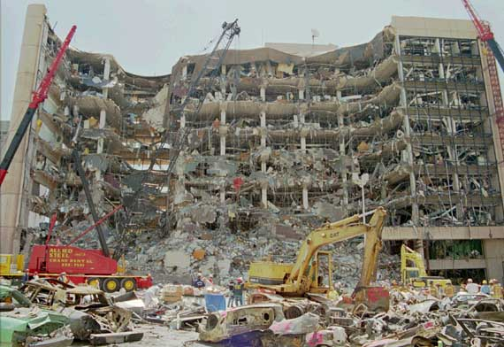
The Murrah Bombing,1995

Slide 7
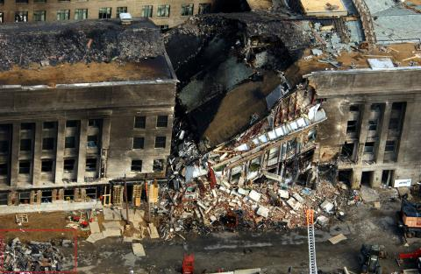
World Trade Center and Pentagon attacks, 2001

Slide 8
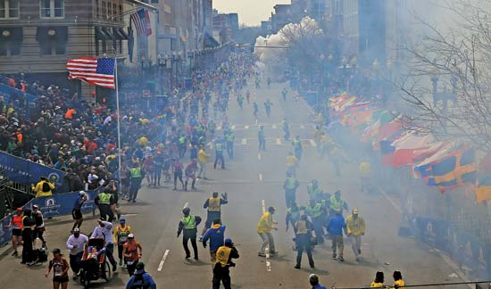
The Boston Marathon attack, 2013

Slide 9
After reading the handout, write 3 sticky notes!
Sticky Note 1- Write one thing that you noticed all the terrorist attacks have in common.
Sticky Note 2- Write one way that any of these terrorist attacks COULD or MIGHT have been prevented.
Sticky Note 3- Write one question that you still have about terrorism or any of these attacks.

Slide 10
The largest terrorist attack on September 11, 2001, killed nearly 3,000 U.S. citizens.
To prevent future terrorism, Congress created the Patriot Act in October of 2001.
The Department of Homeland Security was formed to prevent any future terrorist attacks and to coordinate their investigations with the FBI, CIA, and law enforcement.

Slide 11
Jigsaw Activity
The Patriot Act gave law enforcement more powers to investigate citizens.
Read the section of the Patriot Act that is the same as your assigned number.
Write down one pro about the part of the Patriot Act you read.
Write down one con about the part of the Patriot Act you read.

Slide 12
Jigsaw Activity Discussion
With your Group:
Summarize what this section of the Patriot Act says.
Determine one pro about this section of the law.
Determine the best con about this section of the law.

Slide 13
Weighing the PROS and CONS:
Does the Patriot Act go too far in violating a person’s rights to privacy?

Slide 14
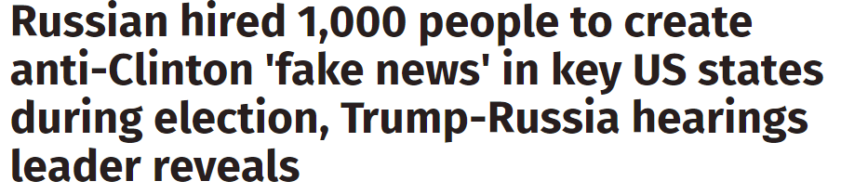
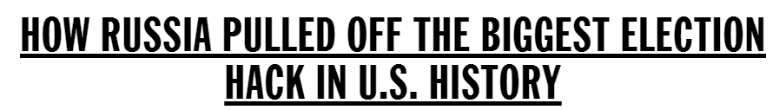


Slide 15
Revise the FBI’s definition of terrorism to include cyberterrorism
The Federal Bureau of Investigation (FBI) defines terrorism as
“the unlawful use of force or violence against persons or property to intimidate or coerce a government, the civilian population, or any segment thereof, in furtherance of political or social objectives.”
Jan 3, 2017
Source: National Institute of Justice
https://www.nij.gov/topics/crime/terrorism/Pages/welcome.aspx

Slide 16
Seven minute opinon paper
Choose one topic to write about.
Does the government go too far in invading citizens’ privacy in the Patriot Act? What individual rights should be protected?
OR
Does the government not go far enough in preventing terrorism? What else should be done?

