Slide 1
Composite Figures in Architecture
Perimeter and Area of Composite Figures

Slide 2
Essential Questions
How can you use formulas to find the perimeter and area of an object with an unusual shape?
How do the dimensions of a figure affect the perimeter and area?

Slide 3
Lesson Objective
Students will be able to find the perimeter and area of composite figures using both pattern blocks and architectural designs.

Slide 4
KWL Chart: Perimeter and Area
What I Know | What I Want to Know | What I Learned

Slide 5
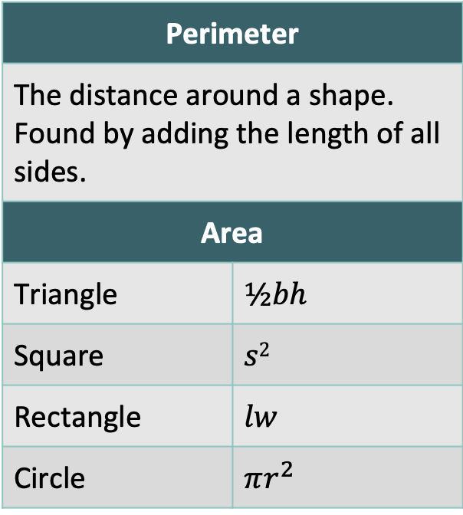
Explore with Shapes
Perimeter
The distance around a shape. Found by adding the length of all sides.
Area
Triangle | $$½bh$$
Square | $$s2$$
Rectangle | $$lw$$
Circle | $$πr^{2}$$
Using pattern blocks, rulers, and the formulas to the right, find the perimeter and area of the unique shapes.

Slide 6
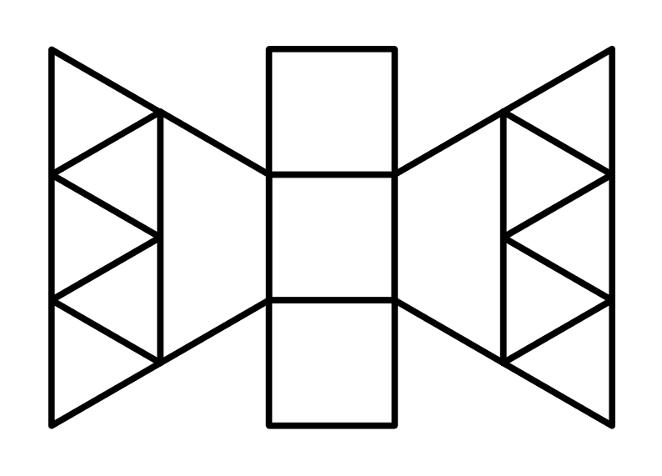
How did you solve for this picture?

Slide 7
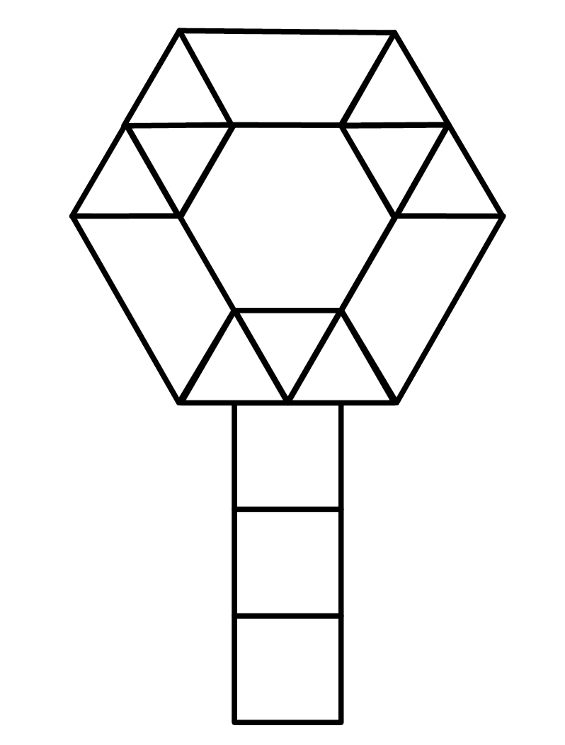
How did you solve for this picture?

Slide 8
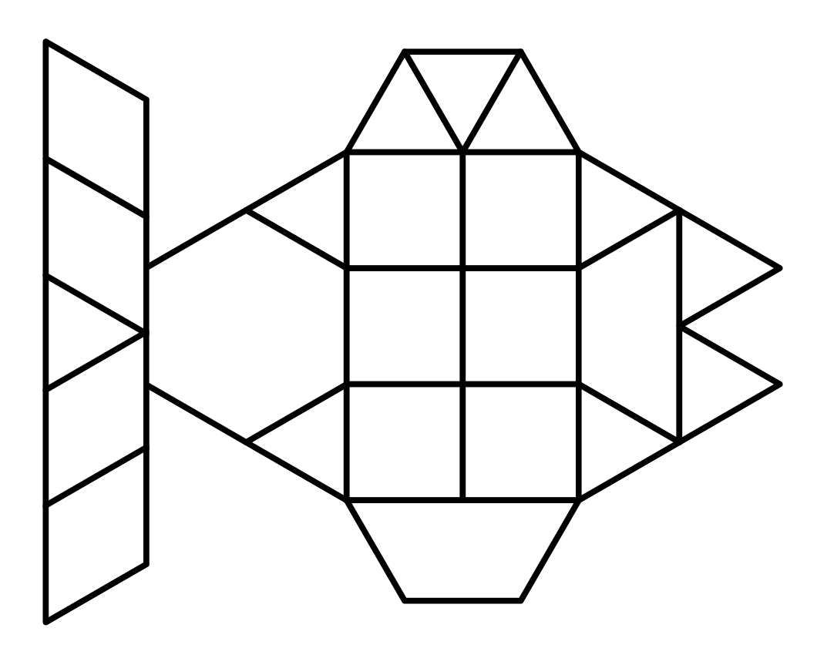
How did you solve for this picture?

Slide 9




Area of a Trapezoid
$$a$$
$$A=\frac{a+b}{2}h$$
$$h$$
$$b$$

Slide 10
KWL Chart: Perimeter and Area
What I Know | What I Want to Know | What I Learned

Slide 11
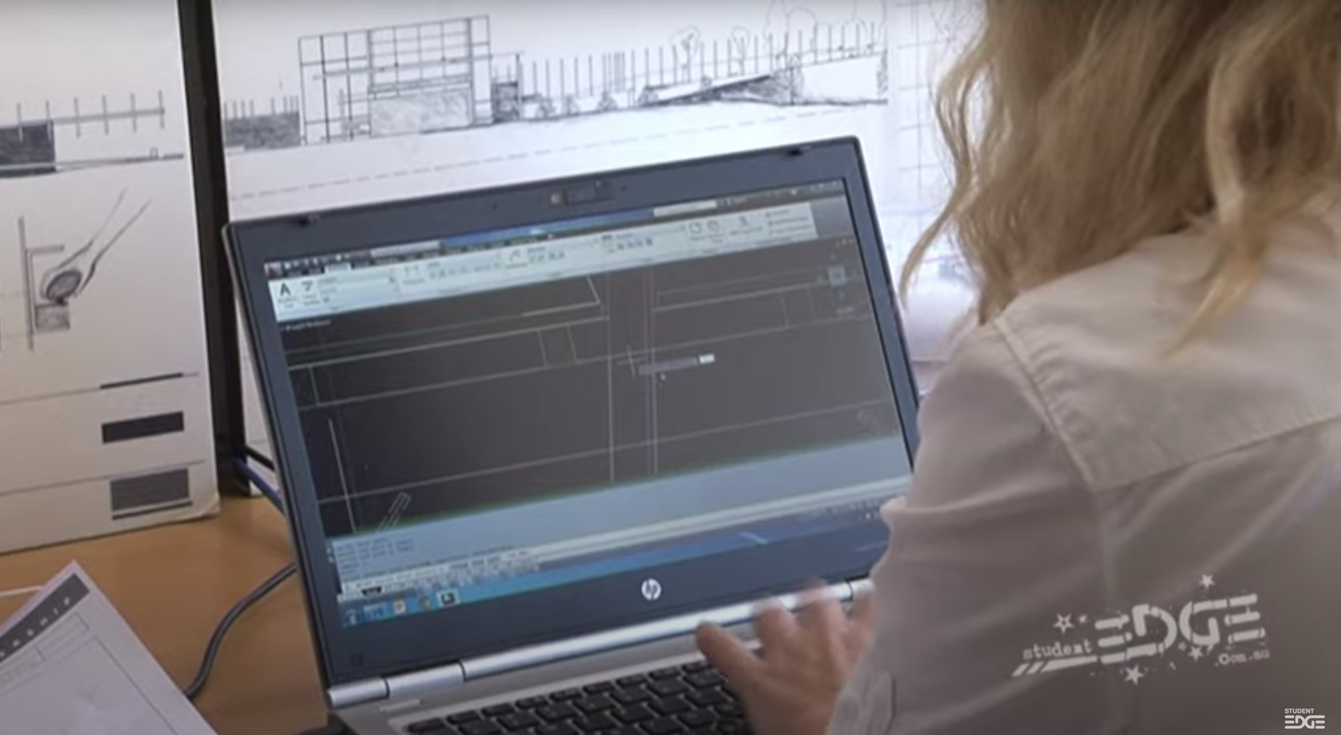
A Day in the Life of an Architect
Student Edge. (2014, May 13). I wanna be an architect - A day in the life of an architect [Video]. YouTube.
https://youtu.be/asdgRAjGK-M
Notes:
Student Edge. (2014, May 13). I wanna be an architect - A day in the life of an architect [Video]. YouTube. https://youtu.be/asdgRAjGK-M

Slide 12
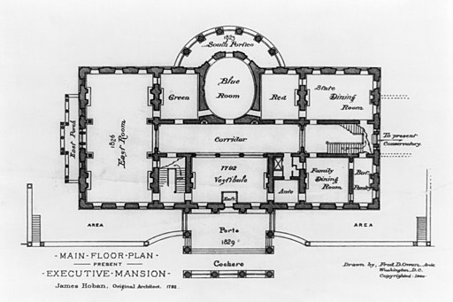
A Day in the Life of an Architect
Design the floor plan for your dream house using the following shapes:
  Rectangles
  Squares
  Triangles
  Trapezoids
  Circles
Find the perimeter and area of your entire floor plan. Write the perimeter and area on your sticky note.
Image Source: Owen, F. D. (1900). Floor plan of the main floor of the White House in Washington D.C. Wikimedia Commons.
https://commons.wikimedia.org/wiki/File:State_floor_plan_-_White_House_-_1900.jpg
Notes:
Image Source: Owen, F. D. (1900). Floor plan of the main floor of the White House in Washington D.C. Wikimedia Commons. https://commons.wikimedia.org/wiki/File:State_floor_plan_-_White_House_-_1900.jpg

Slide 13
Pass the Problem
Round 1: Pass your floor plan to the group member on your right. Find the perimeter of your group member’s floor plan.
Round 2: Pass the floor plan to your right again. Find the area of your group member’s floor plan.
Round 3: Return the floor plan back to its original designer. Check your group members’ answers. Are they correct?

