Slide 2
The Attraction is REAL
Physical Science/Chemistry

Slide 3
Essential Question
Learning Goals
How do the interactions between molecules affect chemical properties?
Use information on the properties of molecules to determine the intermolecular forces at play.

Slide 4
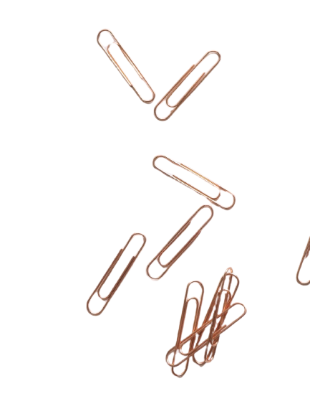
How many paperclips does it take?
As a group, make a hypothesis about how many paperclips can fit into the full cup of water before it spills over.
Then SLOWLY add paperclips to the full glass of water to see how many it actually takes before the water spills over.
Be sure to keep count of how many you are adding!

Slide 5
How many paperclips did it take?
Revisit your original hypothesis, how far off were you? How many did it actually take?
Using the words such as cohesion, surface tension, etc. describe what happened as you added the paperclips and what happened at the end when the water finally spilled over.

Slide 6

Jigsaw
You and your group will research your assigned intermolecular force.
Be sure to cover all four questions posed:
1. What type of attraction is the basis for your IMF?
2. Is your IMF weak, strong, or somewhere in between? WHY?
3. What types of common substances are held together by your IMF? (Try to be as common and real world as possible)
4. How does your IMF directly affect and/or explain a substance’s physical properties?
Notes:
Pass out the questions that students need to answer about their specific IMF, and allow the students to research their IMF and construct a presentation over it.

Slide 7
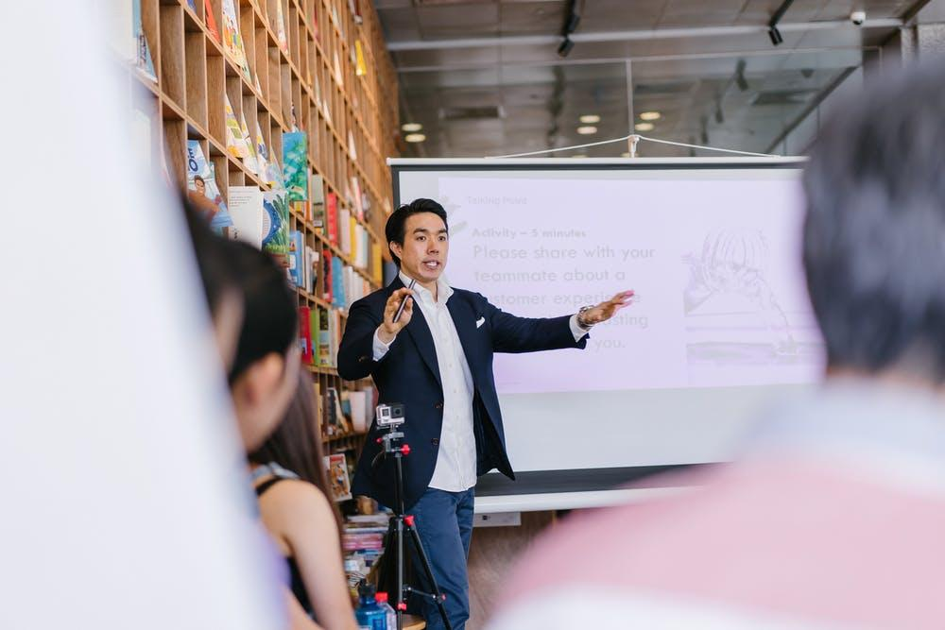
Presentations
Your group will construct a presentation of the information you collect.
Make it creative, but informative.
Notes:
To help students stay engaged during presentations, try having them do a strategy like 3-2-1 or something similar to help them summarize what they are learning about from their peers. If doing a 3-2-1, present students with the writing prompt: What are three things you learned? What are two questions you still have? What is one thing you found interesting? for each of the presentations (excluding their own). This might seem time consuming but will help students stay focused and can be used to formatively assess student learning. Students could also share some of their questions that they had with the presenting group so their questions can be answered by their peers.

Slide 8
Claim Cards
In your groups, discuss whether each of the claims are correct or incorrect.
Be sure to include a justification statement.
Notes:
After the presentations, pass out a set of Claim Cards to each group. Have each group discuss whether each claim is correct or incorrect, and why each is correct or incorrect. When the discussion is over, talk about the answers (which is in the teacher key).

Slide 9
Types of Reactions
You will observer 5 different reactions
  Bent Water
  Oil, Water, and Dish Soap
  Mixing Water and Ethanol
  Mixing iodine in various solutions
  Mixture of water, ethanol, and potassium carbonate
During and after each demonstration, write down which IMF (or IMFs) are involved that cause what you are observing.
Notes:
Present each demonstration to the students. During and after each demonstration, have the students write down which IMF (or IMFs) are involved that cause what they are observing. Keep in mind, all of these demos involve water, and so there's a limited scope of all the IMFs in the demos listed. If you find more phenomena that show more, awesome. If you feel the need to add in more, that is understandable.

Slide 10

Inverted Pyramid
Now that the demonstrations are complete, you and your elbow partner will share your answers with each other and explain what you wrote for each reaction
Be prepared to share out you and your partners reasoning with the whole class.
Turn in your answers at the end of the hour whether you shared out loud or not.
Notes:
Once the demonstrations are done and the students have their answers, pair up students to do an Inverted Pyramid. Have the pairs share their answers with each other and explain what they wrote. Then, have pairs share out their reasoning with the whole class.
Have students turn in their answers so you can read what every student wrote whether they shared out loud or not.

