Slide 2
You Want a Revolution, I Want a Revelation!:
Rethinking the Words of the Declaration of Independence
U.S History and Government

Slide 3
Essential Questions
How has the meaning of major ideas from the Declaration of Independence changed over time?
Must groups achieve social, political, and economic rights to achieve equality?

Slide 4
I Notice, I Wonder Chart
I notice... | I wonder...

Slide 5

The Schuyler Sisters

Slide 6
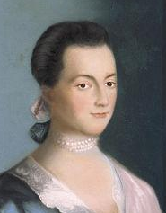
Text Analysis - Adams Letters
With your group, read the series of letters between Abigail and John Adams.
After reading, work with your group to create a summary statement that describes the point Abigail is trying to make to her husband, John about the social and political issues facing women in colonial America.
Identify two words or phrases from the text to serve as evidence to support your response.

Slide 7
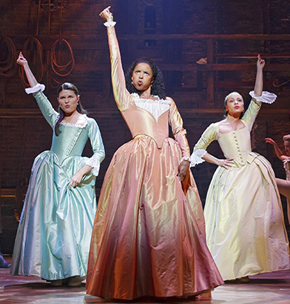
Text Analysis - The Schuyler Sisters
With your group, read back through the lyrics to the song The Schuyler Sisters.
After reading, work with your group to create a summary statement that describes the point Angelica Schuyler is trying to make about the political and social issues facing women in colonial America.
Identify two words or phrases from the text to serve as evidence to support your response.

Slide 8
Two - Texts Together
Work with you groups to create a short hypothetical conversation between Abigail Adams and Angelica Schuyler about the political and social issues facing women in colonial America.
Prepare two people in your group to read your finished conversation to the class.
Notes:
Listen and talk through student responses

Slide 9
Political and Social Issues Facing Women in Colonial America
Notes:
can type student repsonses here

Slide 10
Political and Social Issues Facing Women in Colonial America
not able to vote
did not have access to education
did not have representation or opportunity to serve in government.
seen as less than men
women having opinions about political issues was deemed inappropriate/not-their-place.
Notes:
examples you can share with the class

Slide 11
Questions the Texts Raise about the Declaration of Indepdence
Notes:
can stick post-its up under this heading

Slide 12
Questions the Texts Raise about the Declaration of Independence
Considering the questions you all came up with:
  How do we interpret the words of the Declaration of Independence now?
  Have interpretations of these words changed over time?
  Are there still contradictions between the words in the Declaration and realities of American society today? Examples?
Notes:
clarify student responses correcting any misinformation

Slide 13
Justify It!
First decide whether each statement is true or false. Then you must justify your answer with 3-4 sentences using evidence from the lesson to support your answer.
The words and ideas in the Declaration of Independence were interpreted in the same way in 1776 as they are today.
The practices of American society went against the ideas in the Declaration of Independence in 1776 but we fully live up to those ideas today.
Notes:
Listen and talk through student responses

