Slide 1
Grandmother, What a Big Culture You Have!
Social Studies

Slide 2
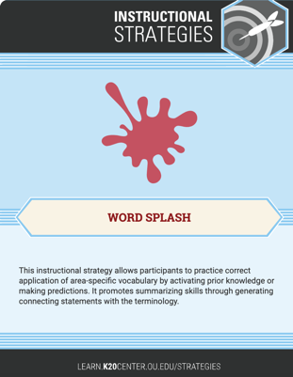
Word Splash
Based on the words/phrases below, what do you think this lesson will be about?
Customs
Traditions
Heritage
Way of Life
Habits
Beliefs
Food
Clothing
Shelter
Language
Family Structure

Slide 3
Essential Questions
How do the characteristics of a culture show up in the stories from the region?
How to these characteristics affect the ways in which people live?

Slide 4
Learning Objectives
Identify the cultural characteristics of the United States in Honestly, Little Red Riding Hood Was Rotten!, by Trisha Speed Shaskan.
Explain how the cultures are represented in the stories and how parents use the stories to teach lessons to their children.
Compare and contrast the cultural characteristics found in Honestly, Little Red Riding Hood Was Rotten!, by Trisha Speed Shaskan, “Little Red Riding Hood,” by The Brothers Grimm, and a third version of your choosing.

Slide 5

Snap-Clap-Pop
Customs | Pretend to play a musical instrument (e.g., flute).
Traditions | Dance in your seat.
Heritage | Make a tree pose.
Way of Life | Make a heart shape with your hands.
Habits | Stack your hands on top of each other to demonstrate “building.”
Beliefs | Put your hands over your eyes.
Food | Pretend you are eating out of a bowl.
Clothing | Stand up and pretend you are putting on pants.
Shelter | Make a roof over your head with your hands.
Language | Put your hands over your mouth.
Family Structure | Hug yourself.

Slide 6

Gallery Walk
Honestly, Red Riding Hood Was Rotten!
By: Trisha Speed Shaskan
For each page, analyze the following for signs of cultural characteristics, and provide examples.
Text
Dialogue
Images
Cultural Characteristics | Examples

Slide 7
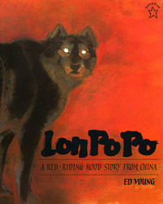
Lon Po Po:
A Red-Riding Hood Story from China
By: Ed Young
A version of Little Red Riding Hood told from a Chinese cultural perspective
Three sisters are home alone while their mother leaves to check on their grandmother
She warns the girls about not opening the door to strangers.
Young, E. (2012). Lon Po Po: A Red-Riding Hood story from China.
New York: Penguin Putnam Books for Young Readers.

Slide 8
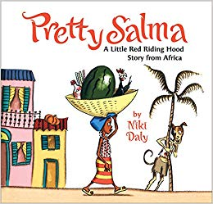
Pretty Salma:
A Little Red Riding Hood Story from Africa
By: Niki Daly
A version of Little Red Riding Hood told from an African cultural perspective
Salma is a young girl who lives with her grandparents.
She is sent to the marketplace and warned not to wander but to come straight home afterward.
Daly, N. (2007). Pretty Salma: A Little Red Riding Hood
story from Africa. Boston: Clarion Books.

Slide 9
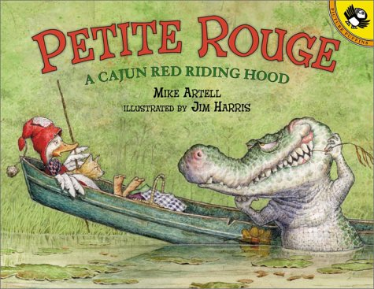
Petite Rouge:
A Cajun Red Riding Hood
By: Mike Artell
A version of “Little Red Riding Hood” told from a Cajun cultural perspective
Petite Rouge is a duck who wants to visit her sick grandmother.
She is warned by her mother not to wander into the swamps where the alligators live.
Artell, M., & Harris, J. (2003). Petite rouge: A Cajun Red
Riding Hood. New York: Puffin Books.

Slide 10
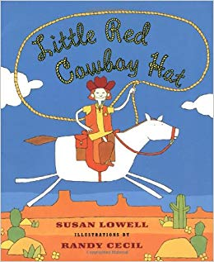
Little Red Cowboy Hat
By: Susan Lowell
A version of Little Red Riding Hood told from a Southwestern cultural perspective
Little Red rides her pony, Buck, to her sick grandma’s ranch to bring her cactus jelly.
Lowell, S., & Cecil, R. (1997). Little red cowboy hat.
New York: Henry Holt & Co.

Slide 11
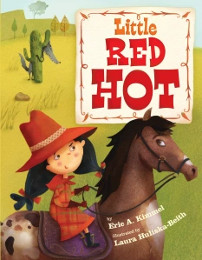
Little Red Hot
By: Eric A. Kimmel
A version of Little Red Riding Hood told from a Texan cultural perspective
Little Red Hot loves hot things and makes a hot pepper pie for her sick grandmother.
Along the way, she meets Señor Lobo.
Kimmel, E. A., & Huliska-Beith, L. (2013). Little red hot.
New York: Scholastic.

Slide 12
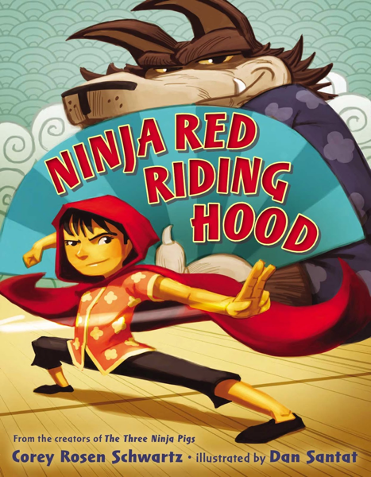
Ninja Red Riding Hood
By: Corey Rosen Schwartz
A version of Little Red Riding Hood told from a Japanese cultural perspective
With the help of a martial arts master, Ninja Red enters into a sparring match with the wolf, which puts him on a new path of enlightenment.
Schwartz, C. R., & Santat, D. (2014). Ninja Red
Riding Hood. New York: G.P. Putnam's Sons.

Slide 13
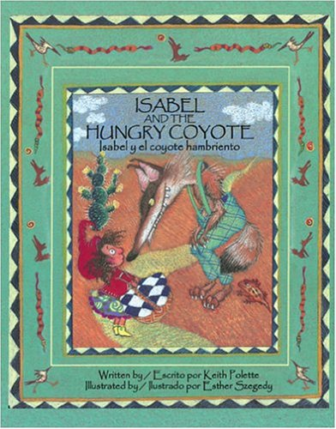
Isabel and the Hungry Coyote
By: Keith Polette
A version of “Little Red Riding Hood” told from a Southwestern cultural perspective
A classic retelling of the original, with a gradual mixing of Spanish words into the story
Polette, K., & Szegedy, E. (2004). Isabel and the
hungry coyote. McHenry, IL: Raven Tree Press.

Slide 14
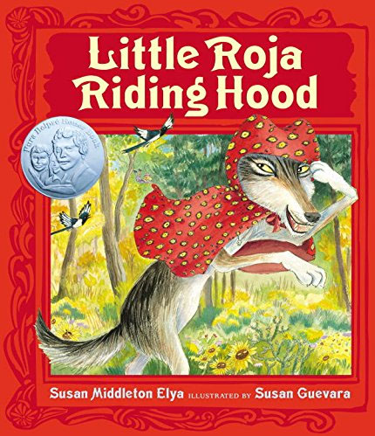
Little Roja Riding Hood
By: Susan Middleton Elya
A version of Little Red Riding Hood told from a Mexican cultural perspective
Bilingual (English/Spanish) retelling of the story
Abuela and Roja work together to find a solution that uses technology
Elya, S. M., & Guevara, S. (2014). Little Roja Riding
Hood. New York: G.P. Putnam's Sons.

Slide 15
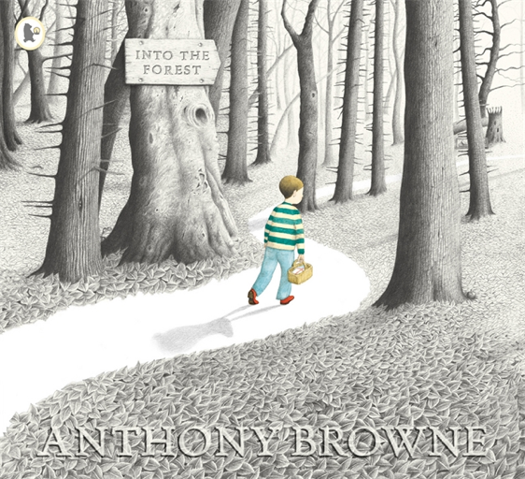
Into the Forest
By: Anthony Browne
A version of Little Red Riding Hood told from a British cultural perspective
A boy ventures into the forest against his mother’s wishes and meets a variety of familiar characters along the way
Browne, A. (2004). Into the forest. Somerville, MA: Candlewick Press.

Slide 16

Affinity Process: Part 1
As you’re reading, note each new example that you find on a sticky note.
Customs
Traditions
Heritage
Way of Life
Habits
Beliefs
Food
Clothing
Shelter
Language
Family Structure
Notes:
Remind the students that each new piece of evidence should get its own sticky note.

Slide 17
Affinity Process: Part 2
With the students who read the same version of the story as you:
Discuss some examples of cultural characteristics found throughout the story.
Combine examples that multiple group members wrote down.
Combine examples that represent similar cultural characteristics.
  For example, all sticky notes that show examples of the culture through food should be combined.

Slide 18
Affinity Process: Part 3
As a whole class:
Share examples of cultural characteristics found throughout the stories.
Combine examples that represent similar cultural characteristics.
  For example, all sticky notes that show examples of the culture through food should be combined.
Notes:
Instructor Notes: Consider charting all of this on one large anchor chart.

Slide 19
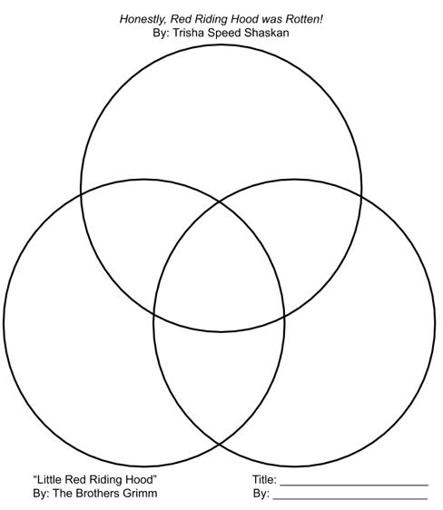
Venn Diagram
Compare and contrast the three versions of Little Red Riding Hood that you have read.
Include the following:
  At least two ways that EACH story is culturally unique
  At least two ways that each pair of stories is culturally similar
  At least one way that all three stories are culturally similar

Slide 20
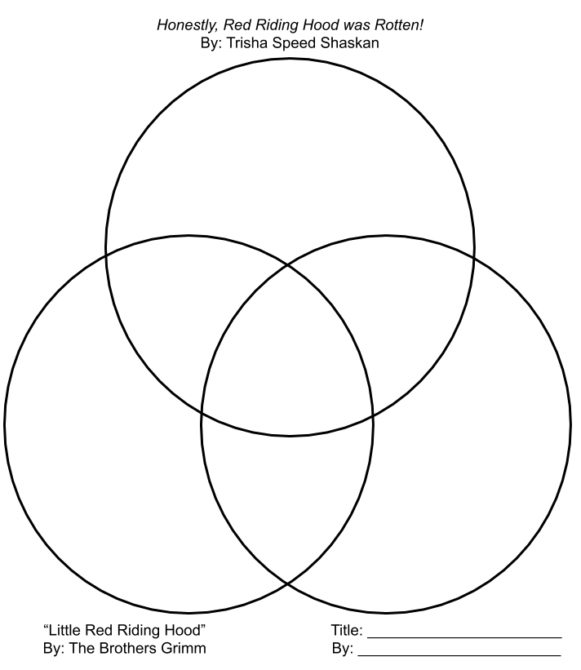
Include 2 or more ways the book Honestly, Red Riding Hood Was Rotten! is culturally unique.
Include 2 or more ways the story Little Red Riding Hood is culturally unique.
Include 2 or more ways the book of your choice is culturally unique.

Slide 21
Include 2 or more ways Honestly, Red Riding Hood was Rotten! and Little Red Riding Hood are culturally similar.
Include 2 or more ways Honestly, Red Riding Hood Was Rotten! and the story version of your choice are culturally similar.
Include 2 or more ways Little Red Riding Hood and the story version of your choice are culturally similar.

Slide 22
Include 1 or more ways all three stories are culturally similar.

Slide 23

Two-Minute Paper
Take a moment to reflect on your learning.
How do the characteristics of a culture show up in the stories from the region, and how do they affect the ways in which people live?

