Slide 1
Sharing is Caring
7th, 8th, & 9th Grade Mathematics

Slide 2
Essential Question
How do you use the distributive property to evaluate and simplify expressions?

Slide 3
You have invited two of your best friends over for dinner. The dinner consists of their favorite foods: pizza, strawberries, cookies, and lemonade. They are running late, so you decide to make their plates for them.
How do you fill everyone’s plates equally?
Draw what you put on each plate and explain your choice.

Slide 4

Elbow Partners
With your elbow partner, discuss the following questions:
What did you put on each friend’s plate?
How can you ensure that the food is distributed fairly?
C., Rachel (10 June 2016). Lemonade. Pixabay.com. Retrieved from https://pixabay.com/illustrations/lemonade-lemons-glass-beverage-1447521/

Slide 5
Distributive Property Exploration
$$▯(▯x−▯)$$
1
2
3
Roll a polyhedral die. Place the resulting number in the first slot of the equation.
Roll a different polyhedral die. Place the resulting number in the second slot.
Roll the last polyhedral die. Place the resulting number in the third slot.
  Note: The different colored die represents a negative number.

Slide 6
Clarify Understanding
How did you solve the problem?
You used a specific method. What would happen if you tried to solve it a different way?
What do you still not understand?

Slide 7

Explaining the Distributive Property
Break down the process:
$$3(x − 4y)$$

Slide 8

Bonus Challenge
$$4\left(x+5\right)−2(x−6)$$

Slide 9
Which Is Cheaper?
When you order fast food, is it cheaper to buy items separately, or together in a combo meal?

Slide 10
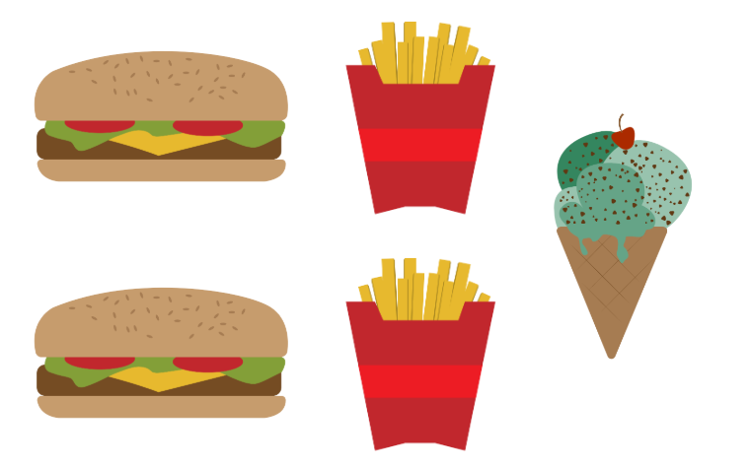
Combo Meal Challenge
It’s your turn to challenge your peers.
Create your own fast-food scenario. Build a combo meal and draw it in your Create a Combo Meal Handout.
Example:
Maria wants three combo meals, each with two burgers, two fries, and one ice cream cone.

Slide 11
How Much Is in Your Combo Meal?
Solve other customers’ orders to help the restaurant calculate how much food they need to make.
Draw each combo meal, create an equation based on the picture, and then simplify the equation.
Answer: $3(2B+2F+1C)$ Simplified: $6B+6F+3C$

