Slide 1
Going Viral
7th, 8th, 9th Grade Mathematics

Slide 2
Essential Question:
How can you represent, compare, and order numbers to
solve an equation?

Slide 3
Learning Objectives
Solve algebraic equations with rational numbers
Generate algebraic equations with rational numbers

Slide 4
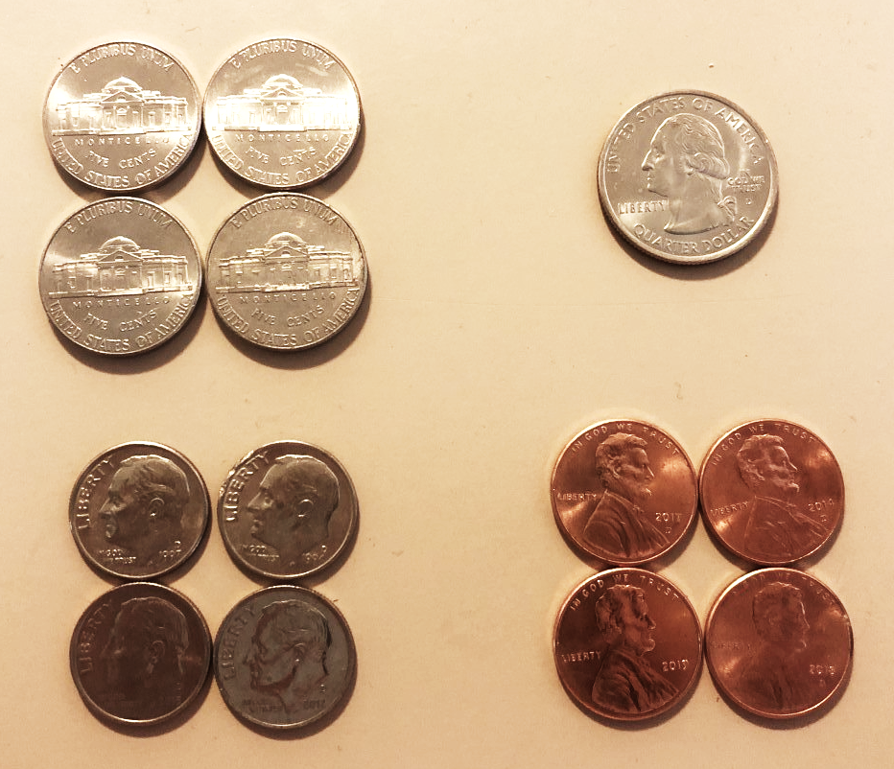
Which One Doesn’t Belong?
Notes:
Use the attached Four Corners posters, this picture, or insert another one of your choosing. Print out whichever picture you decide to use, cut the four squares apart. Hang them in different areas of your classroom.
If you choose, you can do this activity multiple times. If you do so, duplicate this slide.

Slide 5
Pass the Problem
Solve the first line of your viral math post. Show all your work so the next group can follow your thinking. When time is up, pass your problem to the next pair in your group.
Check the work already done. Then, solve the second line (showing your work). Pass again.
Check the work already done, and solve the third line (showing your work). Pass again.
Check your original problem, make any edits, and complete the problem.

Slide 6
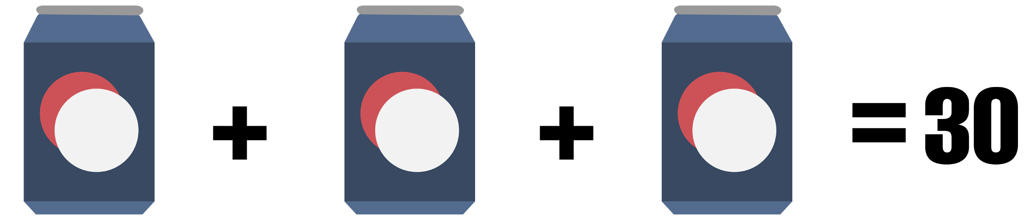
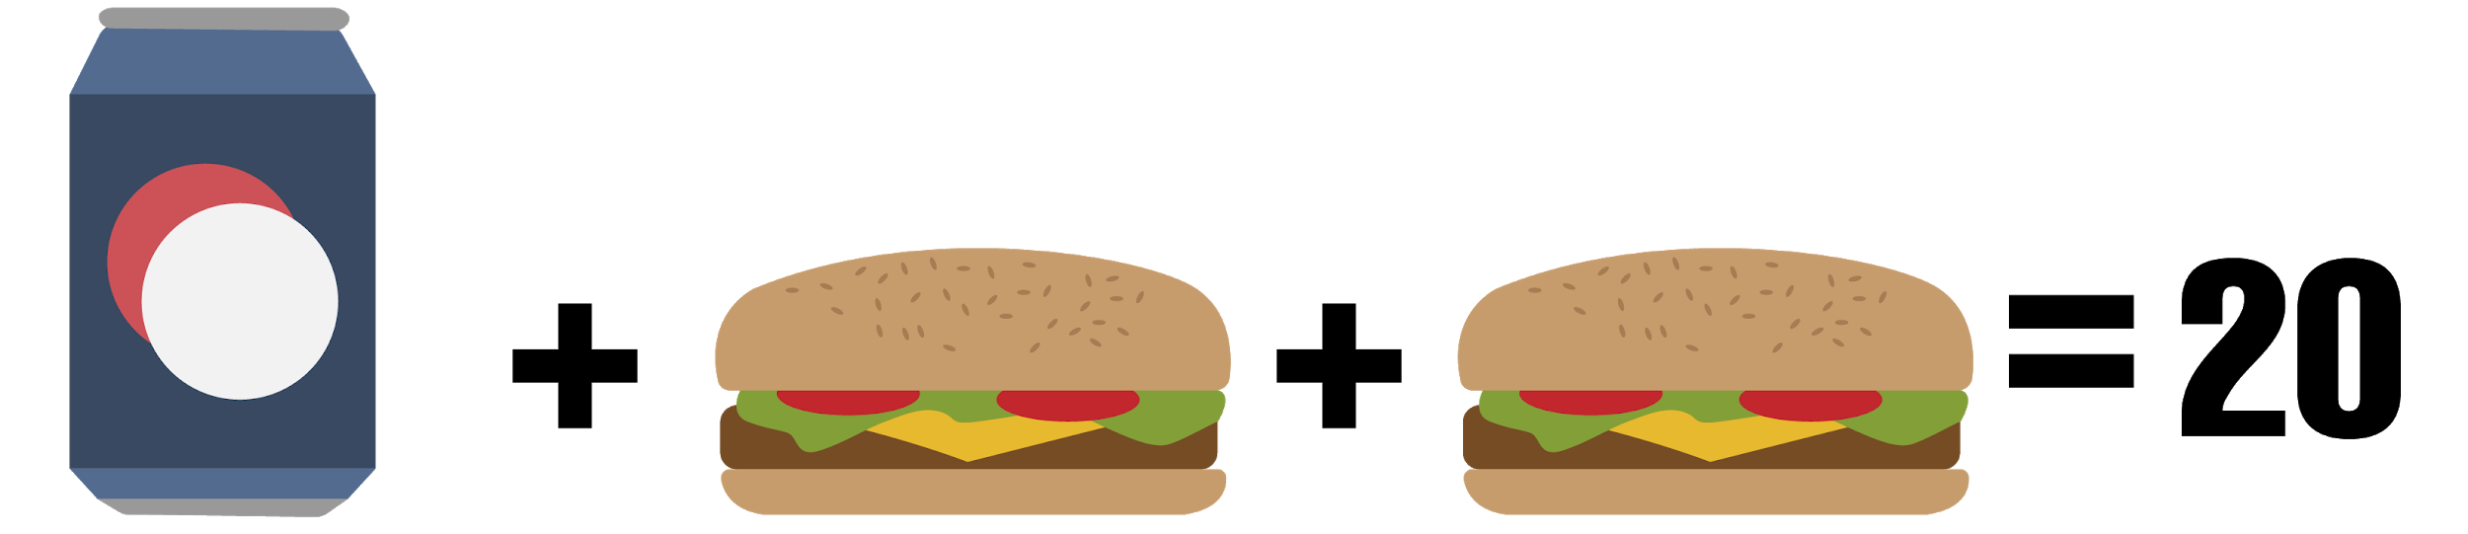
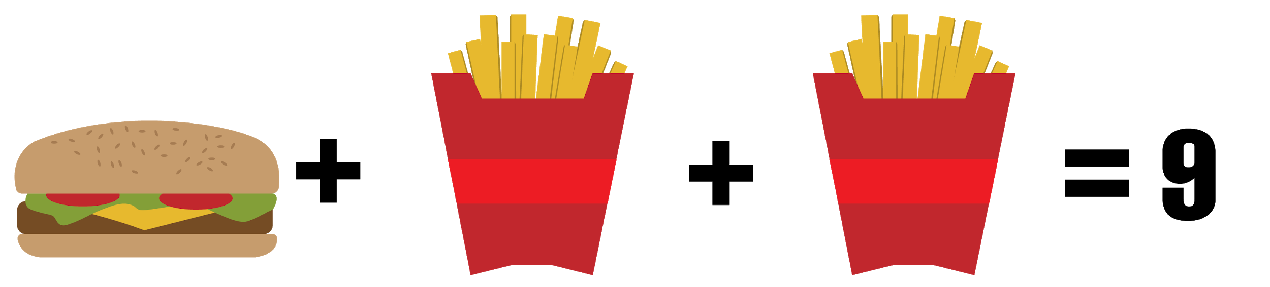
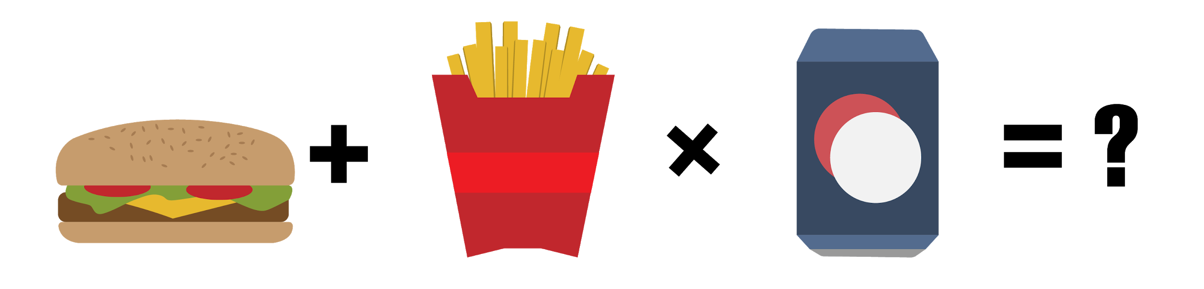




$$3d=30$$
$$d=10$$
Problem 1
$$10+2b=20$$
$$2b=10$$
$$b=5$$
$$5+2f=9$$
$$2f=4$$
$$f=2$$
$$b+f∗d=?$$
$$5+2∗10=5+20=25$$

Slide 7
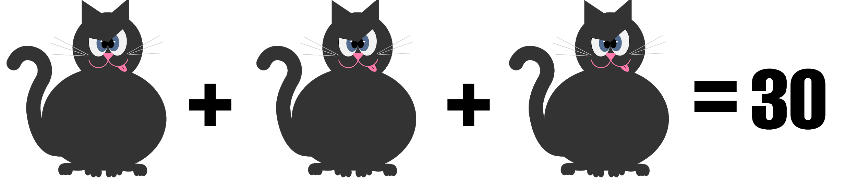
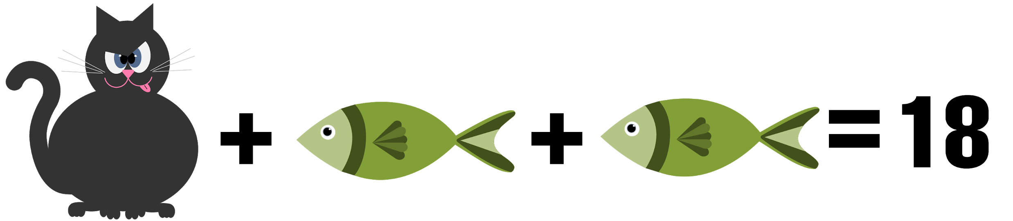
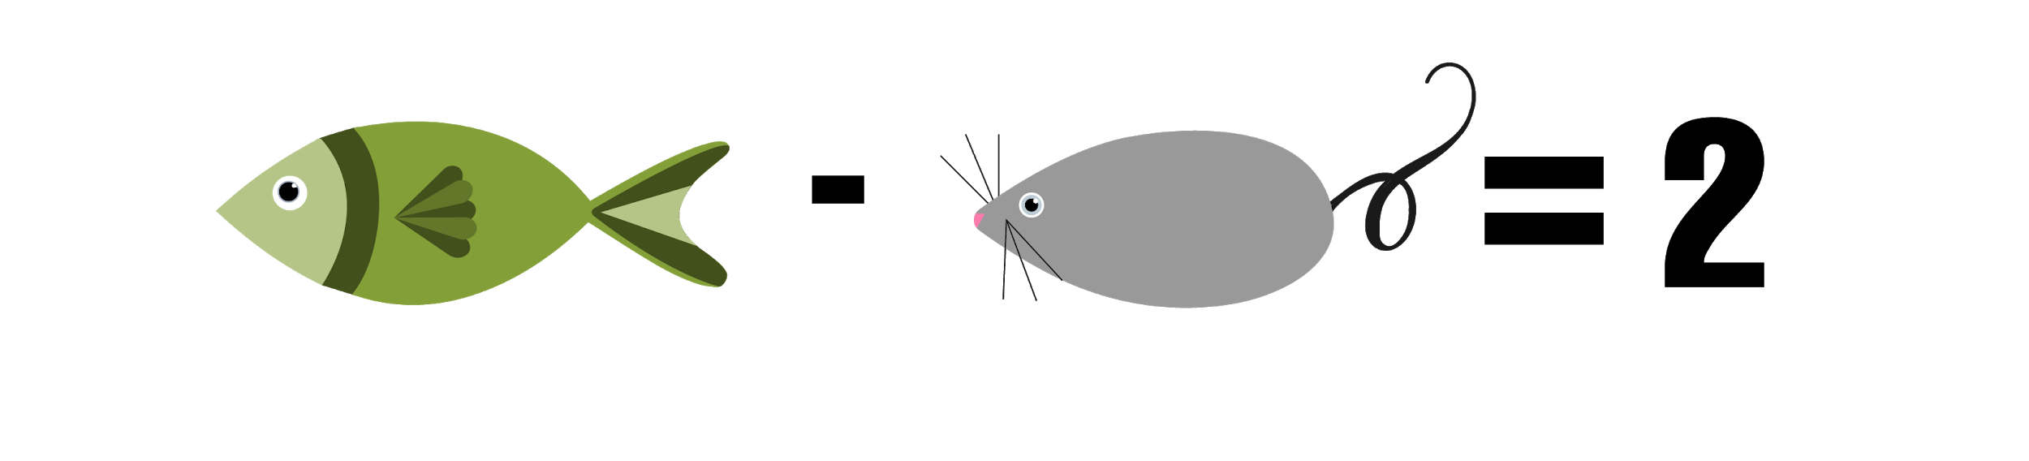
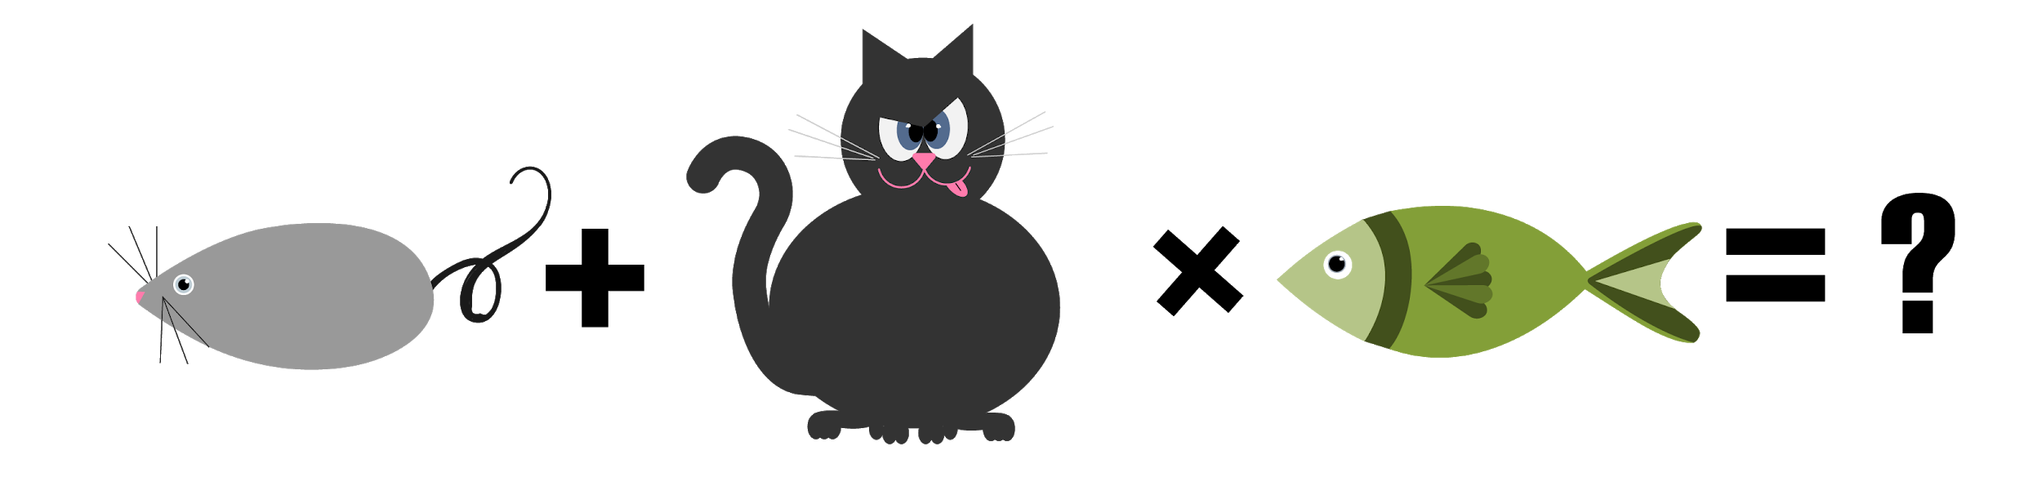




$$3c=30$$
$$c=10$$
Problem 2
$$10+2f=18$$
$$2f=8$$
$$f=4$$
$$4−m=2$$
$$−m=−2$$
$$m=2$$
$$m+c∗f=?$$
$$2+10∗4= 2+40= 42$$

Slide 8
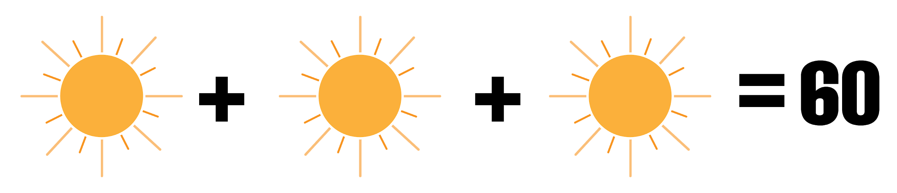
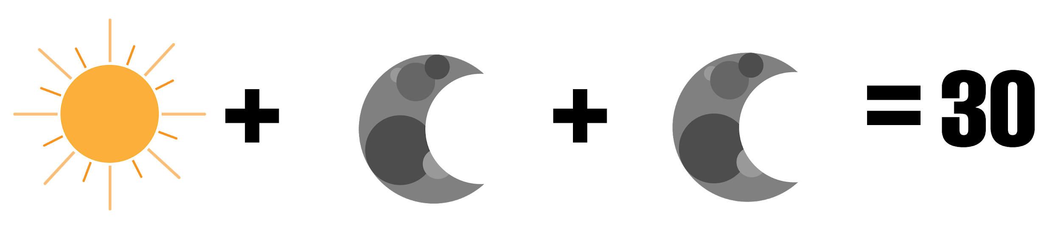
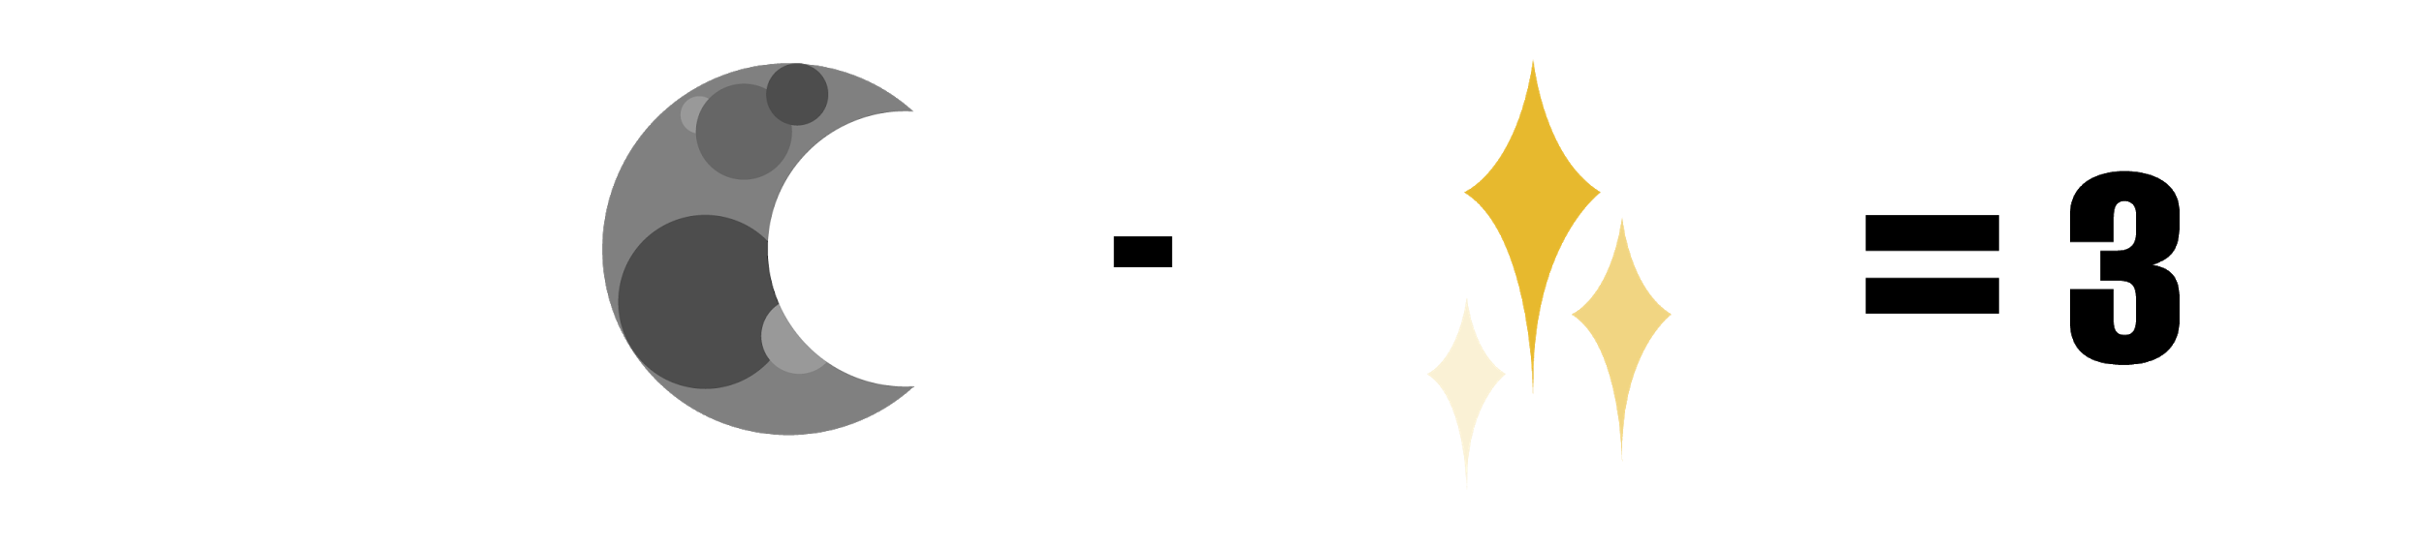
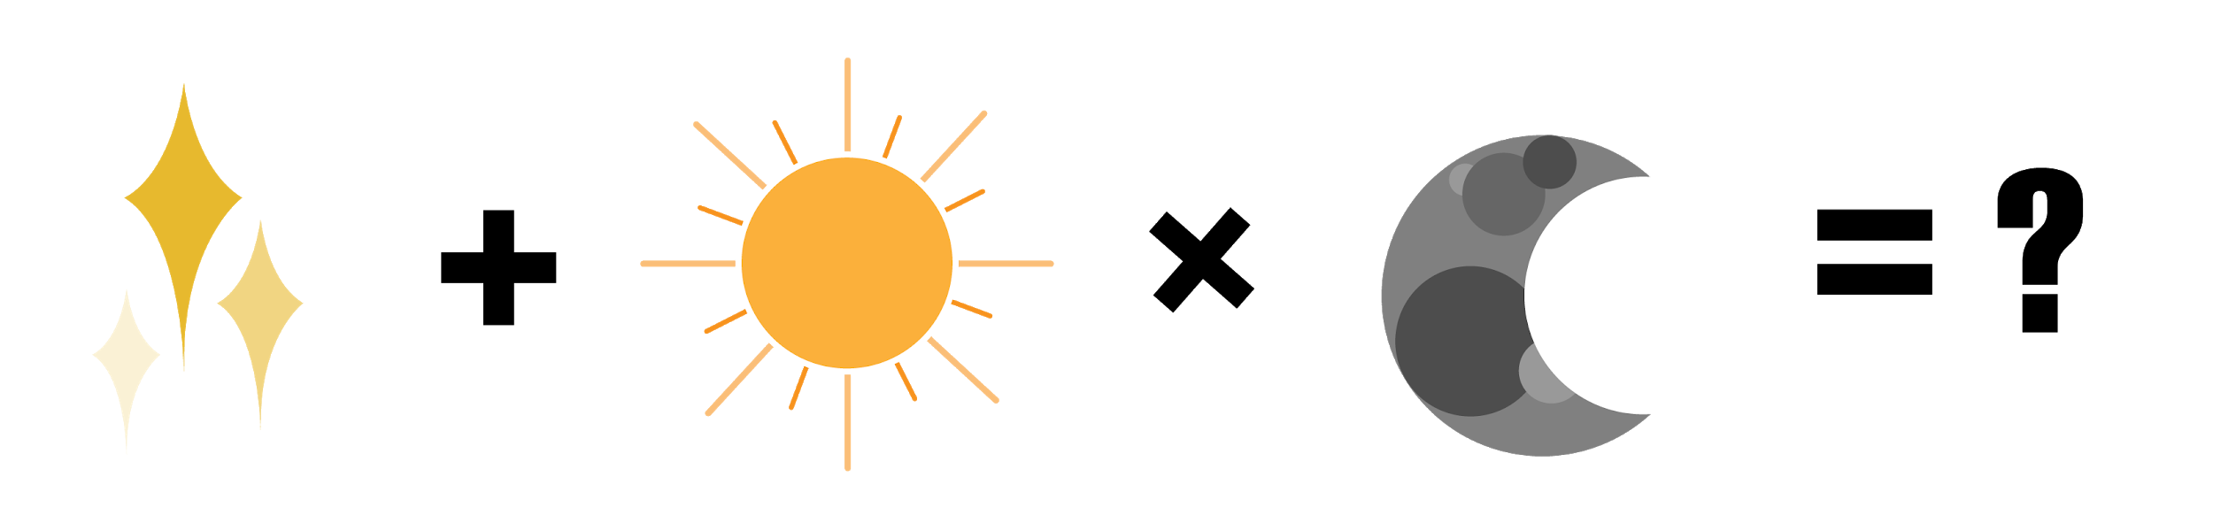




$$3x=60$$
$$x=20$$
Problem 3
$$20+2y=30$$
$$2y=10$$
$$y=5$$
$$5+z=3$$
$$−z=−2$$
$$z=2$$
$$z+x∗y=?$$
$$2+20∗5=2+100=102$$

Slide 9




Solving Equations with Undo Tables
1
$$4x+5=25$$
$$4x+5=25$$
Sequence
  Undo
6
$$x$$
$$∗4$$ $$+5$$ $$=25$$
$$x$$ | $$=5$$
$$∗4$$ $$+5$$ $$=25$$ | $$/4$$ $$−5$$ $$25$$
2
5
3
4

Slide 10
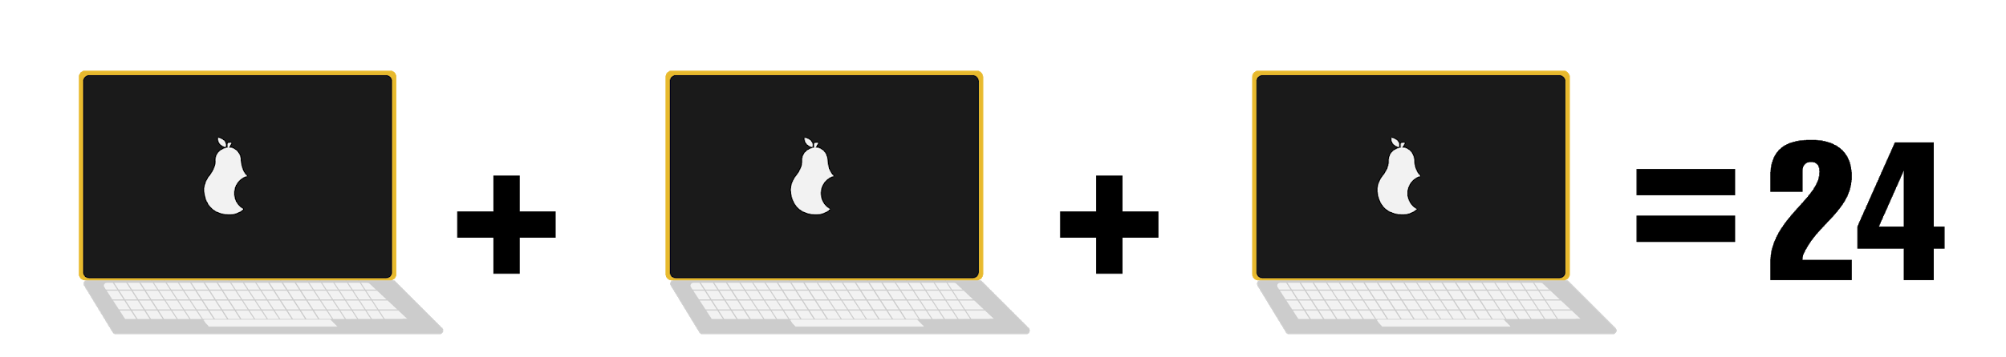
Do/Undo Method
Combine like terms
Make a T-chart

Slide 11


Do/Undo Method
Combine like terms
Make a T-chart
$$3L=24$$
$$L$$ | $$=8$$
$$∗3$$ $$=24$$ | $$24/3$$ $$24$$

Slide 12

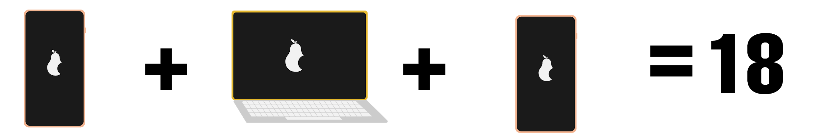
= 8
Do/Undo Method
Combine like terms
Make a T-chart

Slide 13


= 8
Do/Undo Method
Combine like terms
Make a T-chart
$$2P+8=18$$
$$P$$ | $$=5$$
$$∗2$$ $$+8$$ =18 | $$10/2$$ $$−8$$ =18

Slide 14

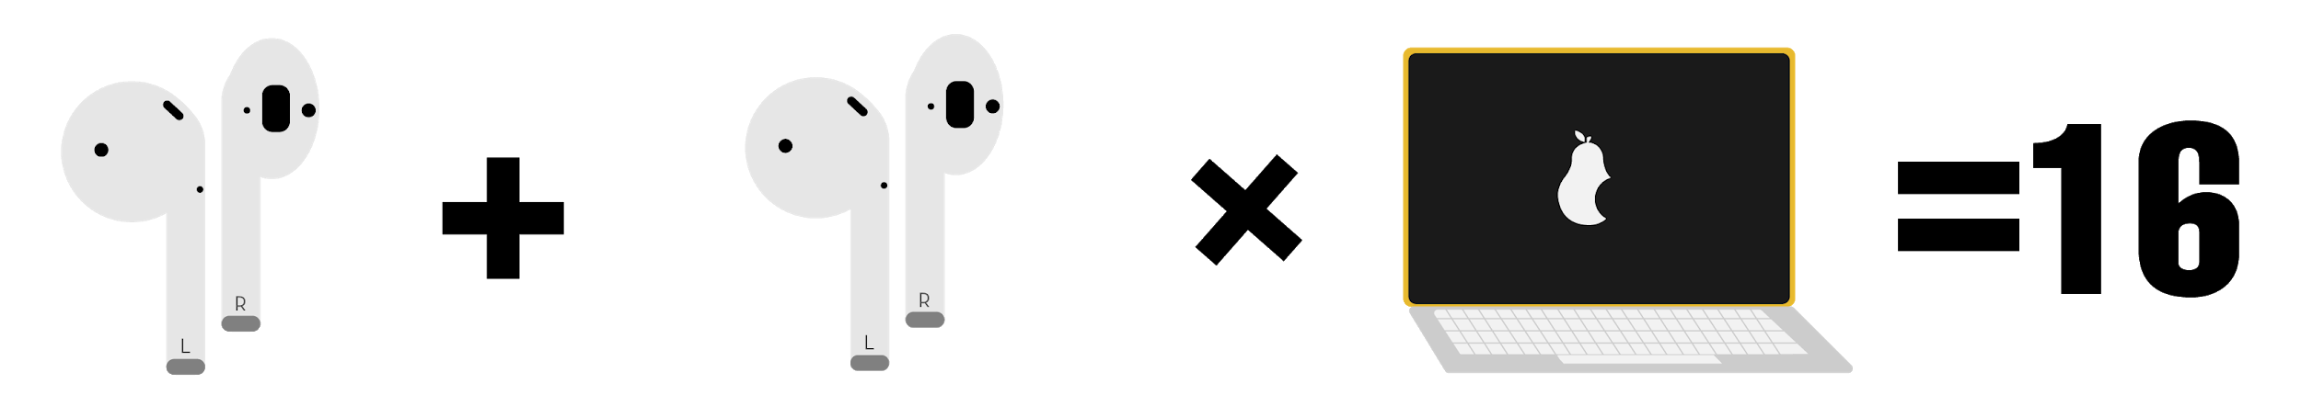
= 8
= 5
Do/Undo Method
Combine like terms
Make a T-chart
( )

Slide 15


= 8
= 5
Do/Undo Method
Combine like terms
Make a T-chart
$$2B∗8=16$$
$$B$$ | $$=1$$
$$∗2$$ $$∗8$$ $$=16$$ | $$2/2$$ $$/8$$ $$=16$$
( )

Slide 16

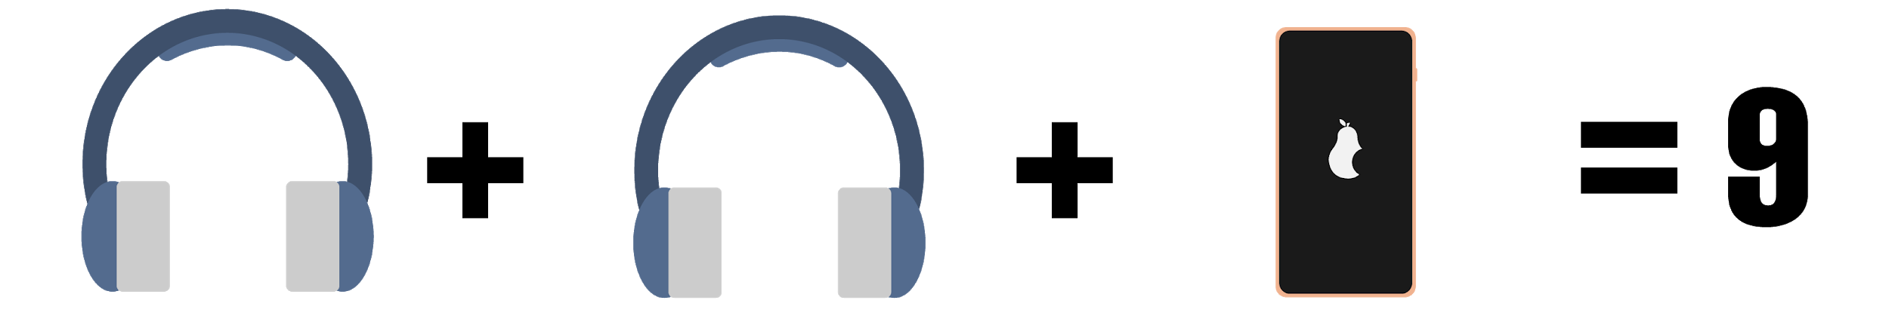
= 8
= 5
= 1
Do/Undo Method
Combine like terms
Make a T-chart

Slide 17

= 8
= 5
= 1
Do/Undo Method
Combine like terms
Make a T-chart
2h+5=9
$$H$$ | $$=2$$
$$∗2$$ $$+5$$ $$=9$$ | $$4/2$$ $$−5$$ $$=9$$

Slide 18

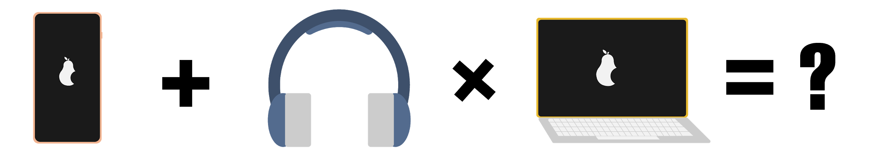
= 8
= 5
= 1
= 2
Substitution

Slide 19

= 8
= 5
= 1
= 2
Substitution
$$P+h∗l= ?$$
$$5+2∗8=$$
$$5+16=21$$

Slide 20
Sample Problems
Combine like terms
Make a T-chart

Slide 21
Make Your Own Viral Post
How are viral posts designed to trick people?
Decide on your variables (pictures, emojis, etc.).
You must include at least:
four lines, and
three variables.
Check your rough draft.
Make a final draft and create a separate answer key.

Slide 22
Gallery Walk
Handout
Answer Key Reveal
For each viral post:
write the original problem,
show all your work, and
solve for what each picture equals.
Check your work as each answer key is revealed.

