Slide 1
Electrostatics
The Basics
ALL CHARGED UP

Slide 2
Charge symbol → q Unit → C (coulomb)
Fundamental property of matter
Single isolated charge, e = 1.6 x 10⁻¹⁹ C
Positive charged objects have a lack of electrons required for neutrality
Negative charged objects have an excess of electrons required for neutrality
Total charge, q =ne, where n is the number of single charges in the object
ALL CHARGED UP
Notes:
Include the engage activity by telling the students the blanket acquired a negative charge due to the friction between the dog and the blanket. Ask students to hypothesize about the charge of the dog’s hair. They should respond it is positive. This is a good time to mention that charge is conserved. If the blanket gained electrons then the dog lost electrons such that the charge of the system remains the same.

Slide 3
Charge is Conserved
- 20
+ 20
Net charge is unchanged
Neutral
Neutral
ALL CHARGED UP
Notes:
One cloud has a negative 20 charge the other has a + 20 charge, the lightning bolt represents the transfer of charge between the two clouds the result is two neutral clouds but the overall charge of the system has been conserved

Slide 4
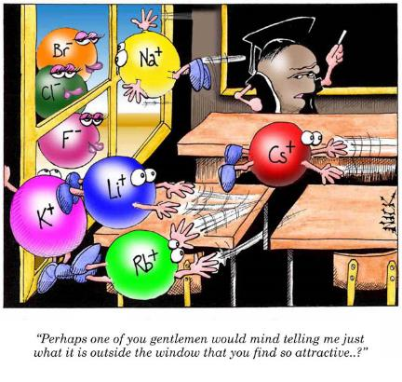
Laws of Attraction
Opposite charges attract
Like charges repel
ALL CHARGED UP

Slide 5
Two like charges repelling
-
-
Two opposite charges attracting
-
+
ALL CHARGED UP
Notes:
Two like charged objects suspended will repel and two opposite charges suspended will attract

Slide 6
Coulomb’s Law
Mutual force of attraction or repulsion proportional to the product of the charges and inversely proportional to the square of the distance between the charges.
F_{e} = (kq₁q₂)/ r² k= 9 x 10⁹Nm²/C²
+
-
+
+
ALL CHARGED UP
Notes:
You will need to explain the equation in terms of direct and inverse relationships. For example if charge is tripled on each object then the force increases by 9. If the distance is quadrupled then the force decreases by 16. If the distance is reduced by one third then the force increases by a factor of 9.

