Slide 2
Zombie Apocalypse:
What do people need to survive?
A US Government Lesson

Slide 3
Movie Clip discussion
What did you see in the movie?
What is happening to society?
What particular incidents or dialogue reveal aspects of the people or actions in the video?
What should be the role of government in this situation?
Can you think of real situations where a government is in chaos?

Slide 4
Scenario:
YOU are the survivors of this zombie apocalypse. All the zombies have been destroyed but they did severe damage and destruction all over the world.
Only small pockets of humans remain scattered around the world, and no political governments or leaders survived. Groups of humans must form new countries and governments to continue the human race.

Slide 5
Class Brainstorming Activity
What will human groups need for their survival and to build a new society?

Slide 6
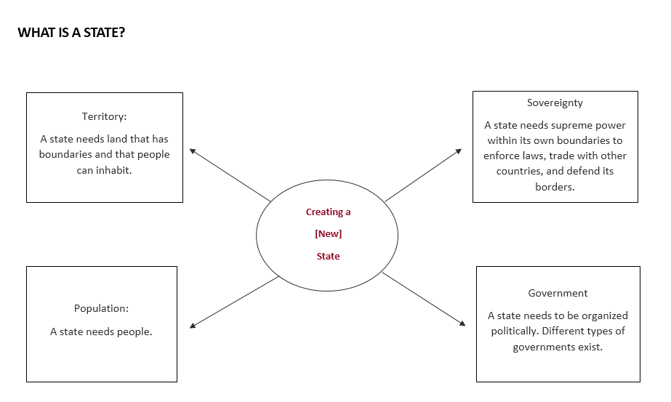
International Law defines humans living in groups in one location as a “state”, society, or country.
Notes:
Explain that the term state is used differently here to mean a group configuration.

Slide 7
Determine your Government’s Structure
Authoritarian: systems in which those in power hold absolute authority over the people.
Direct Democracy: All citizens of the state make all the decisions in mass meetings.
Republic: A Representational democracy where Leaders elected by the people represent the people in matters of common welfare.
Theocracy: A country run by religious leaders that expect citizens to follow that religion.

Slide 8
Government Structures
What are the advantages of your choice of government?
What are the disadvantages of your choice of government?

Slide 9
Country Rubric Checklist
The create a country project consists of two parts:
Part 1 Artifacts that represent your country.
Part 2 Written information that describes your country. The written information includes the four characteristics of state and one other feature that makes your country unique and attractive to “immigrants.” Your written information should include persuasive elements that will help others understand the design of your country
Part 3 Persuasive oral presentation that not only helps your audience understand the design of your country, but appeals to their reason and emotion in order to convince them that your country can succeed after the apocalypse
Artifact List:
­­­­______People Create a flag that represents the culture of your people.
______Territory Create a map where your people live that includes national resources, boundaries, geographical features, and a location for the capitol.
_____ Sovereignty All weapons of mass destruction were destroyed by the zombies. Create a type of defense to maintain your borders from enemies.
_____ Government Choose a type of government for your people. Write a mission statement of the purpose of your government and create five political rules of how the government will be run. Create a symbol for the type of government you have chosen.

Slide 10
Evaluation
Group Presentations of New Countries

