Slide 2
I Can’t Stress This Enough
7th and 8th Grade

Slide 3
Essential Questions
What effect does stress have on my health?
Can I effectively manage stress?

Slide 4
Objectives
By the end of this lesson, students will be able to:
Distinguish between healthy and unhealthy stress
Evaluate the credibility of health information
Identify healthy behavior for managing stress

Slide 5
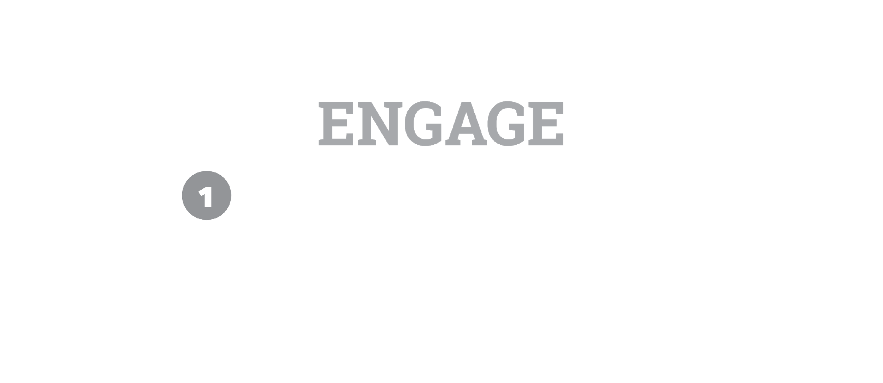

Slide 6
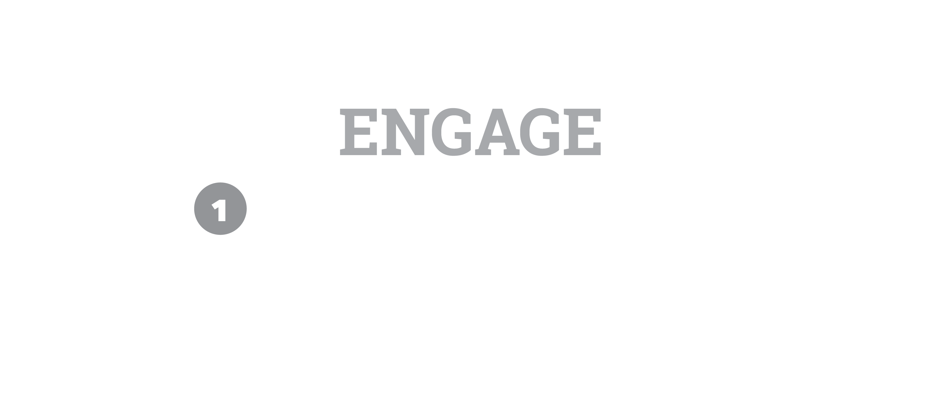
Can Stress Be Beneficial?
Think about this question.
Make a claim and write it down on a notecard.
Example 1: "Too much stress is bad for your health.”
Example 2: "Stress helps to motivate me.”

Slide 7
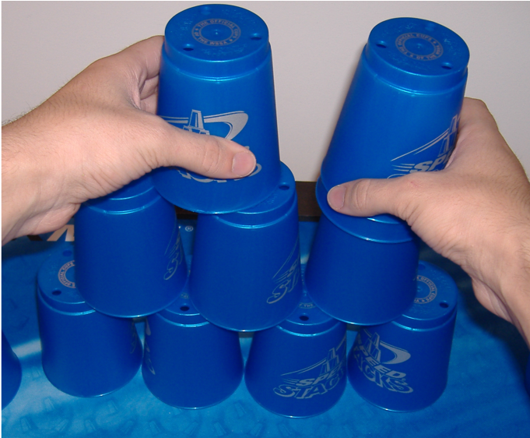
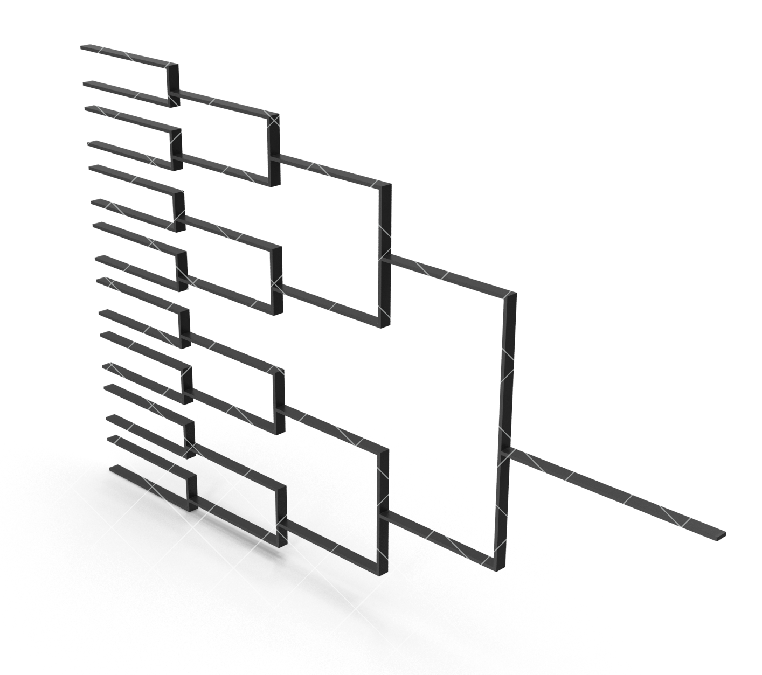
Tournament Time!
File:Sport-Stacking.jpg. (n.d.). Retrieved from https://commons.wikimedia.org/w/index.php?title=File:Sport-Stacking.jpg&oldid=354348735.
Bgaj23. (0AD). Tournament Bracket. Retrieved from https://www.pixelsquid.com/png/tournament-bracket-1172693739890546036?image=H02
Notes:
Most, if not all, students will be familiar with cup stacking. For reference, here are two videos of cup stacking tournaments.
https://www.youtube.com/watch?v=JIdJ0Y6XaMw
https://www.youtube.com/watch?v=3HZOfnq9ZPE

Slide 8
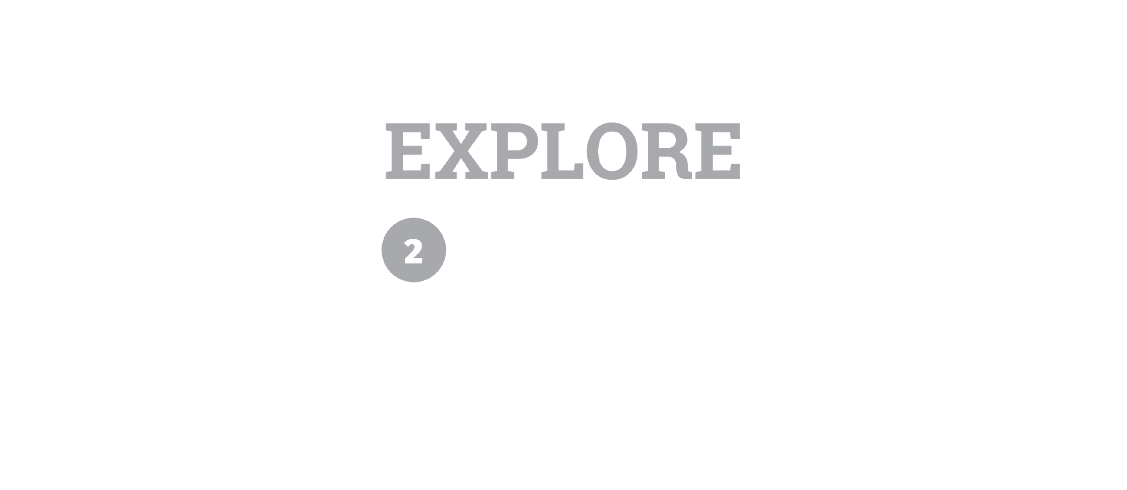

Slide 9
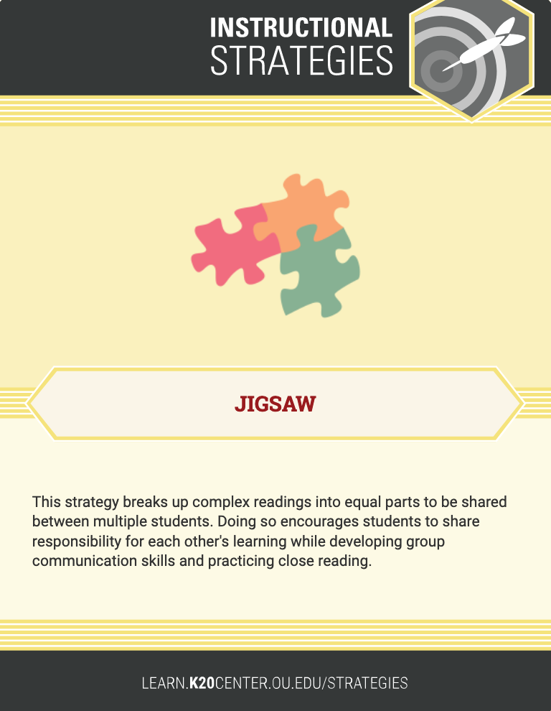
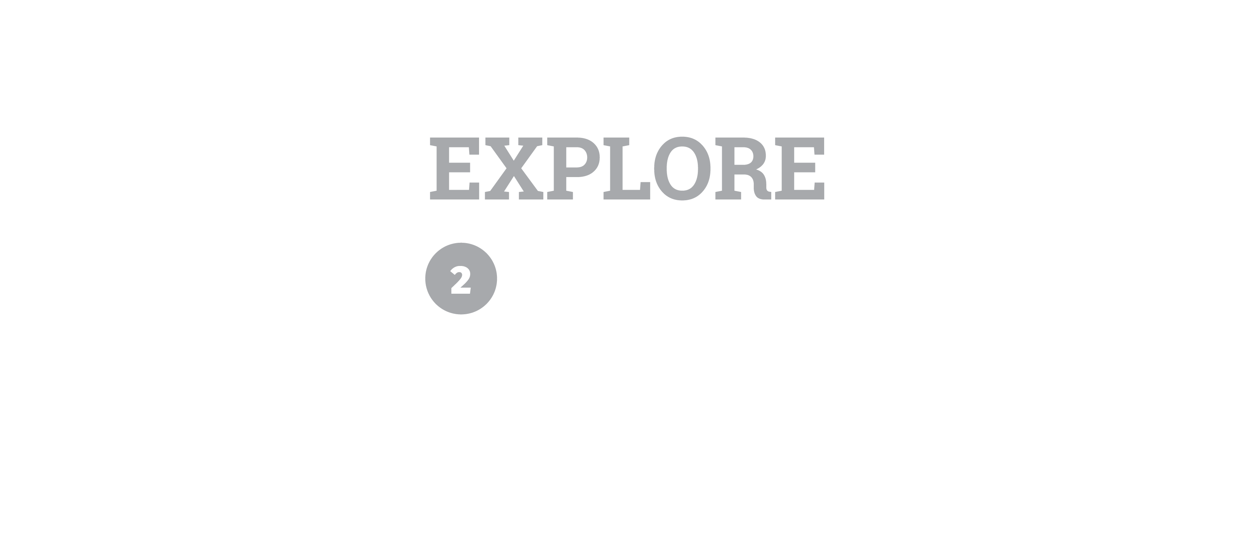
Jigsaw Reading
Group 1—Beginning through "meaning-making instinct."
Group 2—"The Pros of Stress" through "expected to do poorly."
Group 3—"Four ways to embrace" through "life and less depression."
Group 4—"What can happen" through the
end.
Notes:
Article Link: https://www.thestar.com/life/2015/06/02/why-stress-can-be-good-for-you-no-really.html

Slide 10
Jigsaw Reading
Make a note of any unfamiliar vocabulary words.
After you’ve finished reading, talk in your groups to summarize what the author is saying in that section.
Choose one representative from your group that will share out with the rest of the class.
Think of an area in your own life where this information and advice would be applicable.

Slide 11


Slide 12
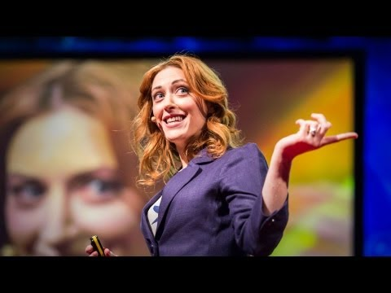
“How to Make Stress Your Friend.”
McGonigal, K. (2013, September 4). How to make stress your friend. Retrieved September 27, 2019, from https://www.youtube.com/watch?reload=9&v=RcGyVTAoXEU.
Notes:
Start the video at the beginning and end at 7:29
URL: http://www.youtube.com/watch?v=RcGyVTAoXEU

Slide 13

Stress Indicators Table
When do you feel stressed? Think about a few specific experiences in your life where you were stressed.
What physical sensations (indicators) did you feel due to stress? List any you can think of (increased heart rate, sweating, nervousness, etc.).
In what scenarios might you experience these indicators?
Consider the article “Why Stress Can Be Good For You—No, Really,” and the video “How to Make Stress Your Friend.” Write down how you can turn your physical response to stress into something more beneficial.

Slide 14
Stress Indicators Table
Discuss your finished table with an elbow partner.
As you hear new ideas from your partner or from the class, fill in any remaining gaps on your table.

Slide 15
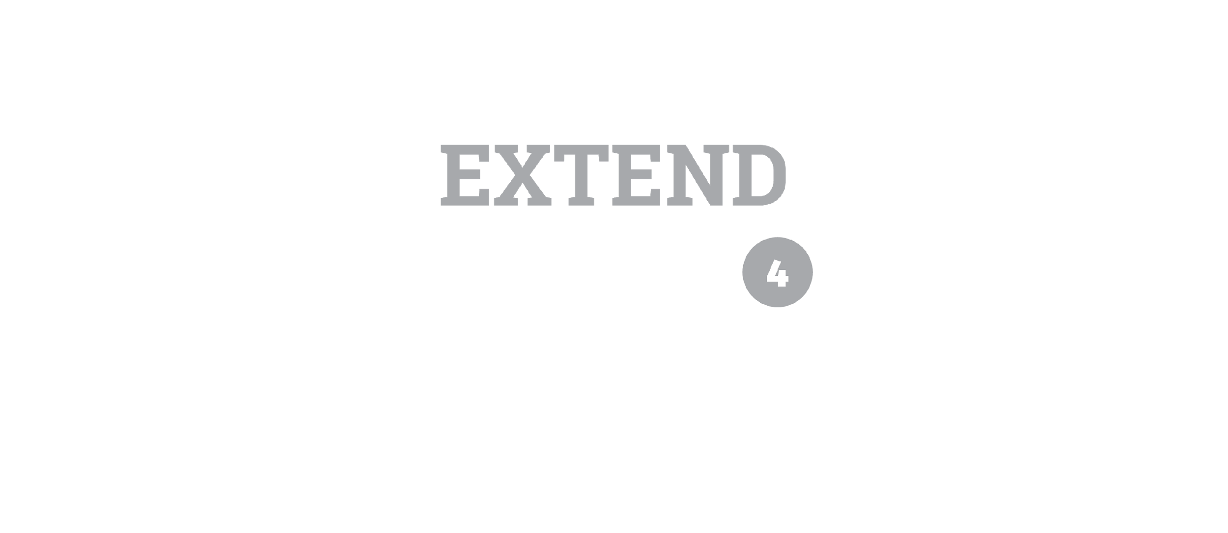

Slide 16
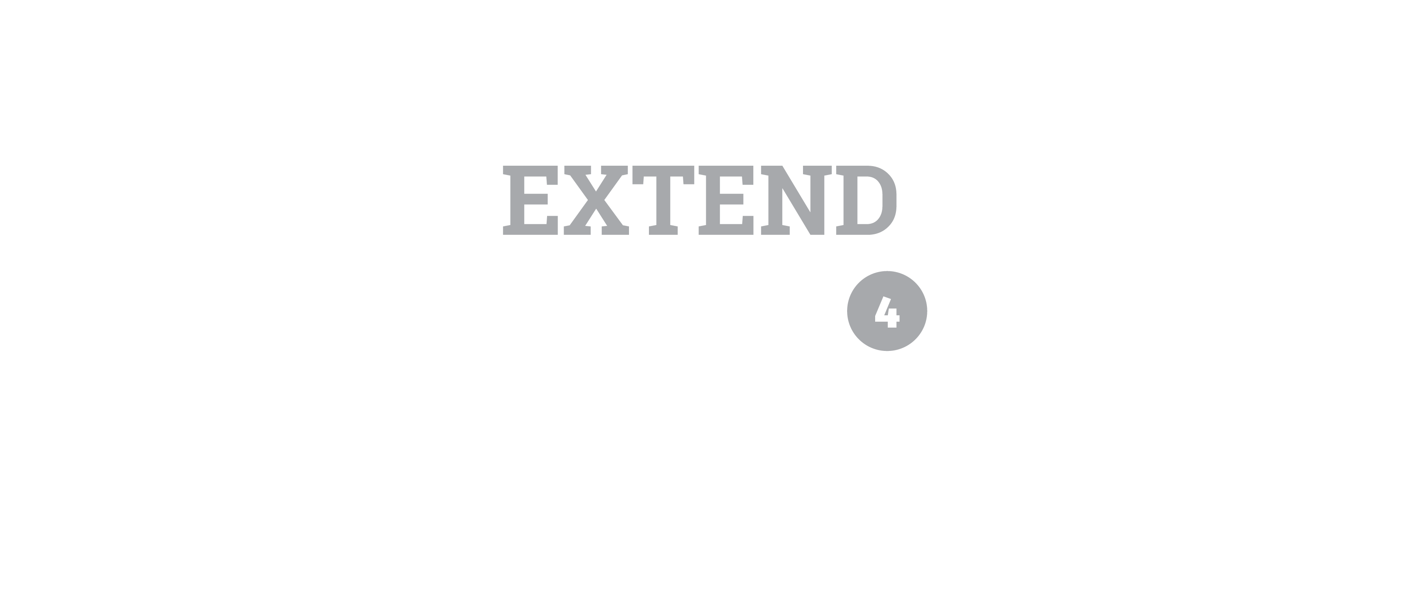
Can Stress Be Beneficial?
Do you remember your claim from the Bell Ringer activity?
Get out the claim card you wrote.
Groups will find, evaluate, and use evidence to support or revise the claim.

Slide 17
Can Stress Be Beneficial?
Use the Website Evaluation Checklist handout to determine the credibility of 2–3 websites from the list provided. As you evaluate, ask:
  Is this a quality resource?
  Does this resource give any evidence to support our claim?
On a separate sheet of paper, use evidence from the sources to write a 3–4 sentence conclusion that supports your claim.
Discuss the credibility of the websites and how you determined this.

Slide 18
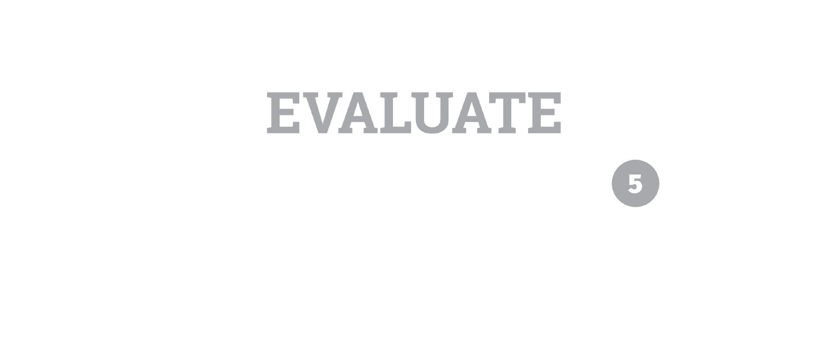

Slide 19
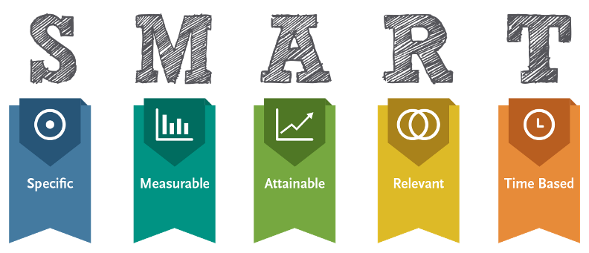
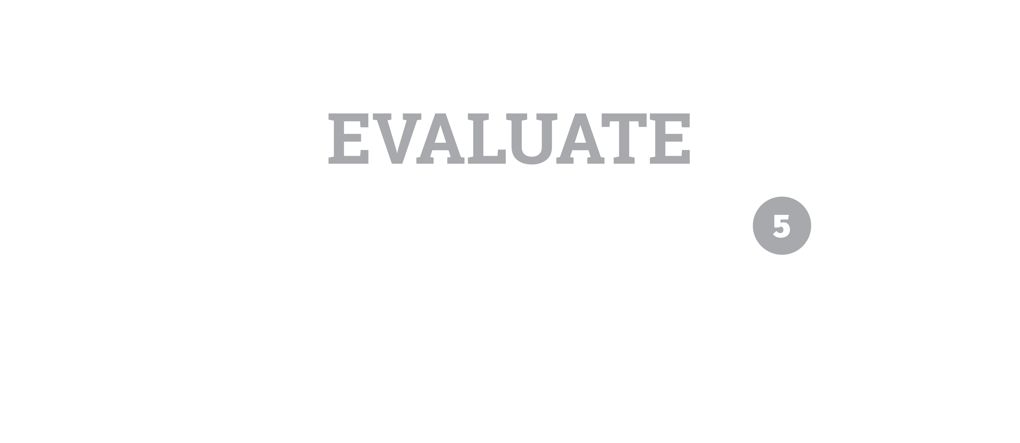

SMART goals is licensed under CC BY-SA

Slide 20
SMART Goals
Specific
  I want to score at least a B in each of my courses (I currently have a mix of As, Bs, and Cs).
Measurable
  Over the next two weeks, I will arrange a time to meet with each of my teachers.
  I will ask for advice on how I can improve my grade in their course.
  I will take notes on their advice and start taking steps to do better.

Slide 21
SMART Goals
Attainable:
  By the day after tomorrow, I’ll create a weekly schedule detailing times outside of school I need to block off for studying, homework, chores, sports, etc.
  I’ll allocate enough time each week for studying and homework.
  I’ll apply any learning strategies based on my teachers’ feedback.

Slide 22
SMART Goals
Relevant:
  I want to reach my full potential as a student.
  Getting better grades now will help me be more successful in high school.
  Getting good grades will help me be better prepared for college.
Time-bound:
  By the next report card, I will be scoring fewer Cs.
  In a year’s time, I will have at least a B in every course.

Slide 23
SMART goals is licensed under CC BY-SA

