Slide 1
Epidemic Outbreak: Can You Save the World in Time?
8th Grade Mathematics

Slide 2
Essential Question
How can properties of integer exponents create expressions?

Slide 3


Slide 4
In your notebook, make a chart:
I notice…
I wonder…

Slide 5
Bacteria Growth
Watch the video closely. It’s not very long.
A disease is spreading rapidly across the world.
We need to stop it!

Slide 6
Whole Class Discussion
We notice…
We wonder…

Slide 7


Slide 8
In pairs, complete the Components of Exponents handout.

Slide 9


Slide 10
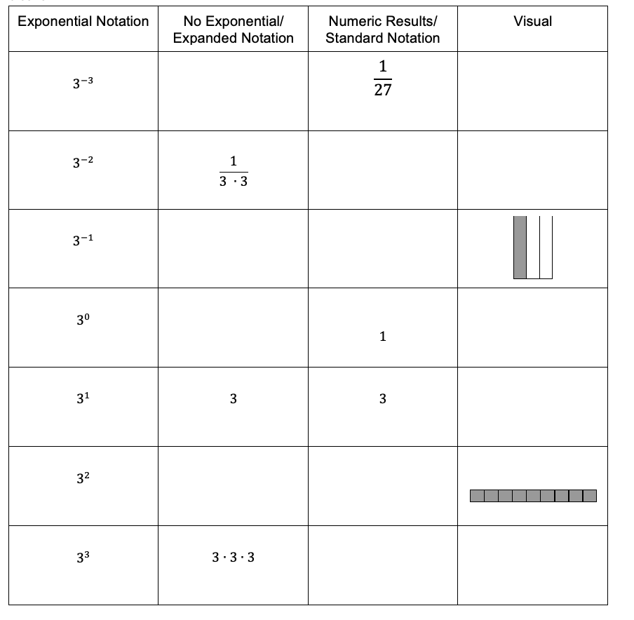

Slide 11
Patterns in Exponents

Slide 13
In pairs, complete the Rules of Exponents handout.

Slide 15
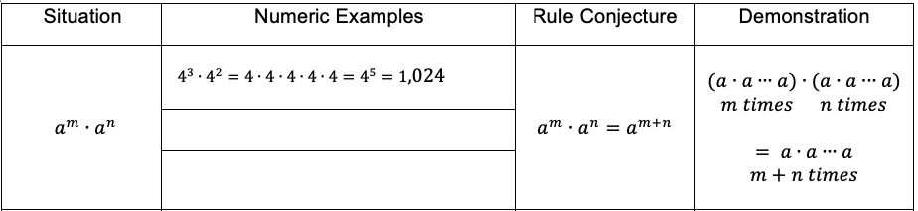
Rules of Exponents

Slide 16
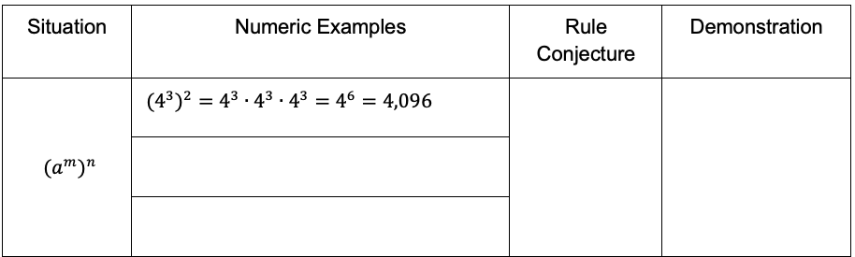
Rules of Exponents

Slide 17
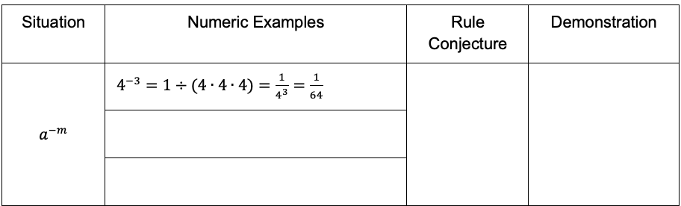
Rules of Exponents

Slide 18
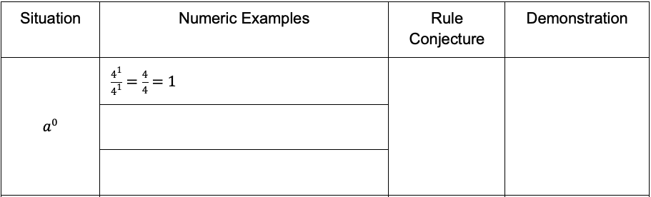
Rules of Exponents

Slide 19
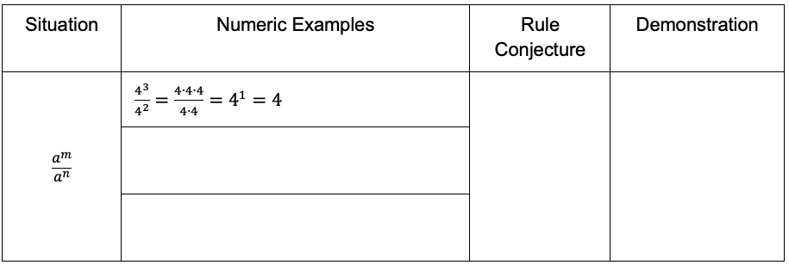
Rules of Exponents

Slide 20
Inverted Pyramid
Pair up with an elbow partner.
Discuss the Components of Exponents you have discovered
Once you have had enough time to discuss the concept, join another pair to form a group of four.
In groups of four, share what you discussed when you were paired.
After sharing in small groups (multiple times if needed or if time allows), groups come together for a whole-class discussion.

Slide 21

Notes:
Brittany and Amber

Slide 22
Digital Breakout
Now is time for your medical team to try to save the day!
See if you can unlock the clues in time.
http://bit.ly/epidemicbreakout
Remember how to solve the clues because you will have to fill out an action report.
Notes:
http://bit.ly/epidemicbreakout

Slide 23


Slide 24
Exit Ticket
Crystal Clear/Muddiest Point
Of everything we have learned today, what do you feel most confident about? What is “crystal clear” to you?
What do you feel least confident about? In other words, what is your “muddiest point” from today?

