Slide 2
Indestructible? Inconceivable!
Chemical Properties and Reactions
6th, 7th, and 8th Grade Science
Notes:
Engage
Students watch a video demonstration of watermelons dropped from a tower with and without a polyurea coating and attempt to explain what they observed.
Explore
Students watch additional video clips showing the chemical reaction which produces polyurea (brand name LINE-X®), draw models to explain what they observe, and build additional models to explore the chemical structure of polyurea and its original components.
Explain
Students share their models and discuss how they know a chemical reaction occurred, how polyurea is formed, and describe the relationship between atomic structure and a substance's properties.
Extend
In small groups students experiment with "Cat's Cradle" string games as a practical demonstration of the characteristics of polyurea that make it virtually indestructible.
Evaluate
Students create a final model that explains how polyurea is formed, why its atomic structure contributes to its near indestructible quality, and the mechanism for how polyurea protected the watermelon observed in the Engage.

Slide 3
Lesson Objectives
Students will be able to:
Develop models to describe the atomic composition of simple molecules and extended structures.
Analyze and interpret data on the properties of substances before and after the substances interact to determine if a chemical reaction has occurred.

Slide 4
Essential Question
How does the atomic structure of a substance influence its properties?

Slide 5
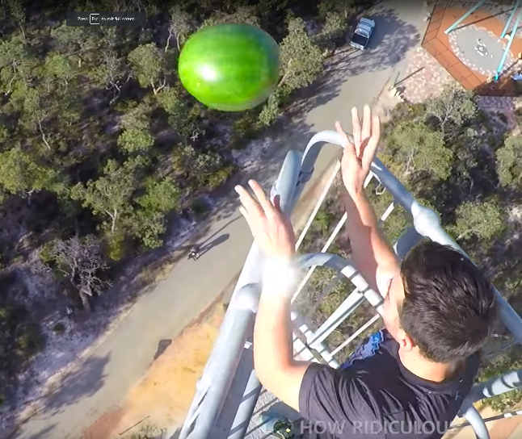
Watermelon Drop
What do you notice?
What do you wonder?
Video source: Veritasium. (2016, December 5). Indestructible coating?! [Video file]. YouTube.
Retrieved from https://youtu.be/DWkYRh6OXy8
Notes:
https://youtu.be/DWkYRh6OXy8 (image links to video)
Watch from 0:00-2:10
Have students complete the I Notice, I Wonder strategy

Slide 6
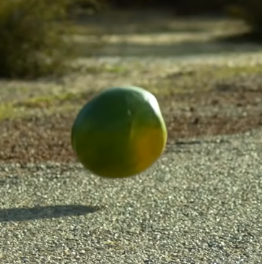
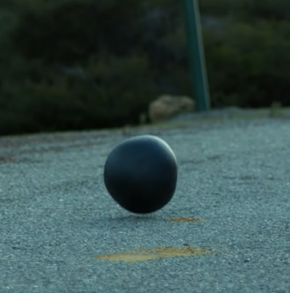
Watermelon Drop
What do you think the polymer coating sprayed on the watermelon is made of?
What properties does the material have that make it so strong?
How do you think it was able to protect the melon?
Video source: Veritasium. (2016, December 5). Indestructible coating?! [Video file]. YouTube.
Retrieved from https://youtu.be/DWkYRh6OXy8
Notes:
Encourage students to come up with their best guesses if they are struggling to come up with answers.
Emphasize that they don't have to know the answer right now because the goal of the lesson is to explain what they saw.

Slide 7
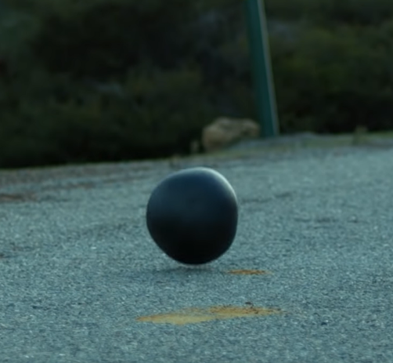
Watermelon Drop
How does the polymer coating protect the watermelon?
Video source: Veritasium. (2016, December 5). Indestructible coating?! [Video file]. YouTube. Retrieved from https://youtu.be/DWkYRh6OXy8
Notes:
Present phenomena goal (explain why the polymer coating can protect the watermelon).

Slide 8
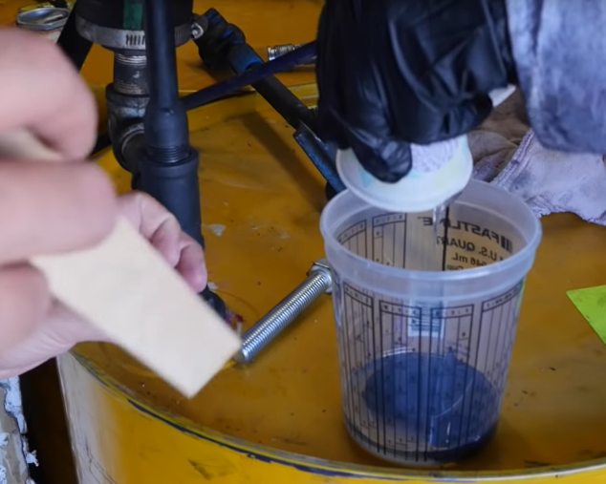
Making the Polymer Coating
Share your observations of what is happening in the clip.
Draw a model that explains how the LINE-X®️ polymer forms.
Video source: Veritasium. (2016, December 5). Indestructible coating?! [Video file]. YouTube. Retrieved from https://youtu.be/DWkYRh6OXy8
Notes:
https://youtu.be/DWkYRh6OXy8?t=160 (image links to video)
Watch from 2:40-3:26
Play the clip at least twice to give students time to pick up on specific details.
Have students make observations.
Discuss the observations as a class.
The observable indicators that a chemical reaction has occurred in the video include:
the release of a gas;
change in temperature; and
change in consistency (i.e., new properties) of the material in the cup.
Ask students to draw a model that shows how the LINE-X® is formed

Slide 9
Making the Polymer Coating
What causes the chemicals to be different from each other?
Add those details to your model.
Video source: Veritasium. (2016, December 5). Indestructible coating?! [Video file]. YouTube. Retrieved from https://youtu.be/DWkYRh6OXy8
Notes:
Students could:
Share these models with partners;
a few volunteers could share with the class; or
set the models aside without sharing out for now.
Ask students to recall what Substance A (clear liquid) and B (dark liquid) looked like.
Then, ask them to explain why the substances are different from each other. If they struggle to develop answers you might ask guiding questions like,
Why is Substance A a clear liquid?
What is Substance B made of that causes it to be black?
Have them add the distinction to their model.
Discuss these revised models and ideas as a whole group.
What causes the chemicals to be different?/Why are the chemicals different?
Accept a variety of answers from students but emphasize those ideas that suggest that A and B are made of different particles.
What causes the chemicals to be different?
You might rephrase the question as “why are the chemicals different” if students struggle to come up with an answer.
Summarize the content of their discussion to provide context for the next activity
(e.g., they’re all made of different kinds of tiny stuff and the new material is made of even tinier stuff from the other two materials’ tiny stuff).
If they are struggling, provide an analogy (e.g., how do you make a cake) to help them hone in on the idea that it takes “ingredients” to make a thing

Slide 10
Building a Polymer Model
Using the materials provided, create a physical model of how Substance A and Substance B turn into the LINE-X® coating.
Notes:
Now have students build a physical model to synthesize these two concepts:
the chemical reaction occurring to form LINE-X® and
its individual components (A & B) are different due to the particles they are composed of
Models should represent what makes each component different from each other." Allow time for students to build their models.

Slide 11
Building a Polymer Model
What are some similarities among your models?
What conclusions can you draw about how LINE-X® is formed?
Notes:
Students should share out their models with the class, formally or informally.
When students identify similarities the comparisons should be about how the materials were used rather than what they are made of. Some examples might include
Model “c” is always made of the same materials as “a” and “b”
Shapes changed
Each model looks different in specific ways
Record their ideas somewhere all students can see to help them draw conclusions and connect the ideas.
If students' models do not represent all the major concepts they need to discover, point them out to the class. For example,
I notice that in most of your models that all three substances are shaped differently;
When I look at your models I see that many of you built LINE-X® out of the same parts you used for Substance A and B
If this is necessary, be sure to ask students to explain why they built their models as they did.

Slide 12
How the LINE-X® Polymer Forms
What big ideas have we learned so far?
Why are the chemicals different?
How is LINE-X® formed?
What do the original chemicals and the LINE-X® have in common?
Notes:
Summarize all the ideas students have developed so far. Record the information where it’s visible so students can take notes over the material as you summarize.
Go over the vocabulary as you discuss the information. The following slide has all the relevant vocabulary in a table for students.
atoms - the particles that make up matter
element - different types of atoms; the elements and how they react with each other determine the properties of substances
molecules - two or more atoms bonded together; they can be the same type of atom or combinations of different types
Why are the chemicals different?
Composition and arrangement of atoms and molecules
properties are determined by those differences
How is LINE-X® formed?
Chemical reaction between substance A and B
atoms and molecules rearrange and bond
What do the original chemicals and the LINE-X® have in common?
Same atoms

Slide 13
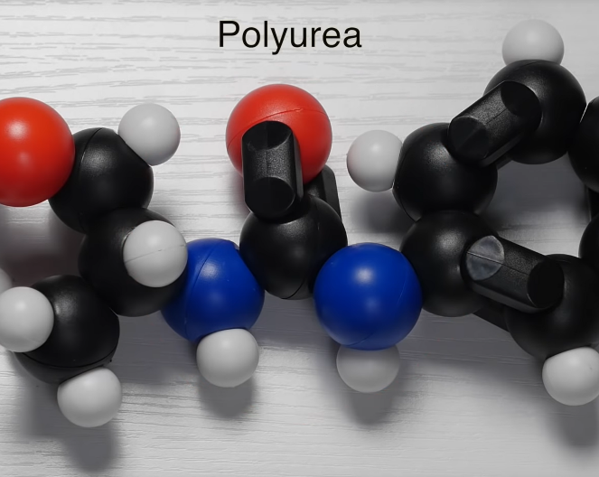
How Polyurea Forms
What other details can we add to our big ideas and conclusions?
Video source: Veritasium. (2016, December 5). Indestructible coating?! [Video file]. YouTube. Retrieved from https://youtu.be/DWkYRh6OXy8
Notes:
https://youtu.be/DWkYRh6OXy8?t=130 (image links to video)
Watch from 2:10-4:05; consider pausing at the following places and probe students to explain what students have just heard
2:40 – talk about properties of the two chemicals (super strong and super long)
Atom, element, molecule vocabulary
3:40 – remind students that LINE-X® is polyurea
talk about bonding and the function of long chain structure
Properties of substance is determined by the structure
Ask students for new information they learned.
You can record these notes as you pause the video or at the end
Conclude by asking students to explain how polyurea/LINE-X® forms. Re-voice student answers to formally summarize how polyurea forms

Slide 14
atoms | particles that make up all matter
elements | different types of atoms the way elements react with each other is what gives substances their unique properties
molecules | two or more atoms bonded together they can be the same type of atom, or combinations of different types
polymers | substances made of many copies of the same molecule type bonded together Substance B makes very long polymer chains
reactive | describes substances with strong chemical reactions Substance A makes very strong bonds with other molecules
Notes:
At this point it is appropriate for students to record the relevant vocabulary.
The word exothermic is relevant, but students do not need to know or remember it since the video defines the word every time.
polymer - substances made of many copies of the same type of molecule bonded together
reactive - this is a video-specific word (~2:18) and is not necessary for students to remember, but for the purpose of this lesson they need to know that Substance A makes very strong bonds with other molecules

Slide 15
Polyurea Structure and Function
Do we have enough information yet to explain how the LINE-X® (polyurea) protects the watermelon?
What else might we need to know?
Notes:
Ask students if they have enough information yet to explain why the LINE-X® coating was able to protect the watermelon. (They don’t at this point.)
Tell them the activity they are going to do next will help them gather the rest of the information they need.

Slide 16
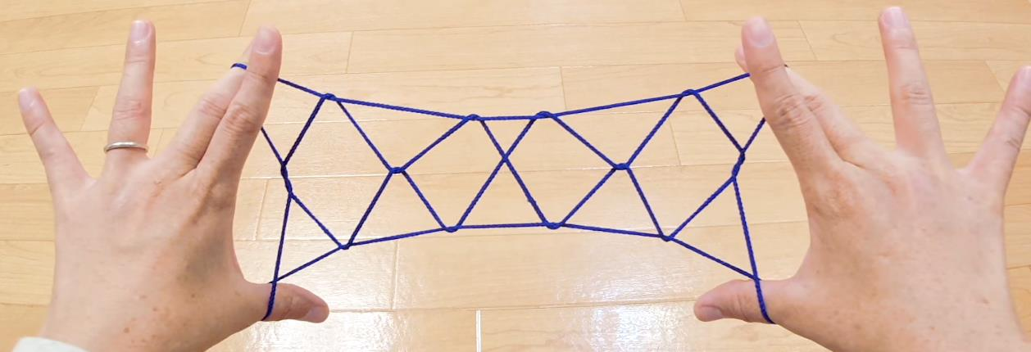
Modeling Polyurea with String Games
inDOOR hobby. (2019, March 29). Cat's Cradle Playlist [Video files]. YouTube. Retrieved from https://www.youtube.com/playlist?list=PLD36uxtvOyM5AQmzGfajBFtB06iGHQYTx
Notes:
Provide pairs of students with yarn or string of at least three different lengths, pre-cut or with guidance for the students to choose the lengths.
Assign students specific "Cat's Cradle" string game designs or let them choose one for themselves.
This YouTube playlist provides many examples with step-by-step demonstrations. https://www.youtube.com/playlist?list=PLD36uxtvOyM5AQmzGfajBFtB06iGHQYTx
Screenshot taken from: https://www.youtube.com/watch?v=1_kf3Mkam4A
This activity could be facilitated in multiple ways. Examples for pairs include:
Two different designs of more or less complexity,
A single design with the complexity distributed across the classroom.
Pairs should attempt to create the same design with their strings and make observations about the experience
which length was easiest to use,
how did length relate to the complexity of their design,
what happened to the string during their play,
etc.
This activity illustrates that the longer threads were able to become most entangled and the more tangled they are the more the web can stretch/hold/etc. without breaking or knotting.
Since polyurea is composed of chemicals that create very long chains, these long chains have more opportunities to form crosslinks (“webs”) and since one chemical bonds very strongly, the webs don’t break easily

Slide 17
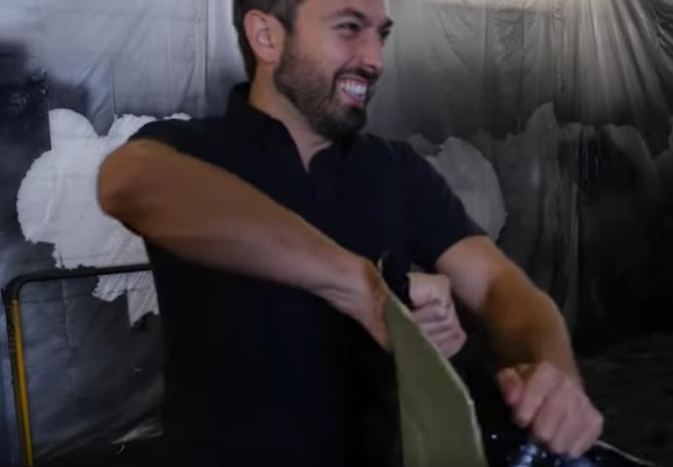
Polyurea Structure and Function
What did playing string games teach you?
How does what you learned relate to LINE-X®/polyurea?
Video source: Veritasium. (2016, December 5). Indestructible coating?! [Video file]. YouTube. Retrieved from https://youtu.be/DWkYRh6OXy8
Notes:
In their pairs or in small groups, have students summarize what they learned while playing string games (i.e., longer threads get tangled more easily and can make more complicated designs; shorter threads are difficult to make designs with and aren't as easy to tangle).
Play the rest of the video (4:05 - end) for students. (Note there are several video-specific vocab words in the remainder of the video that students do not need to remember but should understand for the purpose of the lesson. Add them to the Anchor Chart if necessary. See these vocab words below.)
cross-link - (~5:20) for the purpose of this lesson, students need to understand that different polyurea chains can bond with each other and become "tangled" or "knotted"
tensile strength - (~5:54) for the purpose of this lesson, this can be defined as how much you can stretch/deform a substance without it breaking

Slide 18
Polyurea Structure and Function
Why is LINE-X® so strong?
How does this explain why the LINE-X® protected the watermelon?
Video source: Veritasium. (2016, December 5). Indestructible coating?! [Video file]. YouTube. Retrieved from https://youtu.be/DWkYRh6OXy8
Notes:
After viewing the rest of the video, ask students to explain why LINE-X® is so strong based on what they learned in the video and their conclusions from the game
the long chains form strong bonds among each other ["cross-link"] and get tangled;
the tangled polyurea chains can stretch and go back to their original shape without breaking.
Then ask them to explain why this property protected the watermelon (i.e., the polyurea redistributes the force so less of the impact reaches the watermelon - student answers likely won't be so technical).

Slide 19
How Does LINE-X® Protect the Watermelon?
Create a final model that illustrates:
How the LINE-X® forms
How its structure protects the watermelon when it is dropped
Provide an explanation of your model and how it represents what you learned during the lesson.
Notes:
Students should create a final model that illustrates how the Line-X forms and how its structure protects the watermelon when it is dropped. This might be
drawn
constructed
created digitally
a kinesthetic model.
Each student should provide an explanation of their model and how it represents the concepts they learned during the lesson, (written or oral).

