Slide 2
Probability in Sports
8th Grade Math

Slide 3
Essential Question
How can probability inform coaching staff decision-making for sporting events?

Slide 5
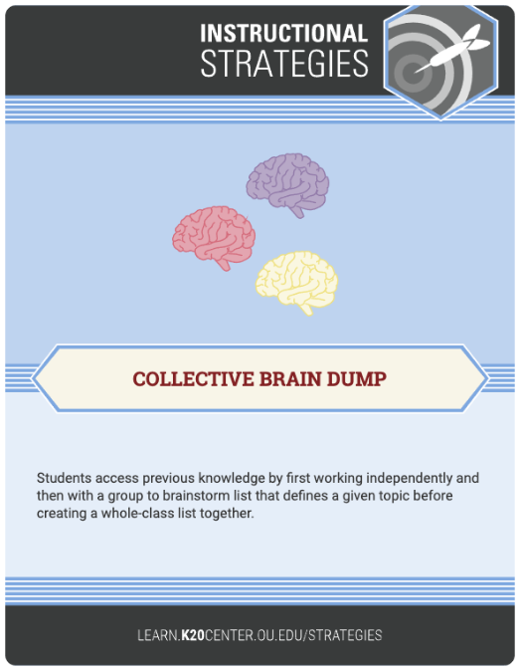
Basketball Brain Dump
On scratch paper, write down everything you know about basketball.
Be ready to share with the class.
Notes:
Collective Brain Dump strategy: https://learn.k20center.ou.edu/strategy/baee4e90c5fa1a7060ca04dd8b00450e
Once students are finished, have a whole class discussion over what they wrote down. You might write down what they say on the board and see what they come up with.

Slide 6
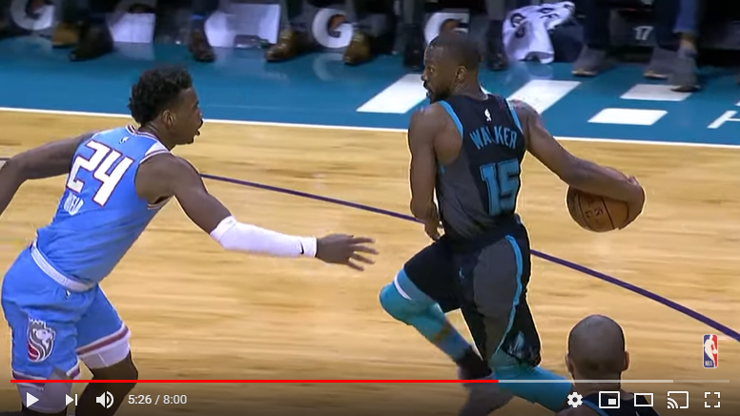
NBA’s Best Ball Fakes 2018-2019
NBA's Best Ball Fakes | 2018-19 Nba Season | #NBAHandlesWeek. (2019). Retrieved from https://www.youtube.com/watch?v=4FdIRPiL5vA
Notes:
Video Link: https://www.youtube.com/watch?v=4FdIRPiL5vA
You might find specific highlights to show, if you do not have time to watch the whole video.

Slide 8
Shot Statistics: Collecting Your Data
Now collect our own statistics!
Work in pairs: one person shoots first while the other records their shots on the Shot Statistics handout. Then switch.
Shoot 10 times each.
What’s your probability of making a shot?
Johnston, K. (n.d.). Basketball. Retrieved from https://pixabay.com/photos/basketball-net-score-rim-hoop-2099656/
Notes:
Teacher Note: before class, place a line on the floor as the boundary line for shooting. Make sure the basket the students are shooting in is in line with the boundary. Depending on class size, you might want to have multiple spots, so multiple groups can go at the same time.

Slide 10
Shot Statistics: Class Discussion
How did you find your probability?
Who has the highest chance of making a successful shot?
Which form (decimal, fraction, or percentage) would be most helpful to a basketball coach? Why?
0.7 $7/{10}$ 70%

Slide 12
Today, you start a new job as an NBA statistician.
Find your team:
https://www.basketball-reference.com/boxscores/
(or scan QR code to the right)
On your Statistician’s First Day handout, gather data from the last four games played. Use data for 2-point shots and 3-point shots.
Find the probability of those shots. Write them as fractions and as percentages.
Rawpixel. (n.d.). Office. Retrieved from https://pixabay.com/photos/office-business-paperwork-document-3295556/

Slide 14
Today, you start a new job as an NBA statistician.
Your team’s coach has asked you to find out what shots the team should practice, based on your data.
What would you recommend, based on your understanding of probability? Write a letter of five complete sentences to the coach to explain what specific shots the team should practice.

