Slide 2
Why Study Geography?
World Geography
7th Grade

Slide 3
Essential Question:
Why is the study of geography important?

Slide 4
Can You Name a Country?
Jimmy Kimmel, a late-night talk show host, asked people to name any country on a blank map.
How many countries could YOU name on a blank map?
One? Three? Five? Ten? More?

Slide 5
Can You Name a Country?
YouTube Video Link here.
Notes:
https://www.youtube.com/watch?v=kRh1zXFKC_o

Slide 6
Geography Definition
“The study of the features and systems of the Earth’s surface, including continents, mountains, seas, weather, and plant life, and of the ways in which countries and people organize their life in an area.”
—The Cambridge Dictionary
Geography. (n.d.). Retrieved from https://dictionary.cambridge.org/us/dictionary/english/geography

Slide 7

I Think
Why is the study of geography important?
Write your ideas in the “I Think” column.

Slide 8
We Think
Why is the study of geography important? Discuss your ideas with a partner.
Together, decide on a reason or reasons why geography is important.
Write your combined answer in the “We Think” column.

Slide 9
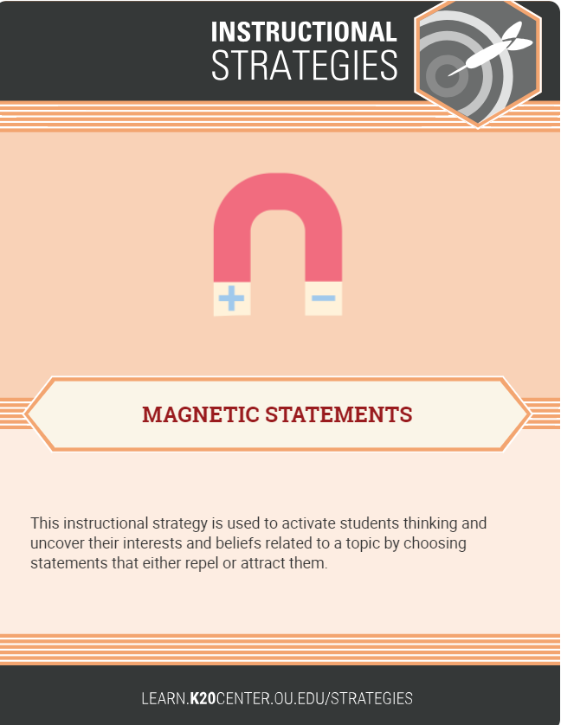
Magnetic Statements
Walk around the room.
Read ALL the statements about the importance of geography.
Choose one that “attracts” you most (like a magnet) or seems most important to you.
Stand next to that statement.

Slide 10
Magnetic Statements
Discuss the magnetic statement you chose with others in your group.
—Explain what the quote means in your own words.
      —Discuss your reasoning for choosing it.
      —Choose a spokesperson to discuss the quote for the group.

Slide 11

We Rethink Column
With your partner…
read the Magnetic Statements again.
circle or highlight important ideas or phrases that support why people should study geography.
rewrite and expand your We Think statements to include at least two ideas from the Magnetic Statements.
Notes:
Clipart source: This Photo by Unknown Author is licensed under CC BY-NC

Slide 12

Quote: “The cool thing about being famous is traveling. I have always wanted to travel across seas, like to Canada and stuff.”
Britney Spears
American singer
Source: Garis, M. (2015). 7 Ridiculous Britney Spears Quotes, Because She Has A Hard Time With The Whole Geography Thing. Bustle.com.
Retrieved from: https://www.bustle.com/articles/98047-7-ridiculous-britney-spears-quotes-because-she-has-a-hard-time-with-the-whole-geography-thing
Photo source: "1859" by Sarah 1992 is licensed under CC BY 2.0

Slide 13

Assessments of the Lesson
I Think, We Think, We Rethink Graphic Organizer
Letter to Britney Spears
This Photo by Unknown Author is licensed under CC BY-NC-ND

