Slide 2

Venom: From
Lethal to Lifesaving
8th Grade Science
Notes:
This is a 8th grade lesson that meets the OAS standard MS-PS1-3 Matter and Interactions. Students will gather and make sense of information to describe that synthetic materials come from natural resources and impact society.

Slide 3
Essential Question
What is the societal impact of creating synthetic materials from natural resources?

Slide 4


Slide 5
How I Know It
Brainstorm everything you know about snakes and venom.
Place facts inside the circle.
On the outside of the circle, write how you know that fact. Draw a line linking the fact to how you know it.
Turn to an elbow partner and share what you wrote with each other.
Notes:
Hand out blank “How I Know It” sheets from the LEARN lesson. See the LEARN lesson for an example of a completed sheet.

Slide 6
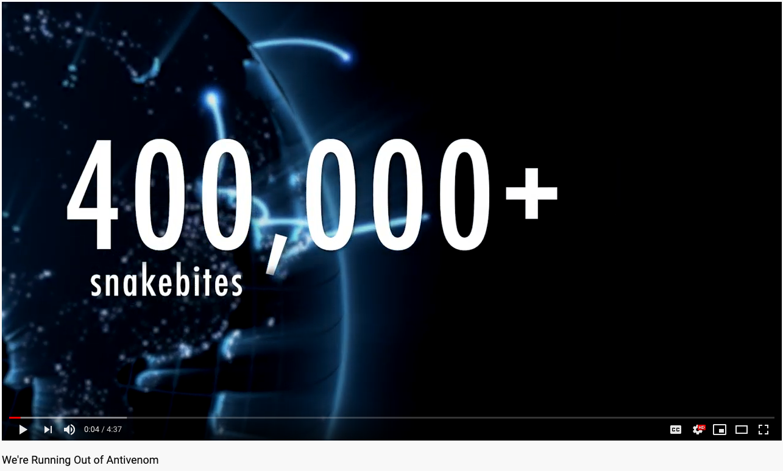
We’re Running Out of Antivenom:
Why does this matter? Why should we care?
Source: Inside Science. (2016, November 18). We’re running out of antivenom [video file].
Retrieved from https://www.youtube.com/watch?v=gudUuRFba3M&feature=youtu.be
Notes:
Video URL: https://youtu.be/gudUuRFba3M
Only show the first 41 seconds of video. While students are watching the video, make sure that they are thinking about the two questions above. Have 2–3 students share out their thoughts after the first 41 seconds are over.

Slide 7


Slide 8
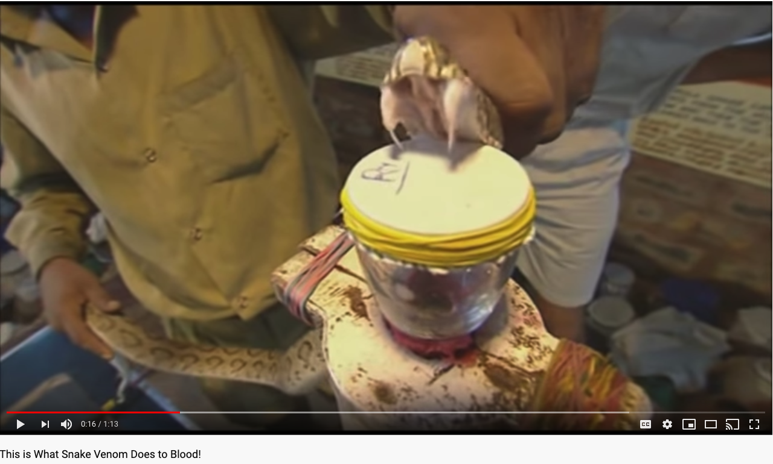
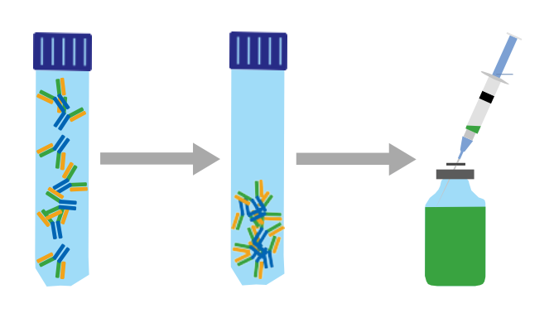
Card Sort Activity
Video: “This Is What Snake Venom Does to Blood!”
Using the cards with pictures, organize them in the steps you think it takes to make human-made antivenom from natural snake venom.
Worchester Web Studio. (2012, April 11). This is what snake venom does to blood! [video file].
Retrieved from https://www.youtube.com/watch?v=4WvnjCkLbvY
Notes:
Video URL: https://www.youtube.com/watch?v=4WvnjCkLbvY

Slide 9


Slide 10
Jigsaw Strategy & CUS and Discuss
Number off 1–6.
On your own, read your number’s section of Antivenom: How It’s Made and Why It’s So Precious.
While you are reading:
  Circle words you don’t know.
  Underline details that support main ideas of your section only.
  Star main ideas of your section only.

Slide 11
CUS and Discuss
Once everyone is done CUSing, find other students that read the same section as you.
Discuss what you underlined and starred.
  After group discussion, choose one person to be your spokesperson. They will share the main points from your section with the entire class.

Slide 12
Card Sort Revisit
Revisit your card sort by placing the text-only cards with the picture cards you used earlier.
Make any changes to the order now that you have more information.

Slide 13
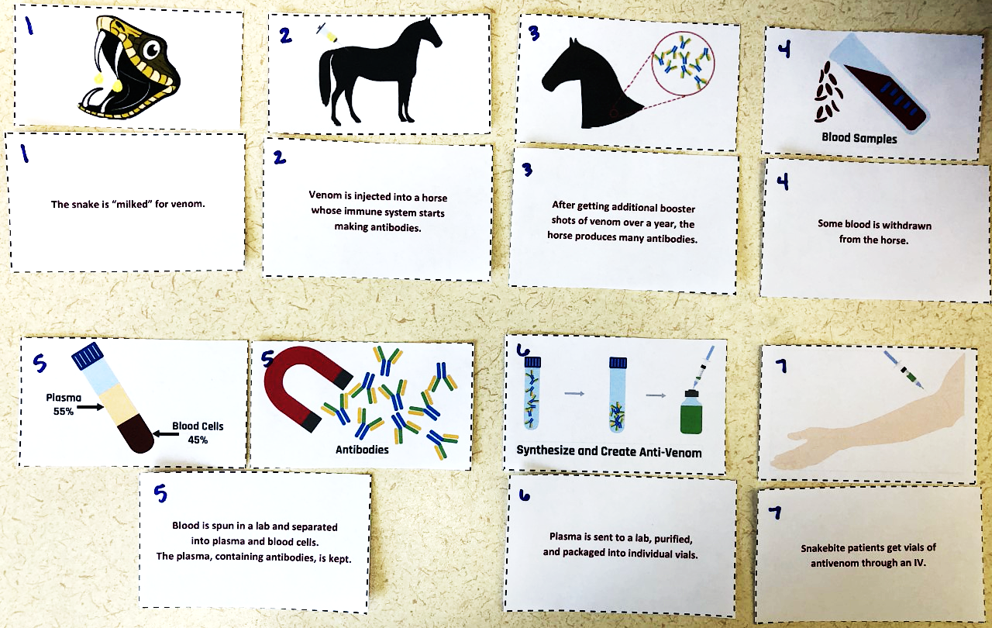
Card Sort Answers

Slide 14
Synthetic Products vs. Natural Resources
Antivenom is one example of a synthetic product that is made from natural resources.
What does synthetic mean?
What does natural mean?

Slide 15
Human-made Products…
are created to solve a problem. They impact society and the environment in some way.
Can you think of any human-made products that…
  have a positive impact? How is the product used?
  have a negative impact? How is the product used?
  have both a positive and a negative impact? Explain how this can be the case.

Slide 16
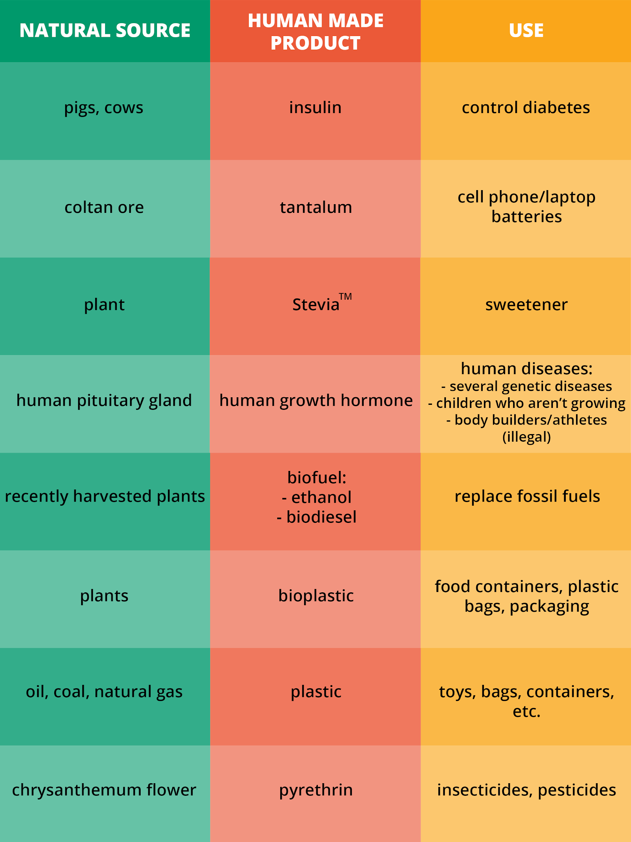
Human-Made Products

Slide 17


Slide 18
High-Quality Research Sources
Reliability: Is an author’s name given? Are they an expert? Check the domain (.com, .gov, .edu, .org). Is there information from other sources?
Accuracy: How current is the material? Has it been updated recently? Does it have spelling errors/slang?
Bias: What’s the purpose (i.e., information, selling something, sponsored page)? Is the tone overly negative or positive?
Relevance: Is the information useful to the topic?

Slide 19

You’re the judge. Which is more reliable?
Using the “Identifying High Quality Sites” handout, compare
the two articles to see which is more reliable.
Socha, Arek. (2017, July 11). Gavel. Retrieved from https://pixabay.com/photos/gavel-auction-law-hammer-symbol-2492011/

Slide 20


Slide 21
Create a Poster
Now that you know what makes a reliable website, choose one synthetic product made from natural resources. Research it and create a poster. Posters will be displayed in class. Your poster should include:
The natural resource
The synthetic (human-made) resource
How the product is made
How the product is used
An explanation for how the product impacts society
Evidence/citations

Slide 22
Gallery Walk
Using the Gallery Walk Rubric, visit each poster.
You will have 3 minutes to provide feedback before moving to the next poster.
Notes:
This slide should be displayed on the actual day that the entire class will be viewing & peer reviewing each other’s posters. Give students an example and a nonexample of feedback. Move around the room to ensure that students are leaving meaningful feedback.

Slide 23
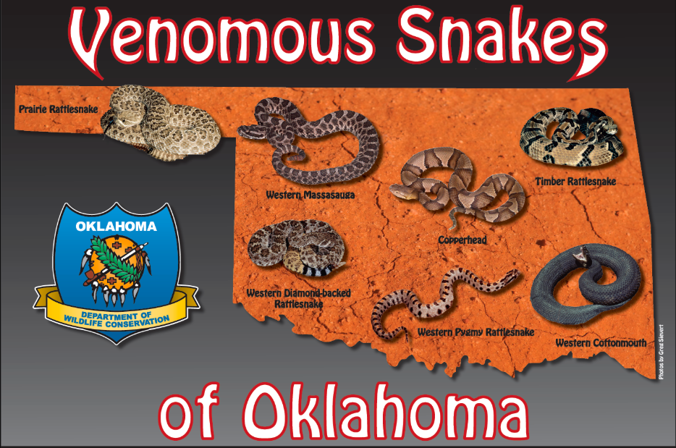
So Now What?
Get out your “How I Know It” sheet from the start of the lesson.
In a different ink color, write down any new facts (inside the circle) and how you know it (on the outside of the circle).
Oklahoma Department of Wildlife Conservation. (2013, January 18). Venomous Snakes of Oklahoma. Retrieved from https://digitalprairie.ok.gov/digital/collection/stgovpub/id/222183
Notes:
See the second example of the completed “How I Know It” sheet in the LEARN lesson.

