Slide 1
TV SHOW RATINGS & STATISTICS
What does the data tell us about TV shows?
Notes:
Teacher Notes: In this powerpoint is provided to help lead students in discussions about how they analyze the data for three TV Shows: Heroes, The Sopranos, and American Idol. They will use ideas covered in the group discussion to analyze other TV shows on their own or in small groups.

Slide 2
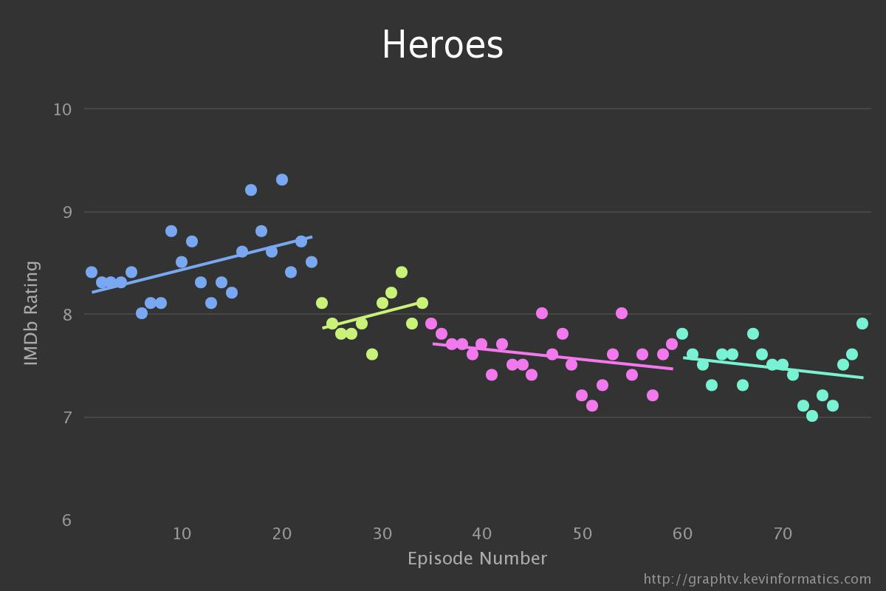
Heroes: Quality (How viewers felt about the show)
Notes:
Teacher Notes: Heroes was cancelled after four seasons for declining viewership. Midway through the 2nd season the shows creator, Tim Kring, apologized to viewers for the shows lack of quality.
Questions for discussion:
What do you notice about the graph?
What does this graph represent? (It represents how people felt about the show on a scale of 1 to 10)
What happened between Season 1 and Season 2? Did the show ever get back on track?

Slide 3
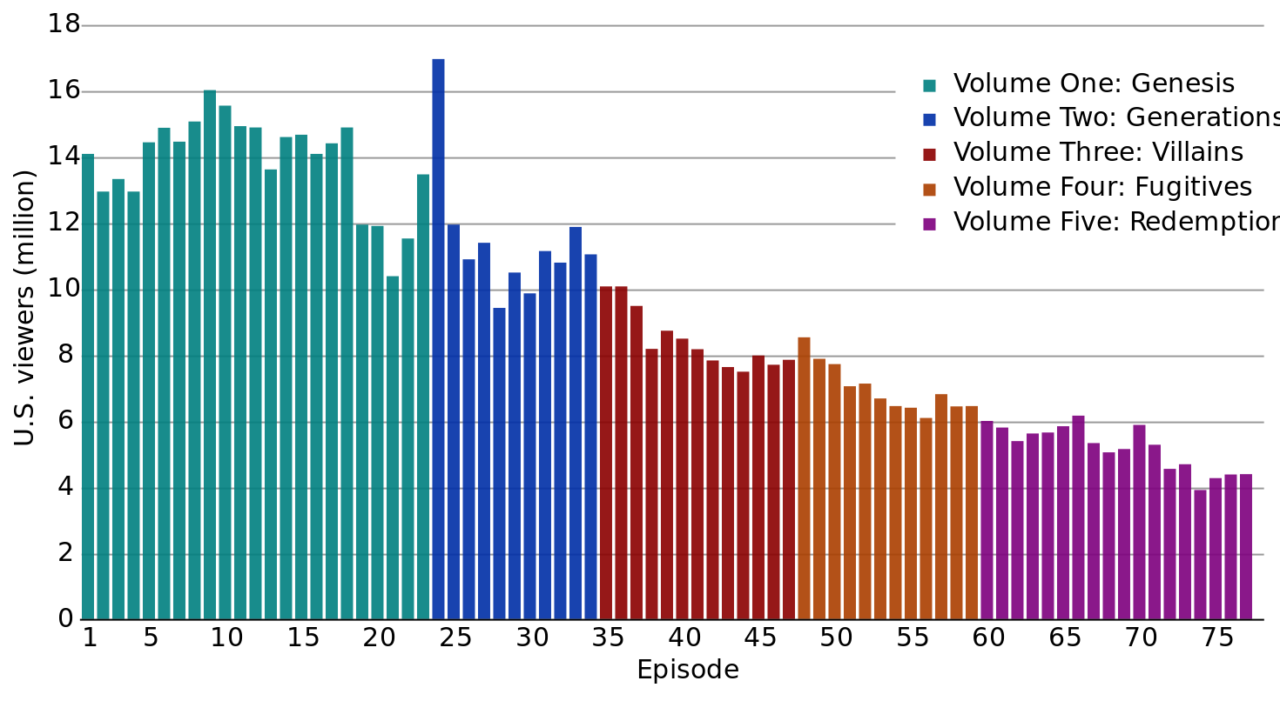
Heroes: Quantity (How many viewers watched the show)
Notes:
Teacher Notes: This graph represents the number of viewers who watched the show according to Nielsen ratings. Students can look for connections between how people felt about the show and how many people watched the show.
Questions for discussion:
What do you notice about this graph?
How is this graph for Heroes different from the last graph?
Does it appear that there is a relationship between the number of viewers and how the viewers feel about the show?
If you were the Producer of Heroes what would you do with the show?

Slide 4
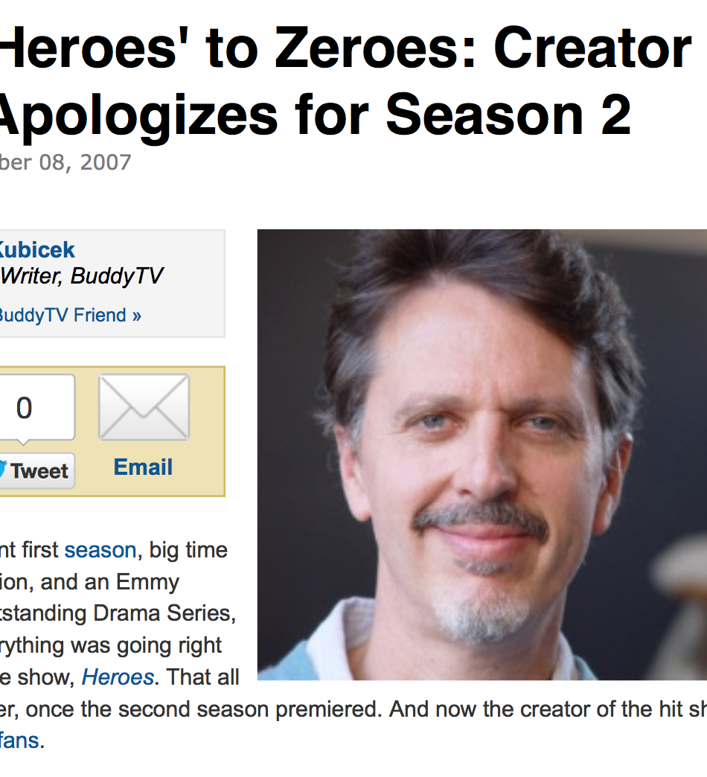
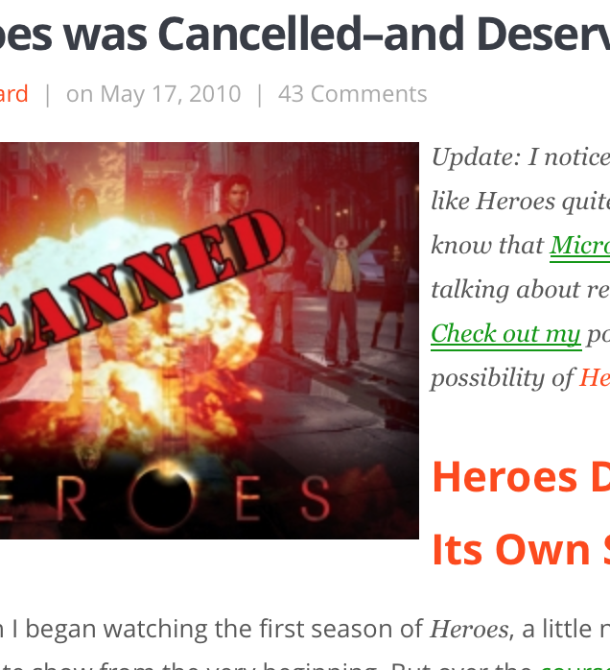
WHAT HAPPENED TO HEROES?
http://www.buddytv.com/articles/heroes/from-heroes-to-zeroes-creator-13520.aspx
http://www.allthatnerdystuff.com/2010/05/17/why-heroes-was-cancelled-and-deserved-it/

Slide 5
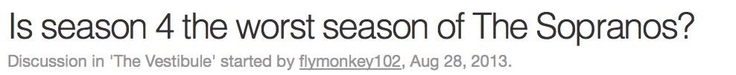
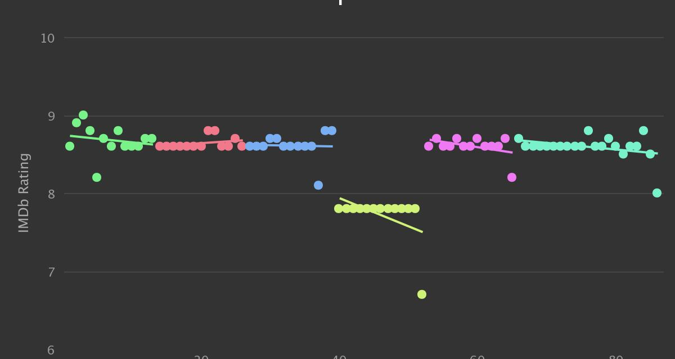
Notes:
Sopranos ran for six seasons. Often fans of the show rank Season 4 as the worst season. For this slide students will analyze the effects of an outlier.
Questions for discussion:
What do you notice about the graph?
What effect could season 4 have on the overall average of the shows quality?
Outside of Season 4 how did viewers feel about the show…was the opinion of the show consistent or varied?

Slide 6
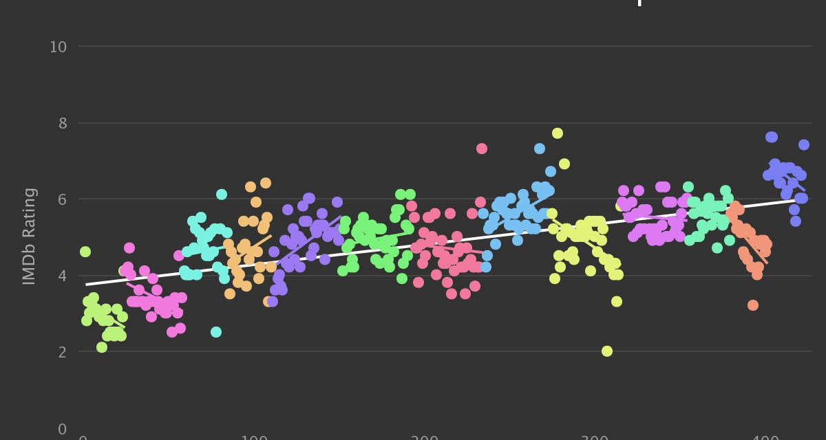
AMERICAN IDOL: SEASON 12 VS. SEASON 13
Notes:
Teacher Notes: This last show is American Idol. American Idol is in its 13th season. There was a lot of conflict between judges last season and instead of cancelling the show the producers hired new judges. Students will compare the quality rating of the show with the viewership and look for differences.
Questions for discussion:
What do you notice about the data presented?
What does the overall trend line indicate about the quality of the show?
What is the difference between Season 12 and 13? What do you think may account for the change?

Slide 7
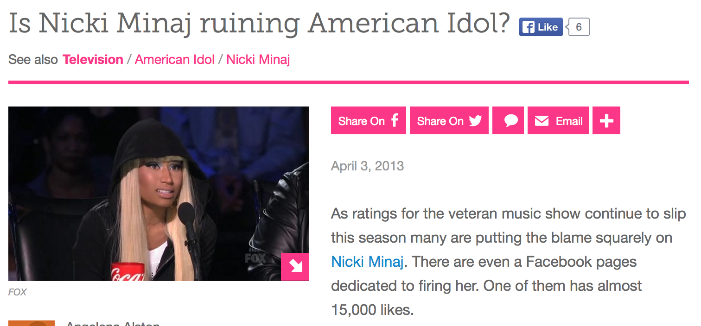

AMERICAN IDOL
Season 12
Season 13
http://www.examiner.com/article/is-nicki-minaj-ruining-american-idol-1
Notes:
Teacher Notes: These headlines address how the cast of the show impacts the quality of the show.
Questions for discussion:
These headlines argue that Nicki Minaj was ruining the show (she was let go after S12) and that Harry Connick Jr. has saved the show. Can you see evidence for this on the last graph?

Slide 8
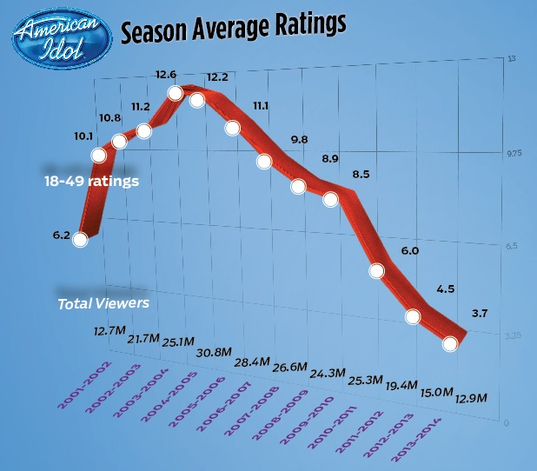
AMERICAN IDOL: SEASON RATINGS
Notes:
Teacher Notes: This graph represents the overall viewership of the show. In this case the viewership peaked early on and has declined ever since. It is not reflective of the chart that shows how viewers feel about the show.
Questions for discussion:
What do you notice about this information?
Are the ratings of the show consistent with how people feel about the show?
On the quality graph you can see how the opinion of S13 is much higher than previous seasons. Has an increase in the show’s quality impacted viewership?
If you were the producer would you continue to work with the show or cancel it?

