Slide 1
For Engage card sort part 2:
Print slides 2-6 of this PowerPoint as handouts. (4 or 6 per page will work best).
Or, you can make your own graphs with a similar variety of slopes.
Have students work in pairs to order the cards from least slope to greatest slope with a justification of their order.

Slide 2
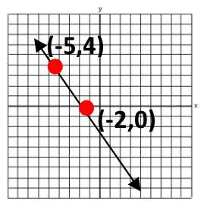

Slide 3
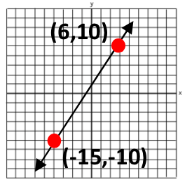

Slide 4
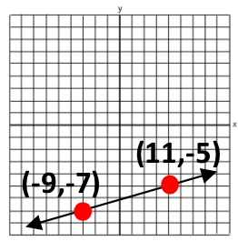

Slide 5
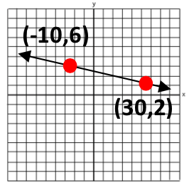

Slide 6
