Slide 2
Beyond the Slinky®, Part 1
Qualitative Characteristics of Waves

Slide 3
Essential Question
What is a wave?

Slide 4
Lesson Objectives
We will use mathematical representations:
to support a claim regarding relationships among the frequency, wavelength, and speed of waves traveling in various media; and
to describe a simple model for waves that includes how a wave’s amplitude is related to its energy.

Slide 5
Microwave Demonstration
Draw a picture of the microwave and use your diagram to show how things are heated inside.
Draw and label the chocolate and the cardboard. Then, predict what will happen to the chocolate if it is heated without rotating.
What happened?

Slide 6
Wave Stations
Rotate through the Wave Stations that have been set up around the classroom.
Follow the directions on the Wave Stations handout.
Use your handout to document your experiences at each station.

Slide 7
What did you find out?

Slide 8
3-2-1
On your handout, write:
3 things all the stations had in common,
2 differences you observed among the various stations, and
1 question you still have.
Notes:
Strategy: K20 Center. (n.d.). 3-2-1. Strategies. https://learn.k20center.ou.edu/strategy/117

Slide 9
Card Sort
The Card Sort has three different categories:
Wave (arrange by length)
Wave name (arrange by numerical size)
Object (arrange by size)
Organize the cards into sets of wave, name, and object, then arrange the sets in what you think is the correct order from longest to shortest.
Notes:
Strategy: K20 Center. (n.d.). Card Sort. Strategies. https://learn.k20center.ou.edu/strategy/147

Slide 10
Card Sort Answers
Notes:
Image source:
Slay, J. (n.d.). Electromagnetic spectrum [Image]. NASA’s Imagine the Universe. http://teacherlink.ed.usu.edu/tlnasa/reference/imaginedvd/files/imagine/docs/science/try_l2/emspectrum.html

Slide 11
Claim, Evidence, Reasoning (CER)
Justify this claim with evidence from your observations and use scientific reasoning to explain why it happens:
To heat food evenly, a microwave needs a rotating plate.
Notes:
Strategy: K20 Center. (n.d.). Claim, Evidence, Reasoning (CER). Strategies. https://learn.k20center.ou.edu/strategy/156

Slide 12
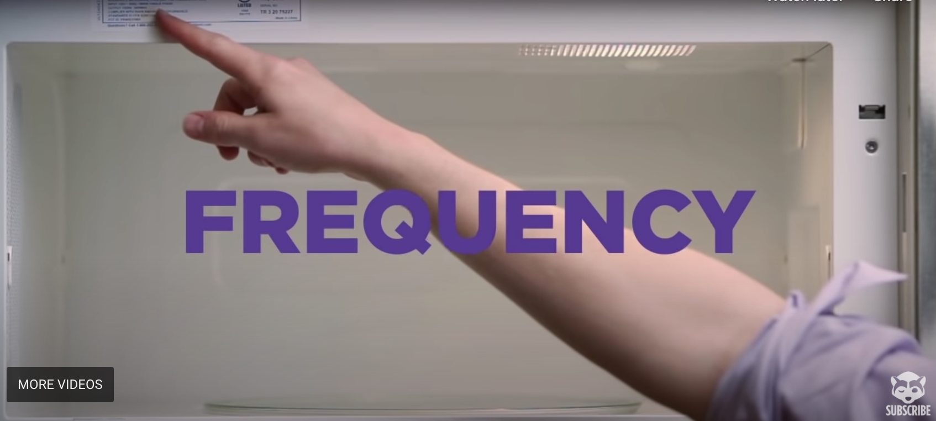
Finding the Speed of Light (With Peeps)
Notes:
To play the video, click on the image or paste this link into your browser: https://youtu.be/HwREvdUWSKE
Video source:
NPR’s Skunk Bear. (2015, April 13). Finding the speed of light with Peeps [Video]. YouTube. https://www.youtube.com/watch?v=HwREvdUWSKE

Slide 13
Microwave Diagram Revision
Return to your Microwave Demonstration handout.
Revise your microwave diagram from the beginning of the lesson based on what you’ve learned since then.

Slide 14
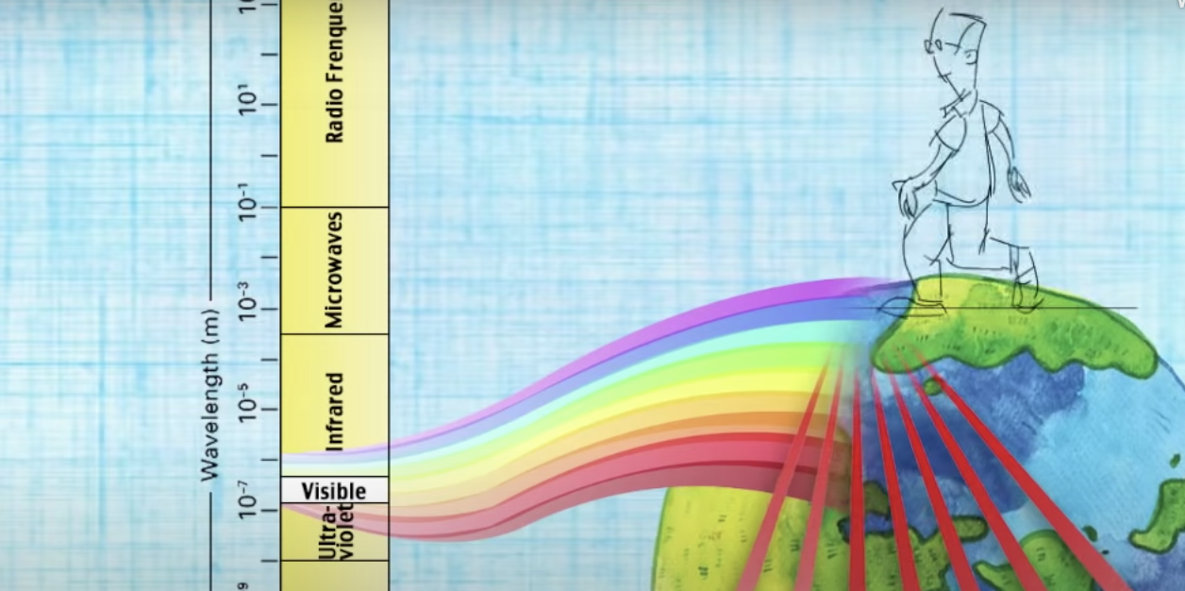
The Visible Spectrum
Notes:
To play the video, click on the image or paste this link into your browser: https://www.youtube.com/watch?v=MX2gUpYTPls&feature=youtu.be
Video source:
University of Illinois Extension. (2014, September 15). Visible spectrum of light [Video]. YouTube. https://www.youtube.com/watch?v=MX2gUpYTPls

