Slide 2
Ethos, Logos, Pathos
Persuading Your Audience

Slide 3
Essential Question
What techniques do speakers and writers use to persuade their audiences effectively?

Slide 4
Learning Objectives
Students evaluate commercials and infomercials for rhetorical devices and persuasive techniques.
Students create their own commercials using rhetorical devices and persuasive techniques. (optional)

Slide 5
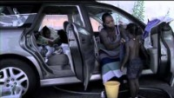
Volunteers of America
Write down one observation on one of your sticky notes.
What do you notice about the persuasive techniques used in this commercial?
Notes:
Volunteers of America Ohio & Indiana. (2013, March 25). Volunteers of America "stats" commercial [Video]. YouTube. https://www.youtube.com/watch?v=VtBGKw7pZS4

Slide 6
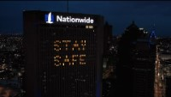
Nationwide
Write down one observation on one of your sticky notes.
What do you notice about the persuasive techniques used in this commercial?
Notes:
Nationwide. (2020, April 14). Our promise. [Video]. YouTube. https://www.youtube.com/watch?v=clIfHRbMvQ4

Slide 7
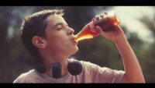
Coca-Cola
Write down one observation on one of your sticky notes.
What do you notice about the persuasive techniques used in this commercial?
Notes:
McGreevy, D. (2016, January 31). Coca Cola-Brotherly love. [Video]. YouTube. https://www.youtube.com/watch?v=qdPXQLrueRg

Slide 8

What Do You Notice?
After grouping similar ideas on the board, discuss the following:
What similarities and differences do you notice in responses?
Was Commercial 1 persuasive? Why or why not? Who would be persuaded?
Was Commercial 2 persuasive? Why or why not? Who would be persuaded?
Was Commercial 3 persuasive? Why or why not? Who would be persuaded?
Notes:
K20 Center. (n.d.). Sticky bars. Strategies. https://learn.k20center.ou.edu/strategy/129

Slide 9

Magnetic Statements: Part One
Review each posted statement.
Choose the statement that most attracts you. Stand by it.
Discuss why you made your choice with fellow students who made the same selection. Explain its importance.
Choose a representative to share out your choice and reasoning with the class.
Notes:
K20 Center. (n.d.). Magnetic statements. Strategies. https://learn.k20center.ou.edu/strategy/166

Slide 10
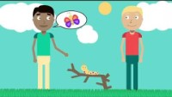
Ethos, Pathos, & Logos: Note Catcher
Notes:
Padilla, R. (2020, June 12). Ethos, pathos & logos TAMUWRITINGCENTER. [Video]. YouTube. https://www.youtube.com/watch?v=aUpiy67_nt4

Slide 11
Magnetic Statements: Part Two
Review each of the posted statements a second time.
Choose a statement that either strongly attracts or repels you. Stand by the statement.
Discuss with your group why you chose this new statement and if/why/how your ideas changed. Focus on the concepts of ethos, logos, and pathos.
Each group should choose a representative to share out your choice and reasoning with the class.

Slide 12
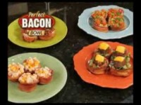
Bacon Bowl Infomercial
As you watch the infomercial, write down your answers:
Which persuasive techniques do you notice?
Which appeals do you notice?
Notes:
Allstar Marketing. (2013, November 25). Perfect bacon bowl [Video]. YouTube. https://www.youtube.com/watch?v=5kjujVnwZEs

Slide 13
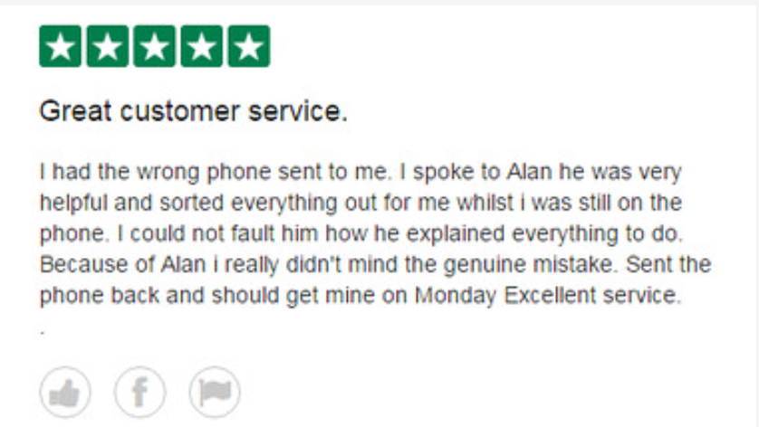
Testimonial
A testimonial is a review from a happy customer who voluntarily promotes a company’s product.
Notes:
Source: Direct Mobiles UK. Customer testimonial on TrustPilot. Licensed under CC BY-NC-SA 2.0. https://search.creativecommons.org/photos/5577f5bf-f36e-416f-9a84-95506481bf92rg)

Slide 14

Case Study
A case study is written by the company itself to promote what it can do for a customer.
Notes:
Source: Castle Communication Systems. (2012). Maple Place Dental Centre. https://castlecs.com/vancouver-marketing-advertising-vancouver-marketing-portfolio-case-studies/

Slide 15
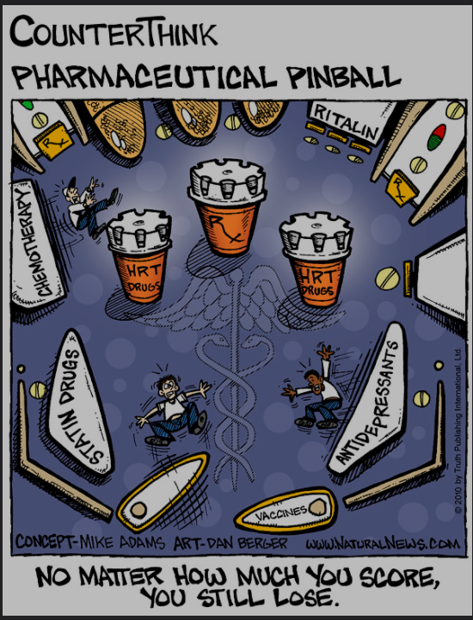
Magnified Problems
A company describes how bad the problem can get for the customer before explaining how their products can help.
Notes:
Source: Berger, D. (2014, May 1). Pharmaceutical pinball. Natural News. https://www.naturalnews.com/028624_pharmas_drugss.html)

Slide 16

Repetition
Repeating or reframing the key message increases memorability.
Notes:
Source: Readerwalker. (2013, Feb. 9). The dark art of persuasion. Flikr. https://www.flickr.com/photos/17842909@N00/8456609735
Licensed under CC BY-NC-SA 2.0

Slide 17
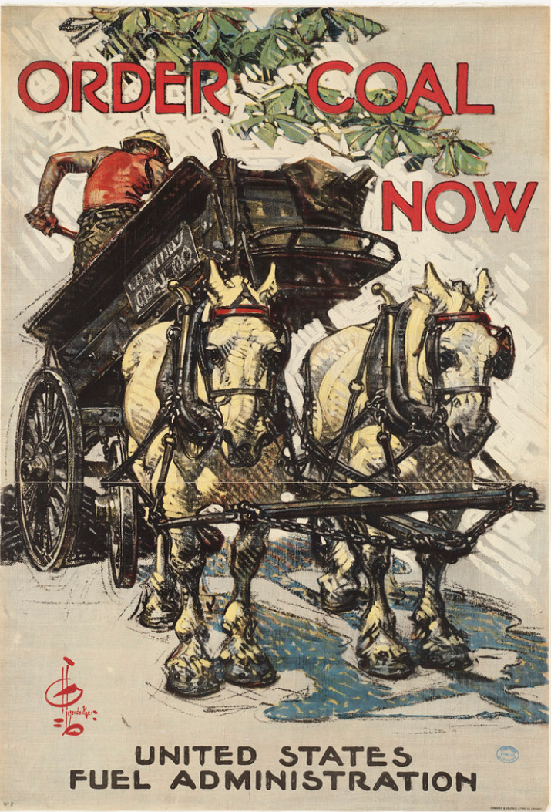
Scarcity
A vendor limits the number of items to sell or the amount of time the item is available, or both, and intentionally creates or emphasizes a sense of urgency.
Notes:
Source: Leyendecker, J. C. (1918). Order coal now. Boston Public Library. //www.flickr.com/photos/24029425@N06/3552165412
Licensed under CC BY 2.0.

Slide 18
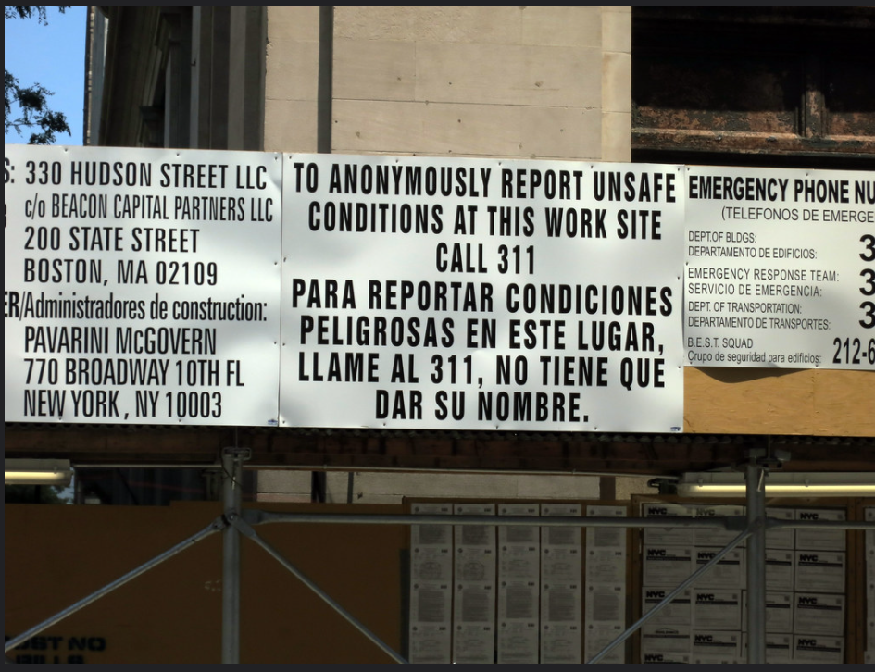
Call to Action
An agency or business explicitly tells an audience what to do: call this number, make a donation, or take action immediately.
Notes:
Source: Lobo, D. (2012). Anonymously report unsafe conditions. Flikr. https://www.flickr.com/photos/daquellamanera/7866834178/in/photostream/

Slide 19
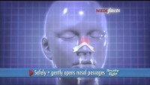
Which persuasive techniques do you notice in the infomercial?
Notes:
DigiBeeVideo. (2013, September 22). Breathe Right [Video]. YouTube. https://www.youtube.com/watch?v=hhrwNTjrCZ0

Slide 20
Infomercial Creation
Each group member should actively participate in this assignment. As a group:
Create an item or a service to sell.
Write a script that contains persuasive techniques and appeals.
Create a visual design for your product or service.
Create a name for your product or service.
Practice your infomercial.
Present your infomercial to the class.

Slide 21
Infomercial Presentations
As groups present, focus your feedback on the following:
Use of ethos, logos, pathos
Use of persuasive techniques
  Testimonials
  Case studies
  Magnified problem
  Repetition
  Scarcity
  Call to Action
Would YOU buy this product or service? Why or why not?

Slide 22
Reflection
What is the purpose of a persuasive essay?
How can you use the appeals (ethos, logos, pathos) in a persuasive essay?
Which persuasive techniques could be effective in a persuasive essay? (Testimonial, Case Study, Magnified Problem, Repetition, Scarcity, Call to Action)

