Slide 2
Trees in the Wind
Middle School Science
How does the environment influence plant growth and development?
Notes:
Engage
Students observe and generate questions about the cause(s) of unique plant growth phenomena in several environments.
Explore
Students choose a plant phenomenon to investigate, construct an initial explanation about how the environment causes the observed phenomenon, and find evidence through research to support or refine their explanation.
Explain
Students share their phenomena with the class and construct explanations for how the local environment influenced the patterns they observed.
Extend
Students will collect data from an indoor plant investigation to use as further evidence of the impact of environment on plant growth.
Evaluate
Students will use their own data to support a revised explanation of the phenomena they investigated. They will make predictions about the role of genetics in the phenomena they observed.

Slide 3
Lesson Objective:
Students will be able to use argument, based on empirical evidence and scientific reasoning, to support an explanation for how characteristic animal behaviors and specialized plant structures affect the probability of successful reproduction of animals and plants respectively.

Slide 4
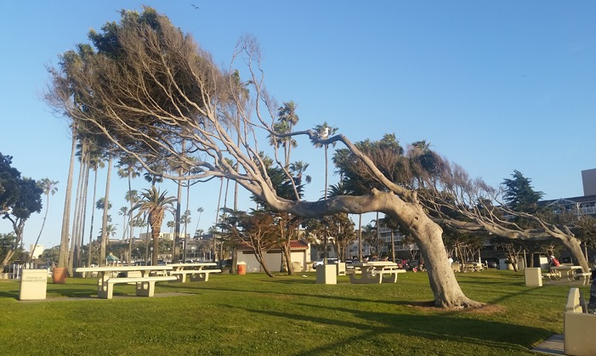
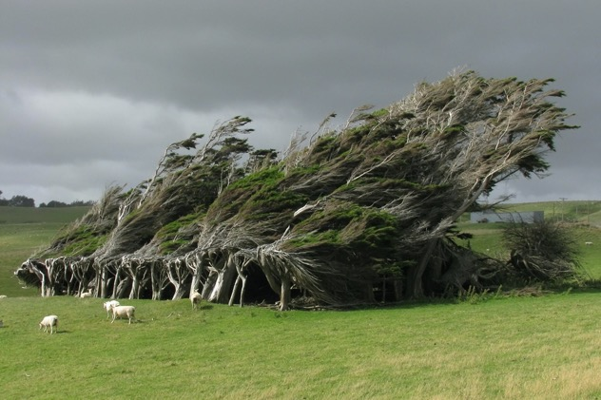
What do you notice?
What do you wonder?
Image Source: Trees growing sideways in Redondo Beach, CA. Photo credit: Chelsea Archie
Image Source: Ben. (2011, February 20). Slope Point.
Retrieved from https://www.flickr.com/photos/55198242@N03/5460426633
Notes:
Have students make observations (notice) and ask questions (wonder) about the sideways trees pictured.
"I notice" statements should be qualitative observations, not inferences (see next slide for comparison).
"I wonder" questions may or may not be testable or scientific, which is acceptable at this point.
I notice, I wonder strategy: https://learn.k20center.ou.edu/strategy/d9908066f654727934df7bf4f507d1a7

Slide 5


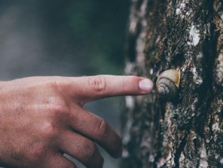

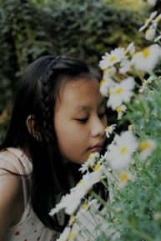
Are you sure you know what caused that?
Observations
Inferences
Descriptions of events or objects based on our five senses
Conclusions we make based on observations, reasoning, and other things we already know
Image 1
Image 2
Image 3
Image 4
Image 5
Image 1 Source: Prudente, P. (2018, May 9). Photo by Patricia Prudente on Unsplash. Retrieved from https://unsplash.com/photos/LqaLgCnnh3Y
Image 2 Source: Köpfer, N. (2017, June 13). Photo by Nine Köpfer on Unsplash. Retrieved from https://unsplash.com/photos/iPbwEiWkVMQ
Image 3 Source: Doyle, S. (2016, March 24). Photo by Seth Doyle on Unsplash. Retrieved from https://unsplash.com/photos/jJfreew6A84
Image 4 Source: Be, H. (2017, March 25). Photo by Henry Be on Unsplash. Retrieved from https://unsplash.com/photos/bAFiBDMeiVI
Image 5 Source: Min, A. S. (2018, November 25). Photo by Aung Soe Min on Unsplash. Retrieved from https://unsplash.com/photos/BU8VGYRxPRs
Notes:
Observations vs. inferences
This slide is optional if students need help distinguishing between observations and inferences. The slide can be unhidden if you choose to use it.
Instructions for hiding/unhiding slides can be found here: https://support.office.com/en-us/article/hide-or-show-a-slide-8313e1ec-3e20-4464-952f-387931554d69
Photo by Patricia Prudente on Unsplash: https://unsplash.com/photos/LqaLgCnnh3Y
Photo by Henry Be on Unsplash: https://unsplash.com/photos/bAFiBDMeiVI
Photo by Aung Soe Min on Unsplash: https://unsplash.com/photos/BU8VGYRxPRs
Photo by Nine Köpfer on Unsplash: https://unsplash.com/photos/iPbwEiWkVMQ
Photo by Seth Doyle on Unsplash: https://unsplash.com/photos/jJfreew6A84

Slide 6
We Noticed … We Wondered …
Notice | Wonder
Notes:
Develop a whole-class list of observations and questions where it can be referenced throughout the lesson.
One way to do this is to have students write each of their "notices" and "wonders" on individual sticky notes. Each student then shares at least one idea out loud and adds their sticky note to the class list.
In small groups, students come to consensus on one to three observations and questions they think are most important. Each group should share out while a scribe (you or a student) records the ideas.
Facilitate a whole-class discussion for students to share and respond to one another's ideas while a scribe (you or a student) records them.

Slide 7
Answering our “Wonder” questions
In your small groups, select a plant phenomenon to explore. Examples include but are not limited to:
Plants that turn red in sunlight
The exploding “touch-me-not” (Impatiens capensis)
Mimosa pudica sensitive plants
Notes:
Students will research answers to the questions they developed and attempt to explain a phenomenon.
Students should be grouped as small as possible with pairs being ideal (if technology is available).
Pairs should select a plant phenomena from a short list.

Slide 8
Answering our “Wonder” questions
Write an initial explanation for how the environment might cause the phenomenon you chose.
In your group, go online to research the information on the Explore Notes handout.
  You can try to answer some of our other “Wonder” questions if you finish your Explore Notes early.
  Use the back of the handout if you need more space.
Notes:
Before beginning research, have students write an initial explanation for how the environment contributes to their phenomenon of choice.
Using these phenomena as their starting place, students should investigate the life history of their plant of choice using the prompts.
Next, they can gather information that will help them construct a more accurate explanation later.

Slide 9

How I Know It
3
Inside the circle, write everything you know about how the environment affects plant growth.
Draw an arrow from each fact inside the circle to the outside
Outside the circle at the end of your arrow, write where you learned that information
1
2
1
3
2
Notes:
After students conduct their research, the class should engage in some independent/small group and whole-group processing activities.
KEEP TRACK OF IDEAS
Give students the How I Know It handout.
Ask them to record everything they know about how the environment affects plant growth based on their prior knowledge and the research they conducted during their Explore on the inside of the circle.
Outside the circle they should provide evidence that supports the ideas they listed.
These pieces of evidence could be personal learning experiences, quotes or brief summary statements with their source, or other observations.
One example is of a personal anecdote as evidence. The second example is where the information was learned.
In some cases, a fact might require a source and a description of evidence
How I Know It Strategy: https://learn.k20center.ou.edu/strategy/d9908066f654727934df7bf4f5067d68

Slide 10
Sharing Research Findings
We will now share out our research findings.
Notes:
SHARE RESEARCH
Have the student groups share out their research findings.
If multiple groups have the same phenomena, consider structuring the share out like one of the following:
After the first group reports ask the following groups to provide any other information they found in their research.
Groups who studied the same phenomenon could team up to develop a visual (poster, Google Slides presentation, etc.) representation of their collective research. The class could then share out through group presentations or a carousel of research posters.
DEVELOPING INDIVIDUAL UNDERSTANDING
As students learn about their classmates' research, they should add ideas inside the circle of their "How I Know It" graphic organizer and cite their classmates' presentations in the square outside the circle (see next slide).
Gallery Walk/Carousel Strategy:

Slide 11

How I Know It
While your classmates present:
Add anything new learned about how the environment affects plants
Include the evidence they describe
Notes:
DEVELOPING INDIVIDUAL UNDERSTANDING
As students learn about their classmates' research, they should add ideas inside the circle of their "How I Know It" graphic organizer and cite their classmates' presentations in the square outside the circle (see next slide).
If this is a whole-class discussion, take a few minutes after each group to allow students an opportunity to update their graphic organizers.

Slide 12
How the Environment Affects Plants
What have we learned?
Are we missing anything?
What “wonders” have we not covered?
Notes:
After the share out, provide additional content details students might need that they did not discover on their own.
These details will depend on the phenomena students are researching but should highlight the environmental factors involved.
This is also the time to address student misconceptions, either through direct instruction or guided questioning of the class.
Revisit the class "wonders" from the Engage and have the students answer any questions the class has uncovered in their research.

Slide 13
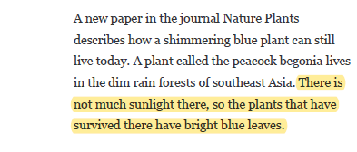
How the Environment Affects Plants
As you read, “whylight” anything that describes how the environment affects plants.
Highlight the most important information
Every time you highlight something, write why you highlighted it in the margin.
The amount of sunlight can change leaf color
Notes:
Unhide this slide if you choose to use this reading strategy
READING FOR ADDITIONAL INFORMATION
After the share-out, provide students an opportunity to explore some additional reading resources (suggestions and links are provided in the LEARN lesson).
Ask students to think about what environmental factors are affecting plant growth and how those factors are affecting the growth and development of plants as they read.
"Whylighting" is a useful literacy strategy to facilitate this.
Students should add additional ideas to their "How I Know It" graphic organizer as they read.
Whylighting Strategy: https://learn.k20center.ou.edu/strategy/d9908066f654727934df7bf4f505e7d5

Slide 14
How the Environment Affects Plants
Based on the class research, what are all the ways we came up with for the environment to affect plants?
What are other ways we can think of?
Notes:
CLASS CONSENSUS
Following the reading, have the class come together and develop a list of all the environmental factors affecting plant growth that they discovered.
Record the list on a poster, whiteboard, etc. and leave it available to students for the Extend.

Slide 15
How the Environment Affects Plants
Notes:
Provide students with an opportunity to develop investigations which explore the effects of environmental factors on actual plants. Student investigations should involve either growing their own plants or working with plants which are already established (e.g., from a nursery or garden center). Investigating with real plants for themselves provides all students a shared concrete experience to which they can apply their understanding and collect further data. Depending on the class composition, resources available, and collection of environmental factors the students developed, the structure of these investigations will vary. Allow students to self-select their environmental factor for investigation and provide the scaffolding and boundaries appropriate for your classroom.
Some potential scaffolds and the considerations they address include:
limiting the number of environmental factors available for investigation - resource limitations
having each class period choose a different environmental factor and share plants for observations across all classes - class size, resource limitations
having students work in pairs or in teams with assigned roles - class size, level of on-task behavior, resource availability
developing a class consensus for investigation set-up - level of on-task behavior, prior investigation experience
sharing all plants for observations across all classes - class size

Slide 16
How the Environment Affects Plants
Let’s set up the plant investigations.

Slide 17
Collecting Data
Use your Plant Growth Observations handout to record your data.
Notes:
Students should record their plant growth observations in their science notebooks (or somewhere else they can reference later). After the investigations have concluded, students should revisit their ongoing "How I Know It" graphic organizer. This time, students will add final ideas from their own plant growing experience. Before moving onto the Evaluate, give students time to reflect upon the content of their graphic organizer and ask any clarifying questions they still have. Student reflection should be on determining the most important ideas they captured during the lesson that explain how the environment affects plant growth. These ideas will serve as the basis of their final explanation. This reflective time could be structured in many ways, including the following possibilities:

Slide 18
Annotate Your “How I Know It”
Look at all the information on your “How I Know It” sheet
Mark the pieces of information that are most important to understand how the environment affects plants.
Notes:
Unhide this slide if you choose to use this strategy
ANNOTATION
Students might highlight, circle, or otherwise mark the ideas which they feel are the most important effects of the environment on plant growth.
They might further refine their list by deciding which sources of evidence are most reliable (e.g., readings, peer presentations, etc.).
If students have not evaluated the quality of scientific information, this would be a good opportunity to work on that science practice.

Slide 19
Summarizing Your “How I Know It”
Look at all the information on your “How I Know It” sheet
Choose the information that is most important to understand how the environment affects plants
Rewrite only these facts on a blank “How I Know It” sheet
How do we evaluate whether a source is reliable?
Notes:
Unhide this slide if you choose to use this strategy
SUMMARY GRAPHIC ORGANIZER
The "How I Know It" graphic organizers may have become quite cluttered with information by this point in the lesson.
Students could create a new graphic organizer that only contains the most important effects of the environment on plant growth from the most reliable sources.

Slide 20
How the Environment Affects Plants
I used to think …
But now I know …
Notes:
Unhide this slide if you choose to use this strategy
Depending on how much time you have, this activity allows students to explicitly reflect on what they see as the most important way their ideas have changed since the Engage.
I used to think, but now I know strategy: https://learn.k20center.ou.edu/strategy/d9908066f654727934df7bf4f50639f2

Slide 21
We Wondered …
Wonder
Are there any “wonders” we still haven’t addressed?
Notes:
Revisit class “wonder” questions from the Engage and try to answer any that are left.

Slide 22
How the Environment Affects Plants
Look back at your initial explanation for how the environment might cause the phenomenon you chose.
Now write a final explanation based on everything you have learned.
Use evidence from your “How I Know It” sheet and importance science ideas to support your explanation.
Notes:
Students revisit their initial phenomenon explanation. They should revise their original explanation or write a new explanation based on their understanding of how the environment affects plant growth.
The revised or new explanation should include the evidence students selected from their "How I Know It" graphic organizer in addition to the scientific details.

Slide 23
How Genes Affect Plants
Predict how a plants’ genes might help cause the phenomenon you studied.
Predict how the environment and genes could work together to cause the phenomenon.
Notes:
Unhide this slide if you choose to include the genetics content
If the class will be continuing into genetic impacts on plant growth and development at some point following this lesson, they should also take a moment to predict how genes might play a role in explaining these phenomena.
If they have sufficient background knowledge to do so, this might be extended further to predict how genes and the environment might interact to produce the phenomena.

