Slide 2
Parrots, Penguins, and Parts
Revealing Scientific Relationships
8th Grade Science

Slide 3
Lesson Objectives
Students will be able to:
Identify anatomical similarities and differences between organisms.
Explain the relationships between organisms based on homologous structures.

Slide 4
I Used to Think…
Essential Question: How do scientists determine relationships between today’s organisms and their ancestors using their physical appearance and characteristics?
Answer this question on the left side of your “I Used to Think… But Now I Know” handout.

Slide 5
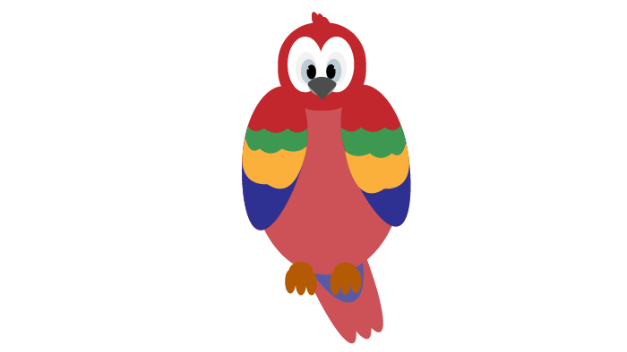
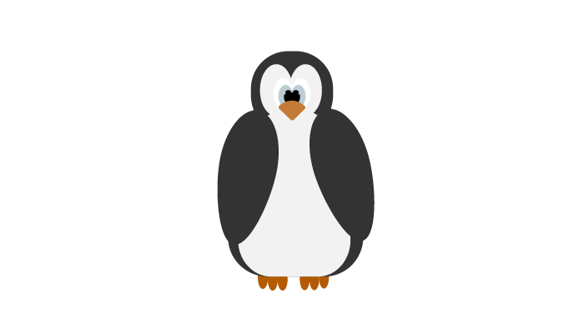
How I Know It
Choose “parrot” or “penguin.”
On the handout, use one color of marker to write down everything you know about that animal inside the circle.
Outside the circle, write down how you knew that information.
Draw a line to connect the information you know with how you know it.
Notes:
ENGAGE

Slide 6
Squawkzilla vs. Crossvallia Penguin
Find two other classmates who chose the same animal as you. Form a group and read the article that matches your animal.
Divide up the reading similarly to the chart to the right.
Once you are all done reading, take turns sharing information from your reading section with your group.
Parrot groups:
  Student 1: paragraphs 1-5
  Student 2: paragraphs 6-10
  Student 3: paragraphs 11-15
Penguin groups:
  Student 1: paragraphs 1-3
  Student 2: paragraphs 4-6
  Student 3: paragraphs 7-9
Notes:
ENGAGE

Slide 7
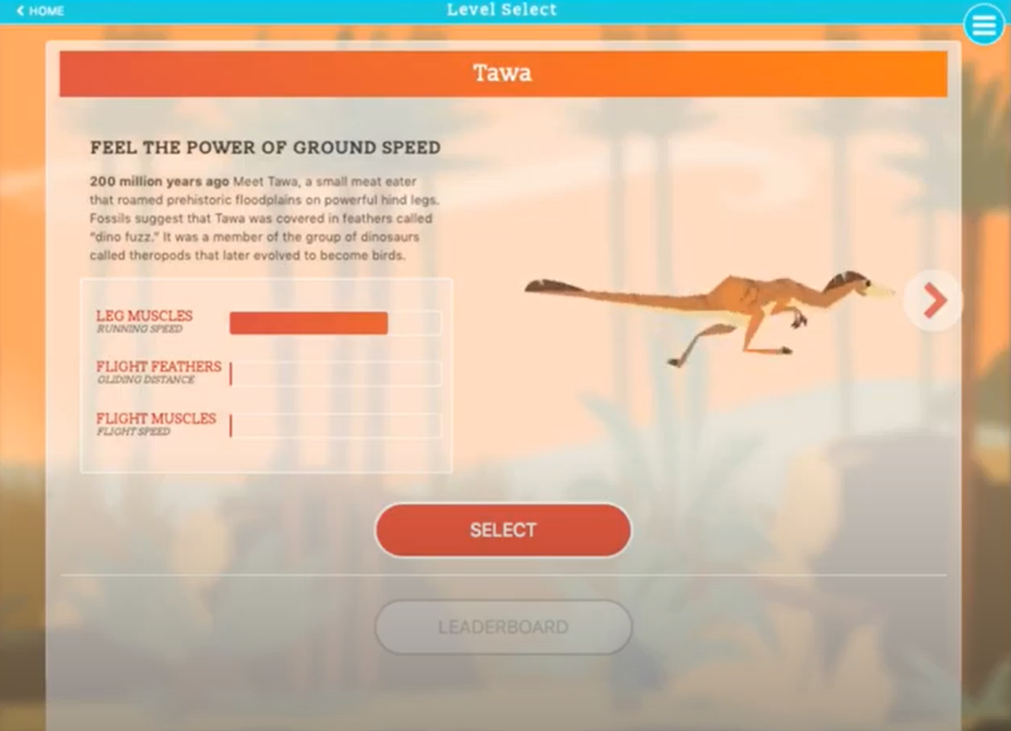
Flap to the Future: Level 1
Watch the “Flap to the Future” game play video.
Listen closely to the narration.
In the “Level 1” box on your handout, sketch the animal and take notes.
Notes:
EXPLORE– Level 1 (https://youtu.be/w60cN5Spje4)

Slide 8
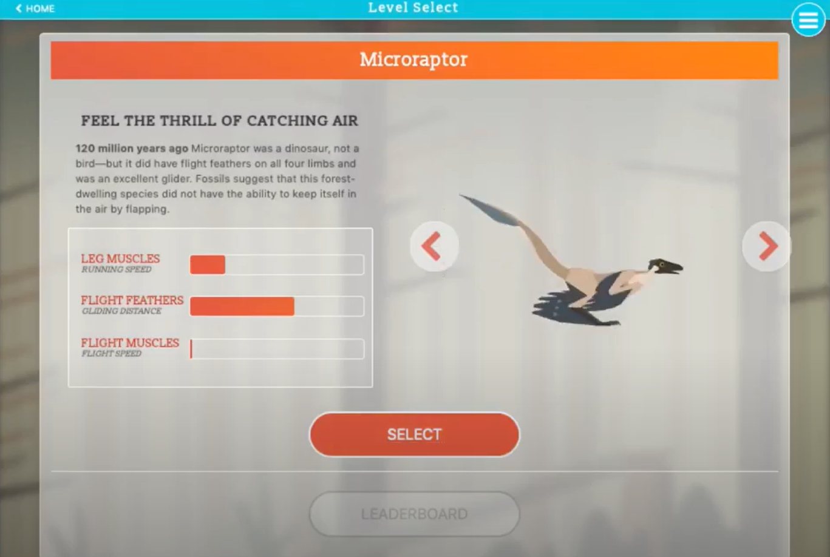
Flap to the Future: Level 2
Listen closely to the narration.
Sketch the animal in the box on your handout, and take notes. How has this animal changed?
Notes:
EXPLORE– Level 2 (https://youtu.be/y7TTxIp5rHo)

Slide 9
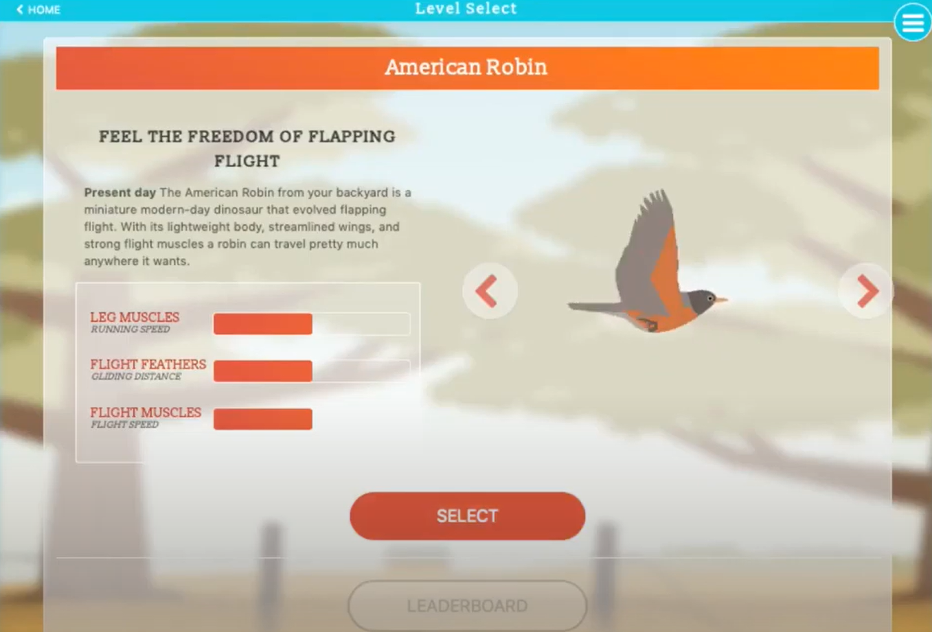
Flap to the Future: Level 3
Listen closely to the narration.
Sketch the animal in the box on your handout, and take notes. How has this animal changed?
Notes:
EXPLORE– Level 3 (https://youtu.be/9OHdPjLZwLE)

Slide 10
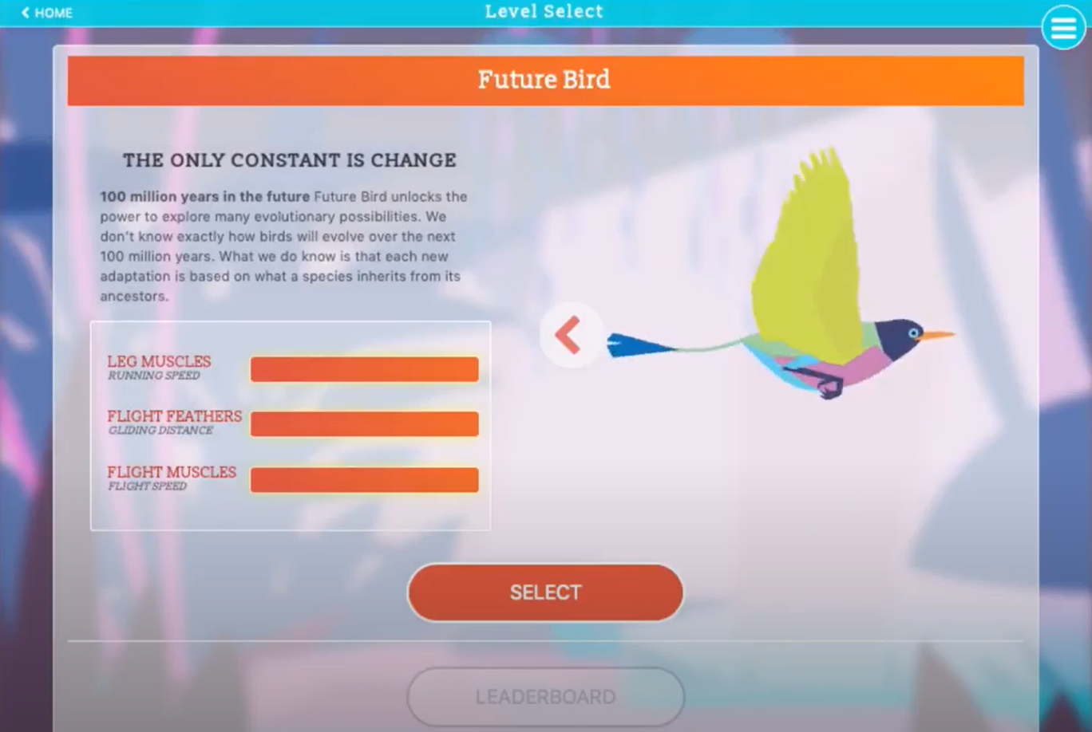
Flap to the Future: Level 4
Listen closely to the narration.
Sketch the animal in the box on your handout, and take notes. How has this animal changed?
Notes:
EXPLORE– Level 4 (https://youtu.be/Kl17zFYRoaU)

Slide 11
Game Over
Were there any differences between the organisms? What were they?
Were there any similarities between the organisms? What were they?
Turn to your Elbow Partner and share your answers.
Discuss: what did the game say about the relationship between the organisms?
Notes:
EXPLORE

Slide 12
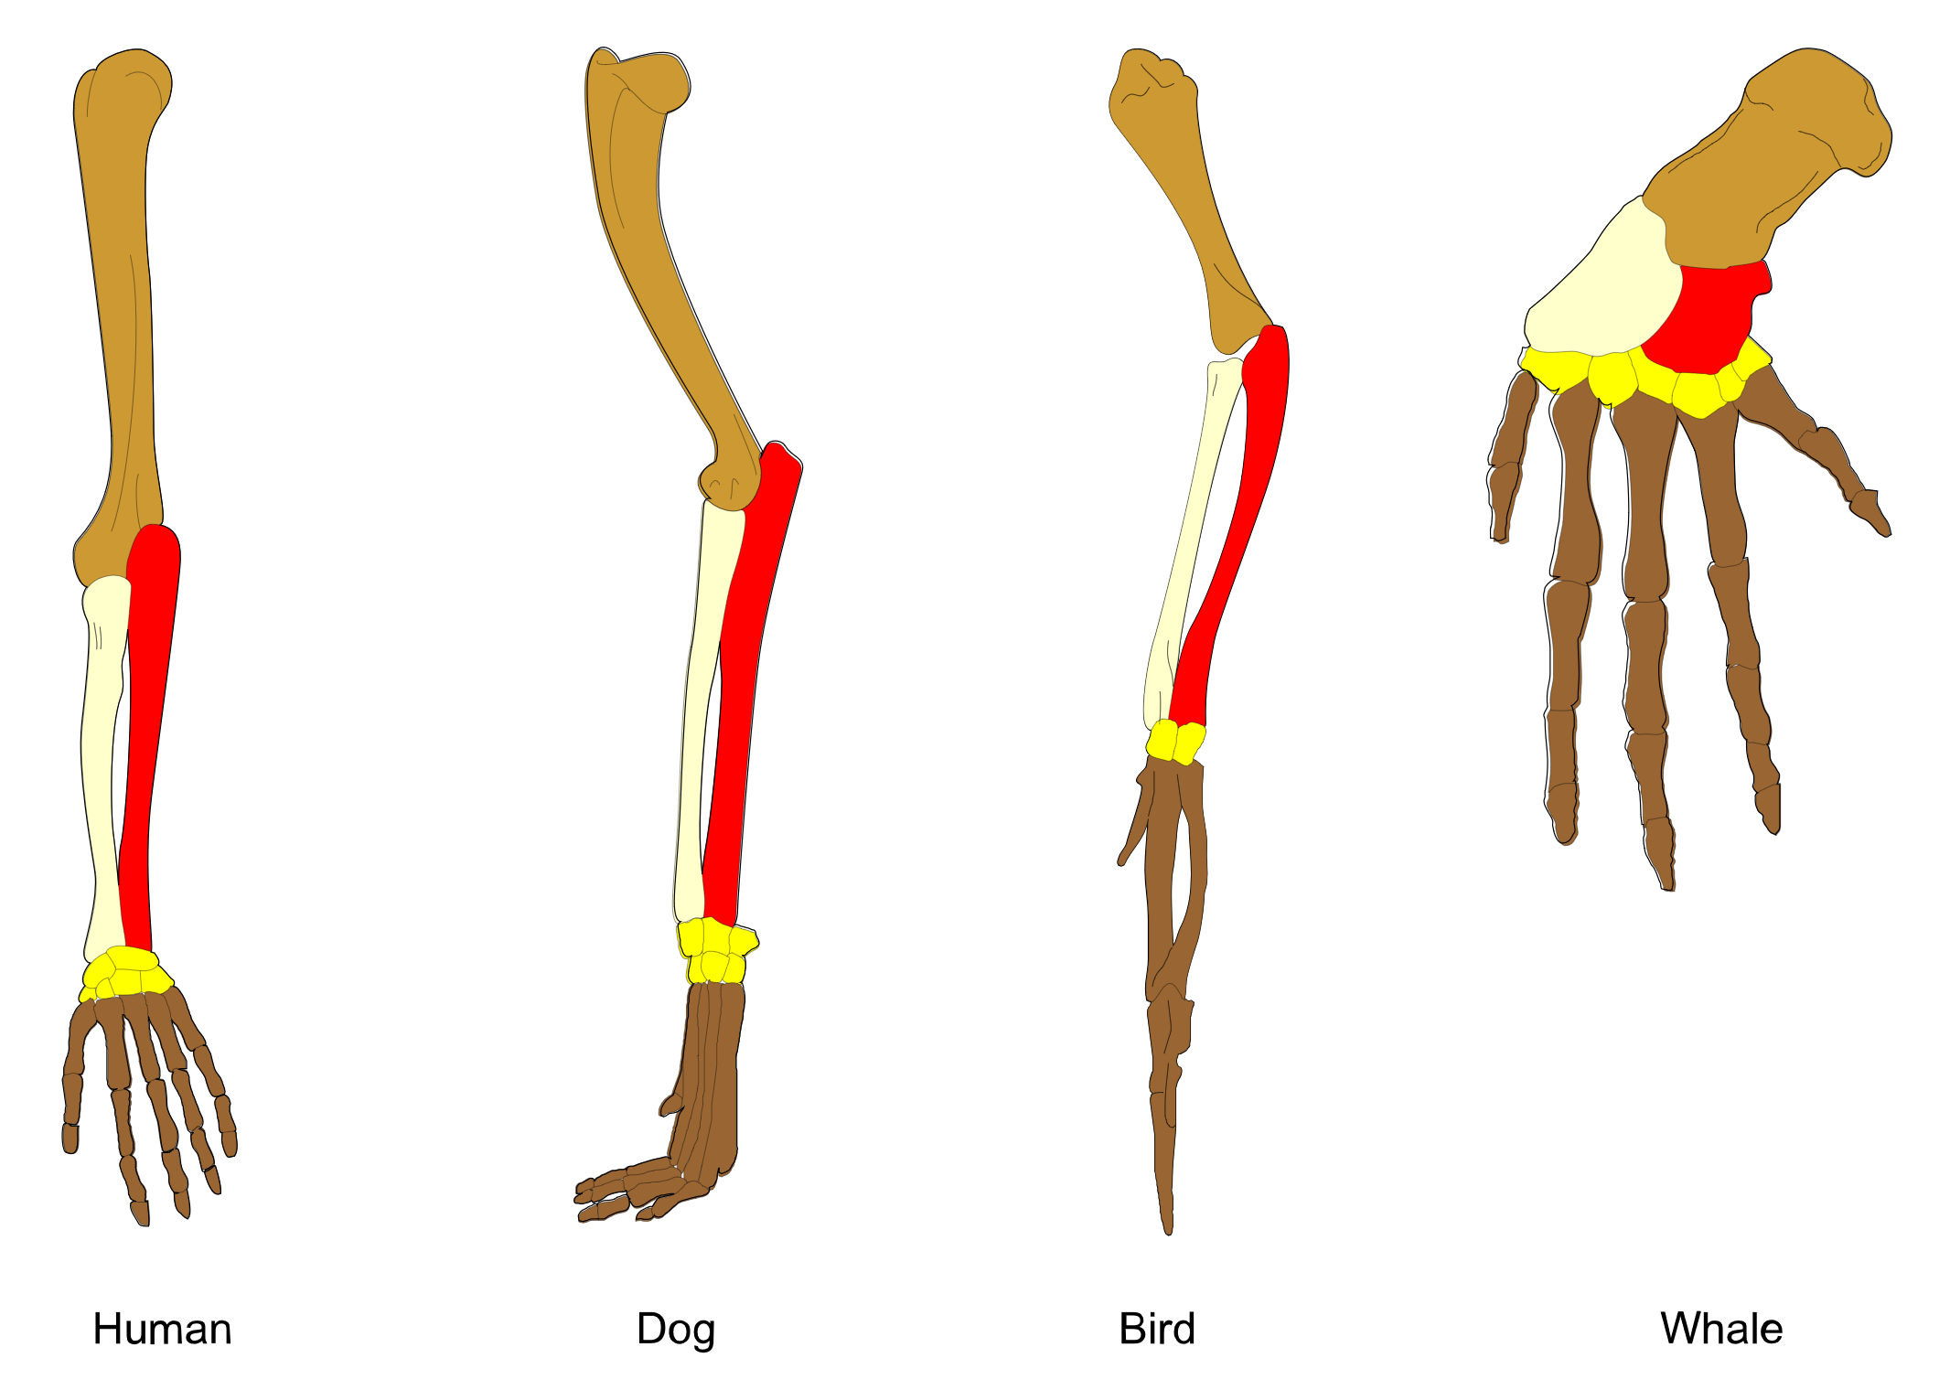
Photo Deconstruction
Describe what you see.
What do you think this represents?
Source: Petrovič, V. V. (2011). Homology vertebrates. Wikimedia Commons. Https://commons.wikimedia.org/w/index.php?curid=37704829
Notes:
EXPLAIN
Source: Petrovič, V. V. (2011). Homology vertebrates. Wikimedia Commons. Https://commons.wikimedia.org/w/index.php?curid=37704829

Slide 13
Let’s Dig Deeper
Bozeman Science Video (1:35 - 2:08)
What evidence can you see that suggests these organisms are related?
Source: Petrovič, V. V. (2011). Homology vertebrates. Wikimedia Commons. Https://commons.wikimedia.org/w/index.php?curid=37704829
Notes:
EXPLAIN
Source: Petrovič, V. V. (2011). Homology vertebrates. Wikimedia Commons. Https://commons.wikimedia.org/w/index.php?curid=37704829

Slide 14
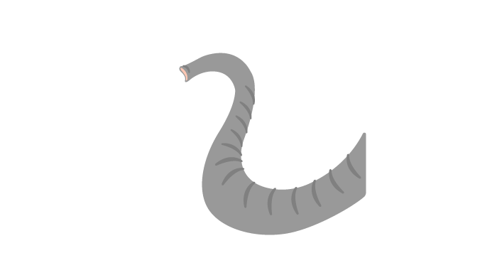
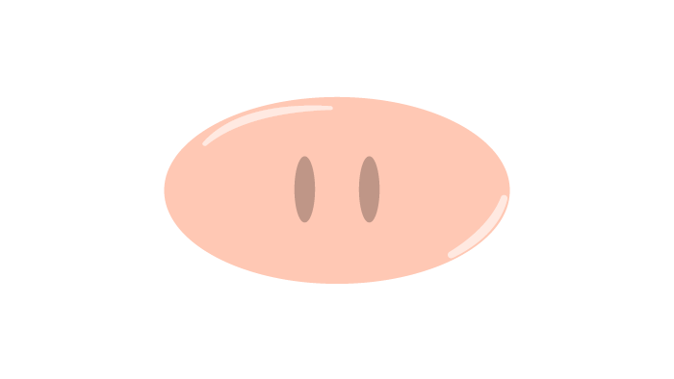
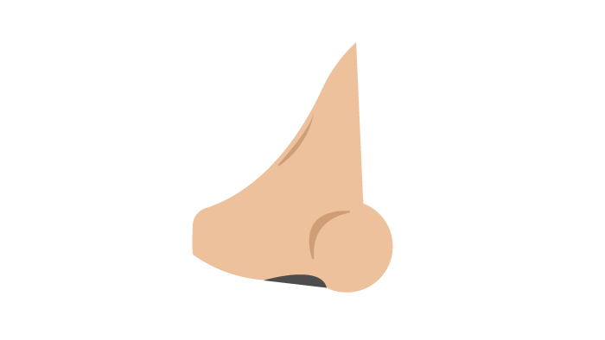
Who “Nose?”
Do these organs all have the same function?
Similar appearance?
Similar location?
Similar structure?
Homologous structure: An organ or body part that appears in different animals and is similar in structure and location—but it doesn't necessarily share the same purpose.
Source: N.a. (n.d.). Homologous structure. YourDictionary. Https://www.yourdictionary.com/homologous-structure
Notes:
EXPLAIN
Definition source: N.a. (n.d.). Homologous structure. YourDictionary. Https://www.yourdictionary.com/homologous-structure

Slide 15
Hand It to the Animals
Let’s explore the hands of 10 different zoo animals.
Bring up the “Hand It to the Animals” document. Link: https://tinyurl.com/animalhands
  Click “Make a copy.”
In each row, click on the number in the first column to view the x-ray. Then, answer the questions on the paper copy of the handout provided.
Notes:
EXTEND

Slide 16
Claim, Evidence, Reasoning
Join your assigned groups.
On the CER handout, develop a claim about the following prompt: “What is the relationship between the animals? Base your claim on what you see in the x-rays.”
Provide evidence for your claim.
Explain your reasoning for how the evidence justifies your claim.
Notes:
EXTEND

Slide 17
But Now I Know…
Revisit your “I Used to Think… But Now I Know” handout.
Compare your thoughts before the lesson versus after the lesson. Consider this question: “How do scientists determine relationships between today’s organisms and their ancestors using their physical appearance and characteristics?”
Answer this question while filling in the “But Now I Know” column on the right side of the handout.
Notes:
EVALUATE

