Slide 2
Are the Odds in Your Favor?
A Lesson for Personal Financial Literacy
Standard 12: Gambling

Slide 3
Essential Questions
What are the odds of winning at games of chance?
What impact does gambling have on people and society?

Slide 4
Lesson Objective
Evaluate the costs and benefits of gambling on individuals and society.

Slide 5
The Eleven Game: Rules
In this dice game, the only winning roll is 11.
How to play:
Player #1 rolls all three dice. The scorekeeper adds one tally to Player #1’s “Total Rolls” column.
If the numbers on the dice total 11, the scorekeeper adds 11 to the player’s score in the “Score” column. If not, the player’s score remains the same.
Player #1 passes the dice to Player #2. Repeat.
The first player to 99 points is the winner.
The scorekeeper keeps score for both players.
The scorekeeper tallies, or counts, the total number of times each player rolls the dice, whether it’s a winning or losing roll.

Slide 6
The Eleven Game: Scoring
Count the number of times each player rolled the dice, regardless of whether they won the roll. (This number should be about the same for both players.)
Next, record the number of times each player scored the winning number. (99 points = 9 winning rolls, 44 points = 4 winning rolls, etc.)
For each player, write the ratio of the winning rolls to the number of total rolls as a fraction.
Use the number of winning rolls for the numerator, and the number of total rolls as the denominator. If the winning player has 9 winning rolls out of a total of 15 total rolls, their ratio is 9/15, which reduces down to 3/5. If the losing player has 4 winning rolls out of a total of 15 rolls, their ratio is 4/15.
Change each fraction into a percentage by dividing the numerator by the denominator.
For example, 3/5 = 60%. The fraction of 4/15 = 26%.

Slide 7
What were the percentage scores in this game?
Winning Percentages | Losing Percentages

Slide 8
Discussion
In looking at the list of winners' percentages, what is the median percentage? (Note: Median is the most frequent percentage.)
In looking at the list of losers' percentages, what is the median percentage?
Gambling is staking money on the outcome of games that are primarily based on chance. If you were to gamble on a game, what percentage or odds would you want to favor you? 50/50? 60/40? Higher?
Looking at the odds (percentages) on the board, would you "gamble" (place any money) on your chances of winning? Why or why not?
What about other games of chance? Would you be willing to gamble on a winning lottery ticket? A horse race? The outcome of a football game before it happens? Why or why not?

Slide 9
Stop and Jot Reading Activity
Read the article one or two paragraphs at a time.
In the margin of your reading, write a few important phrases or ideas about what you just read.
Continue reading in this manner, making notes in the margin.
In your groups, write a summary of part of the article, based on your group number:
Groups of 1s: paragraphs 1-6
Groups of 2s: paragraphs 7-13

Slide 10
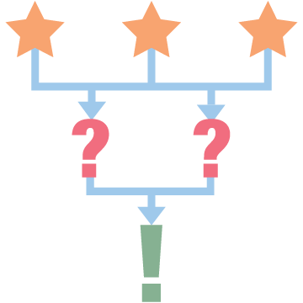
3-2-1
As you watch “A look at gambling addiction,” use the 3-2-1 strategy to identify:
3 things that might indicate a person has a gambling problem.
2 ways that casinos might encourage repeat gamblers.
1 thing that might help someone quit a gambling addiction.
Notes:
Source: KTVQ News. (2019, June 2). A look at gambling addiction [Video]. YouTube. https://youtu.be/e9COYjna5Go

Slide 11
PSA Poster
Create a Public Service Announcement (PSA) poster that highlights the problems with gambling.
With your group, answer the guiding question on your poster:
Use the rubric to complete your poster.
What impact does gambling have on people and society?

Slide 12
Evaluate
Your grade for this lesson will be based on the PSA Poster Project according to the rubric.

