Slide 2
Awesometh Degree of a Function
How do we know if a pattern is correct or not?

Slide 3
Two-Minute Paper
Polynomial Functions
Write as much as you can about this in 2 minutes
What did you write? Share time.
2
1
0
How do we know if a pattern is correct or not?
Notes:
The timer line is activated by a click. It may seem like nothing is happening, but the line should wipe away as two minutes passes.

Slide 4
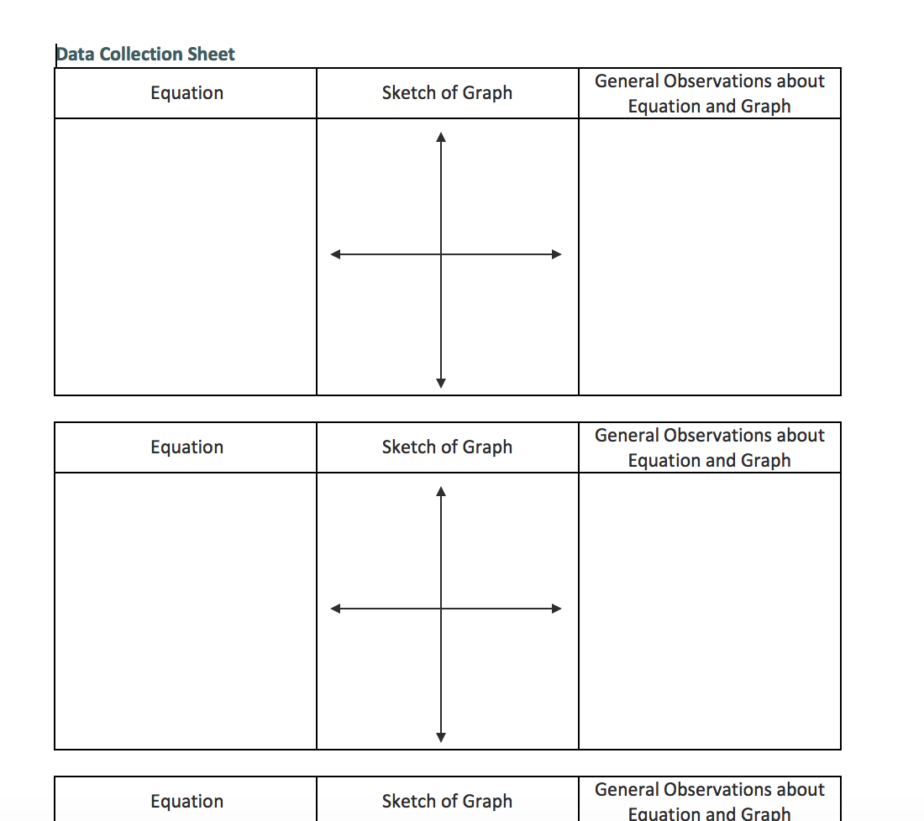
Card Sort
Use the constants, variables, operations, and exponents to construct functions
Use your graphing calculator to see what your function looks like
Write down your observations on your handout
Be creative! Explore!
How do we know if a pattern is correct or not?

Slide 5
Inverted Pyramid
Once you’re done with your data sheet, turn to a partner
Share your findings, both interesting and generalizations
Now, find another partnership to make a group of four
Repeat the sharing process
Finally, what groups would like to share their most interesting finding or generalization with the class?
How do we know if a pattern is correct or not?

Slide 6
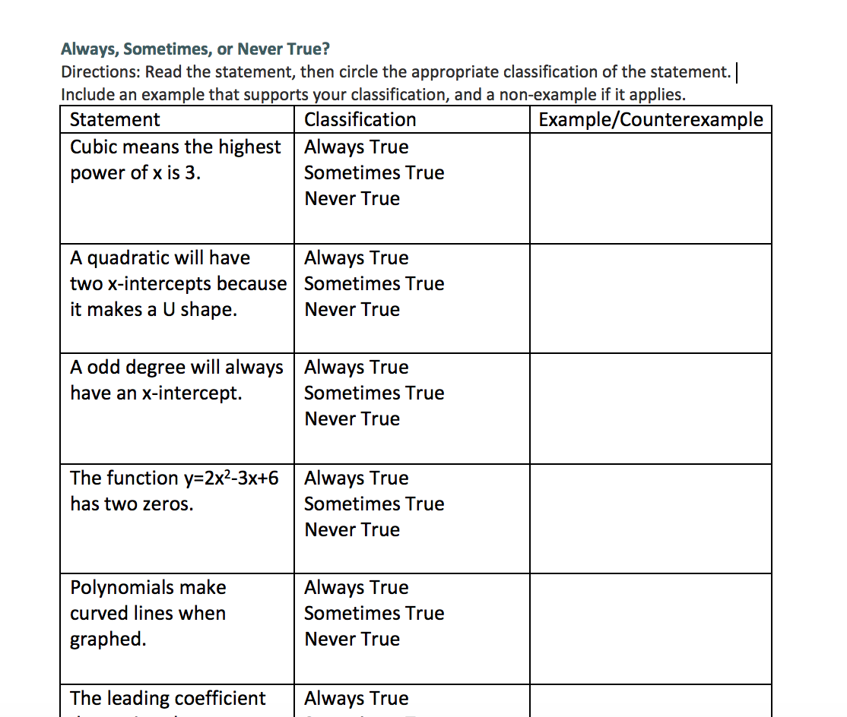
Always, Sometimes, or Never True
Find a partner
Work together to determine the ‘truthiness’ of the statements
Watch out, be diligent; some of them are tricky
How do we know if a pattern is correct or not?

Slide 7
Word Splash
Look back on your two-minute paper, and reflect on what you said that was correct, and what you learned that wasn’t correct.
Using these 6 words, construct a paragraph.
Be accurate, and as in-depth as possible
Keep in mind the essential question: How do we know if a pattern is correct or not?
Polynomial
Degree
X- and Y-Intercepts
Maximum and Minimum
End Behavior
Turning Points
How do we know if a pattern is correct or not?

