Slide 2
Who were the Mayans?
World Geography
6th Grade

Slide 3
What do I know about the Mayans? Fist to five activity
Rate yourself on how much you know about the Mayans. A fist or one finger is vey little. The more fingers you show, the more information you know.
This Photo by Unknown Author is licensed under CC BY-SA

Slide 4
OPTIC Photo Deconstruction
O - Observations: What is happening in the photo?
P - Parts: Describe the placement of objects in the photo.
T - Title: What does the title tell you about the photo?
I - Inferences: What clues in the photo help you to understand the photo?
C - Conclusion: Draw a conclusion about the meaning or the message.

Slide 5
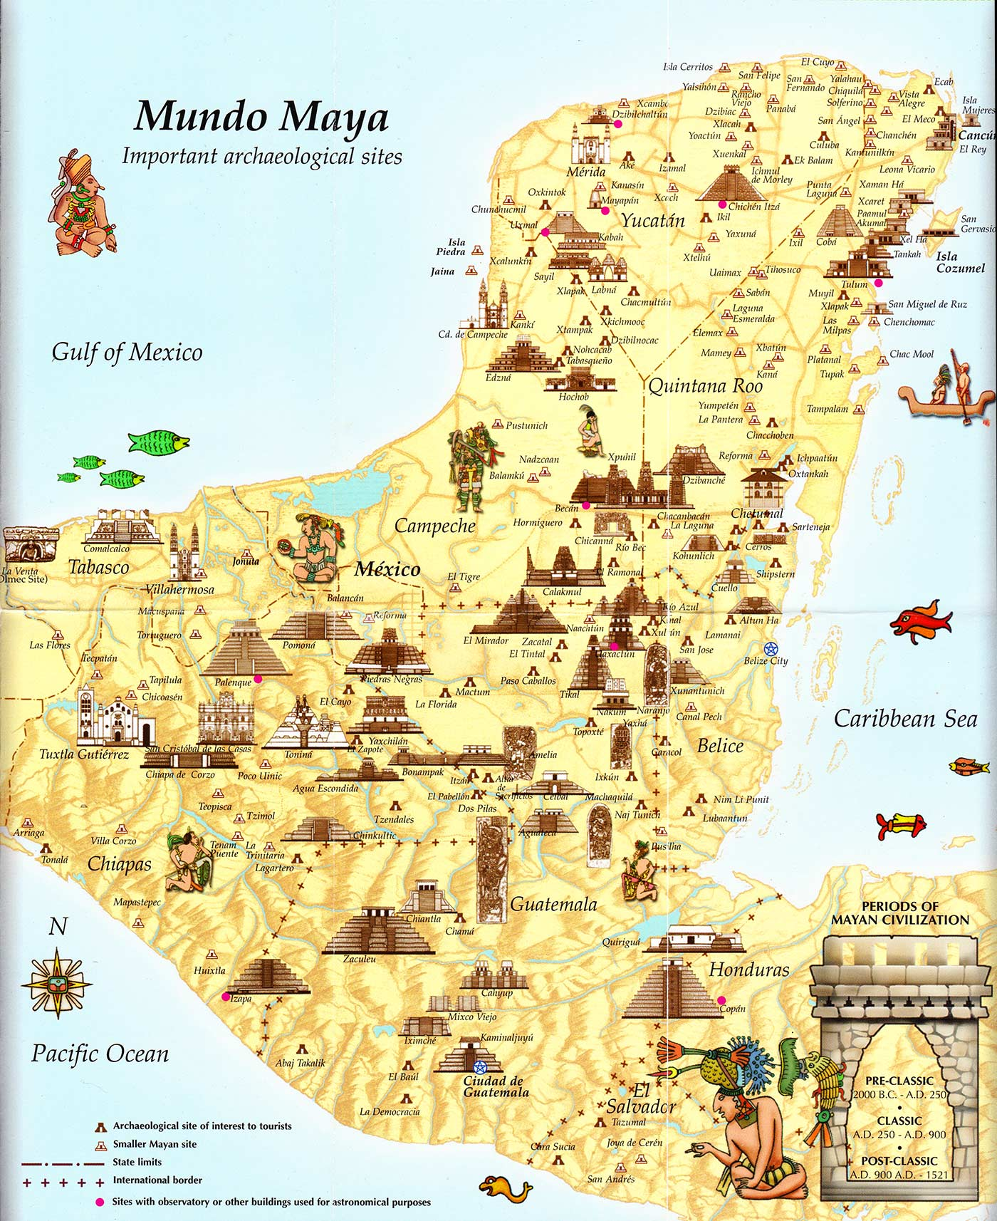
Photo page 1:
The World of the Mayans
Source: Heyworth, R. (2014, Aug. 6). Map of Mayan cities and Mayan ruins. Uncovered History. Retrieved from https://uncoveredhistory.com/mesoamerica/maya/mayan-cities-map/

Slide 6
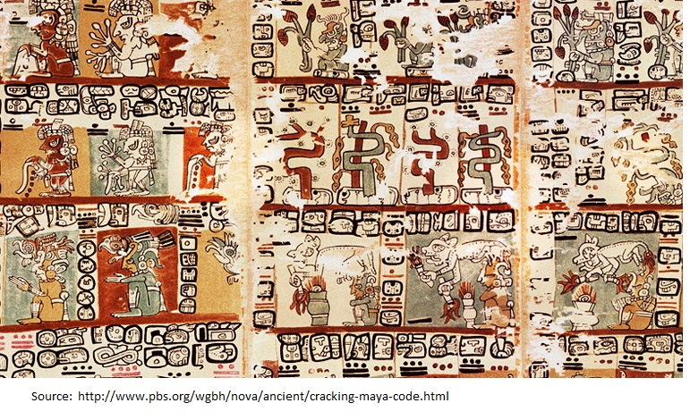
Photo page 2:
Mayan Writing
Source: PBS. (2018). Cracking the Maya code. Retrieved from http://www.pbs.org/wgbh/nova/ancient/cracking-maya-code.html

Slide 7
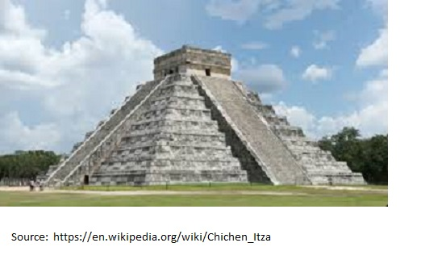
Photo page 3:
Chichen Itza, Mayan City
Source: Schwen, D. (n.d.). Pyramid in Chichen Itza. Wikimedia Commons. Retrieved from https://commons.wikimedia.org/w/index.php?curid=7647000

Slide 8
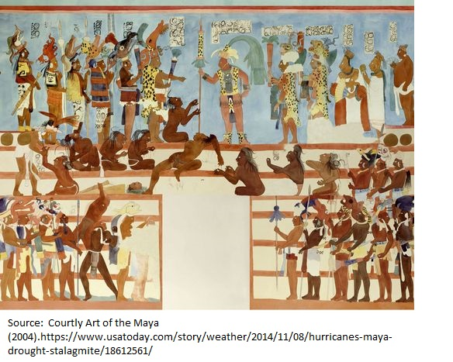
Photo Page 4:
A Mayan King and His Court
Source: A Mayan king and his court. (n.d.). The Maya: History, culture, and religion. Retrieved from http://the-maya.eu/MayanCivilization/mayan-civilization-fall

Slide 9
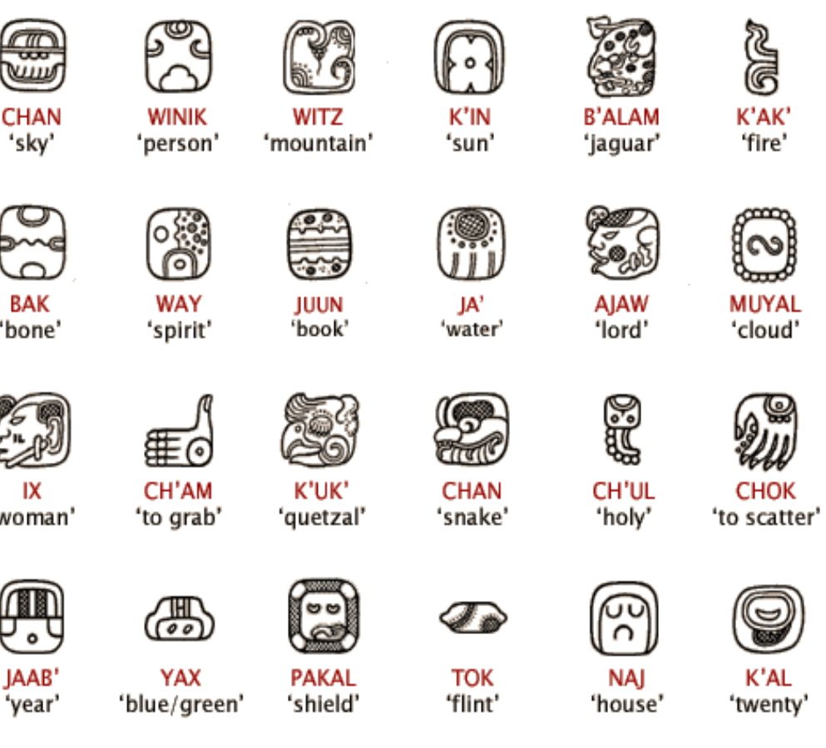
Photo Page 5: Mayan Alphabet
Source: Inca Mayan Aztec.com (2018). Ancient Mayan art. Retrieved from http://incamayanaztec.com./ancient-mayan-art.html

Slide 10
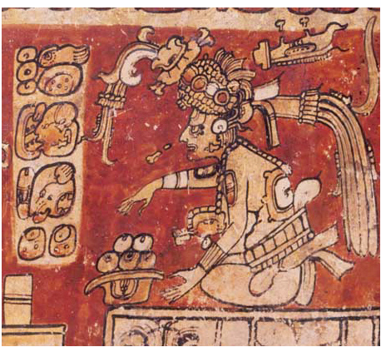
Photo Page 6:
Food for the Gods
Source: History on the Net. (2016). Mayan religion and cosmology image. The Mayans. Retrieved from https://www.historyonthenet.com/mayan-religion-and-cosmology/

Slide 11
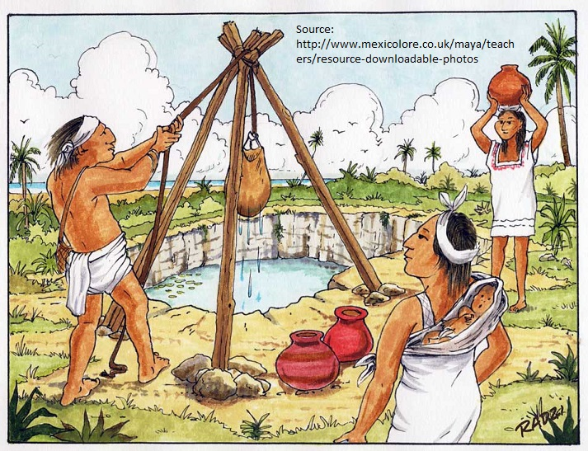
Photo Page 7:
Daily Life
Source: Mexicolore. (n.d.) Mayan drawing fresh water image. Retrieved from http://mexicolore.co.uk/maya/teachers/resource-downloadable-photos

Slide 12
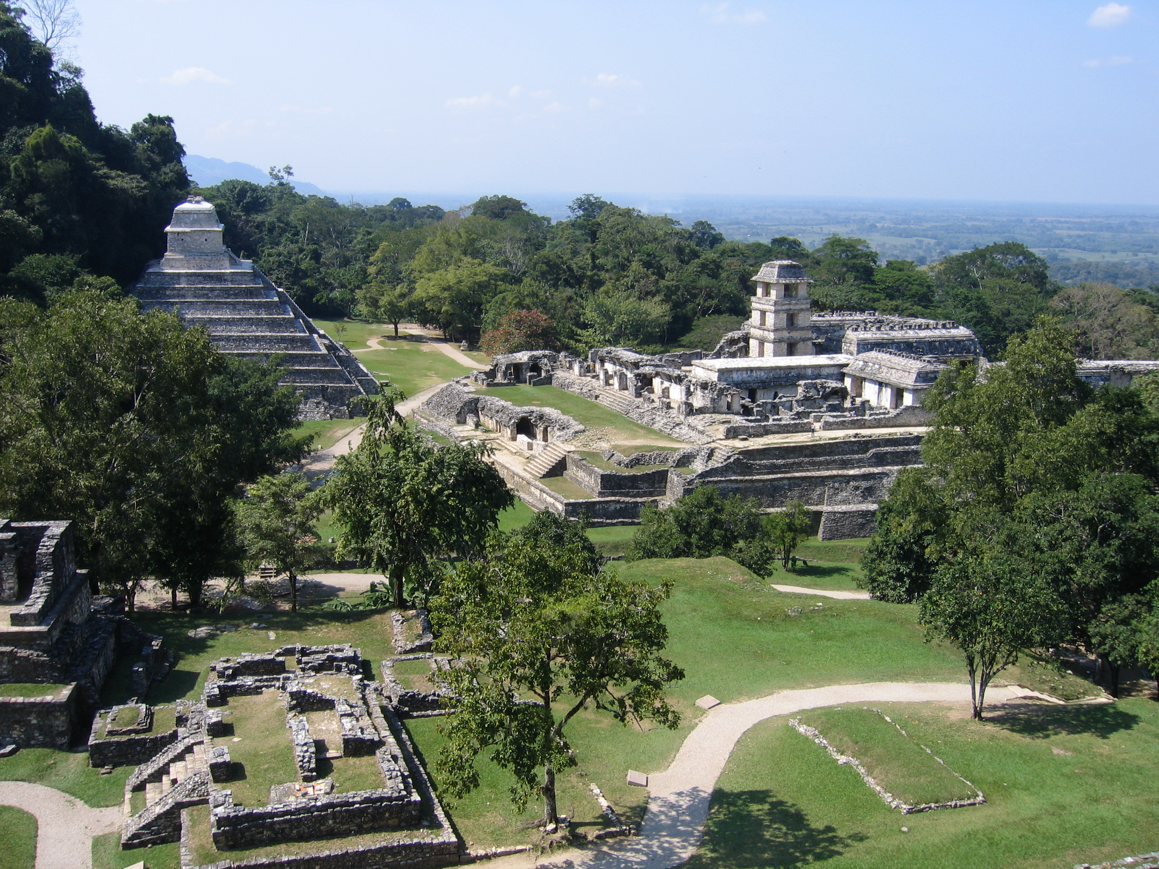
Photo Page 8:
Palenque: Life in the Jungle
Source: Harrenburg, J. (2008). Ruins of Palneque. Wikimedia Commons. Retrieved from https://commons.wikimedia.org/wiki/File:Palenque_ruins_web.jpg

Slide 13
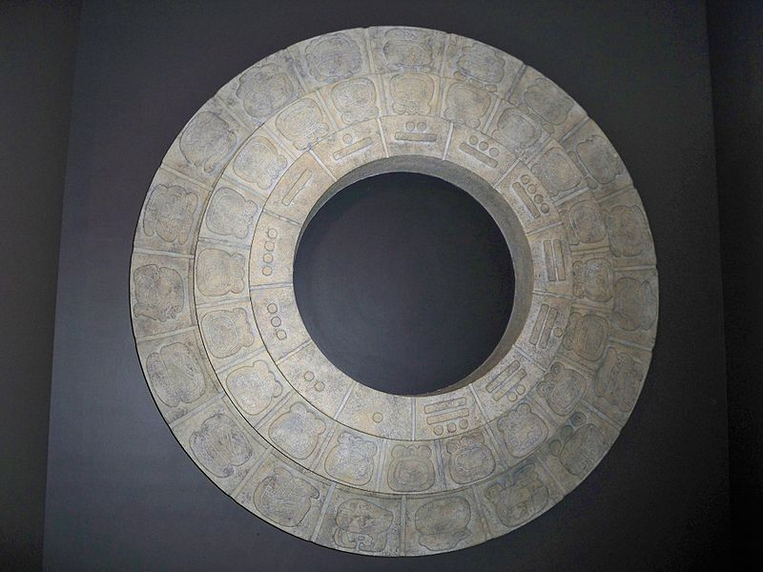
Photo Page 9:
Mayan Calendar
Source: Bisanz, M. (2009). Maya Calendar. Wikimedia Commons. Retrieved from https://commons.wikimedia.org/wiki/File:Maya_Calendar_by_Matthew_Bisanz.JPG

Slide 14
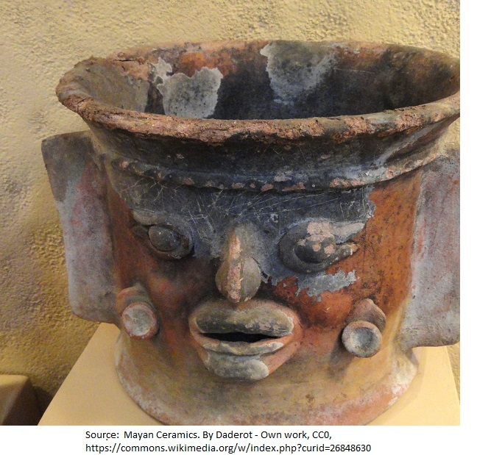
Photo page 10
Mayan Incense Burner
Source: Daderot. (2013, Feb. 24). Exhibit in the San Diego Museum of Man. Wikimedia Commons. Retrieved from https://commons.wikimedia.org/w/index.php?curid=26848630

Slide 15
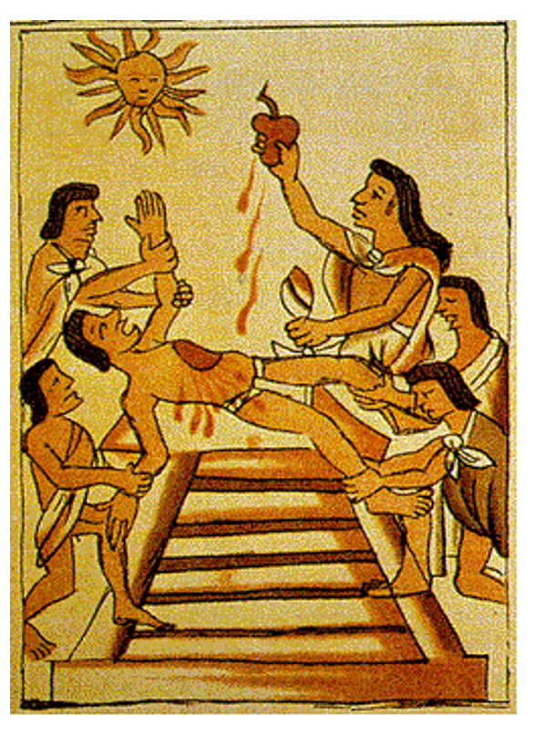
Photo Page 11:
Sacrifice to the Gods
Source: Cheng, C. (2017). Human sacrifice in Maya culture. Emory University. Retrieved from https://scholarblogs.emory.edu/gravematters/2017/02/23/human-sacrifice-in-mayan-culture/

Slide 16
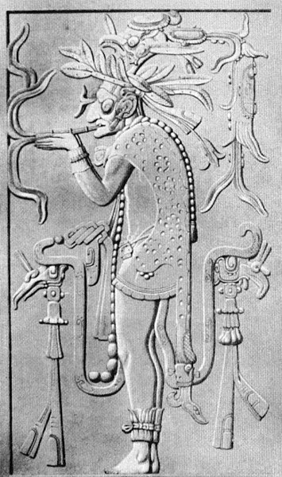
Photo Page 12:
Mayan Priest Smoking
Source: Isotalo, P. (2007). Mayan priest smoking. Wikimedia Commons. Retrieved from https://commons.wikimedia.org/wiki/File:Mayan_priest_smoking.jpg

Slide 17
RAFT writing
ROLE: Write in the viewpoint of the author.
AUDIENCE: Write to the audience.
FORMAT: Write in the format suggested.
TOPIC: Write about the topic.

