Slide 2
There’s a Map for That!
7th Grade Geography
Political Maps of Europe and Russia

Slide 3
Essential Questions
What do political maps tell us?
How are they important to our understanding of geography?

Slide 4
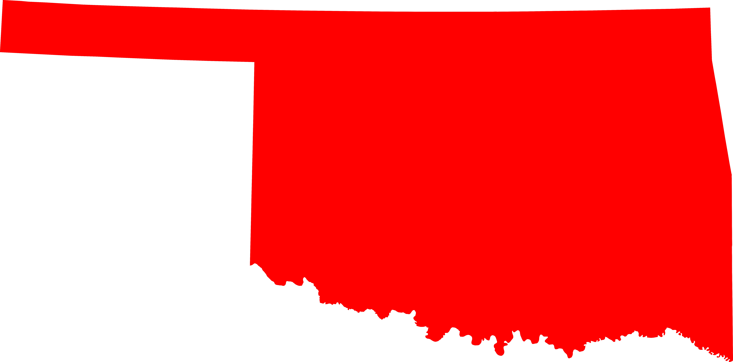
Source: NordNordWest. (2008, April 7). File:Map of Oklahoma highlighting Oklahoma County.svg. [Image file]. Retrieved from https://commons.wikimedia.org/wiki/File:Map_of_Oklahoma_highlighting_Oklahoma_County.svg

Slide 5
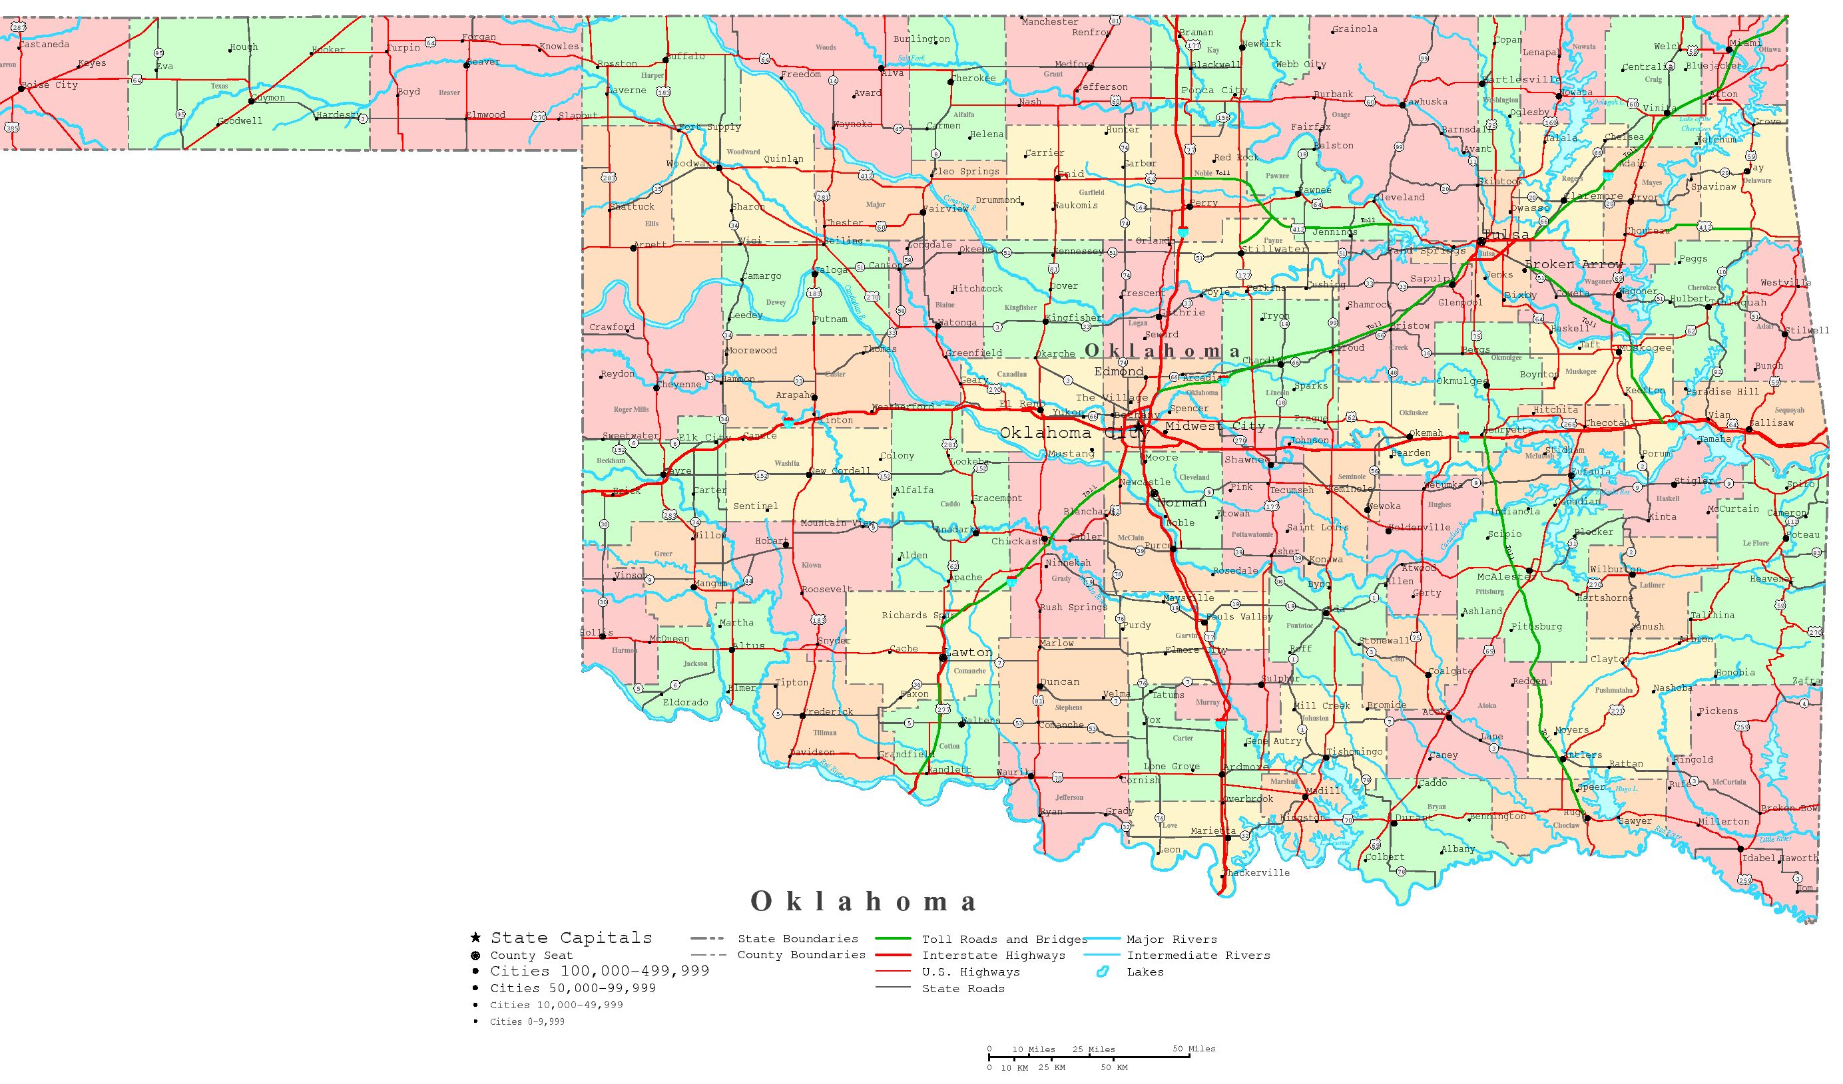
Source: Printable color Map of Oklahoma. (n.d.). [Image file]. Retrieved from http://www.yellowmaps.com/map/oklahoma-printable-map-460.htm

Slide 6
“I Think” Column
List all the features you see on the Oklahoma political map from the previous slide.

Slide 7
“We Think” Column
Discuss with your partner the features you observed in the “I Think” column.
Compare your lists and create one list that you both agree on in the “We Think” column.

Slide 8
Definition of Political Maps
Political maps are designed to show governmental boundaries of countries, states, and counties, the location of major cities, and they usually include significant bodies of water.
Differing colors are often used to help distinguish different governmental boundaries.
Source: https://www.worldatlas.com/aatlas/infopage/political.htm

Slide 9
Group discussion:
How might political maps be useful?

Slide 10
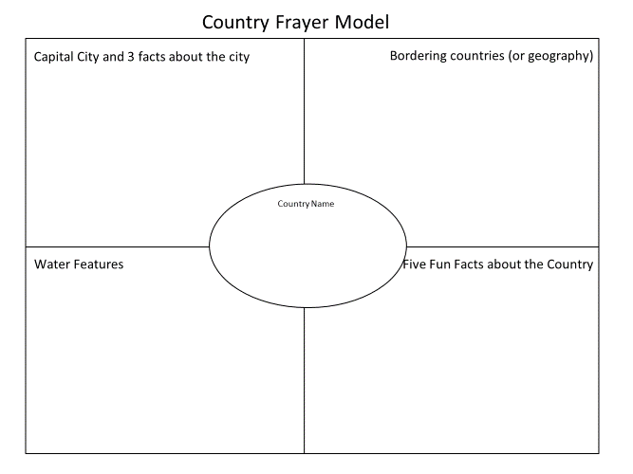
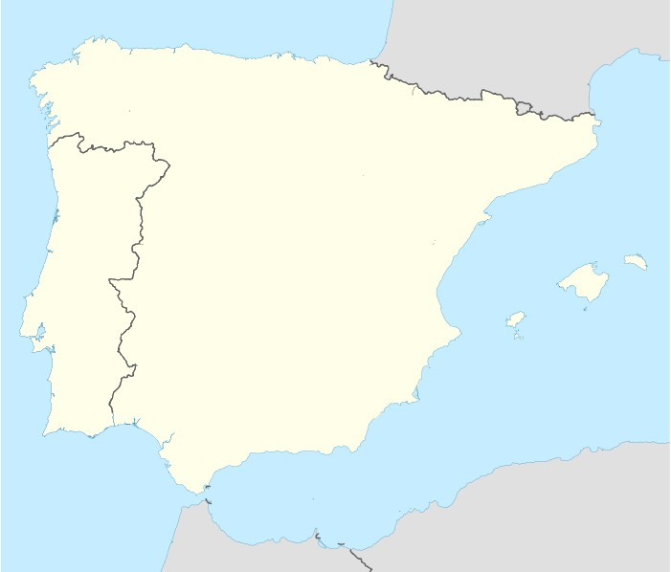
Political Map Presentation
Chart tablet paper one:
Political Map of Spain
Barcelona
•
Madrid
•
Portugal
Mediterranean
Sea
Source: NordNordWest. (2008, April 7). File:Spain location map.svg. [Image file]. Retrieved from https://commons.wikimedia.org/wiki/File:Spain_location_map.svg
Notes:
Groups are to create a chart tablet map using the rubric.

Slide 11
Geo-Pictionary Rules
Round One:
Three teams are formed.
One person from each team is chosen as the artist.
The artist will have three minutes (total) to draw and have their team guess the country.
The team has only three guesses.
If the team does not guess correctly, the next team can steal with the correct answer.

Slide 12
Geo-Pictionary Rules
Round Two:
One person is chosen as the artist
The artist will have two minutes (total) to draw and have their team guess the country.
The team has only one guess.
If the team does not guess correctly, the next team can steal with the correct answer.

Slide 13
Geo-Pictionary Rules
Round Three:
Each team will name the capital of the eight countries.
OR
Each team will name the country if given the capital.
If a team guesses incorrectly, the next team can steal the point with the correct answer.

