Slide 1
Analyzing American Historical Figures
U.S. History

Slide 2
Essential Question
Do people make history, or does history make people?

Slide 3
Objectives
Analyze and summarize the impact of key historical figures in American history.
Make connections between historical figures.

Slide 4
Tell Me Everything!
On a blank sheet of paper, tell me …
  Every American historical figure you can think of
You have 1 minute.

Slide 5
Tell Me More!
Using your list, tell me …
  Everything that you know about the people on your list.
You have 1 minute.

Slide 6
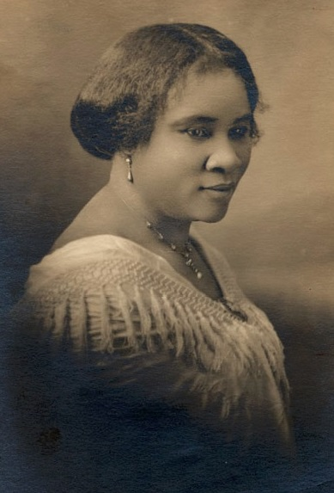
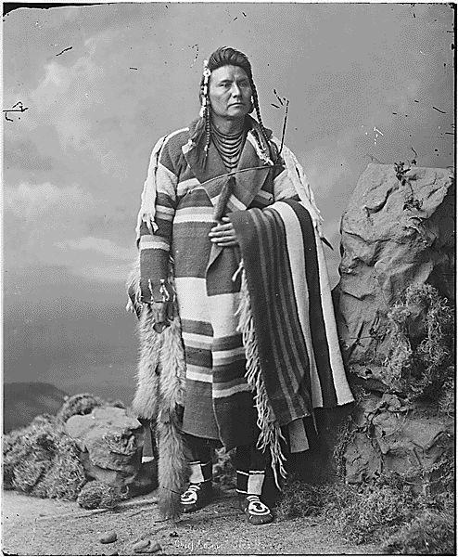
American Historical Figures
Who are these American historical figures?
Were they included on your list? Why or why not?
Notes:
Madam C. J. Walker Image Source: Scurlock Studio. (ca. 1914). Madam C. J. Walker. Smithsonian Institution, National Museum of American History. Wikimedia Commons. https://commons.wikimedia.org/wiki/File:Madam_CJ_Walker_face_circa_1914.jpg
Chief Joseph Image Source: National Archives at College Park. (ca. 1871-1904). Chief Joseph, Nez Perce, when young. Wikimedia Commons. https://commons.wikimedia.org/wiki/File:Chief_Joseph,_Hin-mah-too-yah-lat-kekt.jpg

Slide 7
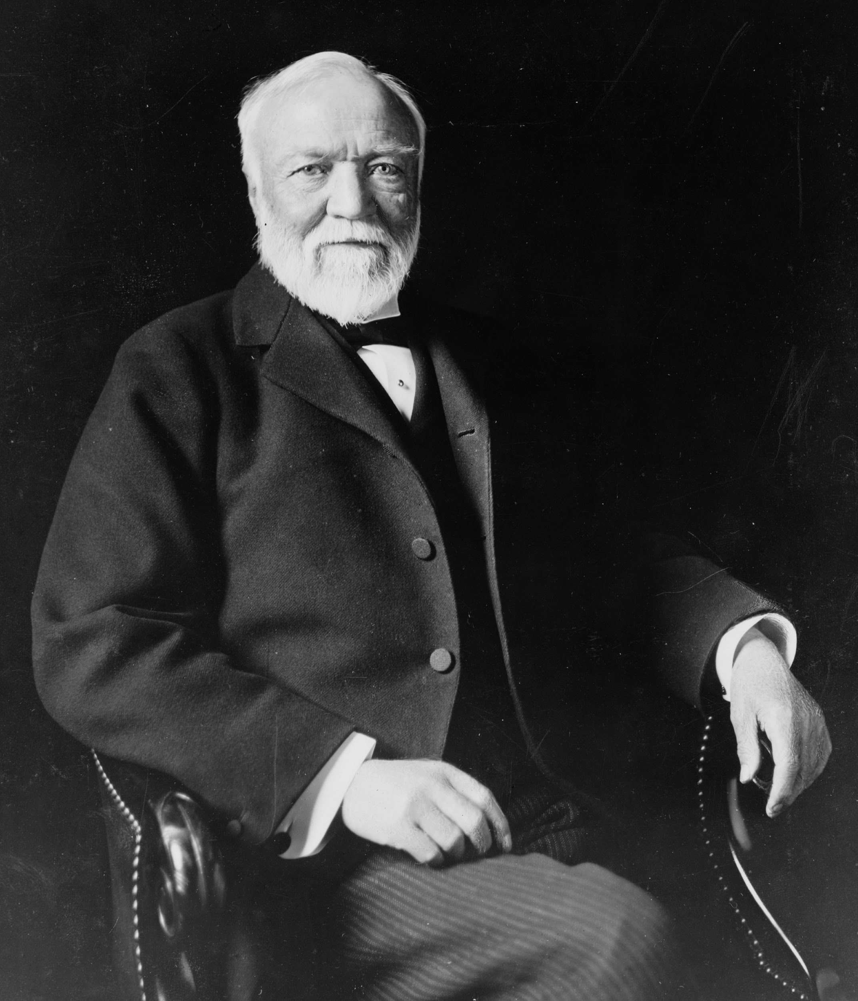
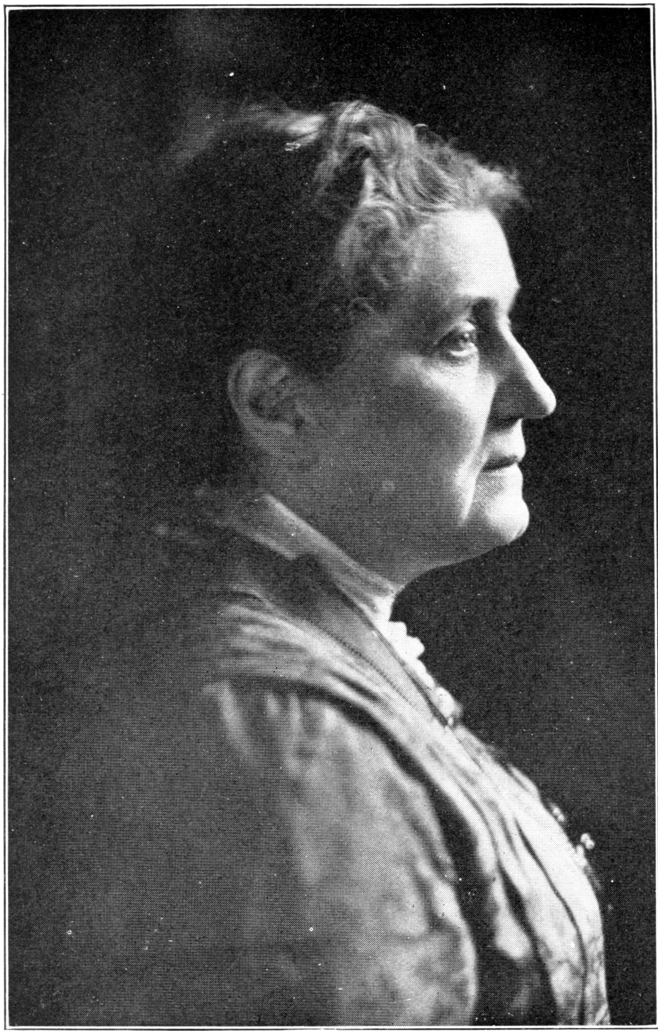
American Historical Figures
Who are these American historical figures?
Were they included on your list? Why or why not?
Notes:
Andrew Carnegie Image Source: Marceau, T. C. (1913). Andrew Carnegie, American businessman and philanthropist. Library of Congress. Wikimedia Commons. https://en.wikipedia.org/wiki/File:Andrew_Carnegie,_three-quarter_length_portrait,_seated,_facing_slightly_left,_1913.jpg
Jane Addams ImageSource: Webb, M. G. & Webb, E. L. (1914). Jane Addams. Wikimedia Commons. https://commons.wikimedia.org/wiki/File:Famous_Living_Americans_-_Jane_Addams.jpg

Slide 8
Your Task
Draw a slip of paper.
The name on the paper will be the name of the person you will research for the project.

Slide 9
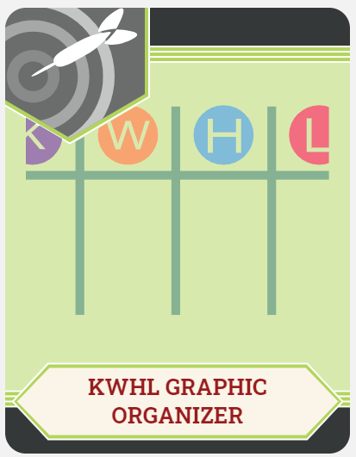
KWHL Chart
Write the name of your historical figure at the top of your KWHL Chart.
In the “K” column, fill in everything that you know about your figure.

Slide 10
KWHL Chart
In the “W” column, write down
everything you want to know
about your figure.
Need help? Think about:
What do I want to know?
What would others want to know?
For what is this person famous?

Slide 11
KWHL Chart
In the “H” column, write down ways
you can find the information you
listed in the “W” column.
For example:
A focused Internet search
Reading encyclopedia articles
What other resources could you use to
learn more about your figure?

Slide 12
Research
Using the “H” portion of your chart as a guide, research your assigned figure.
Some things to consider as you research:
  Notable accomplishments
  Education
  Connections to other historical figures
  Interests or hobbies
  Contributions to their field
  Interesting facts

Slide 13
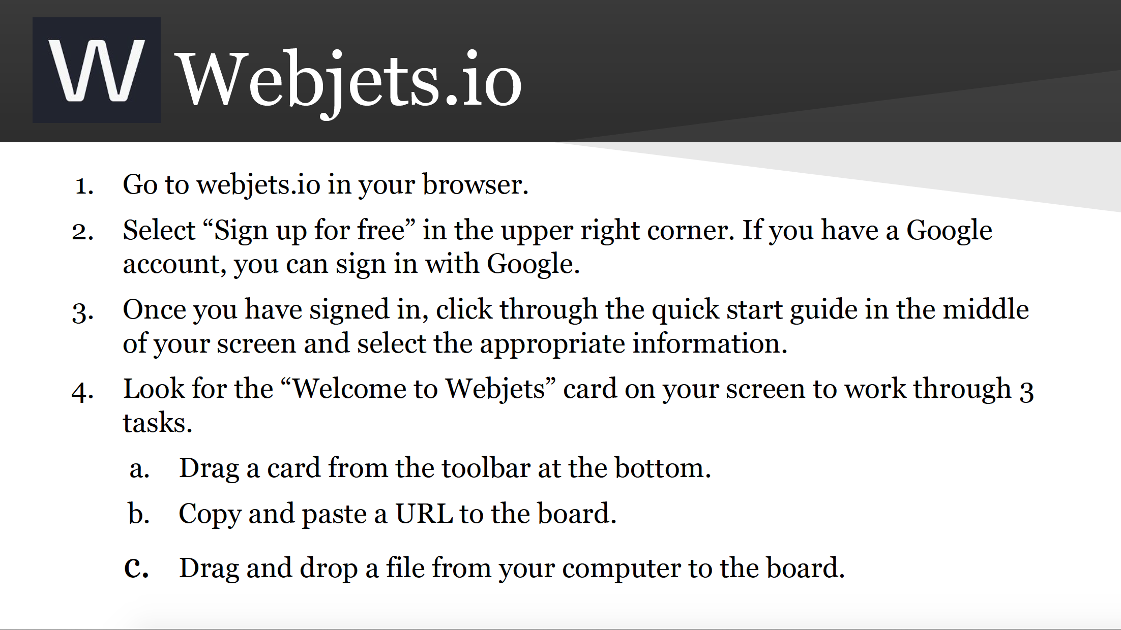
Notes:
Source: Wilson, C. (2020). Interactive classrooms for all contents. Activities. https://learn.k20center.ou.edu/pd/816ff8a793dedf6ff5046224f801b713

Slide 14
Historical Figures Project
Using the template, create a project about your figure that includes each of the following:
Quote
Five fast facts
Historical importance
Six-word memoir
BFF
Worst enemy
Four symbols
Image

Slide 15
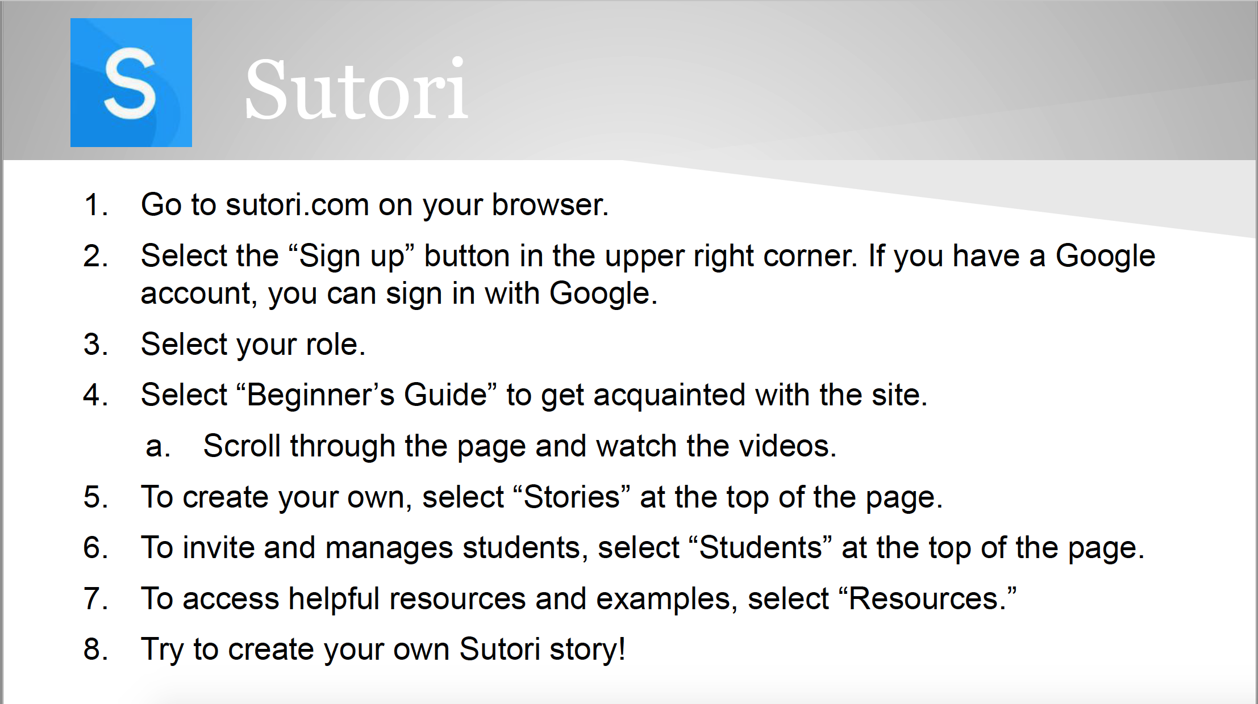
Notes:
Source: Wilson, C. (2020). Interactive classrooms for all contents. Activities. https://learn.k20center.ou.edu/pd/816ff8a793dedf6ff5046224f801b713

Slide 16
Gallery Walk
Find a peer project to review.
  Only ONE person should view each project at a time.
Using sticky notes, write down any praise you have or any helpful tips.
  Did you like their image or symbols? Tell them!
  Did they use the wrong your/you’re? Tell them politely!
Rotate clockwise around the room to the next project.

Slide 17
Sutori Gallery Walk
Share the link to your project in Google Classroom (or another collaborative workspace your teacher specifies).
Review and read through each peer project that you are assigned.
Comment on aspects that you love, and politely offer advice if you notice any issues.

Slide 18
KWHL Chart Revisited
Fill in the “L” column on your chart
with the information that you have
learned about your historical figure.

