Slide 1
Not Just Ninja Turtles
World History and the Renaissance

Slide 2
Essential Questions
What can art tell us about history?
How does art reflect history?

Slide 3
Lesson Objectives
Identify the characteristics of Renaissance art.
Analyze the impact of culture on Renaissance art.

Slide 4
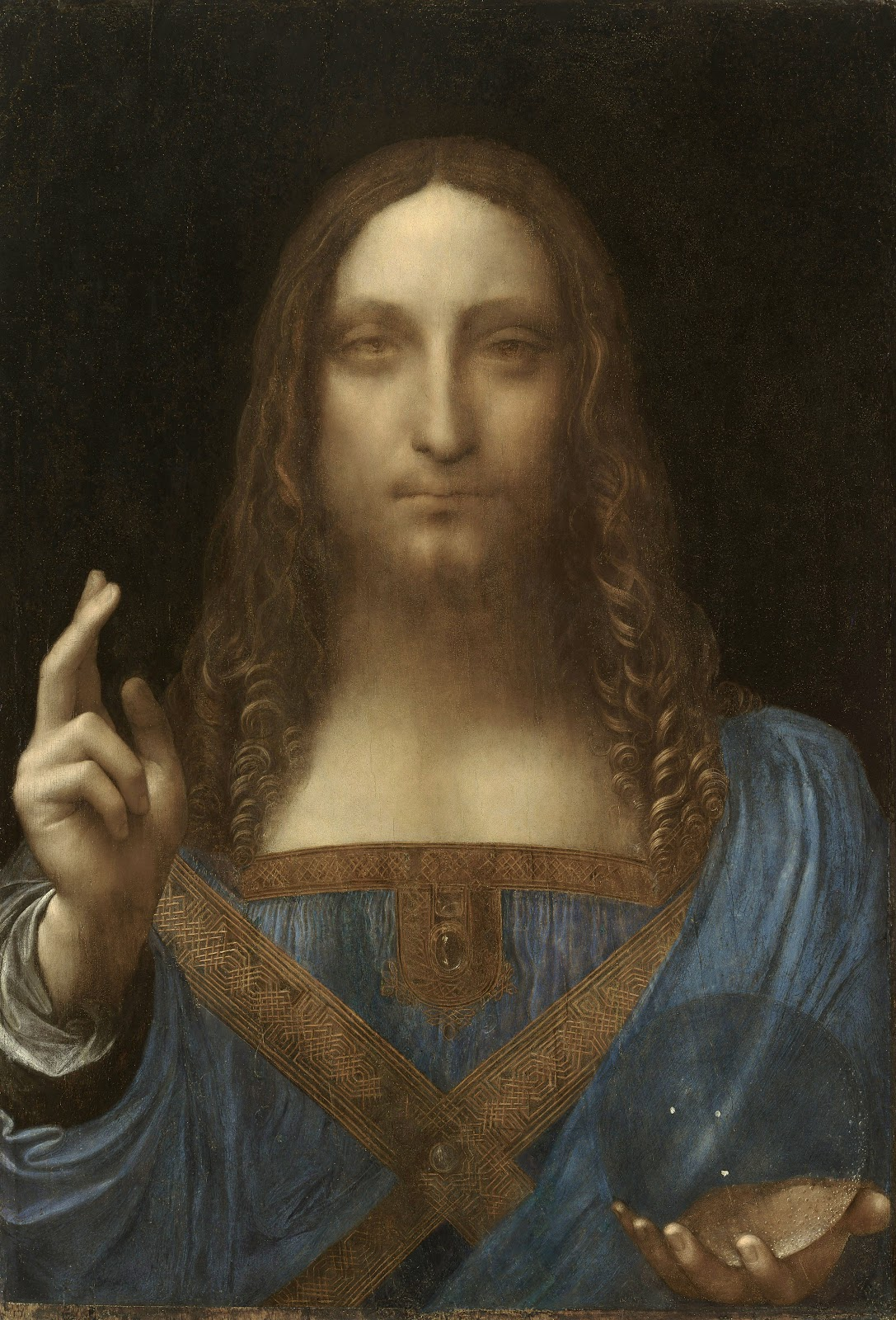
Artwork 1
Notes:
Don’t reveal the title or artist yet—simply give students time to view the image.
Image Source: da Vinci, L. (ca. 1500). Salvator Mundi [Painting: Oil on walnut wood]. Wikimedia Commons. https://commons.wikimedia.org/wiki/File:Leonardo_da_Vinci,_Salvator_Mundi,_c.1500,_oil_on_walnut,_45.4_%C3%97_65.6_cm.jpg

Slide 5
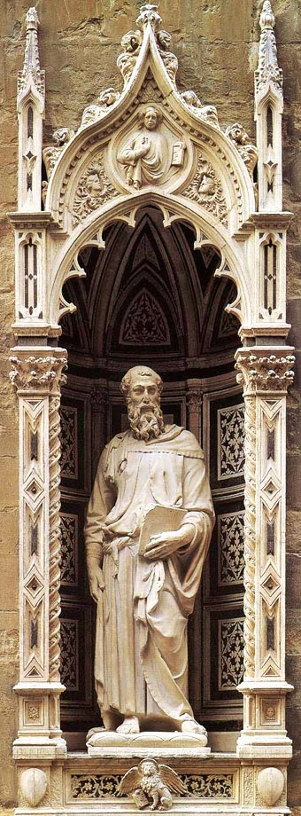
Artwork 2
Notes:
Don’t reveal the title or artist yet—simply give students time to view the image.
Image Source: Donatello. (1411-1413). Saint Mark [Marble statue]. Wikimedia Commons. https://commons.wikimedia.org/wiki/File:Stmark.jpg

Slide 6
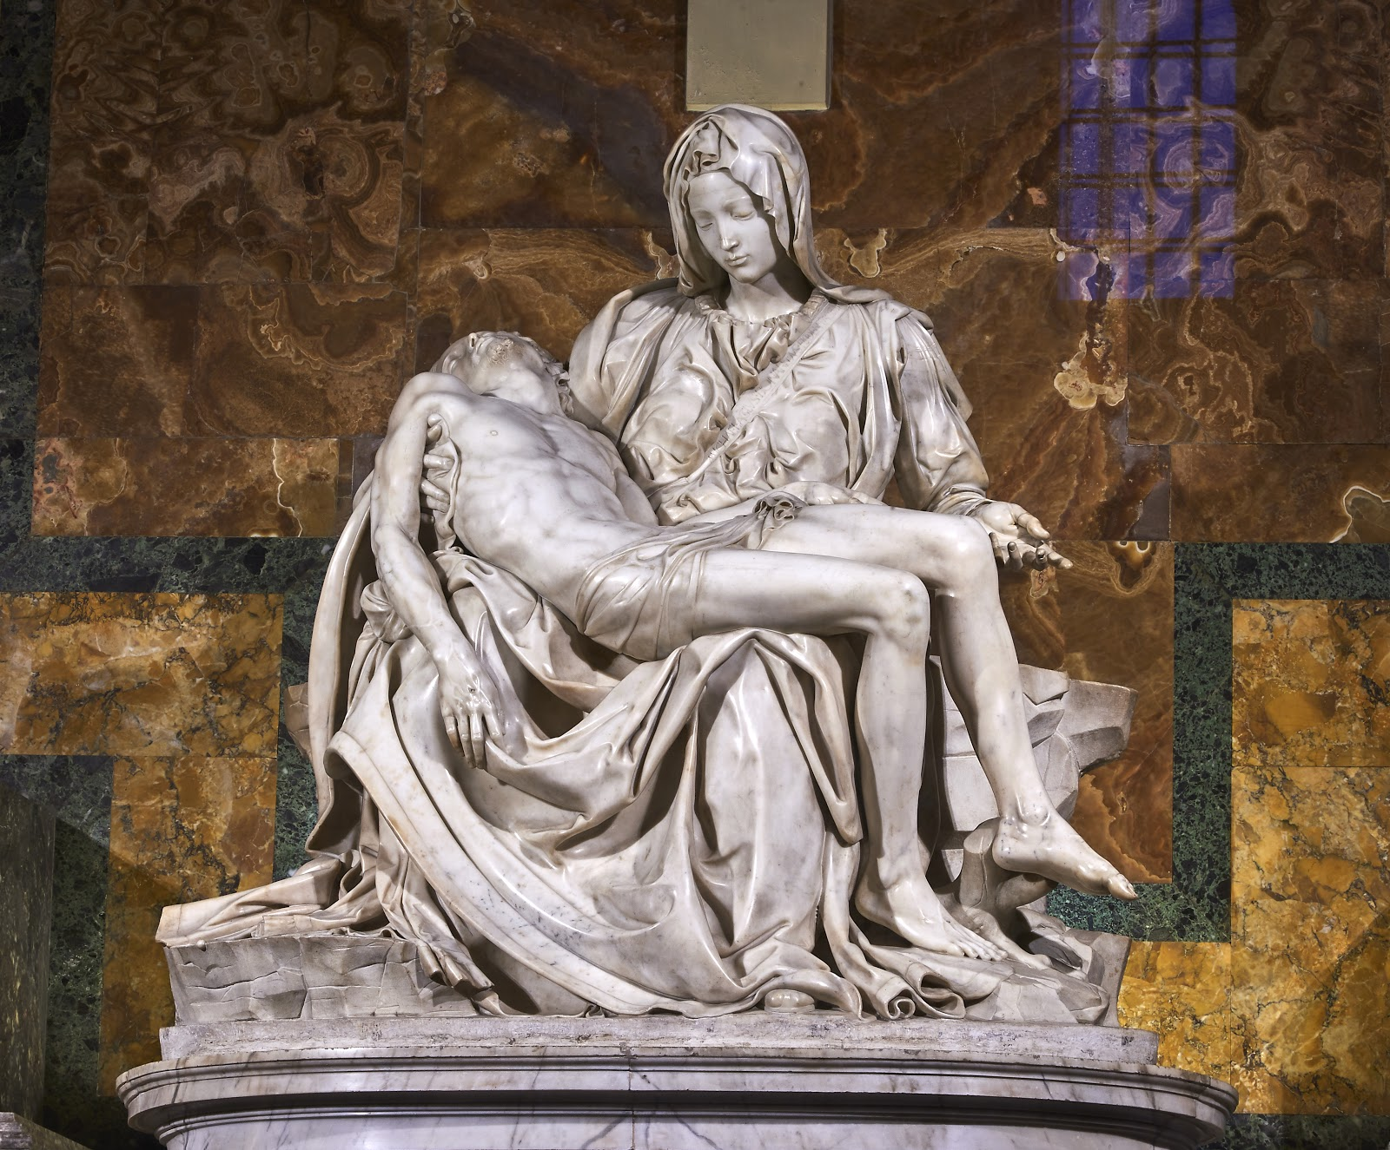
Artwork 3
Notes:
Don’t reveal the title or artist yet—simply give students time to view the image.
Image Source: Michelangelo. (1498-1499). Pietà [Statue]. Wikimedia Commons. https://commons.wikimedia.org/wiki/File:Michelangelo%27s_Piet%C3%A0,_St_Peter%27s_Basilica_(1498%E2%80%9399).jpg

Slide 7
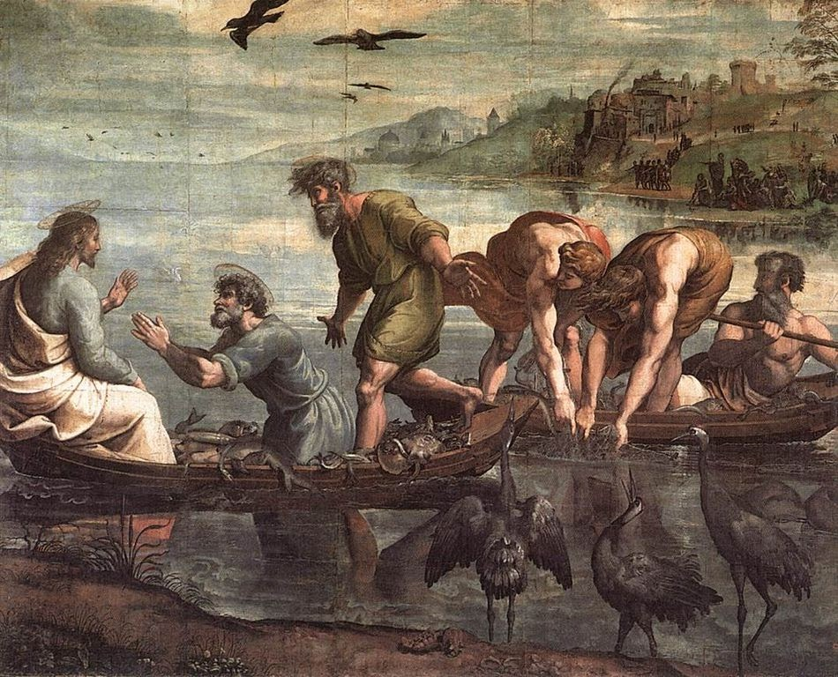
Artwork 4
Notes:
Don’t reveal the title or artist yet—simply give students time to view the image.
Image Source: Raphael. (1515). The miraculous draught of fishes [Painting]. Wikimedia Commons. https://commons.wikimedia.org/wiki/File:V%26A_-_Raphael,_The_Miraculous_Draught_of_Fishes_(1515).jpg

Slide 8
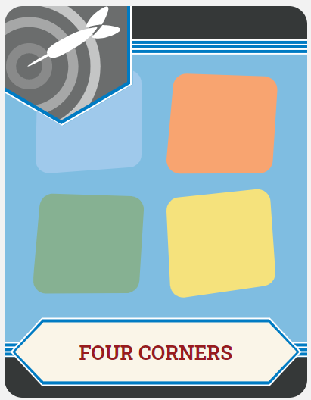
Four Corners
Find the four images hanging in different locations around the room.
Move to the area near the image that you like best.

Slide 9
Four Corners
Say hello to your group members!
As a group, discuss why you chose this piece of art.

Slide 10
Four Corners
Elect a group spokesperson to tell the class why you selected the artwork.

Slide 11
Artwork 1
Salvator Mundi
Leonardo da Vinci
Notes:
Image Source: da Vinci, L. (ca. 1500). Salvator Mundi [Painting: Oil on walnut wood]. Wikimedia Commons. https://commons.wikimedia.org/wiki/File:Leonardo_da_Vinci,_Salvator_Mundi,_c.1500,_oil_on_walnut,_45.4_%C3%97_65.6_cm.jpg

Slide 12
Artwork 2
Saint Mark
Donatello
Notes:
Image Source: Donatello. (1411-1413). Saint Mark [Marble statue]. Wikimedia Commons. https://commons.wikimedia.org/wiki/File:Stmark.jpg

Slide 13
Artwork 3
Pietà
Michelangelo
Notes:
Image Source: Michelangelo. (1498-1499). Pietà [Statue]. Wikimedia Commons. https://commons.wikimedia.org/wiki/File:Michelangelo%27s_Piet%C3%A0,_St_Peter%27s_Basilica_(1498%E2%80%9399).jpg

Slide 14
Artwork 4
The Miraculous Draught of Fishes
Raphael
Notes:
Image Source: Raphael. (1515). The miraculous draught of fishes [Painting]. Wikimedia Commons. https://commons.wikimedia.org/wiki/File:V%26A_-_Raphael,_The_Miraculous_Draught_of_Fishes_(1515).jpg

Slide 15
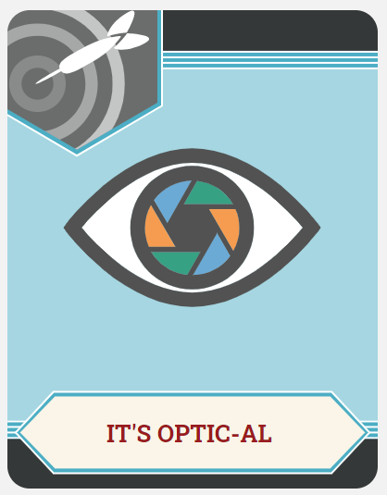
It’s OPTIC-al!
Use your OPTIC-al organizer to describe and analyze your selected artwork.

Slide 16
The Renaissance Crash Course
As you watch the video:
Annotate your OPTIC-al organizer, adding any new information that you think is helpful to understanding Renaissance art.
Consider this question: How do you think the Renaissance is reflected in the art you have viewed today?

Slide 17
The Renaissance Crash Course
Notes:
Source: CrashCourse. (2012, June 21). The Renaissance: Was it a thing? - Crash course world history #22 [Video]. YouTube. https://www.youtube.com/watch?v=Vufba_ZcoR0&feature=emb_logo

Slide 18
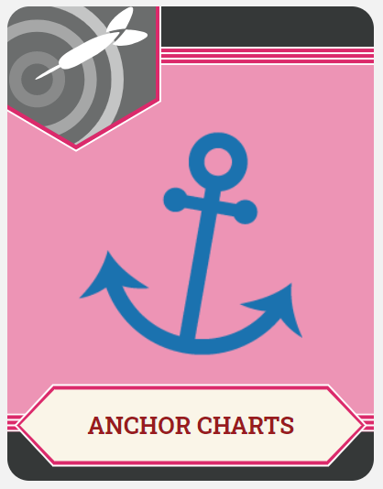
Anchor Chart
Work with your small group to create a poster for your Renaissance artist.
Make sure to include:
The artist’s name.
Graphics (pictures of the artist or their most famous works).
Common themes of the artist’s works.
How the art reflects the Renaissance period.

Slide 19
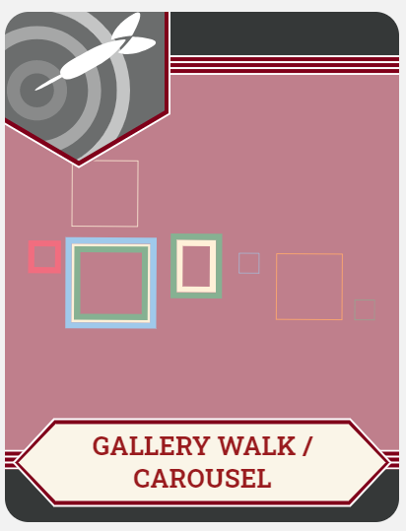
Gallery Walk
Post your presentations around the room.
Elect a spokesperson to stay at your presentation and explain it to visitors.
The rest of your group should move clockwise around the room to view other presentations and leave feedback:
What did the group do well?
Did you find a typo or have some constructive feedback?

