Slide 2
Why Did the Southern States Secede?
The Civil War

Slide 3
List-Group-Label
With you group, consider what the items in this list have in common and determine an appropriate label for the list.
Compromise of 1850
Publication of Uncle Tom’s Cabin
Kansas-Nebraska Act
Dred Scott v. Sandford
John Brown’s Raid on Harpers Ferry
Election of 1860

Slide 4
Essential Questions
What was the principal cause of the Civil War?
Why did the Southern states secede from the Union to form the Confederate States of America?

Slide 5
Learning Objectives
Evaluate the central cause of the Civil War.
Explain, using text evidence, why the Southern states seceded to form the Confederate States of America.

Slide 6
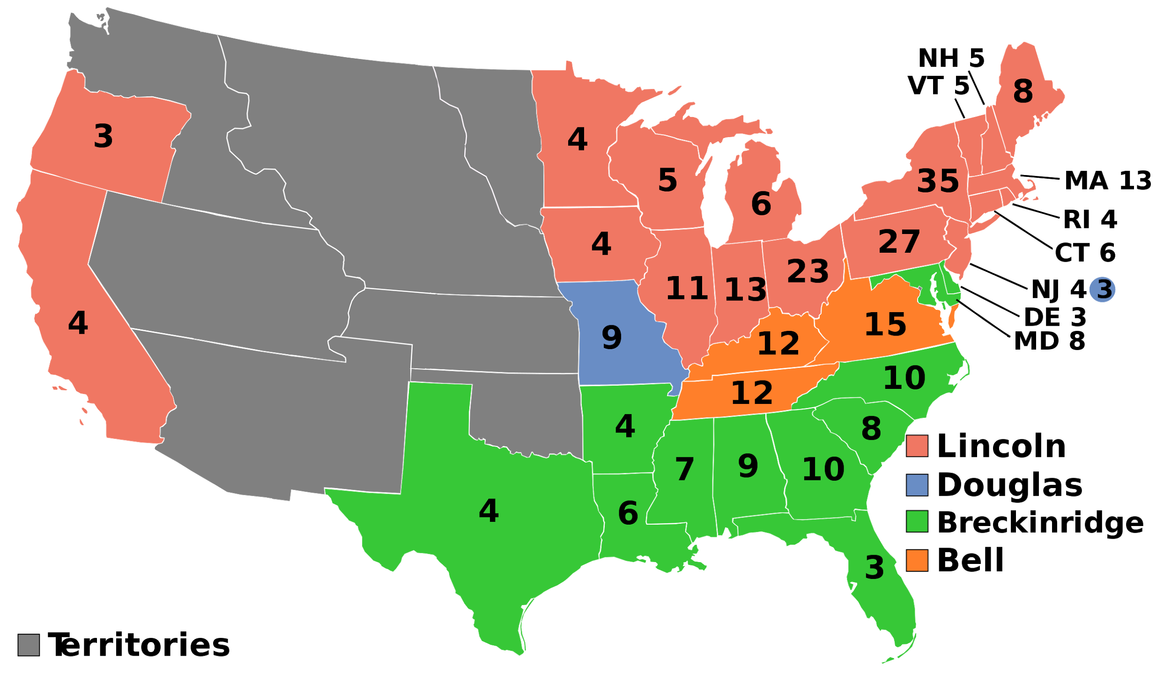
Election of 1860 and Secession
After the Election of 1860, seven slaveholding states seceded from the Union.
Secede: To formally break away
Notes:
Image Source: AndyHogan14. (2011, November 8). 1860 electoral college. Wikimedia Commons. Retrieved August 11, 2020 from https://commons.wikimedia.org/wiki/United_States_presidential_election_maps#/media/File:ElectoralCollege1860.svg

Slide 7
Ordinances of Secession
States that seceded made formal declarations of secession, which explained their decisions to break away from the United States.
Different groups will read the ordinances of secession from three states: South Carolina, Mississippi, and Texas. Your group will read and analyze one of these.

Slide 8
Ordinances of Secession: Why-Lighting
Read the ordinance of secession with your group.
As you read, highlight pieces of the text that explain WHY that state seceded from the Union.
Make notes explaining your reasoning for the highlighted text.

Slide 9
CSA Constitution/“Cornerstone Speech”: Why-Lighting
Read the excerpt from either the CSA Constitution or the “Cornerstone Speech.”
As you read, highlight pieces of the text that explain WHY the Southern states seceded from the Union.
Make notes explaining your reasoning for the highlighted text.

Slide 10
Why Did the Southern States Secede?
As a class, create a claim responding to this question.
Use text evidence from the documents you previously analyzed to support your claim.
State your reasoning by explaining how your evidence supports the claim.

Slide 11
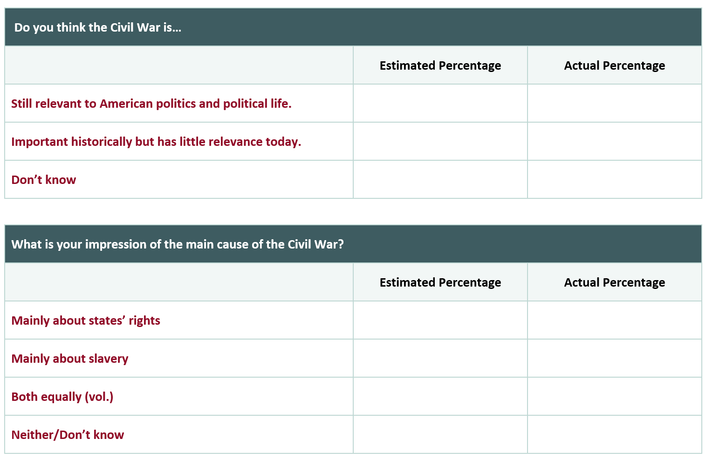
The Civil War’s Legacy
Notes:
Source: Pew Research Center. (2011, April 8). Civil War at 150: Still divisive, still relevant. https://www.pewresearch.org/politics/2011/04/08/civil-war-at-150-still-relevant-still-divisive/

Slide 12
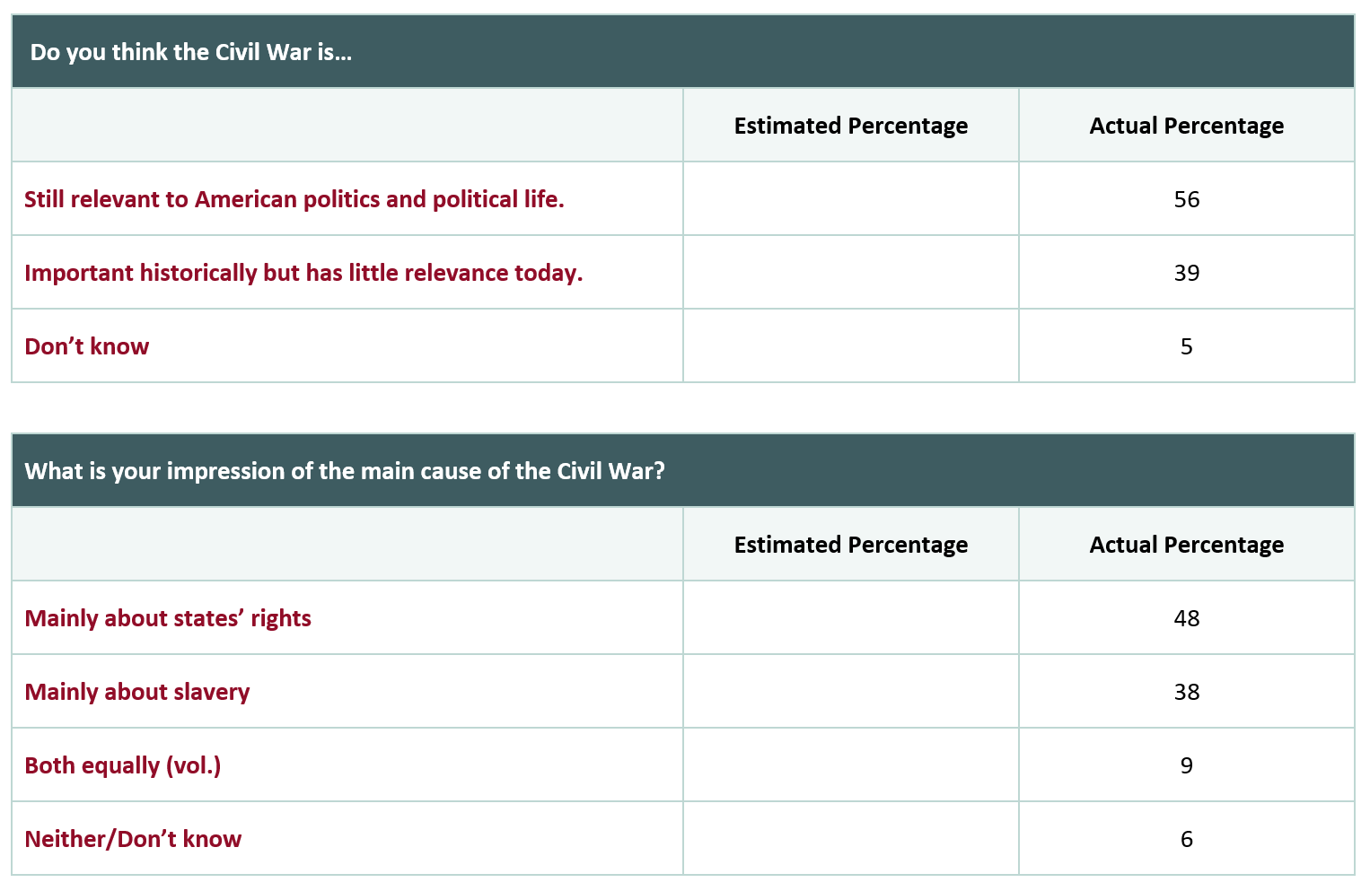
The Civil War’s Legacy
How do the actual response percentages compare to the guesses made by your group?
Notes:
Source: Pew Research Center. (2011, April 8). Civil War at 150: Still divisive, still relevant. https://www.pewresearch.org/politics/2011/04/08/civil-war-at-150-still-relevant-still-divisive/

Slide 13
S-I-T (Surprising, Interesting, Troubling)
After reviewing the information in the Mixed Views of the Civil War’s Legacy chart with your group, identify one:
Surprising fact or idea.
Interesting fact or idea.
Troubling fact or idea.

