Slide 2
The Seneca Falls Convention and the Declaration of Sentiments
8th grade U.S. History

Slide 3
Laws and Practices in the U.S. in 1848 Shaping the Lives of Women
Examine the “Laws and Practices” document with your group.
Using the S-I-T strategy. As a group, determine a surprising fact or idea, an interesting fact or idea, and a troubling fact or idea to share with the class.

Slide 4
Essential Questions
What roles have women played in advancing civil rights historically and currently?
What issues addressed during the women’s rights movement remain relevant today?

Slide 5
Learning Objectives
Students will be able to:
Identify and explain the significance of the Seneca Falls Convention and the Declaration of Sentiments.
Analyze the Declaration of Sentiments to determine the ideals of the women’s suffrage movement.
Evaluate to what extent the grievances in the Declaration of Sentiments have been redressed today.

Slide 6
Seneca Falls and
Declaration of Sentiments - Note Catcher
As you watch the video, consider the following questions, and record your answer in the appropriate section of the note catcher:
  What is the Seneca Falls Convention, and why is it important?
  What is the Declaration of Sentiments, and why is it important?

Slide 7

Women’s Rights Movement - Video
Notes:
HISTORY. (2018, March 8). What happened at the Seneca Falls Convention? | History. YouTube. https://www.youtube.com/watch?v=TcYhuG1y3bc&feature=emb_logo

Slide 8
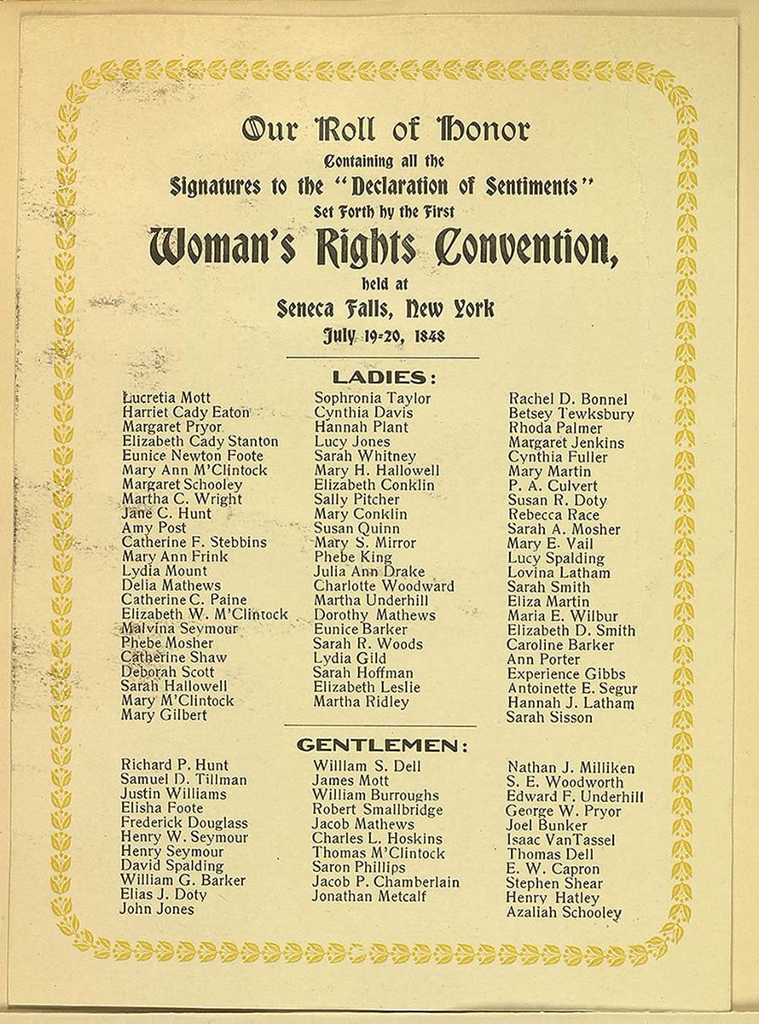
Declaration of Sentiments
What is familiar about the first three paragraphs of the Declaration of Sentiments?
Notes:
https://pbs.twimg.com/media/CKXzBSKWwAEzQT8.jpg. (2018, January 28). List of signatures from the Declaration of Sentiments 1848. Wikimedia Commons. https://commons.wikimedia.org/wiki/File:Woman%27s_Rights_Convention.jpg

Slide 9
Declaration of Sentiments
What point were the authors of the Declaration of Sentiments trying to make by modeling their declaration of women’s rights after the Declaration of Independence?

Slide 10
Declaration of Sentiments
What were the ideals and goals of the women’s rights movement?
How do you know? (Evidence from the Declaration of Sentiments)

Slide 11
Women’s Rights Today
Using information from the Declaration of Sentiments, the Women’s Leadership Fact Sheet, and your own experience:
  evaluate to what extent each grievance listed on the handout has been fixed.
  support your decision with evidence and reasoning.

Slide 12
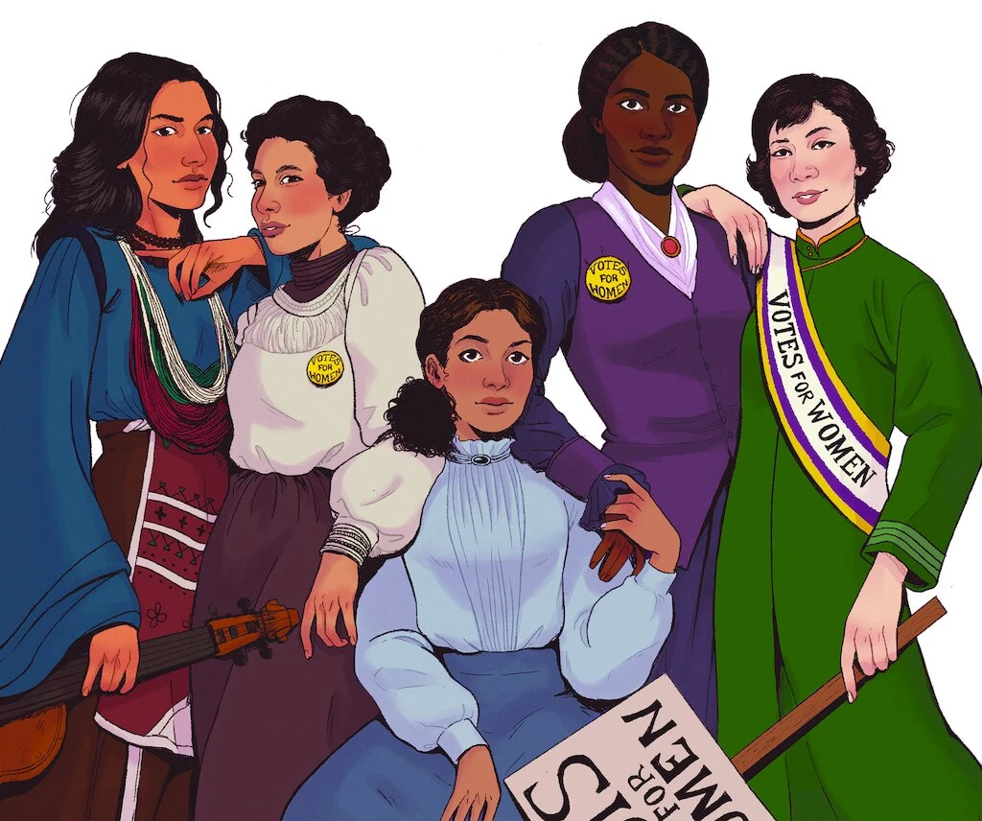
Exit Ticket
What roles have women played in advancing civil rights historically and currently?
What issues addressed during the women’s rights movement remain relevant today?
Notes:
The cover art for “Finish the Fight!” Finish the Fight! published by HMH/Versify, Art by Steffi Walthall, 2020

