Slide 1
I Spy Something Wild
Grades 1-3 English Language Arts

Slide 2
Honeycomb Harvest
Sort the cards into groups that make sense to you.

Slide 3
Essential Question
How do authors include literary elements such as setting, plot, and main characters to help “paint a picture” of a story?

Slide 4
Learning Objectives
Describe different literary elements.
Identify the characters, setting, and plot of a given story.
Write a story that includes the different literary elements.

Slide 5
Literary Element Anchor Chart
Characters
Setting
Plot

Slide 6
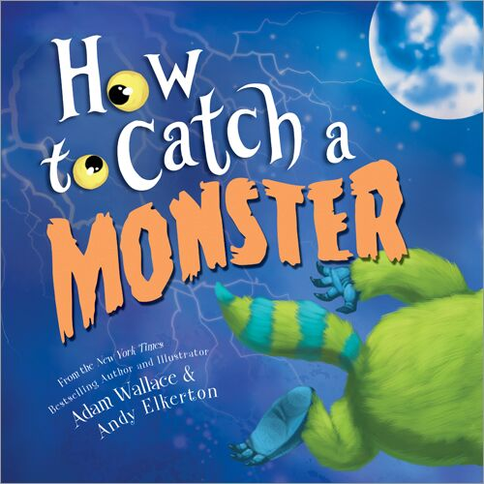
Notes:
Image sources:
Bright, R. (2012). Love monster book cover [Digital image]. Goodreads. https://www.goodreads.com/book/show/13407153-love-monster
McWilliam, H. (2009). I need my monster book cover [Digital image]. Wikipedia. https://en.wikipedia.org/wiki/File:I_Need_My_Monster.jpg
Elkerton, A. (2017). How to catch a monster book cover [Digital image]. Goodreads. https://www.goodreads.com/en/book/show/34006773-how-to-catch-a-monster
Sendak, M. (1984). Where the wild things are book cover [Digital image].Wikipedia. https://en.wikipedia.org/wiki/File:Where_The_Wild_Things_Are_(book)_cover.jpg

Slide 7
Love Monster by Rachel Bright
If you hear a new character, setting, or plot twist in the story, raise your hand!
Notes:
Instructor/Facilitator’s Notes:
As you are reading the book Love Monster, by Rachel Bright, tell your students that if they hear something they believe is related to one of the concepts, they should raise their hands. As your students share out things they notice, write them down on a sticky note, and have them include this information on an interactive anchor chart paper.

Slide 8
Characters
People, animals, or creatures in a story.
They can think, feel, or act.
Notes:
Instructor/Facilitator’s Notes:

Slide 9
Elbow Partners
With your Elbow Partner:
Discuss the definition of characters.
Identify the characters in the book Love Monster.

Slide 10
Love Monster
by Rachel Bright
Who are the main characters in the story?
Notes:
Instructor/Facilitator’s Notes:
Once your students have had some time to discuss the questions on the previous slide, have them come back to the whole group and share out their thoughts and conversations. Adjust the anchor chart accordingly.

Slide 11
I Need My Monster
by Amanda Noll
If you hear a new character come into the story, raise your hand!
Notes:
Instructor/Facilitator’s Notes:
Inform your students that today, you will be reading the story I Need My Monster, by Amanda Noll, because this story has a lot of different and unique characters that you can look at and talk about! Tell your students that if they hear mention of a new character as you are reading the book, they should raise their hands. As your students share out, write down what they are saying on a different colored sticky note, and have them include this information on an interactive anchor chart paper (see example below). Keep in mind, you are only focusing on characters right now.

Slide 12
Setting
The time and place of a story.
Answers the questions “When?” and “Where?”

Slide 13
Elbow Partners
With your Elbow Partner:
Discuss the definition of setting.
Identify the setting in the books:
Love Monster
I Need My Monster

Slide 14
Love Monster
by Rachel Bright
What is the setting of the story?

Slide 15
I Need My Monster
by Amanda Noll
What is the setting of the story?

Slide 16
Where the Wild Things Are
by Maurice Sendak
If you hear a new setting mentioned in the story, raise your hand!

Slide 17
Where the Wild Things Are
by Maurice Sendak
Who are the characters in the story?

Slide 18
Plot
The main events of the story
Beginning
Middle
End

Slide 19
Elbow Partners
With your Elbow Partner:
Discuss the definition of plot.
Explain the plot in the books:
Love Monster
I Need My Monster
Where the Wild Things Are

Slide 20
Love Monster
by Rachel Bright
What is the plot of the story?

Slide 21
I Need My Monster
by Amanda Noll
What is the plot of the story?

Slide 22
Where the Wild Things Are
by Maurice Sendak
What is the plot of the story?

Slide 23
How to Catch a Monster
by Adam Wallace & Andy Elkerton
If you hear a change in the plot of the story, raise your hand!

Slide 24
How to Catch a Monster
by Adam Wallace & Andy Elkerton
Who are the characters?
What is the plot?

Slide 25
Cognitive Comic
Write and draw a story about your own monster.
Make sure to include:
Characters
Setting
Plot

Slide 26
Beginning Your Story
One day, _______.
One night, _______.
On a _____ day, _____.
I was with my monster [monster’s name].
We were ________.
I was ________.
My monster [monster’s name] was ______.

Slide 27
Describing What Happens
I was thinking/My monster was thinking ______.
I was sad/My monster was sad because ______.
I saw/My monster saw ______.
I heard/My monster heard ______.
Then ______.
After that, ______.

Slide 28
Ending With a Feeling
I felt _____ because ______.
My monster felt _____ because ______.
It was _________.
I hope ________.
At last _______.
Next time _______.

Slide 29
Two Stars and a Wish
Two stars: What did your partner do well in their writing?
One wish: What could your partner do to make their story even better?

