Slide 1
Hall of Injustice, Part 1
Guided Inquiry Research
ELA & Oklahoma History
Notes:
Students will need a partner for much of this lesson.

Slide 2
Essential Questions
What is injustice?
How does the portrayal of injustice in historical fiction compare with the portrayal of the same event in the news?

Slide 3
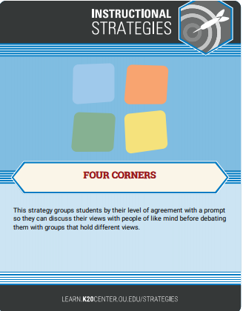
Take a Stand: Four Corners
After you view the video below, stand by the sign that best reflects how you feel about the video’s topic.
Video #1: Boys’ vs. Girls’ Clothing
Do you agree, disagree, strongly agree, or strongly disagree that boys should wear boys’ clothing and girls should wear girls’ clothing? Discuss your choice with your group.
Video #1 Four Corners Answers
Notes:
ENGAGE:
Hang the Agreement signs in four corners of your room before class. Play the video linked on the slide until the 1:37 timestamp: https://www.youtube.com/watch?v=9XPQcWmfXgQ&t=9s
After watching the video, invite students to engage in a Four Corners activity. (You can do this activity by directing your students towards different corners in your classroom; additionally can use the following link to do the activity digitally: https://docs.google.com/document/d/1ppKKuoFEykpk7VlkuzzQ5TE0X5oNRVmuU943xwUrcW4/copy)
Allow students time to discuss why they agree, disagree, strongly agree, or strongly disagree (5-7 minutes). Have a representative from each group share out regarding their choice. Remind students that it is important to respectfully listen to others’ opinions. At the end of the discussion, have students move to a different group if they have changed their mind. If time allows, ask students to explain their change of perspective.
Video source:
Kayas, J. (2016, December 1). Eight year old girl calls Tesco out over ‘sexist’ kids clothes [Video]. YouTube. https://www.youtube.com/watch?v=9XPQcWmfXgQ&t=9s

Slide 4
Take a Stand: Four Corners
After you view the video below, stand by the sign that best reflects how you feel about the video’s topic.
Video #2: Poverty
Do you agree, disagree, strongly agree, or strongly disagree that you would avoid the little girl who was dirty and begging? Discuss your choice with your group.
Video #2 Four Corners Answers
Notes:
(You can use the following link to do the activity digitally: https://docs.google.com/document/d/1jsmiwaDZPLr6Cfj1c6QneW1Jt9hPK75LSheXFjuyrqk/copy)
Video source:
UNICEF. (2016, June 28). Would you stop if you saw this little girl on the street? [Video]. YouTube. https://www.youtube.com/watch?v=MQcN5DtMT-0

Slide 5

Definition of Injustice
Think about the videos with unjust situations.
Pair up with a partner, and write a definition of injustice together.
Use Mentimeter to share your definition.
On menti.com, use this Mentimeter code:
[insert code here]
Notes:
Create a free account with Mentimeter and insert the code for each class on this slide. Make your Mentimeter question “What is injustice?”
Students will need a piece of paper or notecard.
Display Mentimeter answers and discuss students’ answers.

Slide 6

Tulsa Race Massacre (1921)
Pick up a copy of the Tulsa Race Massacre article (digital or physical).
Number the paragraphs 1-15 on the paper copy.
Once in a group, read the assigned paragraphs with your group.
Write a 1-2 sentence summary on the plain white paper provided.
Have one person your group share your group’s summary with the class.

Slide 7
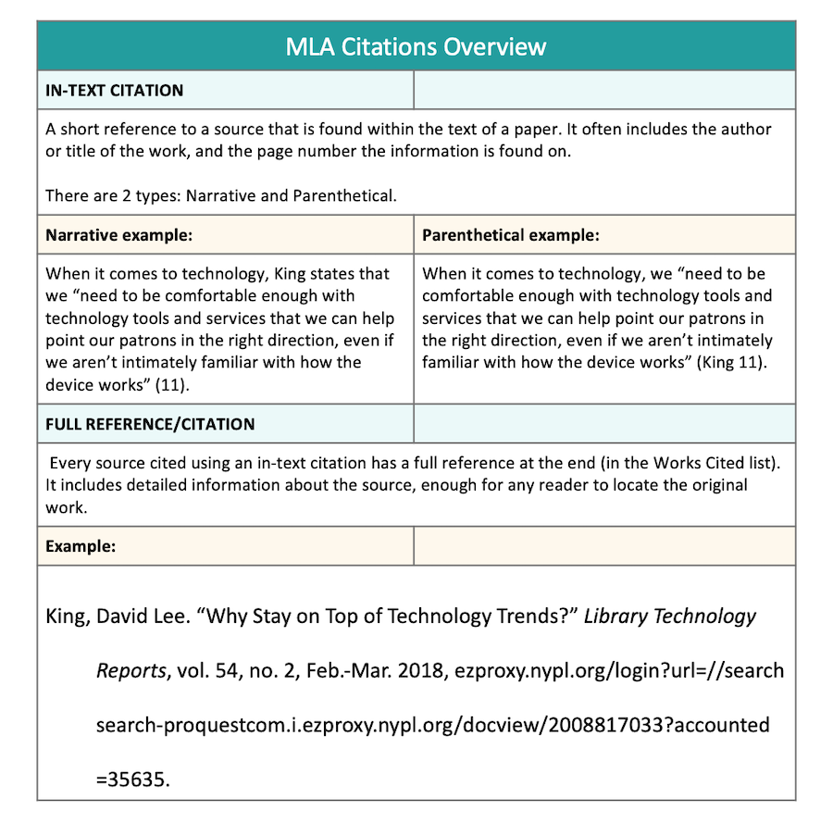
Text Evidence and Parenthetical Documentation
N.a. (n.d.). MLA In-Text Citations & Parenthetical Citations. Easy Bib. https://www.easybib.com/guides/citation-guides/mla-format/how-to-cite-a-parenthetical-citations-mla/

Slide 8

Excerpt: Categorical Highlighting
Read an excerpt from Jennifer Latham’s novel Dreamland Burning (pages 23-27).
Think about the following question: What is the injustice in this excerpt?
Choose two highlighter colors.
Use the two colors to highlight examples of injustice that are demonstrated through the following types of language: racially discriminatory language and inflammatory language.
Notes:
Racially discriminatory language includes any language or terms that offend or exclude different categories of people because of their race.
Inflammatory language refers to language intended to cause an emotional response or incite action. This can include assumptive language as well as nonfactual, gossipy language.

Slide 9
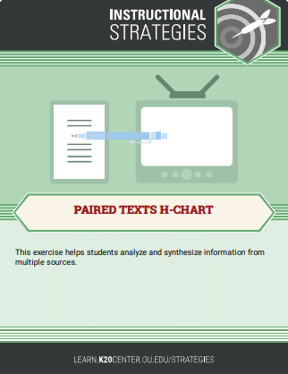
Paired Texts H-Chart
Using the highlighted excerpt, record the answers to the question, “What is the injustice in this excerpt?” on the H-Chart.
On the H-Chart, describe examples of injustice using bullet points. Use text evidence to support your answer.
  Example: The injustice in this quote is the way some police officers assume you are doing something suspicious just because of the color of your skin. “It wasn’t like there was a shortage of news stories about bad cops assuming the worst when it came to brown-skinned kids like me” (Latham 18).
When you have completed your notes, discuss your answers with your partner.
Revise your list if you have anything to add after your discussion.

Slide 10
Article: Categorical Highlighting
Read the article “Tulsa Race Massacre: 1921 Tulsa newspapers fueled racism, and one story is cited for sparking Greenwood’s burning”, Randy Krehbiel Tulsa World, 2019.
Think about the following question: What are the examples of injustice described in this article?
Choose two highlighter colors.
Highlight examples of injustice based on two categories using a different color highlighter for each: racially discriminatory language and inflammatory language.
Notes:
It would be good to discuss some vocabulary strategies before reading the article. One strategy is to have the students underline or circle unknown vocabulary terms as they read. Terms that may be difficult include: intrepid, conflagration, assault, ramshackle, skulking, implied, incited, complicit, bylined, vernacular, etc.

Slide 11
Paired Texts H-Chart
Using the highlighted article, record the answers to the question, “What is the injustice in this article?” on the other side of the H-Chart.
On the H-Chart, describe examples of injustice with bullet points and use text evidence from the article to support your answers.
When you have completed your notes, discuss your answers with your partner.
Revise your list if you have anything to add after your discussion.
Notes:
Hall of Injustice H-Chart Example: https://docs.google.com/document/d/16uhQ4eOFy3mZQdV9BRYg2CUW0-trwsvE/view

Slide 12
Paired Texts H-Chart
With your discussion partner, discuss the article and how it relates to the fiction piece.
Synthesizing the information, answer the following question: “What do these two texts inform us about injustice?”
Answers to the question will be recorded in the center of the H-Chart.
Write a paragraph using text evidence in your answer.
Notes:
The H-Chart will serve as a part of the Evaluation.

Slide 13
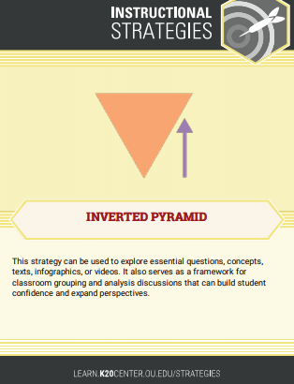
Inverted Pyramid: Class Discussion
With your partner, join another pair to create a group of four.
Discuss the excerpt from Dreamland Burning and the article highlighting the injustice of the Tulsa Race Massacre.
Focus your discussion on the essential questions:
  What is injustice?
  How does injustice in historical fiction relate to its focused historical event?
Optionally, join with another group of four to continue the discussion.
Finally, come together for a classroom discussion regarding both texts and the essential questions.
Notes:
The repetition of ideas allows students to determine what is significant and pushes them to expand their perspective.

Slide 14
Writing a Level 1 or 2 Inquiry Question
Video: “Instant Inquiry: Level 1, 2, and 3 Questions”
Level 1: Right There
Answers are explicitly stated in the text or research material.
Read the passage or research material. Locate a fact that is a “who,” “what,” “when,” “where,” “why,” or “how.”
Turn the fact into a question.
Check the answer to make sure it is found in one place, word-for-word, in the text.
Example: Where did the Tulsa Race Massacre take place?
Level 2: Putting it Together
Answers require you to put information together from different parts of the text or research material.
Read the passage or research material. Locate related facts from at least two different places in the text.
Turn the facts into a question (e.g., “why…” “describe…” “how…”).
Put information together to answer the question in one or more sentences.
Example: What did Rowan find at the
beginning of the novel, and how did it
get there?
Notes:
Higher Order Thinking Questions: https://docs.google.com/document/d/1bk7l6hNO15pvlZfld0wreURJk4X5Y3i3nXSy6E9UuiY/view

Slide 15
Writing a Level 3 Inquiry Question
Level 3: Making Connections
Answers require more than searching the text or research material. They require you to think about what you have just read, what you already know, what you are curious about regarding the topic, and how these ideas relate.
Read the passage or research material or think about the topic you are interested in researching.
Relate something in the passage, research material, or topic you are researching to something you have read, studied, experienced, or are curious about.
Use these stems to make a question:
  How is ___ similar to/different from/related to ____?
  How did ____become an issue or problem?
  What are some different perspectives on the issue of ___?
  Who are/were the major players in the issue of ___, and what effect have they had?
  How was/could the problem/issue of ___be resolved?
  Why is the issue of ____ an important topic for people to understand?
  What are some related problems to the issue of ___?
  What are or will be the long-lasting effects of the issue of ___?
  What have been the long-lasting effects of the issue of ___?
  When did the main events take place regarding the issue of ___, and how were those events connected?
  Where did the events occur, and why is/was that location important to the issue of ___?

Slide 16
Research-Guided Inquiry
Question Choice Board
1. How did this become an issue or problem? | 2. What are some different perspectives on this issue? | 3. Who are/were the major players and what effect have they had?
4. How was/could this problem or issue be resolved? | 5. Why is this an important topic for people to understand? | 6. What are some related problems or issues?
7. What are, or will be, the long-lasting effects? | 8. When did main events take place and how were they connected? | 9. Where did the events occur, and why is/was that important?

Slide 17
Guided Inquiry: Class Practice
Read the Research Questions Choice Board.
As a class, write a research question over the “justness” or “injustice” of no cell phones in the classroom.
What makes your class question a good research question?
  Is the question open-ended (starting with what, why, or how)?
  Is the question researchable?
  Does the question make real-world connections?

Slide 18
Tip of the Iceberg: Deeper Questions
On your Tip of the Iceberg handout, write what you know about the Tulsa Race Massacre on the tip of the iceberg and in the space above the waterline.
As a class, brainstorm the topics you are curious about regarding the Tulsa Race Massacre (Black Wall Street, Population of the Greenwood District, etc. )
Below the surface of the water, write any of the topics you are curious about from the class list or something you think of on
your own.

Slide 19
Guided Inquiry: Independent Question Development
On a note card, write three questions you would like to research about the Tulsa Race Massacre or a related topic inspired by the lesson.
Remember to start your questions with “what,” “why,” or “how.” Use the Research Questions Choice Board to guide you.
Have two classmates read your three research questions and answer the following questions about it:
  Is the question open-ended (starting with what, why, or how)?
  Is the question researchable?
  Does the question make real-world connections?
Star the question you would most like to research and turn in for evaluation.
Notes:
EVALUATE
Research question note card will be used for evaluation.

