Slide 2
Willy Wonka and the Writing Factory
Narrative Writing

Slide 3
He’s a magician with chocolate!

Slide 4
Character Descriptions
Read the character description.
Draw a picture of your group’s character based on the short description.
Notes:
Pass out Anchor Chart paper for each group with the character description at the top. Once all groups have completed their pictures, have them share out with the class.

Slide 5
A greedy boy.

Slide 6
A girl who is spoiled by her parents.

Slide 7
A girl who chews gum all day long.

Slide 8
The hero.

Slide 9
Essential Question
How do effective writers help readers paint pictures in their minds?

Slide 10
Lesson Objectives
Students will describe characters from a story.
Students will identify differences in character descriptions.
Students will analyze a piece of writing and then revise it to enhance character descriptions.

Slide 11
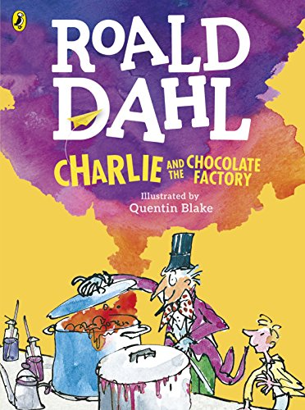
Charlie and the Chocolate Factory
Notes:
Source: Dahl, R. (2016). Charlie and the Chocolate Factory (Colour Edition) (Q. Blake, Illus.). London: Puffin. (Original work published 1964).

Slide 12
Willy Wonka
Mr. Wonka was standing all alone just inside the open gates of the factory. And what an extraordinary little man he was! He had a black top hat on his head. He wore a tailcoat made of a beautiful plum-colored velvet. His trousers were bottle green. His gloves were pearly gray. And in one hand he carried a fine gold-topped walking cane. Covering his chin, there was a small, neat, pointed black beard—a goatee.
And his eyes—his eyes were most marvelously bright. They seemed to be sparkling and twinkling at you all the time. The whole face, in fact, was alight with fun and laughter. And oh, how clever he looked! How quick and sharp and full of life! He kept making quick jerky little movements with his head, cocking it this way and that, and taking everything in with those bright twinkling eyes. He was like a squirrel in the quickness of his movements, like a quick clever old squirrel from the park.
Notes:
Share the following excerpt from the story:
"Mr. Wonka was standing all alone just inside the open gates of the factory. And what an extraordinary little man he was! He had a black top hat on his head. He wore a tailcoat made of a beautiful plum-colored velvet. His trousers were bottle green. His gloves were pearly gray. And in one hand he carried a fine gold-topped walking cane. Covering his chin, there was a small, neat, pointed black beard—a goatee. And his eyes—his eyes were most marvelously bright. They seemed to be sparkling and twinkling at you all the time. The whole face, in fact, was alight with fun and laughter. And oh, how clever he looked! How quick and sharp and full of life! He kept making quick jerky little movements with his head, cocking it this way and that, and taking everything in with those bright twinkling eyes. He was like a squirrel in the quickness of his movements, like a quick clever old squirrel from the park."

Slide 13
Character Descriptions
Read the character description.
Draw a second picture of your group’s character based on the longer, more detailed description.

Slide 14
Augustus Gloop
Notes:
Share the following excerpt from the story:
The very next day, the first Golden Ticket was found. The finder was a boy called Augustus Gloop, and Mr. Bucket's evening newspaper carried a large picture of him on the front page. The picture showed a nine-year-old boy who was so enormously fat he looked as though he had been blown up with a powerful pump. Great flabby folds of fat bulged out from every part of his body, and his face was like a monstrous ball of dough with two small greedy curranty eyes peering out upon the world. The town in which Augustus Gloop lived, the newspaper said, had gone wild with excitement over their hero. Flags were flying from all the windows, children had been given a holiday from school, and a parade was being organized in honor of the famous youth.
“I just knew Augustus would find a Golden Ticket,” his mother had told the newspapermen. “He eats so many bars of chocolate a day that it was almost impossible for him not to find one. Eating is his hobby, you know. That's all he's interested in. But still, that's better than being a hooligan and shooting off zip guns and things like that in his spare time, isn't it? And what I always say is, he wouldn't go on eating like he does unless he needed nourishment, would he? It's all vitamins, anyway. What a thrill it will be for him to visit Mr. Wonka's marvelous factory! We're just as proud as anything!”

Slide 15
Veruca Salt
Notes:
Share the following excerpt from the story:
Suddenly, on the day before Charlie Bucket's birthday, the newspapers announced that the second Golden Ticket had been found. The lucky person was a small girl called Veruca Salt who lived with her rich parents in a great city far away. Once again Mr. Bucket's evening newspaper carried a big picture of the finder. She was sitting between her beaming father and mother in the living room of their house, waving the Golden Ticket above her head, and grinning from ear to ear.
Veruca's father, Mr. Salt, had eagerly explained to the newspapermen exactly how the ticket was found. “You see, boys,” he had said, “as soon as my little girl told me that she simply had to have one of those Golden Tickets, I went out into the town and started buying up all the Wonka bars I could lay my hands on. Thousands of them, I must have bought. Hundreds of thousands! Then I had them loaded on to trucks and sent directly to my own factory. I'm in the peanut business, you see, and I've got about a hundred women working for me over at my place, shelling peanuts for roasting and salting. That's what they do all day long, those women, they sit there shelling peanuts. So I says to them, ‘Okay, girls,’ I says, ‘from now on, you can stop shelling peanuts and start shelling the wrappers off these chocolate bars instead!’ And they did. I had every worker in the place yanking the paper off those bars of chocolate full speed ahead from morning till night.
“But three days went by, and we had no luck. Oh, it was terrible! My little Veruca got more and more upset each day, and every time I went home she would scream at me, ‘Where's my Golden Ticket! I want my Golden Ticket!’ And she would lie for hours on the floor, kicking and yelling in the most disturbing way. Well, I just hated to see my little girl feeling unhappy like that, so I vowed I would keep up the search until I'd got her what she wanted. Then suddenly . . . on the evening of the fourth day, one of my women workers yelled, ‘I've got it! A Golden Ticket!’ And I said, ‘Give it to me, quick!’ and she did, and I rushed it home and gave it to my darling Veruca, and now she's all smiles, and we have a happy home once again.”

Slide 16
Violet Beauregarde
Notes:
Share the following excerpt from the story:
“The third ticket,” read Mr. Bucket, holding the newspaper up close to his face because his eyes were bad and he couldn't afford glasses, “the third ticket was found by a Miss Violet Beauregarde. There was great excitement in the Beauregarde household when our reporter arrived to interview the lucky young lady. [. . .] And the famous girl was standing on a chair in the living room waving the Golden Ticket madly at arm's length as though she were flagging a taxi. She was talking very fast and very loudly to everyone, but it was not easy to hear all that she said because she was chewing so ferociously upon a piece of gum at the same time.
“‘I'm a gum chewer, normally,’ she shouted, ‘but when I heard about these ticket things of Mr. Wonka's, I gave up gum and started on chocolate bars in the hope of striking lucky. Now, of course, I'm back on gum. I just adore gum. I can't do without it. I munch it all day long except for a few minutes at mealtimes when I take it out and stick it behind my ear for safekeeping. To tell you the truth, I simply wouldn't feel comfortable if I didn't have that little wedge of gum to chew on every moment of the day, I really wouldn't. My mother says it's not ladylike and it looks ugly to see a girl's jaws going up and down like mine do all the time, but I don't agree. And who's she to criticize, anyway, because if you ask me, I'd say that her jaws are going up and down almost as much as mine are just from yelling at me every minute of the day.’
“‘Now, Violet,’ Mrs. Beauregarde said from a far corner of the room where she was standing on the piano to avoid being trampled by the mob.
“‘All right, Mother, keep your hair on!’ Miss Beauregarde shouted. ‘And now,’ she went on, turning to the reporters again, ‘it may interest you to know that this piece of gum I'm chewing right at this moment is one I've been working on for over three months solid. That's a record, that is. It's beaten the record held by my best friend, Miss Cornelia Prinzmetel. And was she furious! It's my most treasured possession now, this piece of gum is. At night-time, I just stick it on the end of the bedpost, and it's as good as ever in the mornings—a bit hard at first, maybe, but it soon softens up again after I've given it a few good chews. Before I started chewing for the world record, I used to change my piece of gum once a day. I used to do it in our lift on the way home from school. Why the lift? Because I liked sticking the gooey piece that I'd just finished with on to one of the control buttons. Then the next person who came along and pressed the button got my old gum on the end of his or her finger. Ha-ha! And what a racket they kicked up, some of them. You get the best results with women who have expensive gloves on. Oh yes, I'm thrilled to be going to Mr. Wonka's factory. And I understand that afterwards he's going to give me enough gum to last me for the rest of my whole life. Whoopee! Hooray!’”

Slide 17
Charlie Bucket
Notes:
Share the following excerpt from the story:
Slowly but surely, everybody in the house began to starve.
And every day, little Charlie Bucket, trudging through the snow on his way to school, would have to pass Mr. Willy Wonka's giant chocolate factory. And every day, as he came near to it, he would lift his small pointed nose high in the air and sniff the wonderful sweet smell of melting chocolate. Sometimes, he would stand motionless outside the gates for several minutes on end, taking deep swallowing breaths as though he were trying to eat the smell itself.
[. . .]
And every day, Charlie Bucket grew thinner and thinner. His face became frighteningly white and pinched. The skin was drawn so tightly over the cheeks that you could see the shapes of the bones underneath. It seemed doubtful whether he could go on much longer like this without becoming dangerously ill.
And now, very calmly, with that curious wisdom that seems to come so often to small children in times of hardship, he began to make little changes here and there in some of the things that he did, so as to save his strength. In the mornings, he left the house ten minutes earlier so that he could walk slowly to school, without ever having to run. He sat quietly in the classroom during break, resting himself, while the others rushed outdoors and threw snowballs and wrestled in the snow. Everything he did now, he did slowly and carefully, to prevent exhaustion.

Slide 18
Essential Question
How do effective writers help readers paint pictures in their minds?

Slide 19
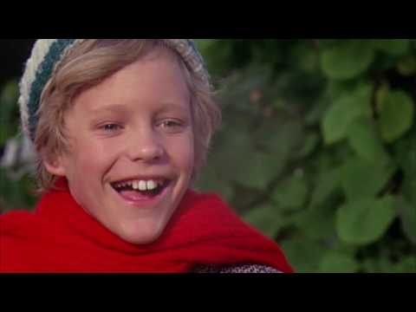
Notes:
How is the way Willy Wonka is depicted in this scene different from how he is depicted in the story?
Source: Stuart, M. (Director), & Husak, T. (Adapter). (2016, September 3). Willy Wonka and the Chocolate Factory [Video file]. https://www.youtube.com/watch?v=qsgQvZOBhEY

Slide 20
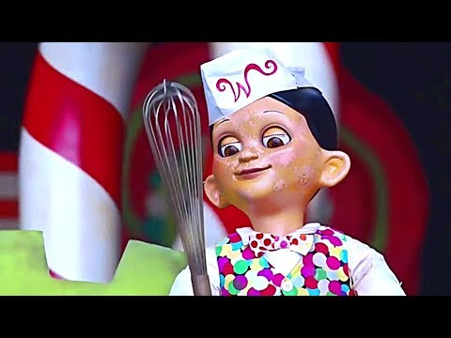
Notes:
How is the way Willy Wonka is depicted in this scene different from how he is depicted in the story and in Mel Stuart's theatrical version?
Source: Burton, T. (Director), & Wonka, W. (Adapter). (2015, September 3). Charlie and the Chocolate Factory [Video file]. https://www.youtube.com/watch?v=a_FiuHOiJiY

Slide 21
Character Depictions
Watch video clips of each character from the movies:
Willy Wonka and the Chocolate Factory
Charlie and the Chocolate Factory
How do the directors of each movie depict the characters differently from how Roald Dahl described them and how you imagined them?

Slide 22
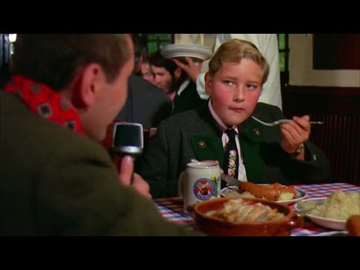
Notes:
Source: Stuart, M. (Director), & Random Youtube Videos (Adapter). (2017, May 20). Willy Wonka and the Chocolate Factory [Video file] https://youtu.be/_qnEBe33ag0

Slide 23
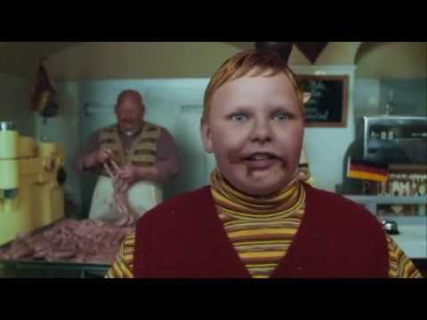
Notes:
Source: Burton, T. (Director), & Zoo, A. (Adapter). (2014, December 16). Charlie and the Chocolate Factory [Video file]. https://youtu.be/FHKOkVVyAVM

Slide 24
Augustus Gloop
How do the directors of the two movies depict Augustus differently from how Roald Dahl described him and how you imagined him?

Slide 25
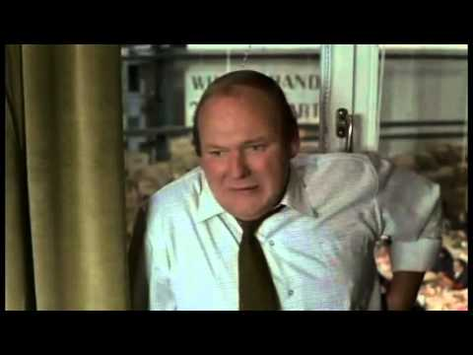
Notes:
Source: Stuart, M. (Director), & Thugboat Woo Woo (Adapter). (2014, March 16). Willy Wonka and the Chocolate Factory [Video file]. https://youtu.be/b9mba2qb9do

Slide 26
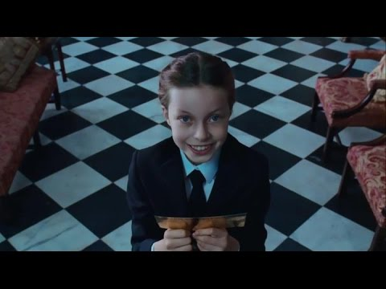
Notes:
Source: Burton, T. (Director), & Zoo, A. (Adapter). (2014, December 18). Charlie and the Chocolate Factory [Video file]. https://youtu.be/9_s-OrWz_Z8

Slide 27
Veruca Salt
How do the directors of the two movies depict Veruca differently from how Roald Dahl described her and how you imagined her?

Slide 28
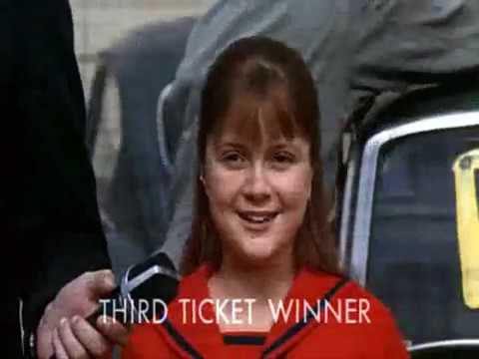
Notes:
Source: Stuart, M. (Director), & Beauregarde, V. (Adapter). (2016, August 8). Willy Wonka and the Chocolate Factory [Video file]. https://www.youtube.com/watch?v=BIXGhUlSBEY

Slide 29
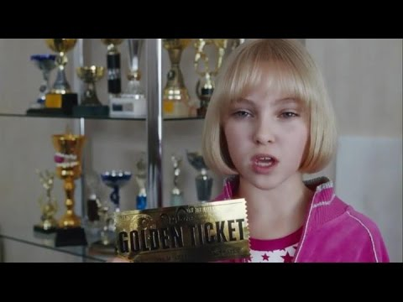
Notes:
Source: Burton, T. (Director), & Zoo, A. (Adapter). (2014, December 18). Charlie and the Chocolate Factory [Video file]. https://youtu.be/SS9UYJSOJDE

Slide 30
Violet Beauregarde
How do the directors of the two movies depict Violet differently from how Roald Dahl described her and how you imagined her?

Slide 31
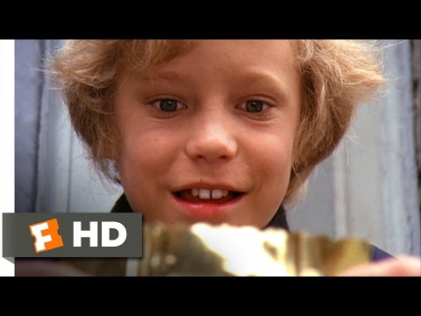
Notes:
Source: Stuart, M. (Director), & Movieclips (Adapter). (2016, December 29). Willy Wonka and the Chocolate Factory [Video file]. https://youtu.be/1Fxq_n8e1qA

Slide 32
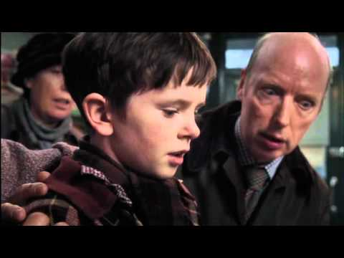
Notes:
Source: Burton, T. (Director), & Camilie39 (Adapter). (2015, November 1). Charlie and the Chocolate Factory [Video file]. https://youtu.be/KR8PscR6N2s

Slide 33
Charlie Bucket
How do the directors of the two movies depict Charlie differently from how Roald Dahl described him and how you imagined him?

Slide 34
Revise Your Writing
Choose one of your character descriptions from your narrative writing.
Make revisions to your character description that will provide more detail.

Slide 35
Share Your Revisions
With your partner, decide who will be Partner A and who will be Partner B.

Slide 36
Partner A
Share your original character description with your partner.
Partner B will draw a quick sketch based on this description.

Slide 37
Partner B
Share your original character description with your partner.
Partner A will draw a quick sketch based on this description.

Slide 38
Partner A
Share your new character description with your partner.
Partner B will draw a quick sketch based on this revised description.

Slide 39
Partner B
Share your new character description with your partner.
Partner A will draw a quick sketch based on this revised description.

Slide 40
Essential Question
How do effective writers help readers paint pictures in their minds?

