Slide 2
Ad Nauseam
Health and Media Literacy: Advertising Practices in the Tobacco Industry

Slide 3
Essential Questions
How can media influence my choice to use or not to use tobacco?
How can I manage the influence of advertising for tobacco and electronic smoking devices (ESDs)?

Slide 4
Lesson Objectives
Identify and describe specific advertising strategies that target children, teens, and young adults.
Create an anti-tobacco ad campaign.

Slide 5
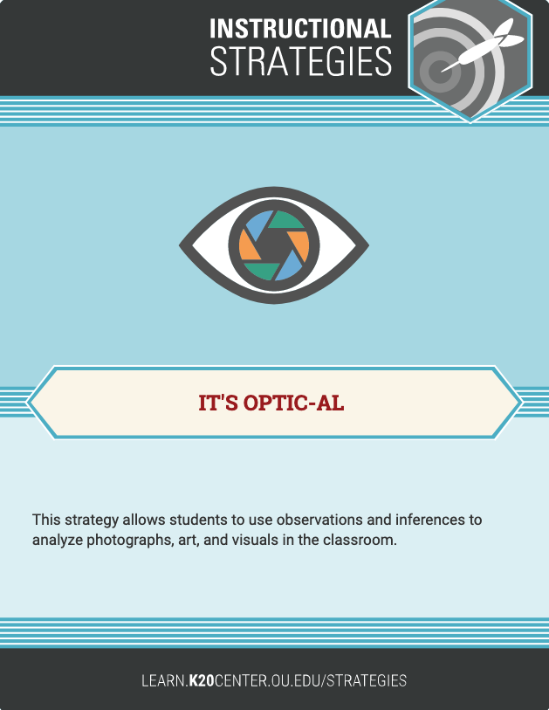
Vintage Tobacco Ads
O = Overview
P = Parts
T = Title/text
I = Interrelationships
C = Conclusions
Notes:
Use the following link for examples of vintage tobacco marketing (and ask students to focus on the images in the ads, not the text):
https://allthatsinteresting.com/vintage-cigarette-ads

Slide 6
Current Tobacco/ESD Ads
O = Overview
P = Parts
T = Title/text
I = Interrelationships
C = Conclusions
Notes:
Use the following links for examples of current tobacco/ESD marketing (and ask students to focus on the images in the ads, not the text):
https://www.smithsonianmag.com/history/electronic-cigarettes-millennial-appeal-ushers-next-generation-nicotine-addicts-180968747/
https://www.vox.com/2019/1/25/18194953/vape-juul-e-cigarette-marketing
http://tobacco.stanford.edu/tobacco_main/publications/JUUL_Marketing_Stanford.pdf

Slide 7
Advertising and Teens
As you read the assigned articles, consider these questions:
How do advertisers make electronic smoking devices (ESDs) appealing?
How would you describe the types of people whom these ads target?

Slide 8
4-2-1
Independently, find the four (4) most important ideas in the text.
In pairs, compare ideas and agree on the two (2) most important ideas.
In groups of four, determine the single (1) most important idea in the text.
Notes:
Use the following two websites for the 4-2-1 activity:
https://www.smithsonianmag.com/history/electronic-cigarettes-millennial-appeal-ushers-next-generation-nicotine-addicts-180968747/
https://www.vox.com/2019/1/25/18194953/vape-juul-e-cigarette-marketing

Slide 9
Facts From the CDC
Notes:
Use these two sets of information for the Stop and Jot activity or the CUS and Discuss activity:
https://www.cdc.gov/vitalsigns/pdf/2016-01-vitalsigns.pdf
https://www.cdc.gov/tobacco/data_statistics/fact_sheets/youth_data/tobacco_use/
Image source:
United States Department of Health and Human Services. (n.d.). Centers for Disease Control and Prevention logo [Image]. Wikimedia Commons. https://commons.wikimedia.org/wiki/File:US_CDC_logo.svg

Slide 10
Stop and Jot
As you read, stop at the end of each paragraph to jot down the main ideas.
Repeat this process for each paragraph.
Once you have finished, share your ideas with the same partner you worked with in the previous activity.
Notes:
https://www.cdc.gov/vitalsigns/pdf/2016-01-vitalsigns.pdf
https://www.cdc.gov/tobacco/data_statistics/fact_sheets/youth_data/tobacco_use/

Slide 11
CUS and Discuss
As you read, do the following:
Circle new words.
Underline any details that support the main idea.
Star the main idea.
Once you have finished, discuss what you did with the same partner you worked with in the previous activity.
Notes:
https://www.cdc.gov/vitalsigns/pdf/2016-01-vitalsigns.pdf
https://www.cdc.gov/tobacco/data_statistics/fact_sheets/youth_data/tobacco_use/

Slide 12
Using Facts From the CDC
How does the information from the CDC readings apply to tobacco/ESD companies’ focus on teen audiences?
Why do these companies target teen audiences?

Slide 13
Deconstructing an Advertisement
Notes:
Pass out and review the Deconstructing an Advertisement handout.
Image source:
PNGkey. (n.d.). Burger with layers [Image]. PNGkey. https://www.pngkey.com/detail/u2y3w7q8r5y3e6o0_king-hamburger-food-fries-fizzy-fast-burger-burgers/

Slide 14
Deconstructing an Advertisement, Part 1
Make observations about the ad. Evaluate the aesthetics.
Look at the people.
Think about gender, race, class, age, facial expressions, etc.
Look at the colors used.
Bright and colorful? Dim and dark? Black and white? Contrasting?
Look at the text.
Think about font, size, color, large text vs. small text, etc.

Slide 15
Deconstructing an Advertisement, Part 2
Establish the ad’s purpose. What product or idea is it promoting?
Who paid for the ad?
Is this clear or hidden?
Who is the target audience?
Children? Teens? Adults? Elderly people?
What feelings or ideas are associated with the product?
Think about values and lifestyle.

Slide 16
Deconstructing an Advertisement, Part 3
Determine the message the ad sends. What assumptions and connections are made?
How does the ad portray people of different backgrounds?
Is it realistic? Does it reinforce stereotypes or challenge them?
Is the information accurate and fair?
Is it biased or balanced?
Is there any subtext?
Look for any underlying messages that are not stated explicitly.

Slide 17
Deconstructing an Advertisement, Part 4
What are possible consequences of the ad’s message? Explain short- and long-term effects.
Consider possible outcomes.
Does the ad create unrealistic expectations?
Is it socially responsible?
Is it glamorizing a particular lifestyle or choice?
These are not the only possible outcomes.

Slide 18
Essential Questions
How can media influence my choice to use or not to use tobacco?
How can I manage the influence of advertising for tobacco and ESDs?

Slide 19
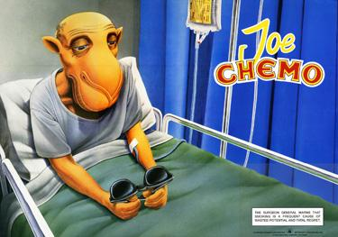
Anti-Smoking Campaigns
Notes:
Example 1 of a parody ad (“Joe Chemo”) compared with a real ad (“Joe Camel”).
Ad 1: Adbusters. (2001). Joe Chemo [Image]. Stanford University Research into the Impact of Tobacco Advertising. http://tobacco.stanford.edu/tobacco_main/images_anti.php?token2=fm_anti_st323.php&token1=fm_anti_img12236.php&theme_file=fm_anti_mt002.php&theme_name=Ad%20Knockoffs&subtheme_name=Camel%20Knockoffs
Ad 2: Camel. (1991). Joe Camel [Image]. Stanford University Research into the Impact of Tobacco Advertising. http://tobacco.stanford.edu/tobacco_main/images_body.php?token1=fm_tn_img10237.php#

Slide 20
Anti-Smoking Campaigns
Notes:
Example 2 of a parody ad (“Utter Fool”) compared with a real ad (“Naturally Kool”).
Ad 1: Tobaccofree.org. (1991). Utter fool [Image]. Stanford University Research into the Impact of Tobacco Advertising. http://tobacco.stanford.edu/tobacco_main/images_anti.php?token2=fm_anti_st324.php&token1=fm_anti_img12252.php&theme_file=fm_anti_mt002.php&theme_name=Ad%20Knockoffs&subtheme_name=Kool%20Knockoffs
Ad 2: Kool. (1990). Naturally kool [Image]. Stanford University Research into the Impact of Tobacco Advertising. http://tobacco.stanford.edu/tobacco_main/images-comp.php?token2=fm_tn_st290.php&token1=fm_tn_img9746.php&theme_file=fm_tn_mt037.php&theme_name=Anti-Smoking%20vs.%20Smoking&subtheme_name=Anti-Smoking%20vs.%20Smoking%20Ads

Slide 21
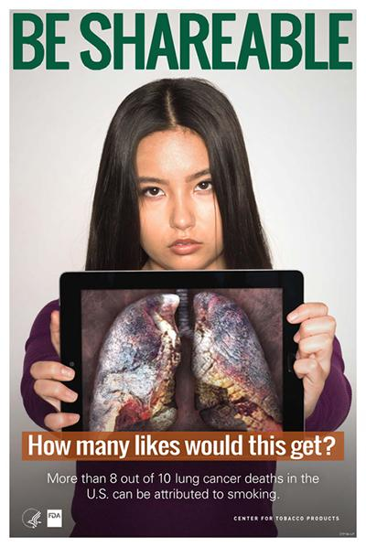
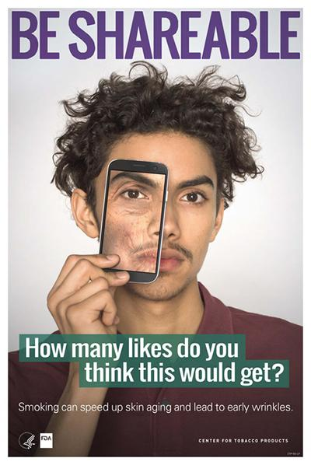
Anti-Smoking Campaigns
Notes:
Example of an anti-smoking campaign with multiple ads. The text on the ads reads as follows: “Be shareable. How many likes do you think this would get?”
U.S. Food and Drug Administration. (n.d.). Be shareable: How many likes do you think this would get? [Images]. Center for Tobacco Products Exchange Lab. https://digitalmedia.hhs.gov/tobacco/print_materials/search?audience=Youth&page=3

Slide 22
Anti-Smoking Campaigns
Notes:
The text on the ad reads as follows: “Urea is found in cigarettes. Urea is also found in cat pee. What? I used the litter box.”
Truth Initiative. (n.d.). Urea [Image]. Stanford University Research into the Impact of Tobacco Advertising. http://tobacco.stanford.edu/tobacco_main/images_anti.php?token2=fm_anti_st379.php&token1=fm_anti_img12493.php&theme_file=fm_anti_mt028.php&theme_name=Specifics%20Groups&subtheme_name=Teens

Slide 23
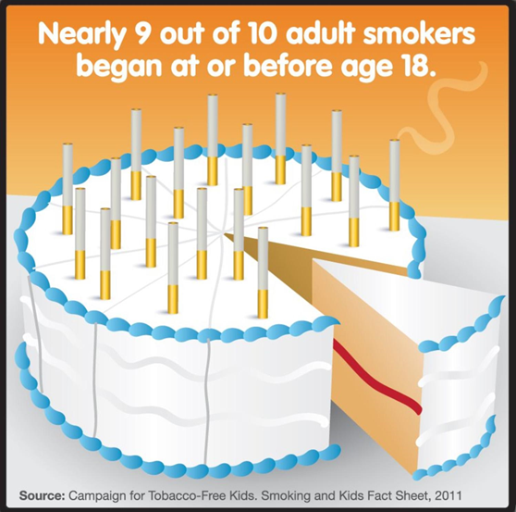
Anti-Smoking Campaigns
Notes:
The text on the ad reads as follows: “Nearly 9 out of 10 adult smokers began at or before age 18.”
Tobacco Free Florida. (2011). Smoking and kids [Image]. Stanford University Research into the Impact of Tobacco Advertising. http://tobacco.stanford.edu/tobacco_main/images_anti.php?token2=fm_anti_st355.php&token1=fm_anti_img12469.php&theme_file=fm_anti_mt012.php&theme_name=Facts%20&%20Figures&subtheme_name=Curious%20Facts

Slide 24
Anti-Tobacco Campaigns
Notes:
The text on the ad reads as follows: “The first warning sign of cancer is believing that smokeless tobacco will not leave a mark on your life. It’s deadly. Don’t spit. Quit.”
Alabama Department of Public Health. (n.d.). The first warning sign of cancer [Image]. Stanford University Research into the Impact of Tobacco Advertising. http://tobacco.stanford.edu/tobacco_main/images_anti.php?token2=fm_anti_st441.php&token1=fm_anti_img14914.php&theme_file=fm_anti_mt021.php&theme_name=Anti-Chew&subtheme_name=Anti-Chew

Slide 25
Create Your Own
To make your advertisement, explore these project options or cut and paste pictures from magazines!
Venngage
Infogram
Easelly
Bannersnack/Creatopy
Piktochart
Notes:
Pass out and review the Anti-Tobacco Ad Campaign handout.

