Slide 2
Is Pizza Epic?
7th and 8th Grade ELA

Slide 3
Essential Question
How can word choice affect communication?

Slide 4
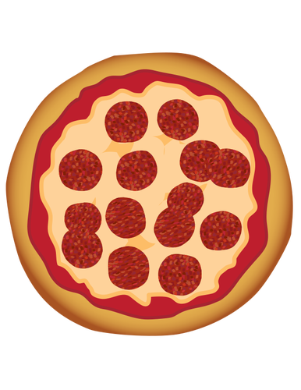
Matching Challenge: Part 1
Get into groups of 2 or 3.
With your partner(s), take 5 minutes to look through Matching Set #1, and match each image with the definition that most closely matches it.

Slide 5
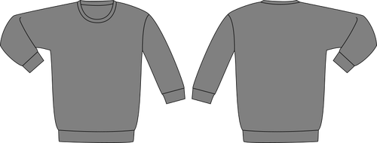
Matching Challenge: Part 1
Which definitions did you choose for each image?
How did you choose which definition went with each image?

Slide 6

Matching Challenge: Part 2
You will be doing another round of matching, this time with new definitions.
With your partner(s), look through Matching Set #2, and match each image with the definition that most closely matches it.

Slide 7

Matching Challenge: Part 2
Which definitions did you choose for each image?
How did you choose which definition went with each image?
In which round were you able to find a description for each image more quickly? Why?

Slide 8
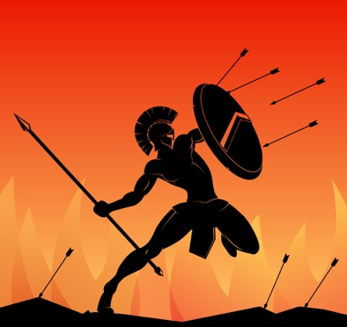
Epic
relating to a long poem, typically one derived from ancient oral tradition, narrating the deeds and adventures of heroic or legendary figures or the history of a nation
Notes:
Photo courtesy of Freepik: https://www.freepik.com/free-vector/silhouette-spartan-warrior-with-javelin_3272121.htm#query=greek&position=40

Slide 9
Look at Your Handout, and Consider…
Why does precision in word choice matter?
For what audience would you be particularly careful about your word choice?
For what purpose would you be particularly careful about your word choice?

Slide 10
Turn Over Your Handout, and…
Write 4 misused/overused words and phrases.
For each word/phrase, write the “problem” with the word choice in the “Consider That” column and alternatives to the word or phrase in the “Consider Using” column.
Think about using sites like Thesaurus.com and Dictionary.com.
Notes:
Photo courtesy of Freepik: https://www.freepik.com/free-photo/copy-space-light-bulb_7797972.htm#page=2&query=light+bulb&position=7

Slide 11
Claim, Evidence, and Reasoning (CER)
With your group:
Write a claim about which word or phrase should be reconsidered due to overuse or misuse.
Back up the claim with evidence (from the “Consider That” and “Consider Using” columns).
Support the evidence with reasoning. (Why do the alternatives for this word or phrase more appropriately suit a particular purpose or audience?)

Slide 12
Yes, Because…
Line up in 2 even rows facing each other.
Each pair will refer to the handouts as we move down the line.
Partner 1 tells us about a word we should reconsider using.
Partner 2 says, “Yes, because…”, and proceeds to explain why.

