Slide 2
More than Meets the Eye
Direct and Indirect Characterization

Slide 3
Take Note!
How does the passage describe the person?
How would you describe this person?

Slide 4
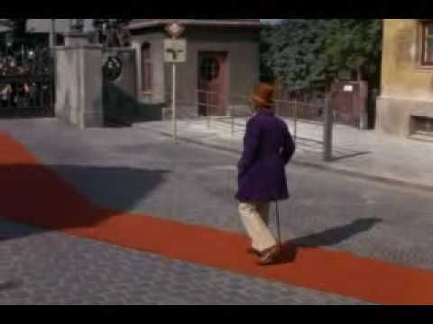
Notes:
Jobned1. (2009, June 16). Wonka's Grand Entrance [Video]. YouTube. Retrieved July 24, 2020, from https://www.youtube.com/watch?v=sz9jc5blzRM

Slide 5
Essential Question
How do authors add layers of complexity to a character’s identity?

Slide 6
Lesson Objectives
Identify direct and indirect characterization in texts.
Write a character description using information gathered from various sources.

Slide 7

Think-Pair-Share
What can a person conclude by just looking at a person and seeing how they are dressed?
What else could someone discern about your personality by looking at you?

Slide 8
Think-Pair-Share
Is it fair for someone to make a judgement about a character based on what they can see?

Slide 9
Think-Pair-Share
In addition to physical characteristics, what other information can provide details about someone’s character?

Slide 10
Think-Pair-Share
What does the phrase “more than meets the eye” mean?
How does this phrase apply to understanding facets of someone’s character?

Slide 11
Think-Pair-Share
What does it mean to discern elements of someone’s character using context clues?
How is that different from understanding a person based on just seeing them?

Slide 12
Direct Characterization
Tells us specifically what a character is like

Slide 13
Indirect Characterization
Shows facets of a character through various context clues
The author does not directly tell us these things. We infer them based on analyzing how characters speak, how they look, how they act toward other characters, and how other characters act toward them.

Slide 14
Charlie and the Chocolate Factory
The Four Rotten Children

Slide 15
Essential Question
How do authors add layers of complexity to a character’s identity?

Slide 16

Pass the Picture
In your small group, take turns passing the picture around and adding examples of:
Direct and indirect characterization.
New details about the character.

Slide 17
Essential Question
How do authors add layers of complexity to a character’s identity?

