Slide 2
“The Lady, or the Tiger?”
Which Would You Choose?
Internal & External Conflict

Slide 3
Learning Objectives
Summarize a story in your own words.
Identify a story’s external conflict through plot and setting.
Identify characters’ motivations and internal conflicts.
Use textual evidence to determine your own ending to a story.
Notes:
Read aloud

Slide 4
Essential Questions
How do readers use characterization, internal conflict, and external conflict to draw conclusions about a story?
How do readers use textual evidence to draw conclusions and determine the author’s purpose for writing a story?
Notes:
Read aloud

Slide 5

Magnetic Statements
Choose one statement that either “attracts” or “repels” you.
Move to that statement.
Discuss the statement with others in the group.
Notes:
Use these as directions with the teacher narrative.

Slide 6
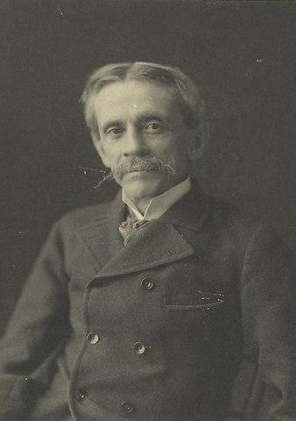
“The Lady, or the Tiger” Story Preview
Written in 1882 by Frank R. Stockton
Written for a magazine
Stockton wrote many fairy tales
Notes:
Image Source:
New York Public Library. (2013, Feb. 8). Frank R. Stockton. Wikimedia Commons. https://commons.wikimedia.org/w/index.php?curid=24515955

Slide 7
Partner work
With your partner:
Read through the story again.
Circle the main ideas.
Create a summary of the story using 20 words or fewer.
CUS
Discuss

Slide 8

Setting
What do the words “amphitheater,” “arena,” “gladiators,” “tribunal,” and “galleries” tell you about the setting?
Who are the king’s “Latin neighbors”?
In what time period would you guess the story is placed?
Notes:
All of these clues in the story point to the time of the Roman empire or shortly after its fall in 500 AD.

Slide 9

Character Analysis
Work with your partner to:
Determine the personality of each character
Support your conclusions with textual evidence from the story

Slide 10
Character Analysis of the King
Personality Traits
Textual Evidence
Notes:
Select information from student volunteers

Slide 11
Character Analysis of the Princess
Personality Traits
Textual Evidence
Notes:
Select information from student volunteers

Slide 12
Character Analysis of the Courtier
Personality Traits
Textual Evidence
Notes:
Select information from student volunteers

Slide 13
External Conflict
Definition: In an external conflict, a character is struggling against another character, the natural world, or society.
What is the external conflict in this story?
Notes:
LitCharts. (n.d.). External conflict [Definition]. https://www.litcharts.com/literary-devices-and-terms/external-conflict

Slide 14
Internal Conflict
Definition: Internal conflict is when a character experiences two opposite emotions–usually vice and virtue, good and evil–inside him.
Who has the most internal conflict in the story?
What is the internal conflict?
Notes:
Literary Devices. (n.d.). Conflict [Definition]. https://literarydevices.net/conflict/

Slide 15

Claim, Evidence, Reasoning
As the reader, which door do you believe the courtier opened?
Claim: The door the courtier opened.
Evidence: Any textual evidence that supports this claim.
Reasoning: Why you believe the princess chose that door and how the evidence supports this belief.

Slide 16
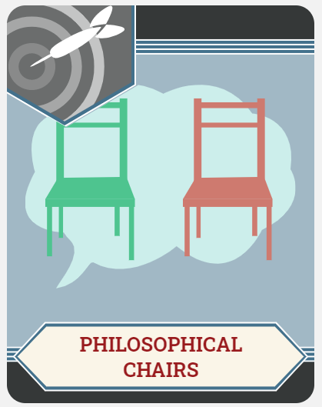
Philosophical Chairs Debate: Which Door?
Choose your side of the room.
Read through your CER statements and be prepared to discuss.
When called upon, share your viewpoint.

Slide 17
Essential Question
What is the author’s purpose for writing this story?
Why does the author ask the reader to determine the ending?

Slide 18
Which Theme Best Fits the Story?
Vote for one:
Humans are basically good.
Humans have a capacity for great evil and violence.
Jealousy can cause people to act cruelly.
True love is unselfish.
In extreme situations, it is impossible to make good decisions.
Family bonds are stronger than other relationships.

