Slide 2
ACTIVATE!
Through Movement, Games, and Activities
Notes:
Introduction, agenda, and instructional strategy note sheet (to be filled out after each instructional strategy and activity completed.
Engaging students authentically
Hooking students into learning
Activate student learning
The Hook

Slide 3
Four Corners
Which of these is a possible outcome of active student engagement?
Increased Student Attendance
Increased Student Performance and Learning
Increased Positive Behavior and Participation
Other Outcomes
Notes:
Research has established a strong relationship between student engagement and student achievement. Students, who are actively engaged in learning, do increase their own learning (Hattie, 2009).
Jenson, E. (2009). Teaching with Poverty in Mind.
If the conversation does not naturally evolve into the CLIMATE of the school or classroom then mention how might these affect the climate of the school and classroom.

Slide 4
Instructional Strategy Note Sheet
Notes:
Inform participants that several new instructional strategies will be introduced to them throughout the session. These strategies are tools to support higher-order thinking in an authentic way. Encourage participants to use their strategies notes sheet to jot down ideas for how they would personalize a strategy to be a tool in their classroom. Once all the new strategies are modeled, the presentation will allow time to reflect on how to use the strategies.

Slide 5
Today we will . . .
Participate in a lesson incorporating movement and academic games/activities.
Identify the benefits of actively engaging students.
Create a resource to link specific tools to Marzano’s Design Question 5 of the TLE.
Notes:
These objectives will provide a road map of where you will go together during the session and let participants know what to expect from the session.

Slide 6
ABC Graffiti
What does active engagement look like in the classroom?
Work in small groups to brainstorm words that connect to the following question.
Be prepared to move after time is called. You will only need the marker provided.
Round 1
Round 2
Round 3
Notes:
Optional Spin to Create a Game: Round 1 (has to start with the letter) how many alphabet letters did you write something down for?
Round 2 how many letters did you add to the previous list?
Round 3 how many letters did you add this time?
Examples of words/phrases that might be written:
Activate learning
Bringing forth prior knowledge
Collaboration/Construction of new knowledge
Discourse/Developing new knowledge
Grapple with new ideas
Ownership of learning
Prior Knowledge
Teacher facilitates and monitors
ZONE (students in the learning zone)

Slide 7
What does active engagement look like in the classroom?
Round 1
Round 2
Round 3
In your small group, generate words or phrases related to the topic for each letter of the alphabet.
Rotate to the next group and read through their list. Begin to add words to the letters that have not already used in their alphabet.
Before you begin this round, read the provided text.
Then, use ideas from the text to further expand your list.
Notes:
Game: Round 1 (has to start with the letter) how many alphabet letters did you have an idea for?
Round 2 how many letters did you add to the previous list?
Round 3 how many letters did you add this time?
After third round move back to original seats and look over your list.

Slide 8
Summary Statement Synthesis
Reflect on your ABC list.
As a group, write a statement that summarizes and synthesizes the information.
Reflecting on the summary statement and information from the ABC list, explain how the information gained might impact your teaching (style, planning, content, etc.), students (learning, interest, etc.), and overall classroom climate.

Slide 9
Notes:
Briefly share this info… Evaluations look for the inclusion of movement, games and activities.
Principals and administrators use the Design Questions as a guide to evaluate teacher performance. Under DQ 5, component numbers 25 and 27 both focus on games and movement during the lesson (not only used for reviews). Games/activities and movement do impact and support the other facets of DQ 5 because when students are actively engaged in the their learning, they are more likely to make personal connections to the new concepts/ideas. Activities should intentionally activate prior knowledge; thus, supporting the other Design Questions.

Slide 10
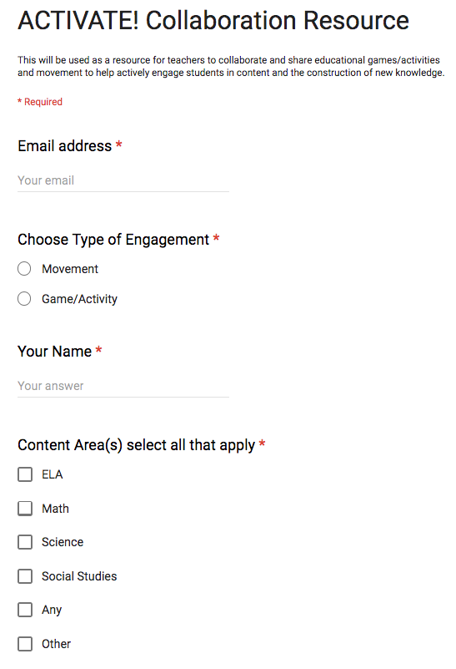
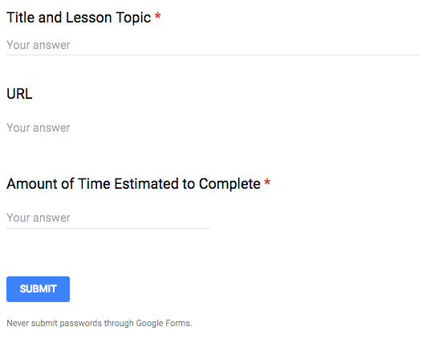
Google Form
Example
Notes:
After some people have begun to submit entries, press the “Responses” button on the online Google Form and show them how they can view the information submitted.

Slide 11
Collaborate!!! What movement and activities/games do you use in your classroom to actively engage students?
Follow the link below to the Google Forms and begin adding your ideas.
Shortened Link Here
Notes:
Extend: Allow participants to spend time adding ideas to the Google doc. Then, after about 15 mins, show the Google doc on the screen. If time allows, have one or two people share what they wrote. These may be content specific, but there also may be some that can be used cross-curricular with few modifications.
After some people have begun to submit entries, press the “Responses” button on the online Google Form and show them how they can view the information submitted.
PRIOR TO PRESENTATION, PRESENTER MUST . . .
You can use this link to make a copy of the form - https://docs.google.com/forms/d/1znZToQ3yoo2mz2huR2S1A-U1x4DDn_3fK-nhbRbCGiI/edit?usp=sharing
Presenter MUST make copy and edit PowerPoint with new link before each presentation. If using a bit.ly or bit.do, double check that it still working and has not been corrupted before each use.
Data can be accessed by anyone who has the link.
Special Note: If participants want access to the spreadsheet, then presenter will have to export the data and then share the new link for the spreadsheet.
INFORMATION NEEDED BY EACH PARTICIPANT:
Your email and name
Title of activity/lesson topic or standard
URL link
Estimated time needed to complete

Slide 12
Reflect…
How might this topic and activities explored today impact your teaching, student engagement, and overall class climate?
Notes:
While they take the evaluation, let them know that spreadsheet will be sent to your site facilitator (or principal, liaison, etc.) and that the site facilitator will share the link with the whole staff.
If you have means to share the spreadsheet link immediately, then allow time for participants to review some of the submitted responses.

Slide 13
3-2-1 Follow Up
Please reflect and write out the following on a scratch sheet of paper. Be prepared to share out your thoughts.
3 things that you are willing to try.
2 people who might be a resource or collaboration team for you. These might be the people you run new ideas by and get feedback from.
1 fear or struggle you might have with implementing movement, games, or activities with your students.
Notes:
Evaluate: Is there three different lessons you are willing to try one of these activities with or is there another idea you have to engage and hook students while activating prior knowledge?
If you did not have TREK evaluation please use the 3-2-1 as your evaluation tool for the session. It will allow participants to reflect on their learning from the session. If there was a TREK evaluation use this as the Reflection for the PD follow up session. This will create great conversation and guide for looking at the data/information submitted to the Google Form.

