Slide 2
Mind-Crafting Robotics Through LEGO® Mindstorms
An Introduction

Slide 3
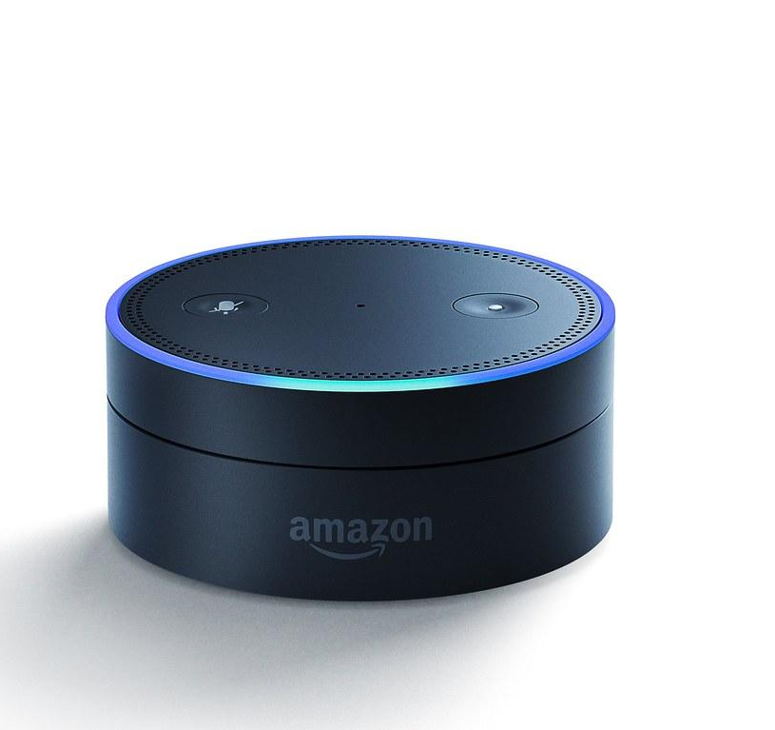
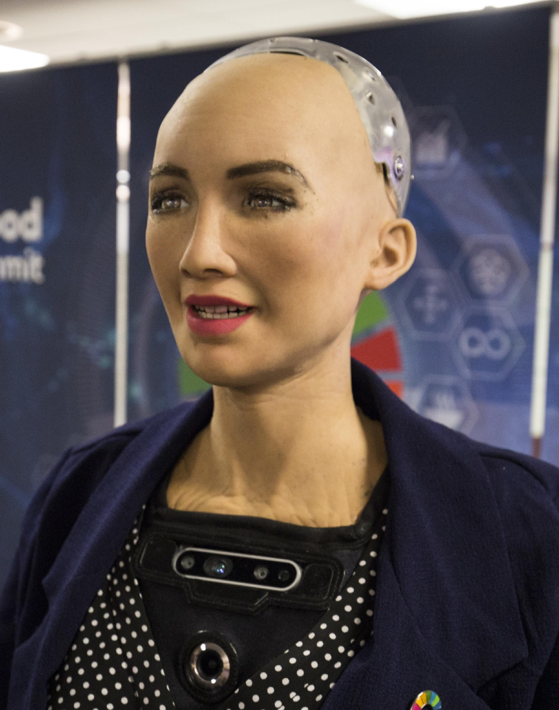
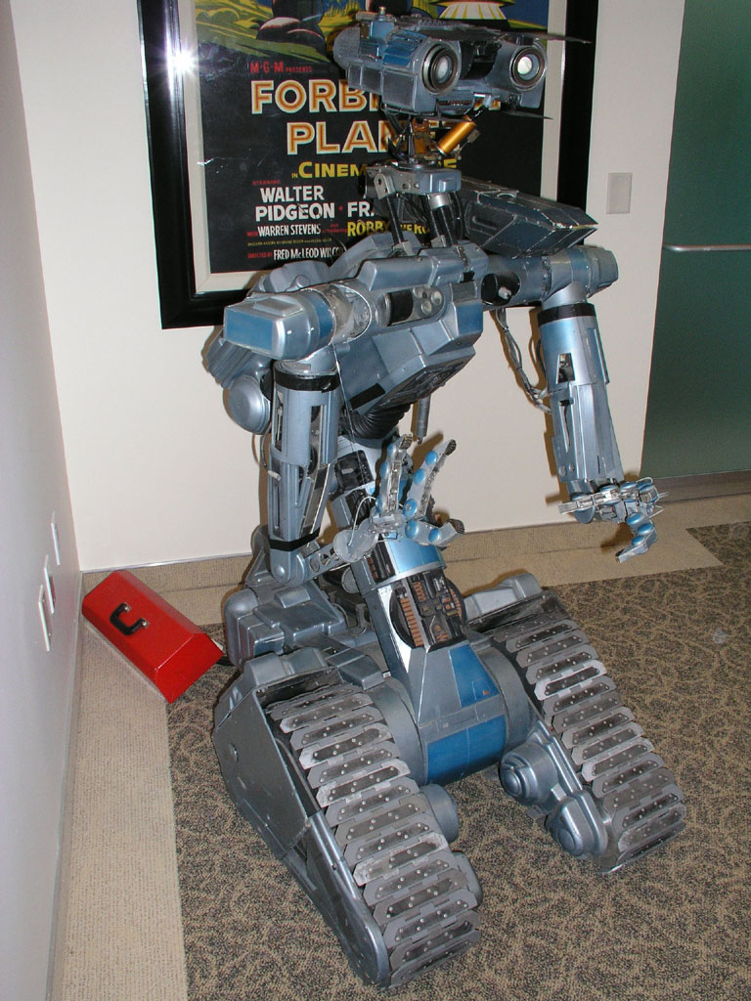
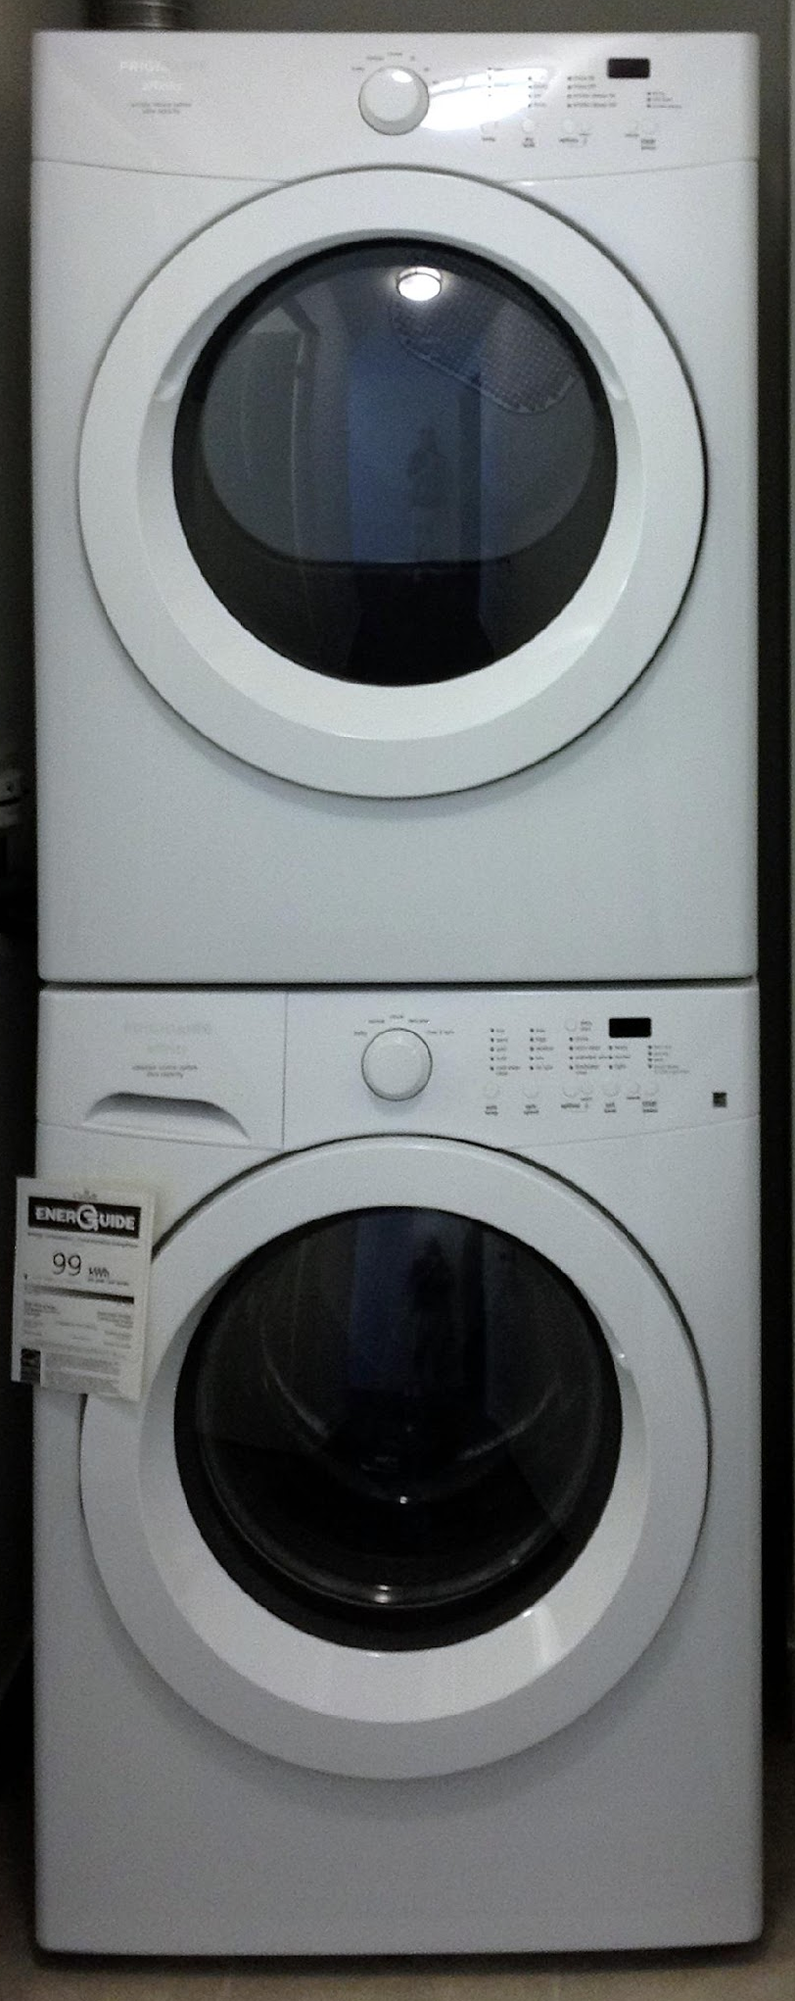

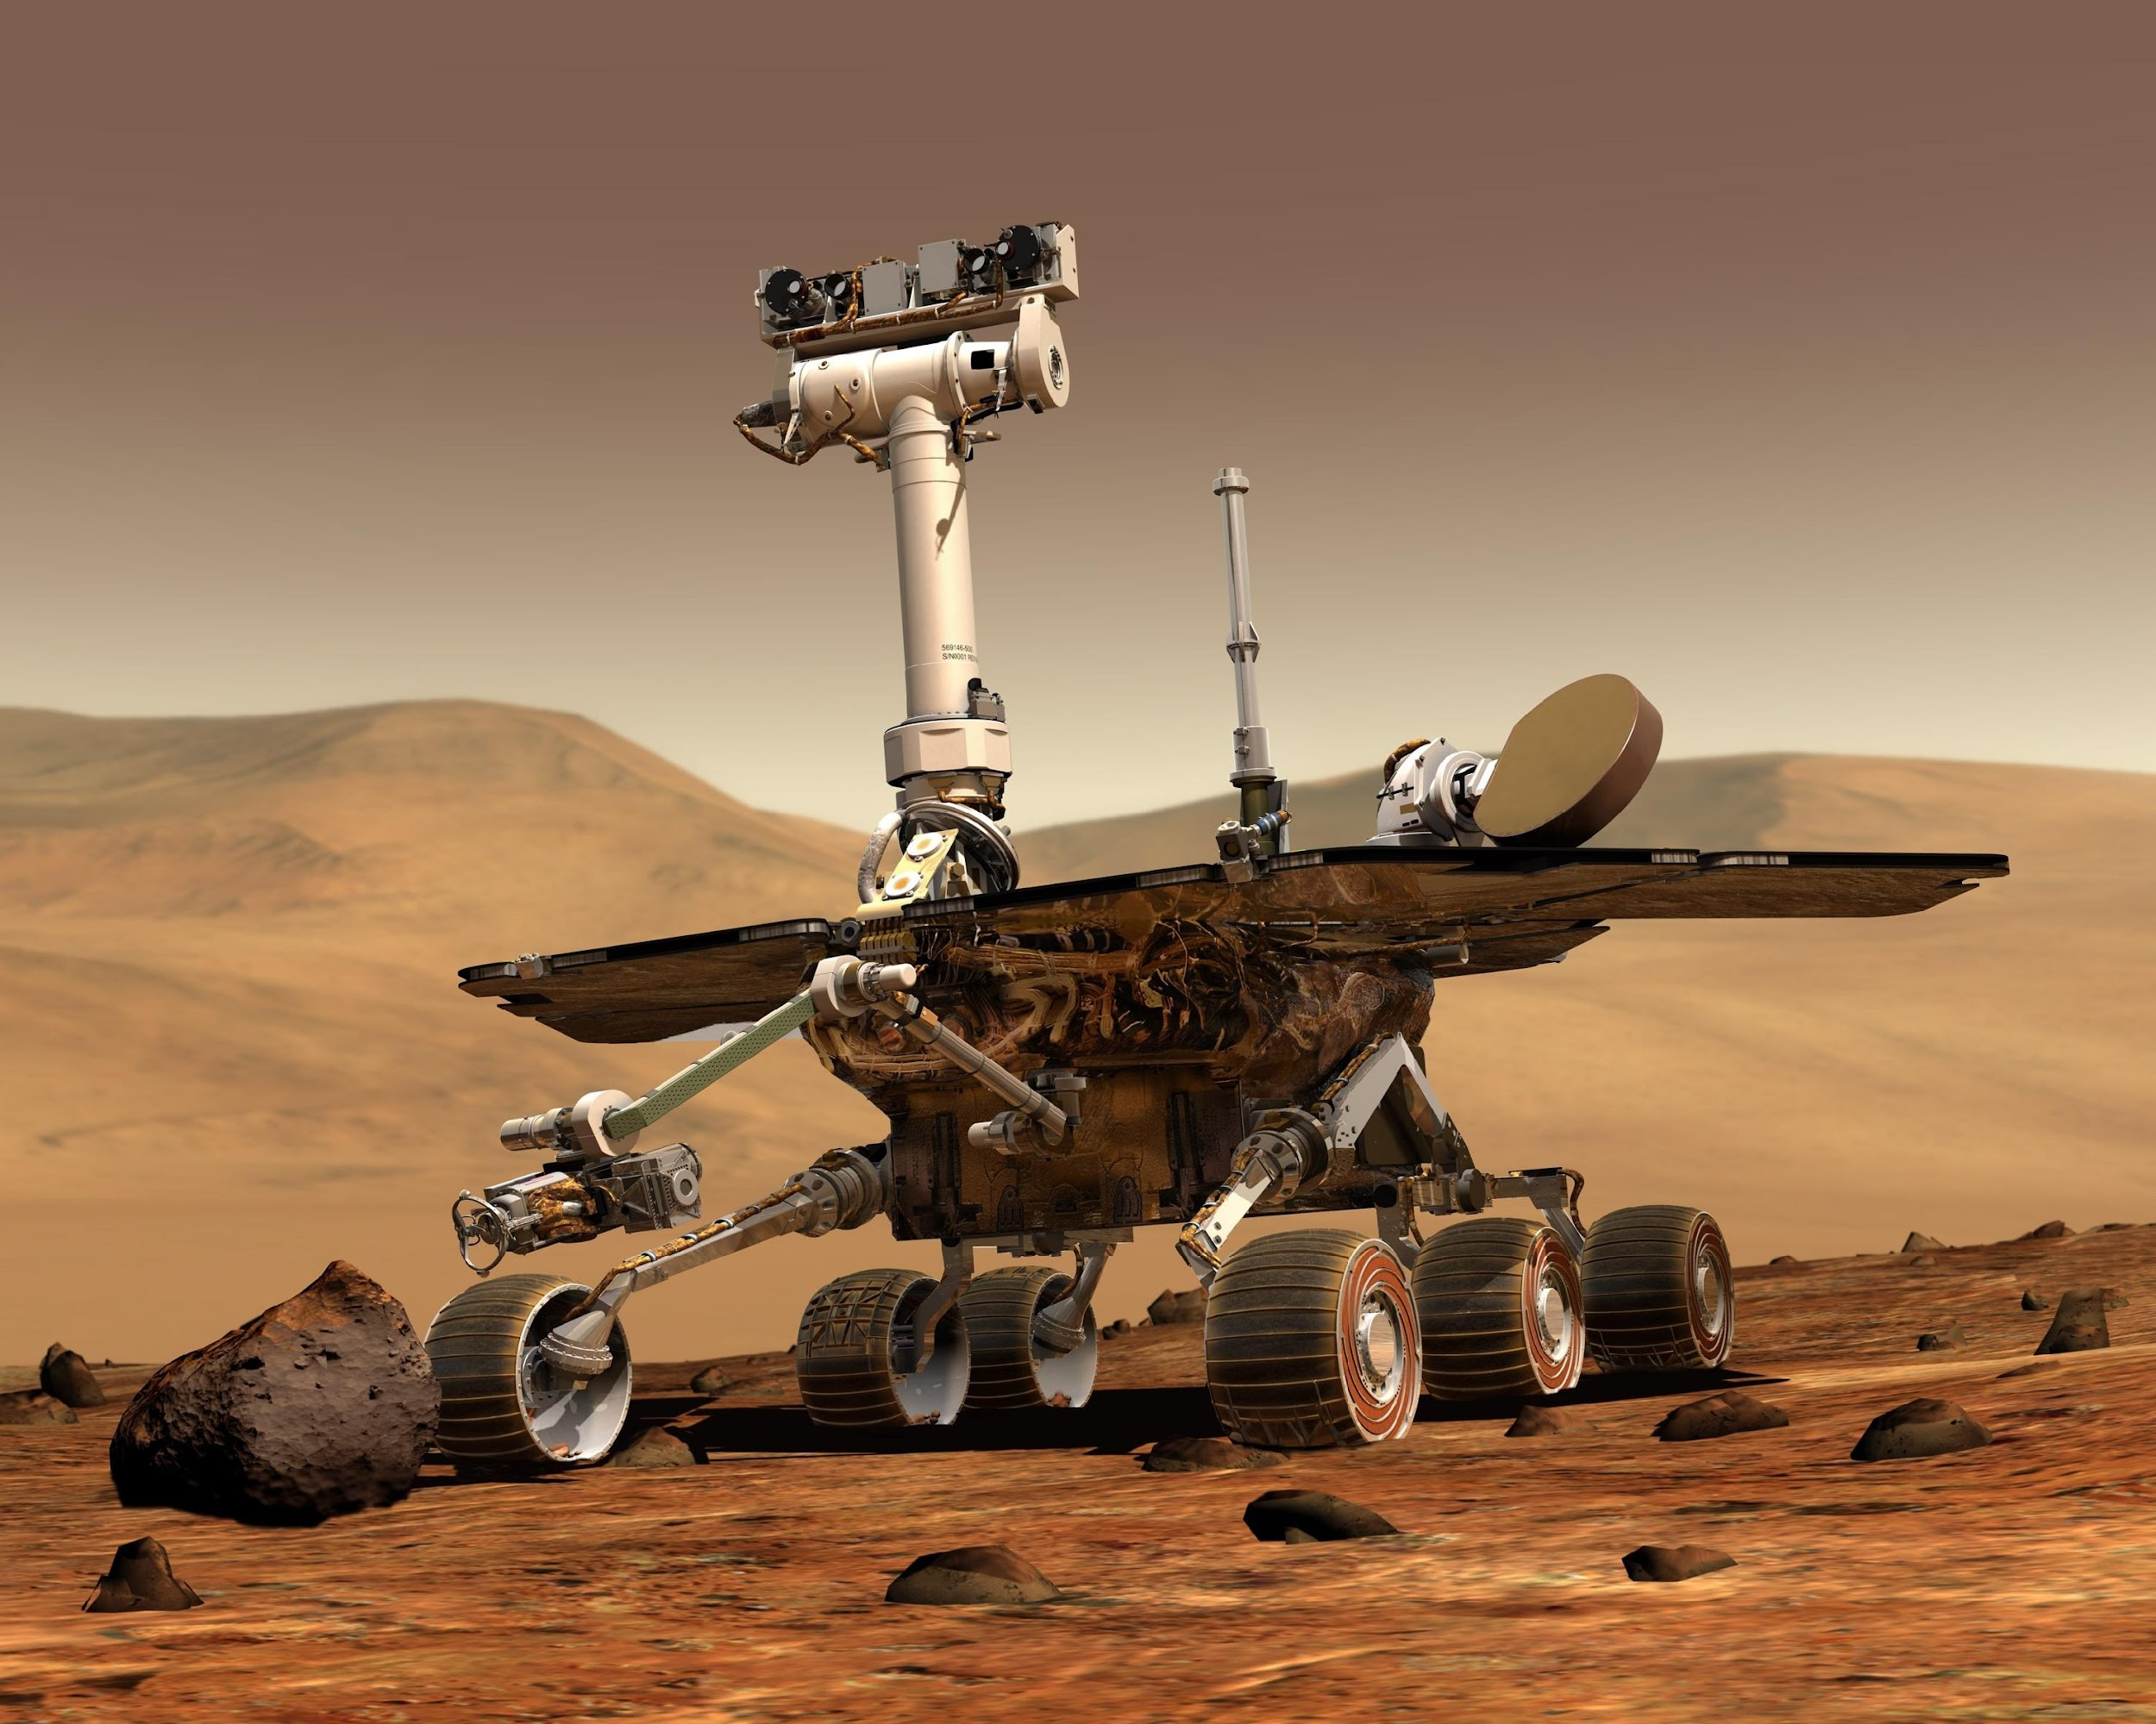
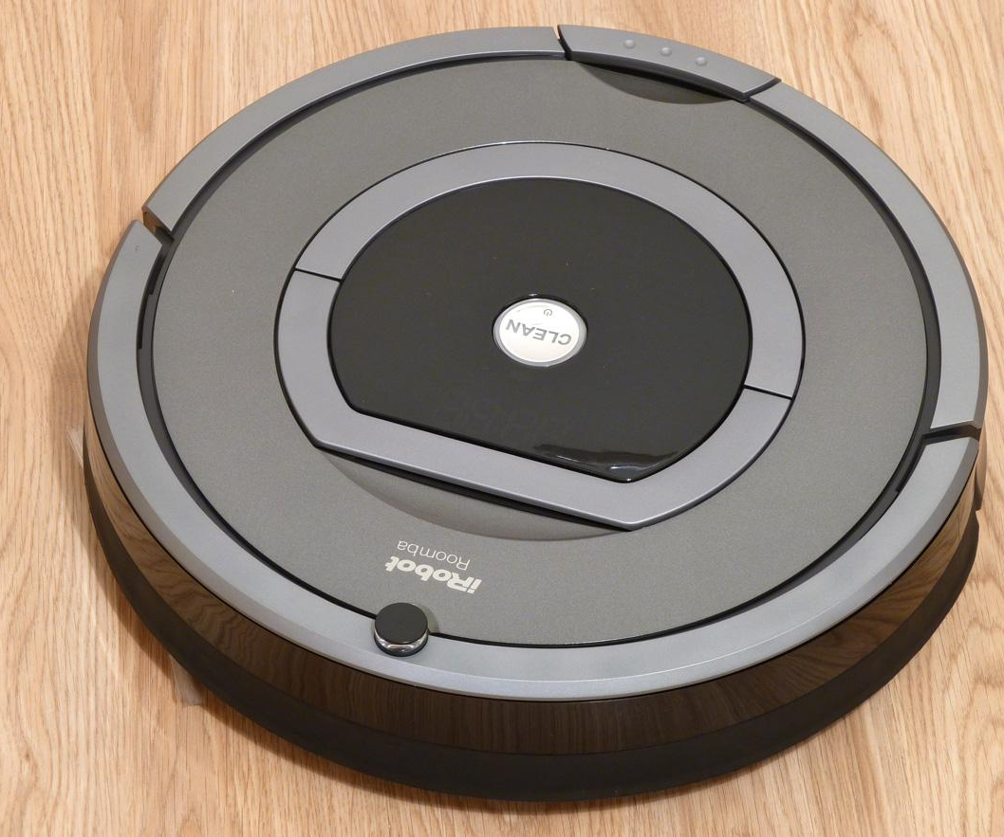
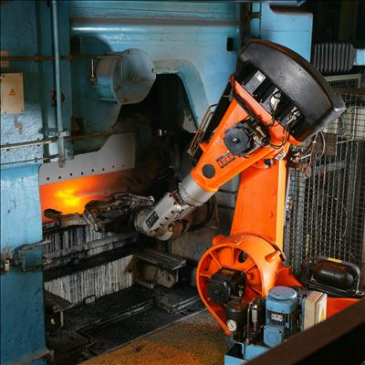
Are these Robots?
Notes:
5 minutes
Bellringer- Is this a robot? Show a variety of images to activate prior
robotics knowledge of the session participants. These images can include
real and fictional robots, but also red herrings, such as washing machines,
to spur the discussion of what a robot isn’t.
Washer and Dryer pic - https://commons.wikimedia.org/wiki/File:Washer_and_dryer.jpg
Gray and White Robot pic - https://www.pexels.com/photo/gray-and-white-robot-73910/
Industrial robots pic - https://en.wikipedia.org/wiki/Robot
Johnny 5 pic - https://commons.wikimedia.org/wiki/File:Johnny5_03.jpg
Sophia pic - https://commons.wikimedia.org/wiki/File:Sophia_at_the_AI_for_Good_Global_Summit_2018_(27254369347)_(cropped).jpg
iRobot pic - https://commons.wikimedia.org/wiki/File:IRobot_Roomba_780.jpg
Amazon Alexa - https://www.flickr.com/photos/131292477@N08/25219116374

Slide 4
What Are the Characteristics of a Robot?
Machine
Programmable
Automated (completes complex tasks automatically)
Notes:
5 minutes
Guiding Question- What is a robot?
Guided Discussion:
• What are the characteristics of a robot? Sample discussion points
include that they are manufactured, they can sense their
environment, they follow instructions, they move, and so on.
• What is an example of a robot, real or fictional, that you can share?
• How does your robot match the characteristics that we just
discussed?
• Why do we make robots? Or, what is the purpose of robotics?

Slide 5
Objectives
Apply research-based practices to support the use of robotics technology in curriculum.
Through the lens of science and engineering practices, connect the impact of classroom robotics technology on students’ lives outside of the classroom.
Troubleshoot potential difficulties for the student learning experience (building and coding) with robotics technology using the Mindstorms platform.

Slide 6
Essential Question
How does the use of robotics in class help students begin to think like a scientist or an engineer?

Slide 7
You DON’T have to know everything for robotics to work in your classroom! You only have to provide activities with clear instructions that are practical, fun, and doable under time constraints.
(Bhounsule et al, 2018)
Notes:
1-2 minutes

Slide 8
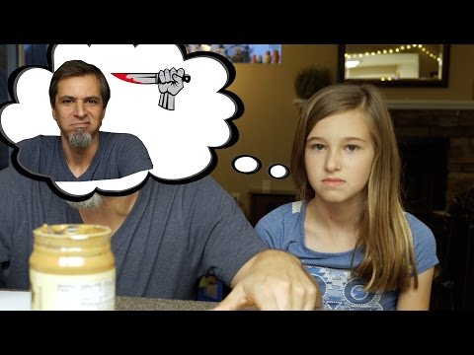
Peanut Butter Jelly Time
Robots will only do what the code instructs them to do. So, when building code, it must be explicit and step-by-step.
Notes:
2-3 minutes

Slide 9
Scavenger Hunt
Determine what each element of the drag and drop coding interface does using the Mindstorms Chromebook application.

Slide 10
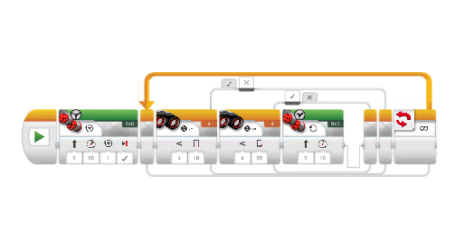
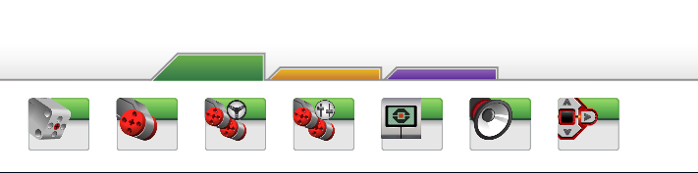
Practice with Coding
Drag and Drop Coding
Play with the coding features within the Mindstorms program and record your process on your troubleshooting reflection sheet.
Insert Image of example for coding site.
Notes:
10-15 minutes
Teachers also to complete Scavenger hunt as they play
***Model how to turn on robot and get it to run code
(individual or in pairs)
Given a simple instruction, such as make the robot move and turn,
teachers will explore the Mindstorms software on Chromebooks and
familiarize themselves with the drag and drop programming
structure.
• Teachers to self-reflect with troubleshooting reflection sheet (under
Explain)

Slide 11
Share out
What did you get your robot to do?
What did you notice about programing your robot?
How can you relate to the kids experience in the PB&J video after working on your robot?
Notes:
3-5 minutes
Math connection:
***How could you calculate how far the robot is going to go? (radians)

Slide 12
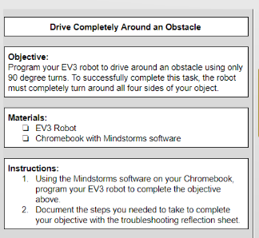
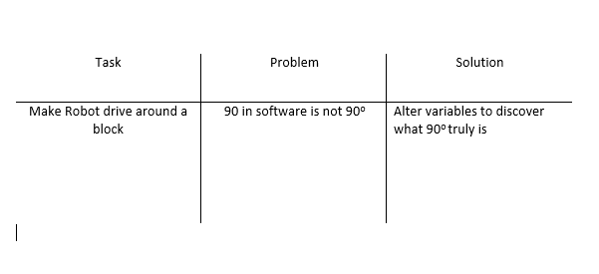
Task Cards
Program your robot according to your task card.
Record your task, problems, and solutions on your note sheet.
Notes:
30+ minutes
Self-Directed Learning
• Teachers will be given differentiated task cards with open-ended
tasks, such as
o Program your robot to drive forward, turn left 90 degrees,
and continue driving.
o Program your robot to drive forward, turn right 90 degrees,
and continue driving.
o Program your robot to drive forward, turn 180 degrees, and
continue driving.
o Program your robot to drive forward and make 90 degree
turns around an obstacle.
• Guidance will be provided as necessary.
• Teachers to self-reflect with troubleshooting reflection sheet (under
Explain)

Slide 13
Reflect and Share Out
Show us your robot’s movements.
What problems did you come across?
How did you troubleshoot and fix the problem?
Notes:
3-5 minutes
Troubleshooting Reflection Sheet [start with a group that completed only one task if every group does all tasks]
• The reflection sheet will have three columns: Task, Problem, and
Solution.
• Teachers will document their experiences for each of the tasks
provided to them.
Share Out
• Teachers to share out in response to questions such as, what did
you do, and what did your robot do? What troubleshooting steps did
you have to take? How did you fix it?
Connect to Research
• Teachers to decide if the activity aligned to the research statement:
was it practical, fun, and/or doable? (Agreement circles?)

Slide 14

Agreement Circles:
Connection to Research
Were the task cards fun?
Were the task cards doable?
Were the task cards practical?
How do these robotics tasks prompt a student to
think like a scientist or an engineer?
How do these robotics tasks aid in the development of a student’s critical thinking and problem-solving skills?
Notes:
[5-10 minutes]
Using the strategy, Agreement Circles, engage participants in these questions.

Slide 15

NSTA Science & Engineering Practices
How would these robotic activities connect to the NSTA Science & Engineering Practices?
https://bit.ly/2xfJPpU
Notes:
Connect to Lesson Goals
• Narrative- “Students need to connect what we have done to
engineering practices and to real life…”
• NSTA Science and Engineering Practices- Teachers to connect
activity to 1-2 different standards.
• Reflection- How are students going to connect these practices to
their lives?
Strategy for Process
• Use think, pair, share to answer the first question and then use

Slide 16

Sticky Bars
Reflect:
Choose one of the practices that students can connect to their lives.

Slide 17
Connections to My Classroom
Using the resources provided, begin identifying lessons or activities that foster the development of skills and knowledge needed within your content area.
Notes:
(goal is to see get teachers to see how robotics can enhance the teaching and learning environment to create authentic learning experiences.)
Share out a few responses
Connect to Teaching Practice
• Written Response- As a teacher in the classroom, how am I going to
integrate LEGO Mindstorms into my practice? (WEBSITE
RESOURCES) (10-15 minutes to explore resources)
(ROBOTICS SUMO COMPETITION/YOUTUBE PLAYLIST)

Slide 18
3-2-1
What are 3 activities with LEGO Mindstorms you could use in your classroom?
What are 2 different NSTA Science and Engineering Practices that would be supported by incorporating a Mindstorms lesson?
What is 1 question or problem that students might have, and how do you plan on answering it (or supporting their struggle to solve it themselves)?
Notes:
3-2-1
• What are 3 activities with robotics you could use in your classroom? (CIRCLE ONE THAT YOU COULD IMPLEMENT IN THE NEXT TWO WEEKS)
• What are 2 different NSTA Science and Engineering Practices that
you could incorporate in a lesson?
• What is 1 question or problem that students might have, and how do
you plan on answering it?
Resources
• Share web and other resources with teachers (Format undecided:
handout, google drive, google classroom?)
TREK Evaluation

