Slide 2
Science Phenomena for Virtual Learning

Slide 3
Lesson Objectives
Recognize the role of phenomena during virtual learning.
Identify grade-appropriate phenomena aligned to state standards.

Slide 4

Phenomena Spend a Buck
In Mentimeter, there are six statements about what makes a phenomenon effective in a virtual setting.
Distribute your 100 points across all six statements based on which ones you think are most important.
menti.com/q5ynzihpbw

Slide 5

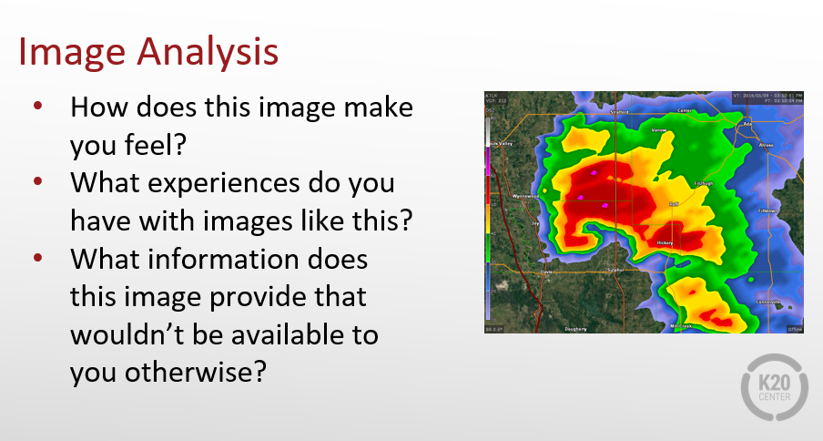
Lesson 1: Feelin’ the Phenomena
As you review this lesson:
Evaluate how the phenomenon is used within the lesson.
Explain what about the phenomenon would make it effective in a virtual setting.
Share your answers in the Whova chat box.

Slide 6
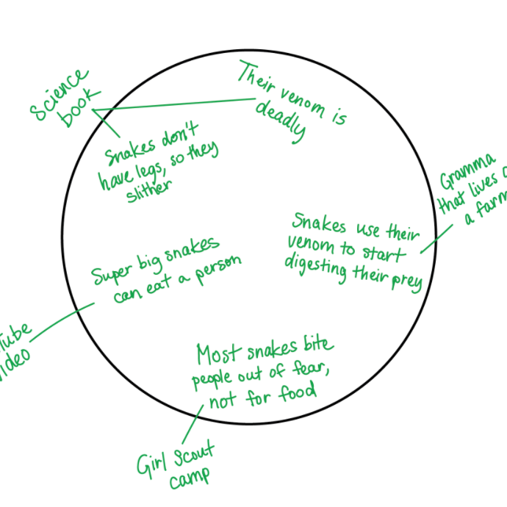
Lesson 2: Venom: From Lethal to Lifesaving
Both lessons:
Can be used in a virtual, face-to-face, or blended classroom.
Refer to phenomena that are accessible and familiar to students.
Rely on students’ prior knowledge and experience.

Slide 7
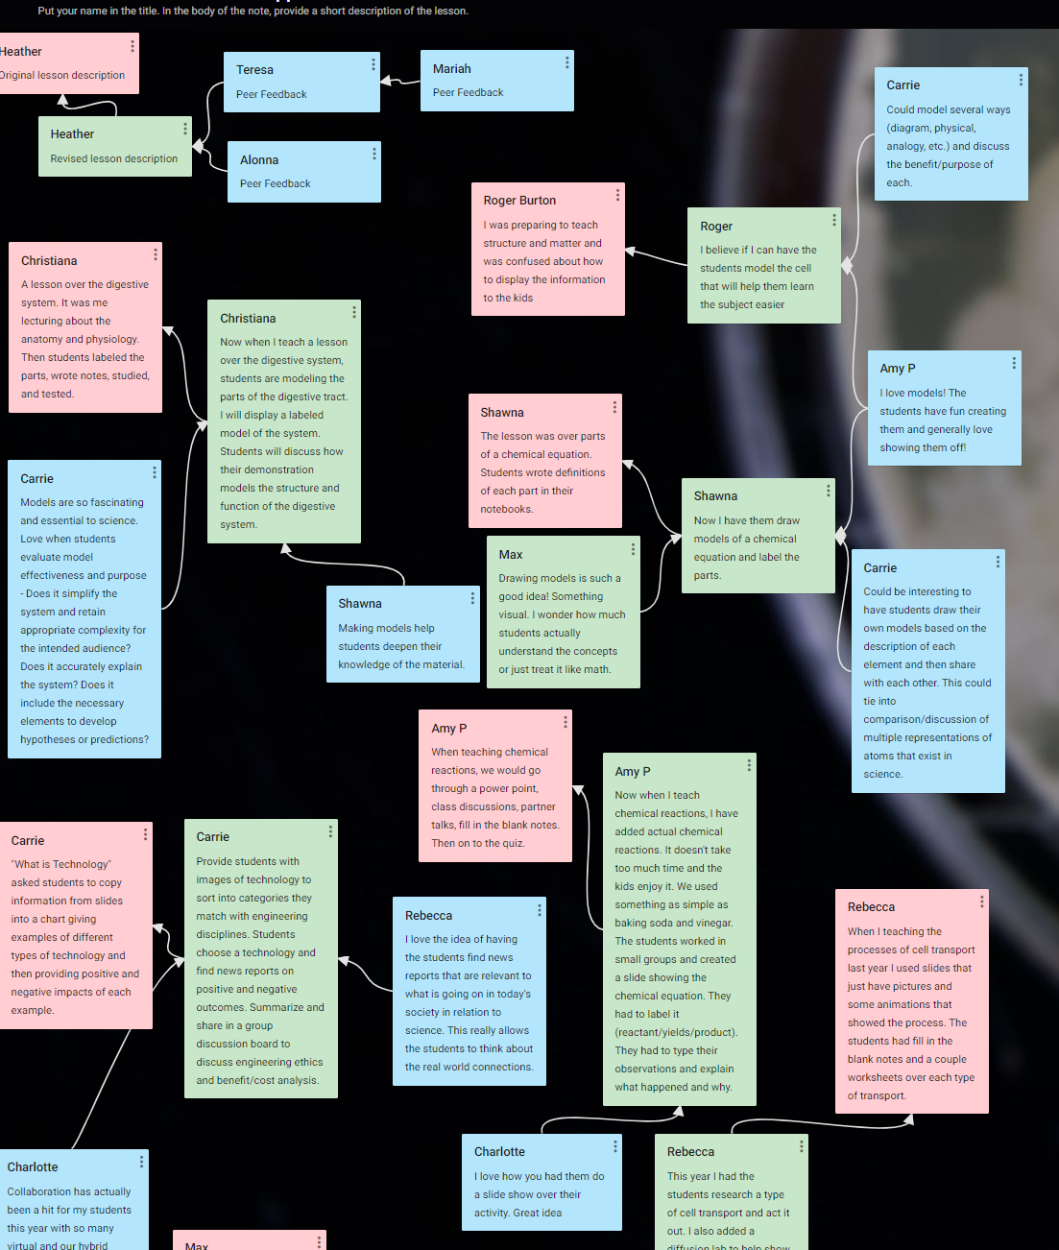
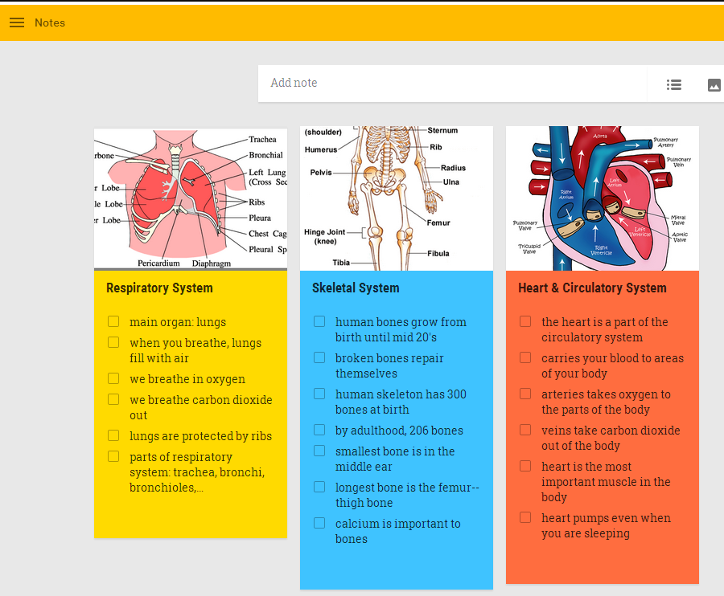
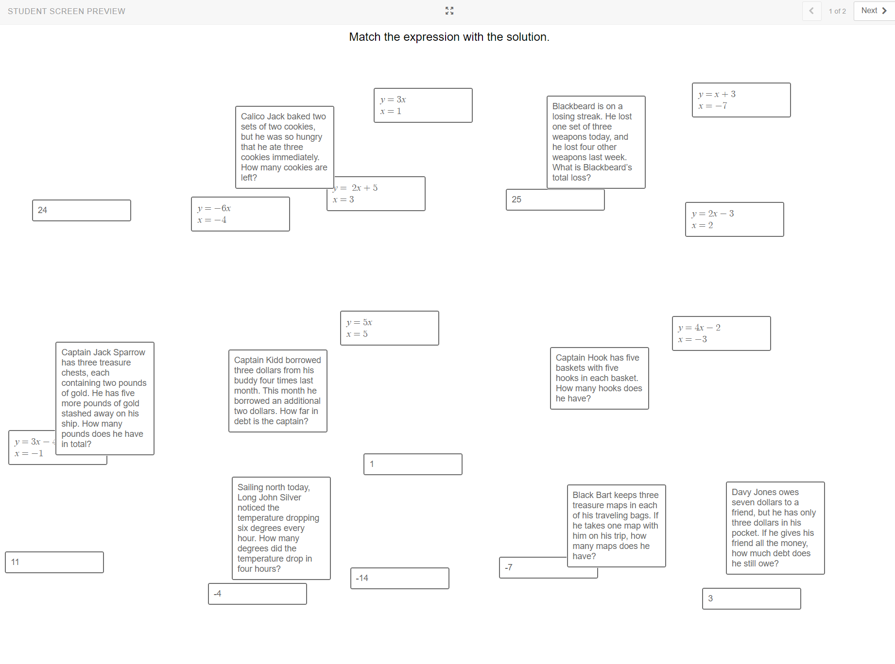
Virtual Modifications
Connect & Collaborate: Padlet
Collect Evidence: Google Keep
Card Sort: Desmos or Quizlet

Slide 8
Using Phenomena Effectively
In any lesson, effective phenomena:
Relate to student interests, experience, locale, etc.
Allow students to make observations, develop models, ask questions, etc.
Are too complex for students to just Google an answer for.
Push students just beyond what they already know.
Should be explainable using the DCI(s) that students are learning.
Engage students in all three dimensions as they discover.

Slide 9
Using Phenomena Effectively in a Virtual Setting
In virtual and blended lessons, effective phenomena:
Are accessible to students through a variety of media formats.
Can be experienced at home or in the classroom.
Emphasize the use of science and engineering practices.
Have the potential to actively engage the entire family, not just the student.

Slide 10
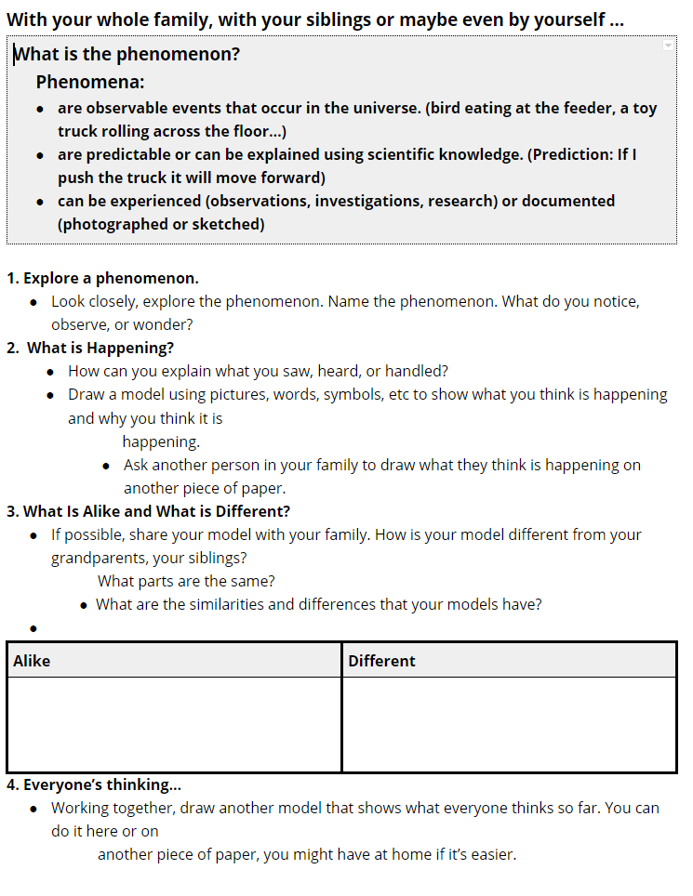
Accessing & Implementing Phenomena
Start by asking simple questions that stimulate students’ curiosity. Strategies like “I Notice, I Wonder” can prompt students to make observations and ask questions.
Use graphic organizers to scaffold student inquiry in a way that promotes collaboration and discussion among groups.

Slide 11
Accessing & Implementing Phenomena
Use discussion starters or sentence stems to get students to discuss the phenomena.
Discussion Starters
What evidence do you have? How do you know?
Is there anything we can measure?
How do you think that is happening?
How could we test our idea?
Sentence Stems
This reminds me of…
I wonder why…
I notice a pattern in…
I think… because…

Slide 12
Choosing a Phenomenon
Visit the Google Slides MS/HS phenomena presentation (linked in the resource list) and choose one of the phenomena provided (three middle school-level phenomena, three high school-level phenomena).
Each phenomenon slide is followed by a virtual engagement slide.
On the virtual engagement slide, describe how you would engage students with the phenomenon virtually.
Detailed instructions are included on slide 1
of the phenomena presentation.

Slide 13
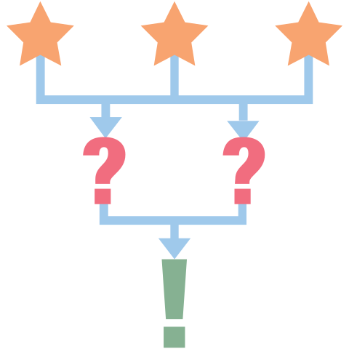
Virtual Phenomena 3-2-1
3 Questions you still have
2 Things you intend to do in your classroom as a result of this session
1 Virtual strategy you’re considering using in your classroom

