Slide 2
UDL: Access for All Learners

Slide 3
Objectives
Identify key principles of universal design for learning in the online environment.
Apply your understanding of universal design for learning to a chosen classroom activity.
Notes:
We want to let you know the purpose of our session today. Our goals are for you to be able to identify key principles of universal design for learning specifically in the online environment and to be able to apply your understanding of UDL to a chosen classroom activity.

Slide 4

Barriers and Access
Notes:
We want to start by showing you this video. As you watch, think about the idea of barriers and access and how it might apply to the classroom.
After video, return to this slide
Often, there are barriers in our education system and our classrooms that prevent our students from accessing the learning and material we are trying to teach. We are going to ask you to think about some of those barriers in our next activity.

Slide 5

The Brick Wall:
Write down a word or phrase related to Barriers in education.
Type here
Type here
Type here
TIME
Type here
Type here
Example response here. Just right-click one of the bricks to the left, click “Copy,” and then Paste it onto the board.
Type here
Notes:
Once you have opened the document, you will see red boxes, representing bricks, on the left hand side. You will need to make a copy of one of the bricks. To do this, right click on a brick, choose copy. That will make your brick for you. Then you can move your brick where you want it on the board. Finally, click inside the brick to highlight the text and type, this will remove the existing text and replace it with what you want.

Slide 6
Barriers to Education
Universal Design for Learning, or UDL, is about knocking down those bricks (barriers) so that learning is accessible for all students.
Notes:
As we saw, there are obvious barriers to education for our students. Some of those barriers are things that we as educators cannot control. But some of them are things that, like the playground creators, we can change if we reimagine the way our classrooms and our lessons are designed. Universal Design for Learning--UDL--is about knocking down the bricks--the barriers--so that learning is accessible for ALL the students in our classrooms.

Slide 7

What Might Access Look Like?
For each image, discuss what you see as bricks (or barriers) to learning and what you see as keys (or access) to learning.
Share out your response, or it in the chat.
Notes:
So what might access look like? We are going to be looking at some images from classrooms next, and asking for your participation. We will ask you to discuss what you see as bricks/barriers to learning and what you see as keys, or access, to learning in each image. If you are live, you can share out your response/in the chat. If you are joining us by viewing this recording at a later time, we ask that you join in through reflection and notice how your ideas compare to our discussion.
Image credit - Mabel Amber. Retrieved from Pixabay on Oct 29, 2020, from https://pixabay.com/photos/red-brick-wall-building-structure-3614976/ and Clkr-Free-Veector Retrieved from Pixabay on Oct 29, 2020, from https://pixabay.com/vectors/key-old-skeleton-lock-metal-door-30417/

Slide 8
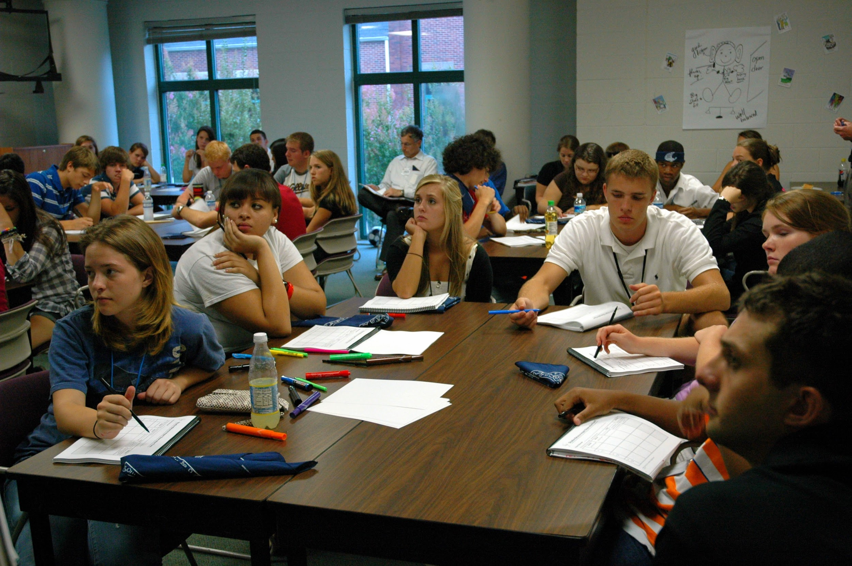
What Bricks or Keys to Learning Do You See?
Notes:
Note what participants notice.
Things to point out:
Keys--Graphic organizers, chart on the wall, teacher in the back of the room, students grouped together, choice of annotation pens/highlighters
Barriers--notes presented? (only verbally?); other ways to take notes given?; can all students see the board/notes/presentation?
Lead Beyond. “Classroom” [image]. July 23, 2009. Retrieved from Flickr on Oct 13, 2020, from https://www.flickr.com/photos/32493043@N00/3788069391/ CC license Some rights reserved

Slide 9
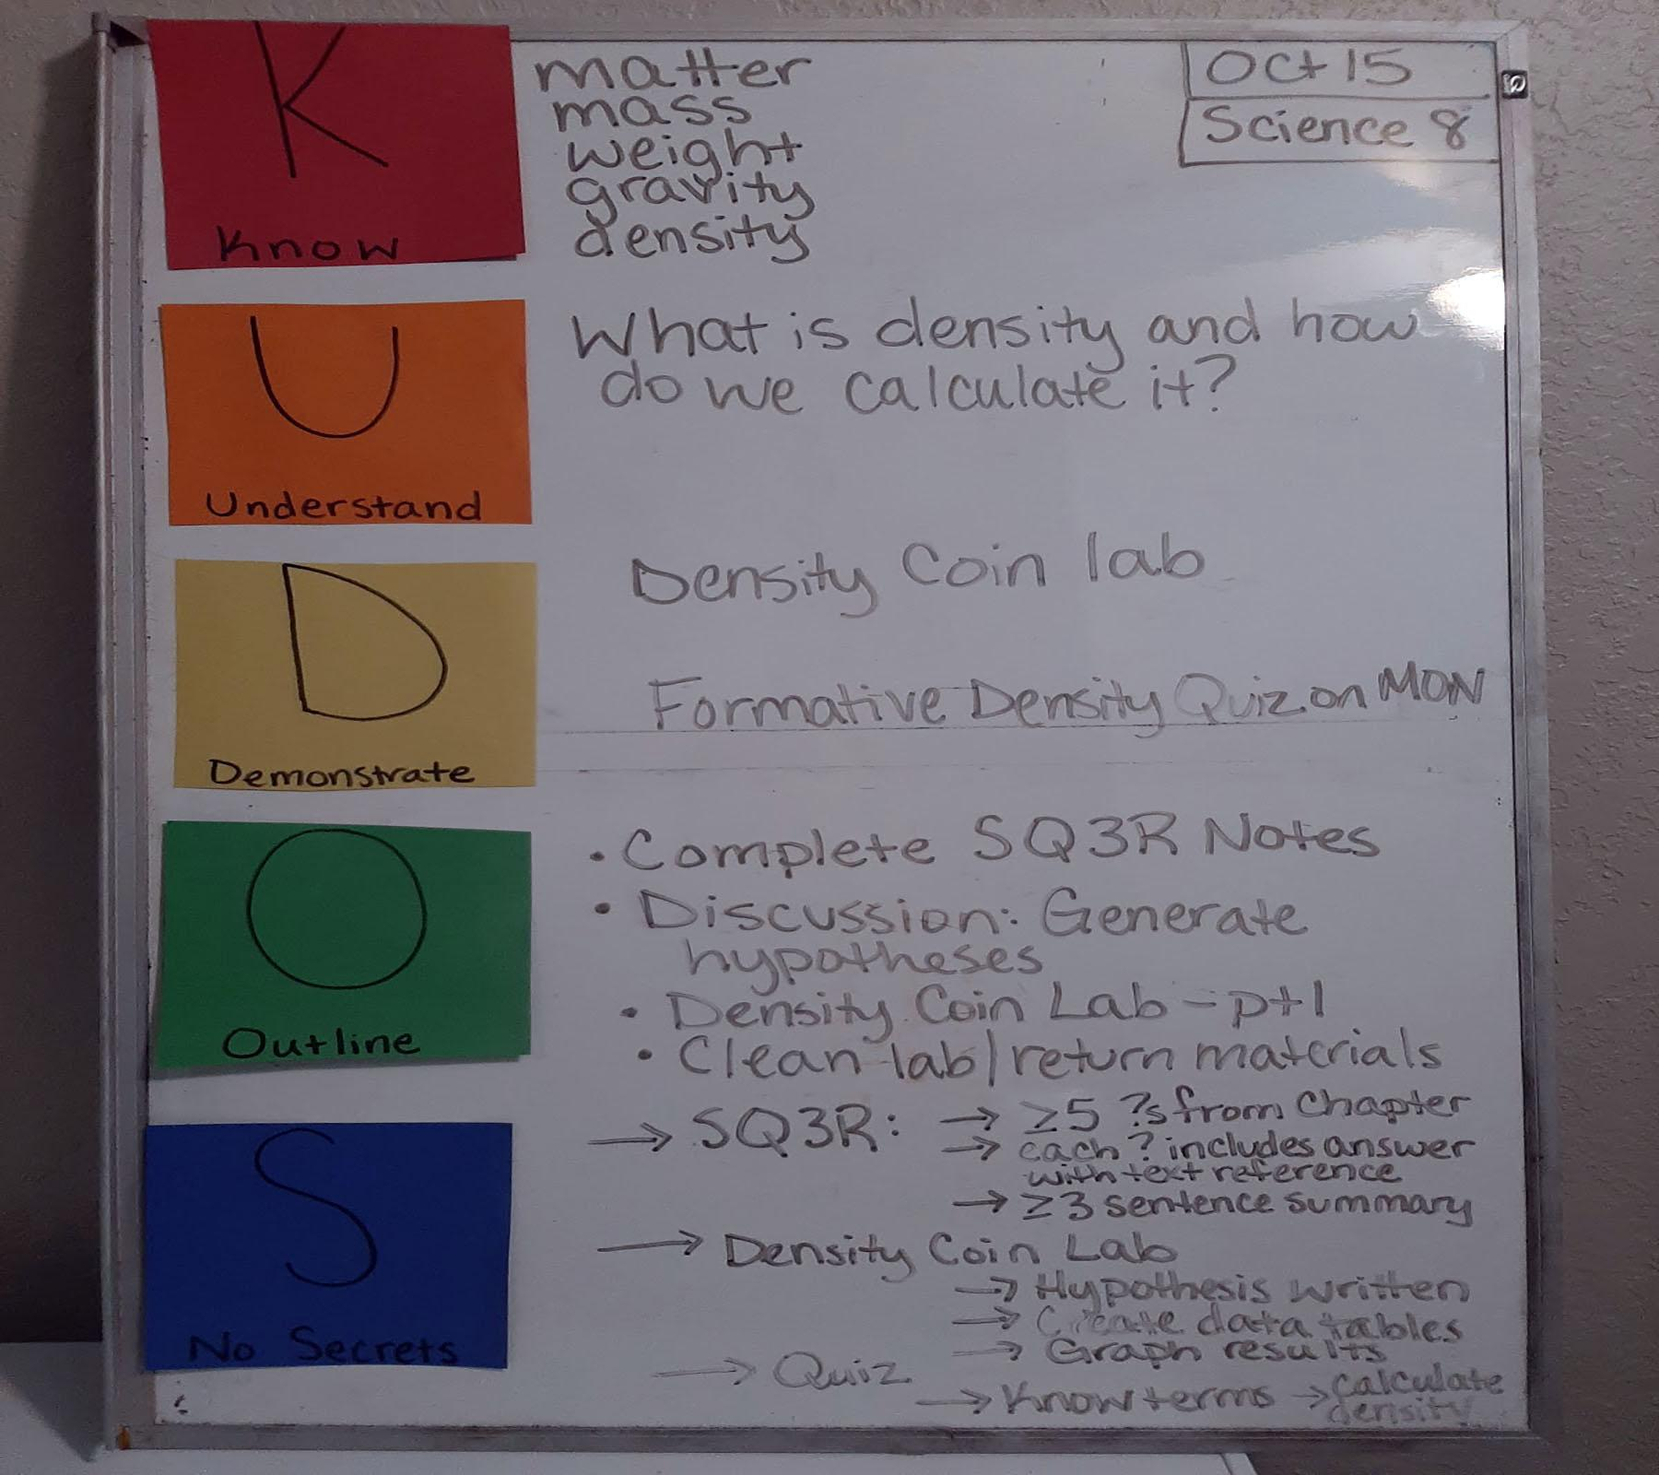
What Bricks or Keys to Learning Do You See?
Notes:
Note what participants notice.
Things to point out:
Keys--Format for student expectations
Barriers--small/hard to see; Do students know what everything means?;

Slide 10

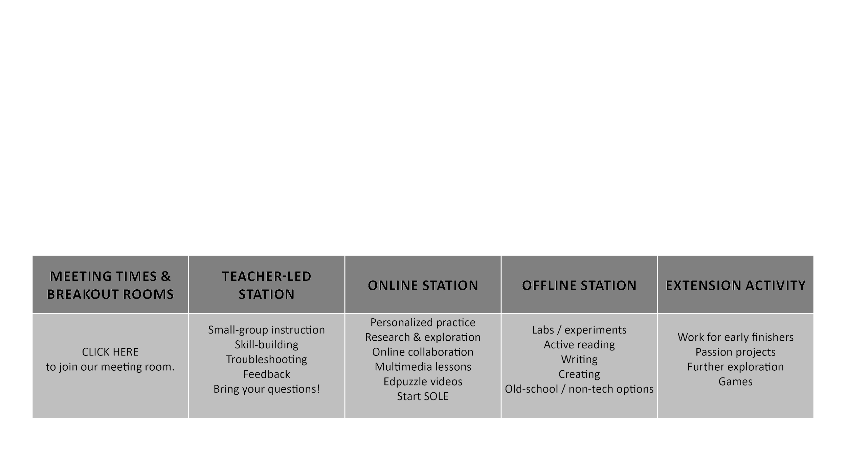
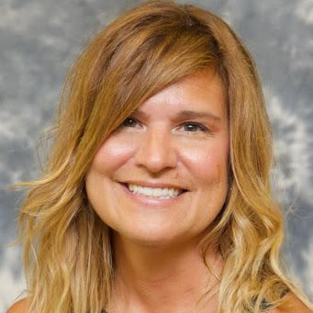



VIRTUAL STATION ROTATION
Replace this image with your own & use onlinevoicerecorder.com to record an audio message that provides a brief overview of the lesson.
[date and subject/topic]
Include a translated version of your overview!
Type a quick message
here.
Also, record an audio clip for non-readers and ELLs.
Use Flipgrid to record a video short too, if you want, but be sure to caption it!
Notes:
Note what participantsnotice
Things to point out:
Keys--stations; extension activity options; would have clear directions; translation options; directions in multiple formats; images match words
Barriers--students would need to know the routine/be taught the routine for this

Slide 11
What Is UDL?
Universal Design for Learning (UDL) is a framework to improve and optimize teaching and learning for all people. It is based on scientific insights into how humans learn.
UDL is designed to remove barriers for ALL learners.
UDL looks at a lesson or activity at the beginning of the planning process and seeks to provide access for as wide an audience as possible, whereas differentiation makes changes to the lesson or activity to respond to particular student needs.
Source: cast.org
Notes:
We’ve taken some time to think through barriers and keys in different classroom scenarios, and now we want to walk you through what UDL is. The definition of Universal Design for Learning that we are using comes from CAST, which is a nonprofit educational research and development organization that created the UDL framework and guidelines. UDL is a framework to improve and optimize teaching and learning for all people based on scientific insights into how humans learn. So it’s based on brain research. UDL is designed to remove barriers for ALL learners. It is looking at the lesson or activity at the beginning of the planning process to provide access for as wide an audience as possible, whereas differentiation is making changes to the lesson or activity as needed for particular student needs.

Slide 12
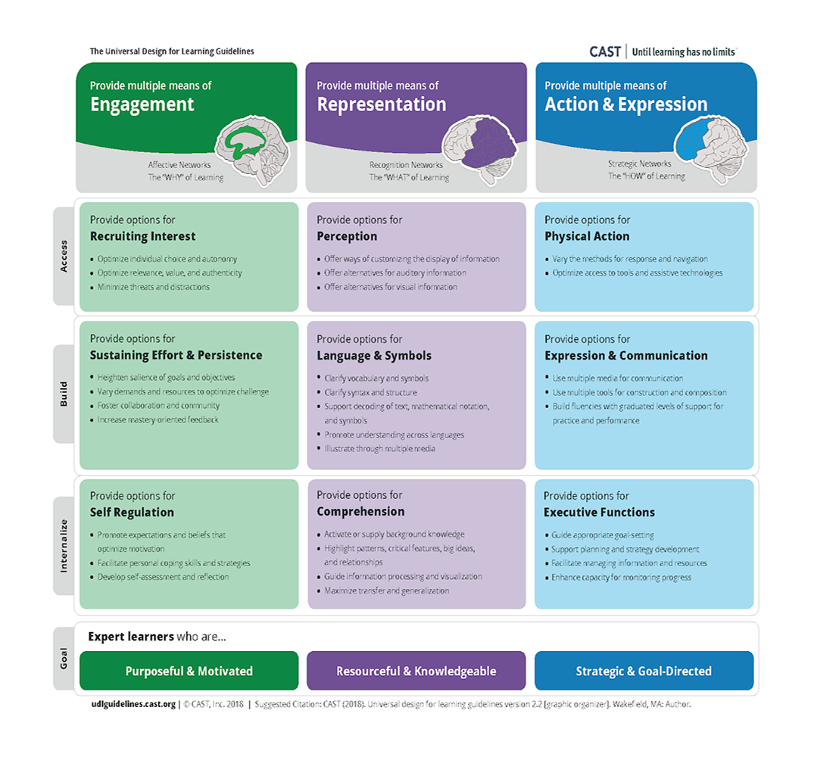
Notes:
We have provided a download for the UDL guidelines from CAST. This is an image of that download. The guidelines, as you can see, are focused on the three networks of the brain: the affective network, which is focused on the why of learning, and to answer that, we as educators can provide multiple means of engagement; the recognition network, which is focused on the what of learning, and to answer that, we as educators can provide multiple means of representation; and the strategic network, which is focused on the how of learning, and to answer that, we as educators can provide multiples means of action and expression. The download goes into detail by breaking down how you can provide access to the learning goal, build students’ effort and persistence, and help learners internalize through self-regulation, comprehension, and executive function. The bottom reminds us of the ultimate goal: expert learners who are purposeful and motivated, resourceful and knowledgeable, and strategic and goal-directed.

Slide 13
Tier 1
Notes:
The guidelines are a great resource, but sometimes it can be helpful to know, specifically, what we as educators can do to break down those specific barriers, especially when so much of our content has gone digital. We want to take you through some specific steps you can take to help your learners access online materials using the framework of UDL. We have broken these steps down into three tiers. Tier 1 includes steps you can take that will help the widest audience.

Slide 14
Create a Clear Structure
Whether it is a document or your LMS course, a clear structure allows students to easily follow the format and know what to expect.
It also allows screen readers to easily read the document that you provide.
Notes:
The first suggestion we have is to create a clear structure. Whether it’s a Google document or your entire Canvas course or Google classroom, a clear structure allows your students to easily follow the format and know exactly what to expect. There’s no guessing for them. This is also helpful because a clear structure allows screen readers to easily read the document you provide.
I’ve heard from many schools that students who are online are feeling overwhelmed because the work they are expected to do online is so daunting. Where to go to find directions for an assignment, how to navigate to the assignment, might change each time. This can be too much of a cognitive load for some students.

Slide 15
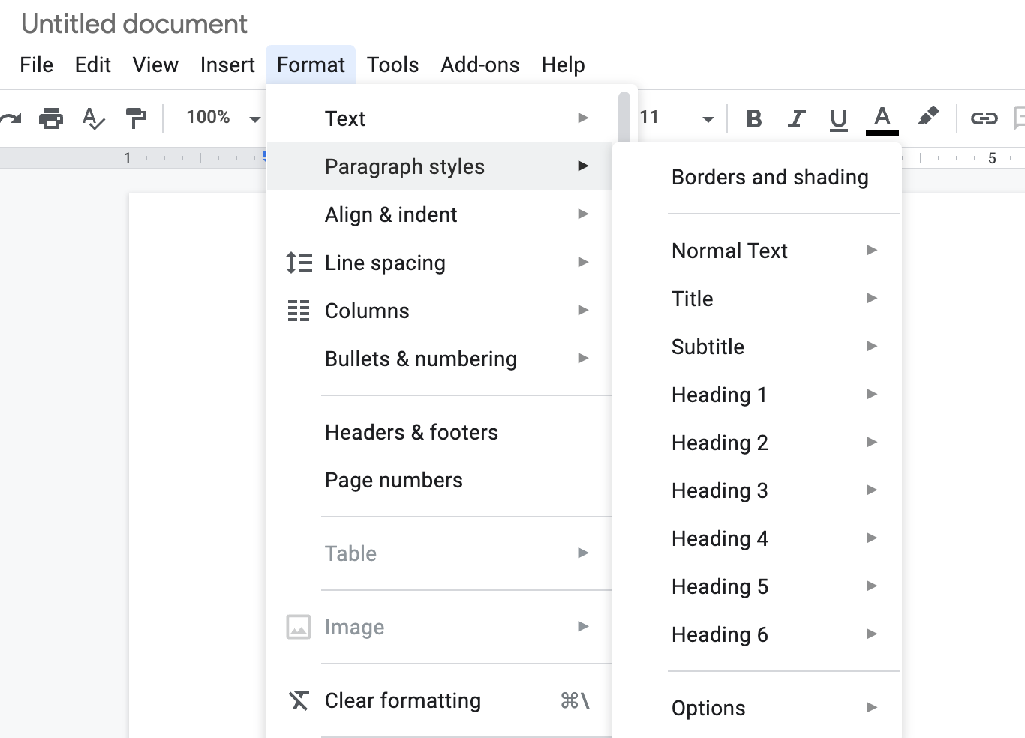
How To Create a Clear Structure
In a Google document:
Format > Paragraph styles >
Title
Subtitle
Heading
Notes:
For the purposes of this presentation, we are going to focus on how to create a clear structure in Google documents and Word documents only. We could spend a whole 60 minutes on creating clear structure in your LMS course, and trust me, we know that is an important topic, but unfortunately that is not the focus of our time today. We do encourage you to check out resources on that topic if you are interested!
To create a structure in a google document that a screen reader can actually read, you will go to format, then paragraph styles. You will choose a title, subtitle, and various headings that fit the structure of your document. For example, I would use heading 1 for all of my section titles in a document and normal text for the rest.

Slide 16
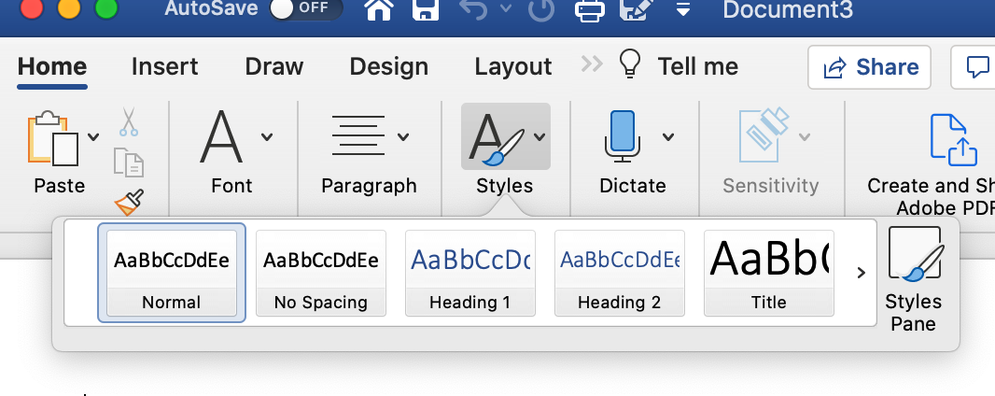
How To Create a Clear Structure
In a Word document:
Home > Styles >
Title
Subtitle
Heading
Notes:
Word uses a similar structure to Google documents. To create a structure for screen readers in word, go to Home, then styles and it will show you the options. I like that word shows you what the headings look like before you choose them.
This isn’t an intuitive way to type a document, but in time you will get used to creating documents this way. While you might not always have a student who uses a screen reader, the headings and subheadings can often help chunk your text for you, which is a good thing, as we will see later.

Slide 17
Use Color Contrast and Avoid Moving Objects
Readability is more important than being flashy.
Two important factors to consider:
The color contrast between text and background should be appropriate. Consider those with low vision, those who may be colorblind, or those whose migraines may be triggered by certain color combinations.
Rapidly moving images can be harmful to audience members with epilepsy or sensory processing issues.
Notes:
Our second strategy suggestion is to use color contrast when creating content and avoid using flashing or moving objects when choosing gifs. Remember, readability is more important than being flashy or catchy.
You want to consider two factors: The color contrast between the text and the background should be appropriate. Those with low vision, color blindness, or those with migraine issues may have issues with certain color combinations. Also, rapidly moving images can be harmful to students with epilepsy or sensory processing issues.

Slide 18
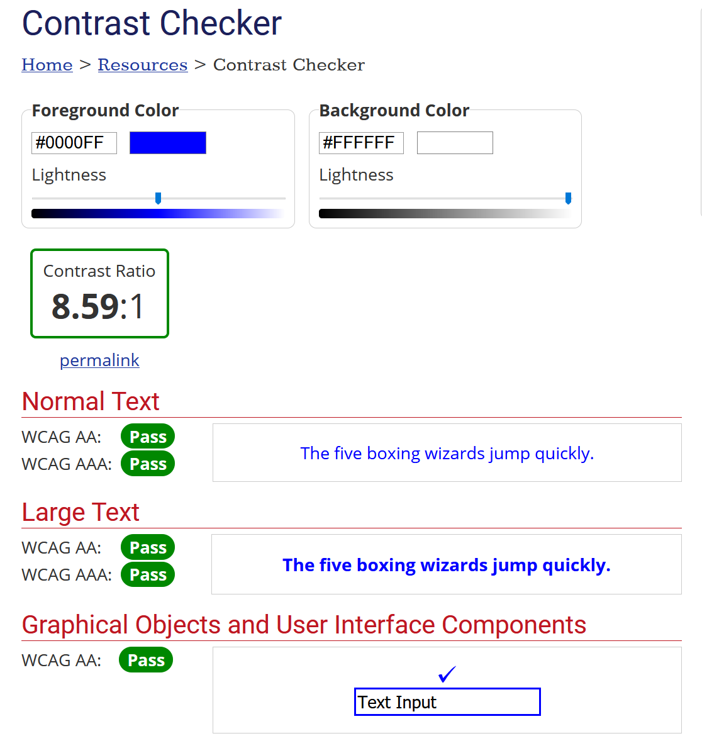
Use Color Contrast and Avoid Moving Objects
https://webaim.org/resources/contrastchecker/
Notes:
If you are unsure about whether the color contrast is appropriate, you can check using Webaim’s contrast checker.

Slide 19
Tier 2
Notes:
Tier 2 strategies are strategies that are focused more specifically, at the lesson/activity level.

Slide 20

Create Clear Directions
Provide clear directions in multiple formats.
Providing directions in more than one format gives students multiple ways to access the information you want to convey and helps them understand exactly what is expected of them.
Online communication is often not as clear as in-person communication. Front-loading the directions is an essential and effective way of ensuring that students have what they need.
Notes:
I am going to say create clear directions and do my best not to also roll my eyes like I imagine half of my audience doing right now. Teachers know to create clear directions. It’s what we do. But we are also used to being face to face with our students and explaining the directions in ten different ways to them in person before sending them off to do their work. When we give students work digitally, we don’t have that luxury. We have to give them such explicit directions, and directions in multiple formats, that students will know exactly what is expected of them without having us there to explain it again. Providing directions in more than one format can provide students with multiple ways to access the information you want them to know. I may not be able to just read the directions and understand what you want from me. I may need to also hear them explained and also see what you are asking me to do before I get it. Online communication is not often as clear as in person communication. Much explanation is often lost, so front-loading the directions is an essential and effective way of ensuring students have what they need. I can imagine it can be frustrating on both ends--for both teachers AND students when the directions aren’t clear. It’s frustrating for students to not understand what they are being asked to do, and it’s frustrating for teachers to field questions, not get work turned in, or to get work turned in that was not what they were hoping for or expecting. So let’s end that cycle!
Image by Roy N. Retrieved from Pixabay on Oct 29, 2020, at https://pixabay.com/vectors/sign-post-arrow-sign-direction-sign-5655110/

Slide 21
Create Clear Directions: Two Examples
Complete the worksheet below. Answer the questions and submit.
What to do: Answer each question in complete sentences.
Why: Provide text evidence to support inferences.
How-to: See first completed example.
Notes:
This is an oversimplified example, but let’s look at these two sets of directions. The one on the left is what I’m used to seeing on a document: Complete the following worksheet below. Answer the questions and submit. --An upper grades example. Assumes the student knows the expectations of the worksheet. The directions on the right are a little more straightforward, and it breaks down the directions into what, why, and how. The teacher could even go some steps further and provide a screencast reading the directions, working through the first example, and or walking through the rubric.

Slide 22
Create Clear Directions
Consider creating a short video explaining the directions and answering questions you expect students to answer on the assignment.
Provide a rubric where appropriate.
Provide exemplars if available.
Notes:
As I mentioned, videos can be very powerful and helpful for students. Don’t be afraid to do short 1-3 minute videos explaining the directions or answering questions you expect students to have about the assignment. Do not think this has to be high quality--a research study showed students actually engage LESS with professionally polished videos! If you can provide a rubric, that can be very helpful--even single point rubrics can be useful for students to know the expectations for the assignment. And, if you have exemplars, even just to show the format of the assignment, those can be helpful as well.

Slide 23
Chunk Large Amounts of Information
When confronted with a wall of text or problems to solve, it can be overwhelming for many students.
Consider ways to chunk the information into manageable parts.
If this is a document you are creating, consider using headings and/or subheadings.
If this is not a self-created text, consider where it might be best to chunk the information.
Provide breaks between chunks to give students an opportunity to process the information.
Notes:
One way to help students process information is to chunk it into manageable parts.
When confronted with a wall of text or problems to solve, it can be overwhelming for many students.
Consider ways you might be able to chunk that information.
If this is a document you are creating, consider using headings/subheadings, as discussed in the Tier 1 section.
If this is not a self-created text, consider where might be best to chunk the information.
You might have to literally create breaks between the chunks to process the information. Consider activities or strategies to help students reflect and process. The K20 Center has an entire section of great strategies geared towards helping students do this on their website, which we have linked in the resources section of this presentation for you to check out!

Slide 24
Chunk Large Amounts of Information
Consider how you want students to process the information you have chunked.
Consider how long each chunk of information will take to read or learn.
Consider how to make explicit connections between chunks or sections.
Notes:
When you are thinking about what activities you use to have students process the information, keep in mind the learning purpose you have for the lesson. Use that to guide you.
When considering how long to chunk each piece of information, consider how long it will take students to read or learn the information. Just because a chunk of text is short doesn’t automatically mean it will take a short amount of time to process. Finally, students may have a difficult time piecing all of the chunks back into a coherent goal. Make explicit connections between the chunks or sections for students and help them make those connections to make sense of the learning as a whole.

Slide 25
Tier 3
Notes:
Tier Three strategies are those strategies that can help all students, but go beyond those typically seen in most classrooms. We will share two examples with you today.

Slide 26
Create Descriptive Links
When creating hyperlinks, ensure that the links are descriptive and clearly convey the destination of the link.
Screen readers do not discriminate when reading hyperlinks.
NON-EXAMPLE: For more information, click here.
EXAMPLE: For more information, visit the K20 Center website.
EXAMPLE: For more information, visit the K20 Center website at k20center.ou.edu/.
Notes:
One strategy to help students is, when linking out in your documents or on your LMS, ensure that your hyperlinks are descriptive and clearly convey the destination of the link. This helps in two ways. One, screen readers cannot discriminate when reading hyperlinks. So those who are using screen readers do not know that you have hyperlinked to something if you do not explicitly label it as such in the document or LMS. Also, They do not know where they are being sent if you do not accurately label the hyperlink. Two, if for some reason the technology is faulty--and we have ALL been there-- and the hyperlink is not working, then an unclear hyperlink is not helpful to students in that event. See the examples here? If we look at the first: For more information, click here, a person using a screen reader would have no idea where exactly they were supposed to click or where they were being taken. If the link was broken, the student would have no idea what to do from that point. A better example is: please visit K20’s website. In this case, the student would clearly know the destination is K20’s website. If the link were not to work, a savvy student might actually Google to find the site (in a perfect world, right?). The even better example is to put the actual URL in the link. In this way, even if the hyperlink doesn’t work, any student could navigate to the site on their own.

Slide 27
Create Alternative Text for Images
When using images, include alternative text, or alt text, to describe them. Alt text allows individuals who are unable to view the image to still have the information and context needed. This is useful for both screen readers and faulty technology.
Decorative images do not need alt text.
Alt text needs to be descriptive and contextual—how would you describe this image over the phone to someone? If it is a chart, describe the axes and the general trend of the graph or important data points.
Notes:
Our final suggestion is to use alternative text when using images on your documents or pages. Alternative text is used to describe images, and this allows individuals who are unable to view the image to still have the information and context needed. This can be useful for people who use screen readers AND for those whom the image does not show. How many of us have tried to open up a webpage, only to have the images NOT load? It can be very frustrating. Alt text can allow your students to get the descriptive information about the images even if the image never loads. If the image is merely decorative, there is no need to use alt text, although you can often label it “decorative image.”
Alt text needs to be descriptive and contextual: How would you describe this image over the phone to someone? If it is a chart, describe the axes and the general trend of the graph or important data points if the question you are asking is about the general trend.

Slide 28
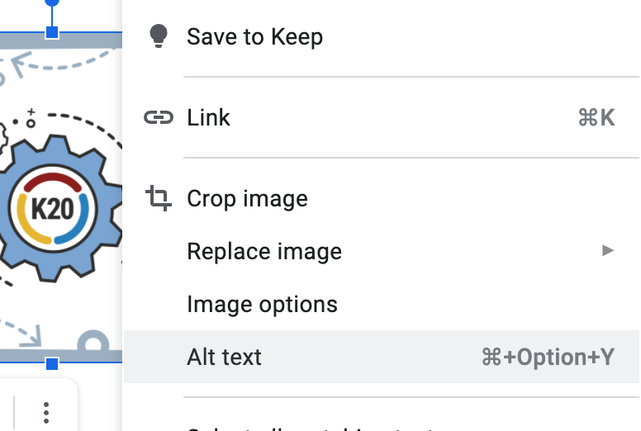
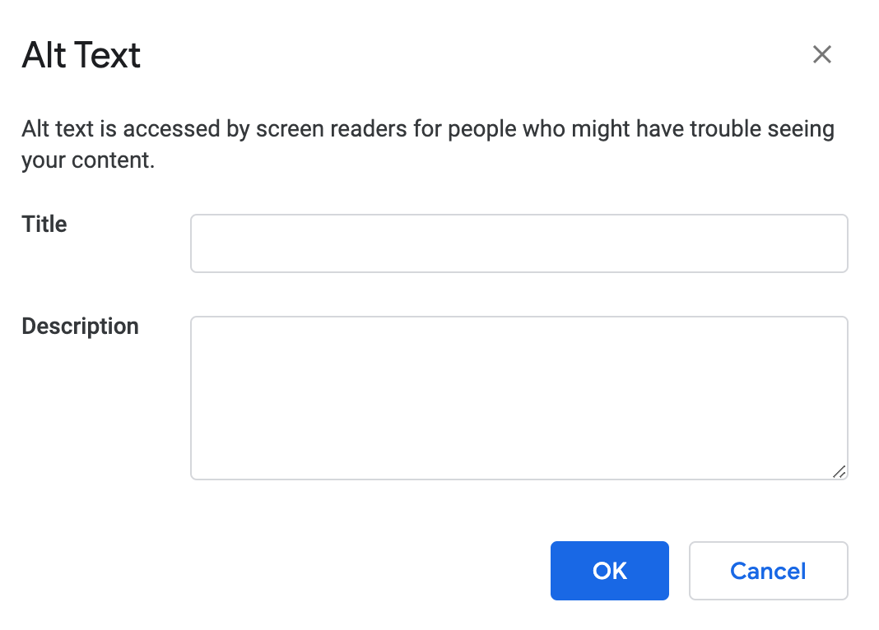
How To Create Alt Text for Images
In a Google document:
Right-click and select “Alt text.”
Enter a title and description.
Notes:
So, how do you do it? In a Google doc, you right click the image and you will see Alt Text as on option in the drop down menu. When you click that, you can type a title for the image and a description.

Slide 29
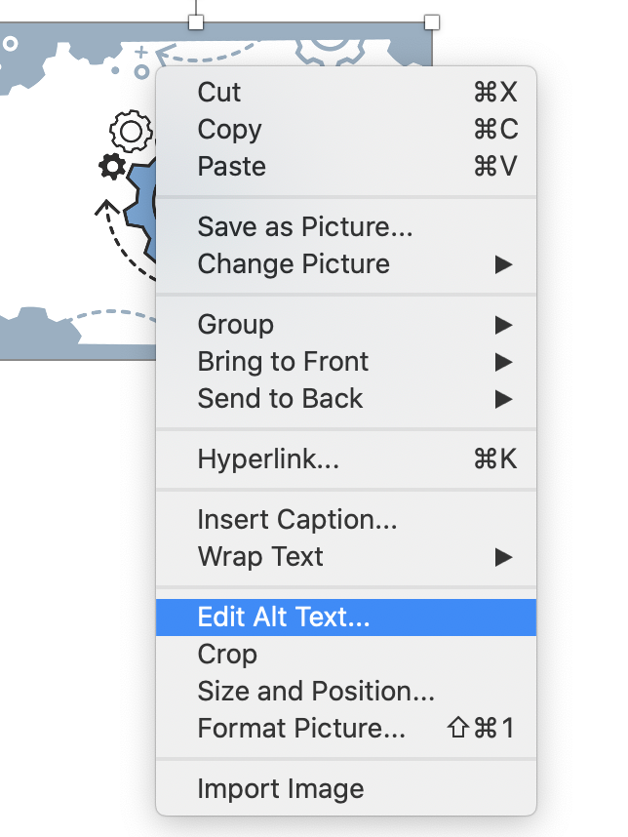
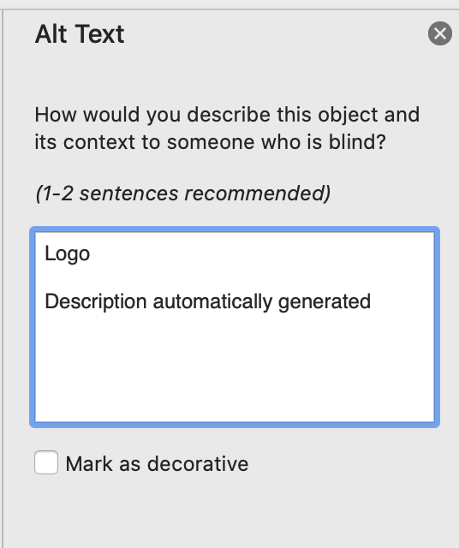
How to Create Alt Text for Images
In a Word document:
Right-click and select “Edit Alt Text…”
Enter the alt text or mark the image as decorative.
Notes:
In a Word document, it’s very similar. You right click the image, then choose Edit Alt Text in the drop down menu. In word, It asks for a Logo, which is like the title, and then a description. Word also gives the option to click and mark it as decorative for screen readers.

Slide 30
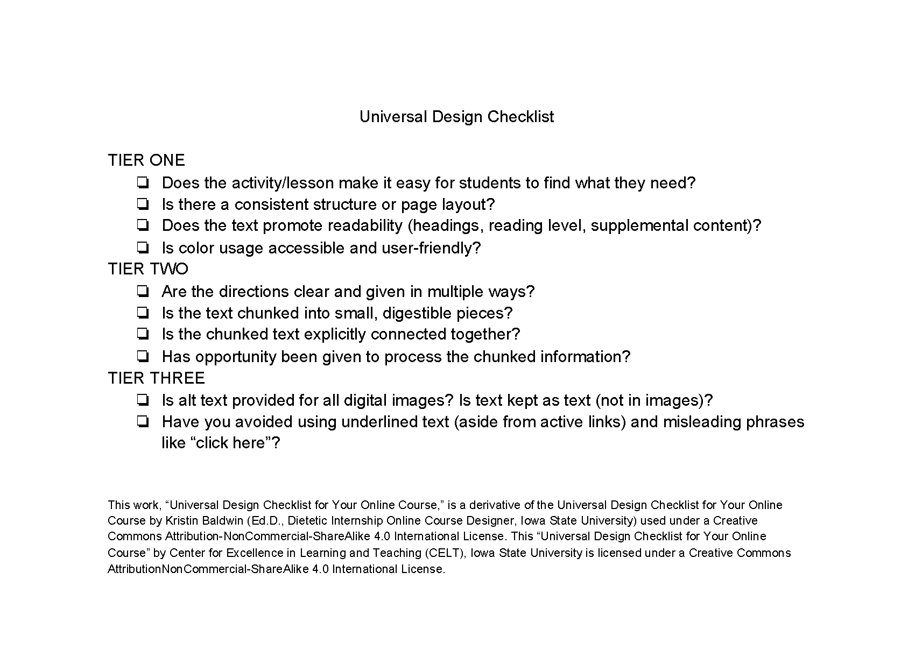
UDL Checklist
How might you use this checklist to plan a lesson or activity?
Notes:
we have a download for you called Universal Design Checklist. It provides the strategies for each Tier that we discussed today. We ask that you take a moment and reflect on one of the classroom activities discussed earlier. Choose one of the three activities we discussed from earlier and use this checklist to guide how you might make changes to the activity. Be ready to share out your group’s plans with the whole group.

Slide 31
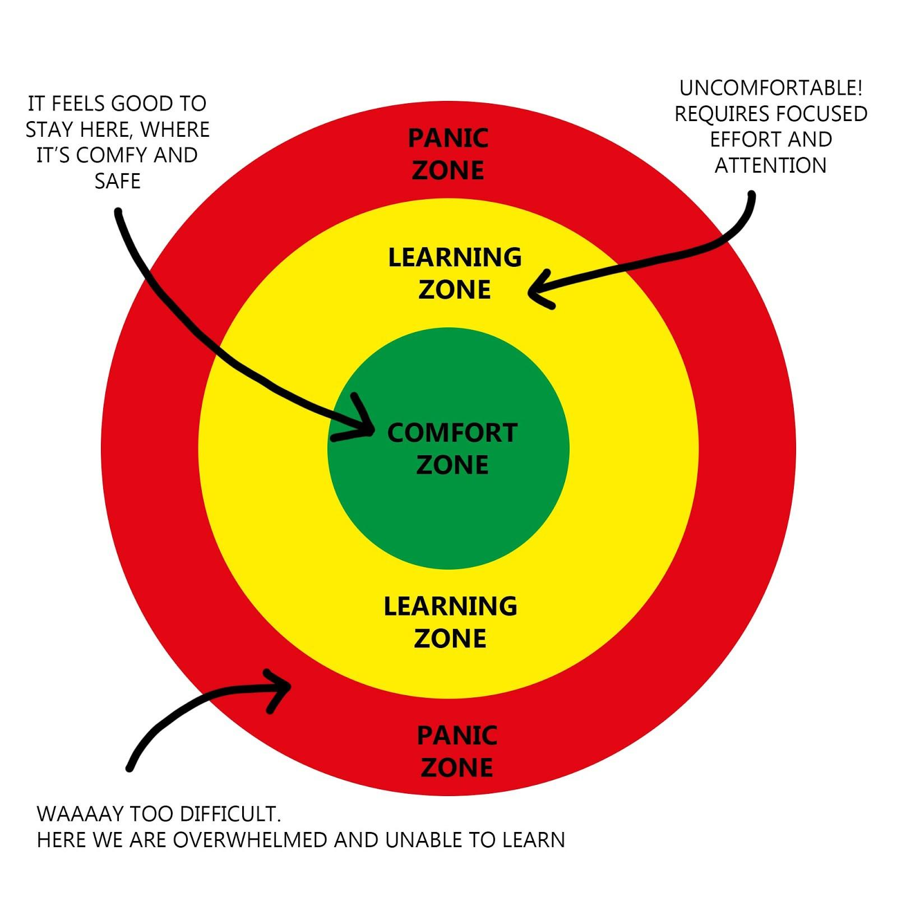
Zones of Comfort
Where do you fall in your level of comfort in using UDL?
Take a moment to reflect on what is contributing to your level of comfort or discomfort.
Notes:
We all have varying levels of comfort when it comes to implementing universal design for learning. Where do you fall in your level of comfort? Are you in the comfort zone? You feel extremely good about implementing various kinds of strategies for your students? Are you in the learning zone? It’s a little uncomfortable--it’s going to take some focused effort to make some changes? Or are you feeling a little panicked? If you are in the panic zone, you might be feeling overwhelmed right now and not able to implement anything. We ask that you take a moment to reflect on your level of comfort. Think about what is causing your level of discomfort. Are there any barriers to your discomfort that could be removed or changed?

Slide 32


Linked here
Keys:
Write down one thing you learned that can be a key to opening up learning for all.
Example response here.
Just right click on one of the keys to the left, click “Copy,” then Paste it to the board.
Type here.
Type here.
Type here.
Notes:
We have one final activity for you. Much like in the beginning, we are going to ask that you return to the Barriers and Keys document you opened at the beginning of this session. On the second slide, you will see Keys. We ask that you write down one thing you learned from this session that can be a key to opening up learning for all in your classroom. Just as before, you can right click on the key to copy and then paste it to the board. You can click inside the text box of the key to type.

Slide 33
Resources
CAST. (2018). The universal design for learning guidelines version 2.2 [graphic organizer]. Retrieved on Oct 08, 2020, from http://udlguidelines.cast.org/more/downloads.
DeMichele, S. (n.d.). Virtual station rotation. Retrieved from SlidesMania on Oct 13, 2020, from https://slidesmania.com/virtual-station-rotations-template-created-by-stephanie-demichele/.
Freethink. (2020, September 22). Playgrounds are boring. Here’s how to make them fun again. [Video]. YouTube. https://www.youtube.com/watch?v=Y3H3BxvDkCM&feature=youtu.be.
Iowa State University. (2019, September 12). Universal design checklist for your online course. Center for Excellence in Learning and Teaching. Retrieved October 8, 2020, from https://www.celt.iastate.edu/wp-content/uploads/2018/10/UDL-QM-accessibilitychecklist.pdf.
Utah State University. (1999). Contrast checker. Center for Persons with Disabilities. Retrieved October 30, 2020, from https://webaim.org/resources/contrastchecker/.
Notes:
We have included resources here for you to access later!

Slide 34
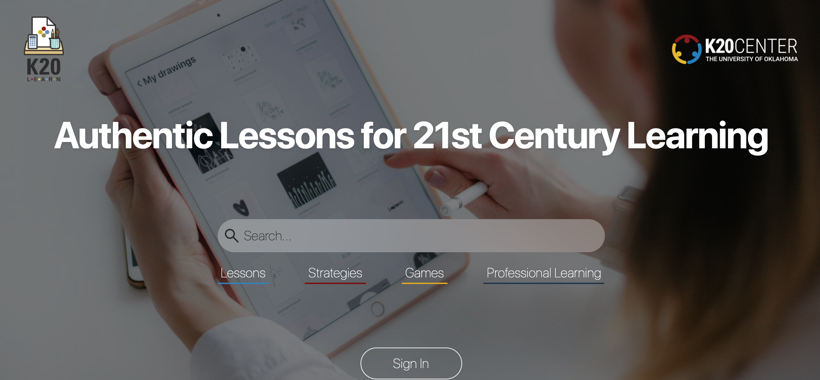
Find K20 Resources at learn.k20center.ou.edu
Notes:
Including our new K20 website!

