Slide 2
Discourse in Social Studies

Slide 3
Essential Questions
Why is discourse important to social studies instruction?
How do we foster meaningful discourse in the social studies classroom?

Slide 4
Learning Goals
Participants will explore instructional strategies and resources that promote discourse in the social studies classroom.
Participants will analyze how these instructional strategies and resources promote discourse in the social studies classroom.

Slide 5
What is Classroom Discourse?
What words or phrases would you use to describe ‘discourse’ as it relates to the social studies classroom?
Go to menti.com and use the code to submit your responses.

Slide 6
What is Classroom Discourse?
Classroom discourse encompasses a variety of written and spoken forms of communication.
Classroom discourse includes students’ engaging in expressing their ideas, discussing their reasoning, and representing their thinking.
Discourse is talking, listening, writing, reflecting, and representing.

Slide 7
Why is Classroom Discourse Important?
Authentic discourse incorporates the following dynamics into the classroom:
Students develop a deeper understanding of the content.
Students participate authentically in content-centered discussions.
Classroom is student-centered.
Students share ideas and respond to the ideas of others.
Students use higher-order thinking skills, such as organizing, synthesizing, and interpreting.
Students express their ideas by constructing supported explanations of their thinking, both written and verbal.

Slide 8
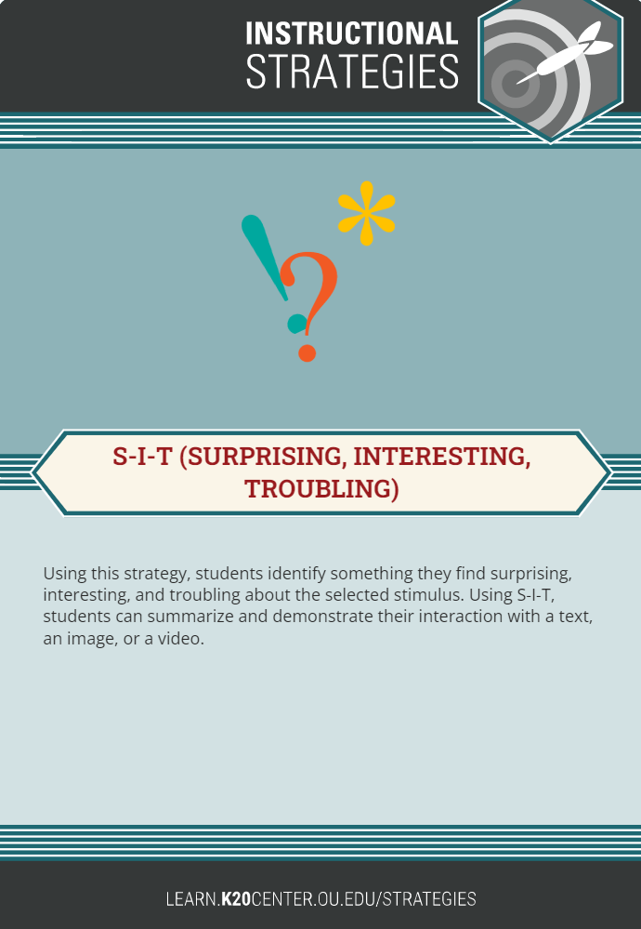
S-I-T: Surprising, Interesting, Troubling
S-I-T provides tools students can use to analyze texts, videos, or images.
Give students a text, video, or image. Based on their observations and analyses, have them identify one surprising fact or idea, one interesting fact or idea, and one troubling fact or idea.
Ask students to share their ideas and reasoning with small groups and/or the whole class.

Slide 9
S-I-T: Surprising, Interesting, Troubling
Using the handout “Laws and Practices Shaping the Lives of Women in 1848,” write down an idea or fact which affects you in the following ways:
  One fact or idea that surprises you.
  One fact or idea that interests you.
  One fact or idea that troubles you.
How can the S-I-T strategy foster discourse in your classroom?

Slide 10
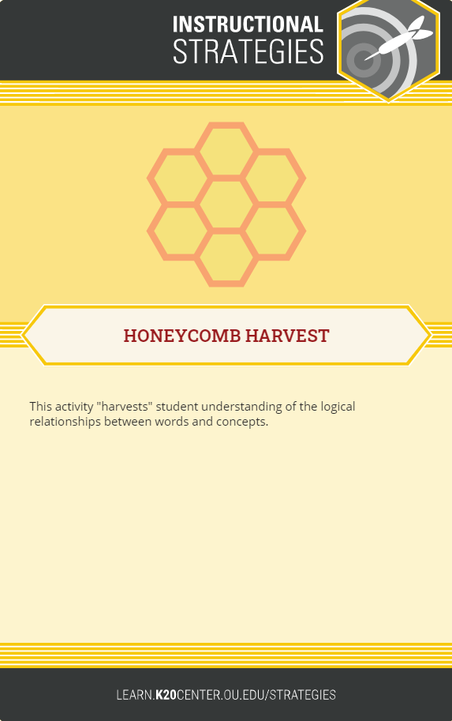
Honeycomb Harvest
This strategy is designed to help students understand logical relationships among words and concepts.
Give students a set of hexagons containing different concepts related to the content they are studying.
Have students work individually or in groups to arrange the hexagons so the sides of related hexagons touch.
Ask students to justify their arrangements.

Slide 11
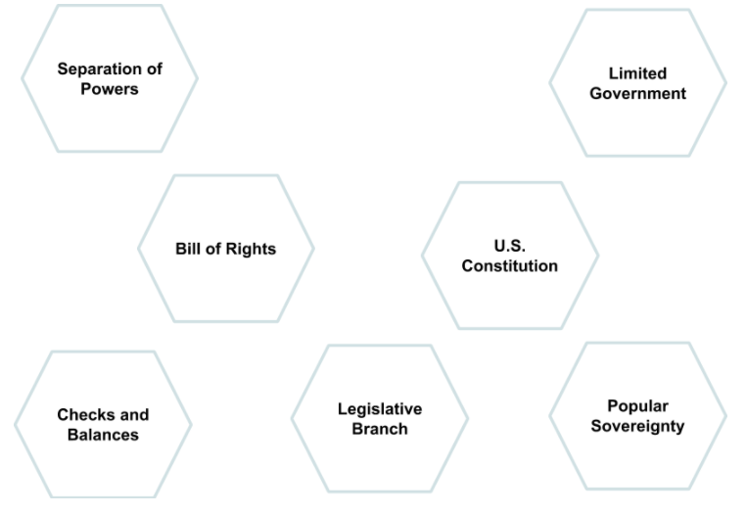
Honeycomb Harvest Sample
How can the Honeycomb Harvest Strategy foster discourse in your classroom?

Slide 12

Say Something
Say Something is a strategy that helps students participate effectively in academic conversations with their peers.
Sentence starters prompt students to express their ideas, ask questions, and support their claims with evidence.
Notes:
Edutopia. (2018, Nov. 16). Encouraging academic conversations with talk moves. https://www.youtube.com/watch?v=kSI4imt0dXg&feature=youtu.be

Slide 13
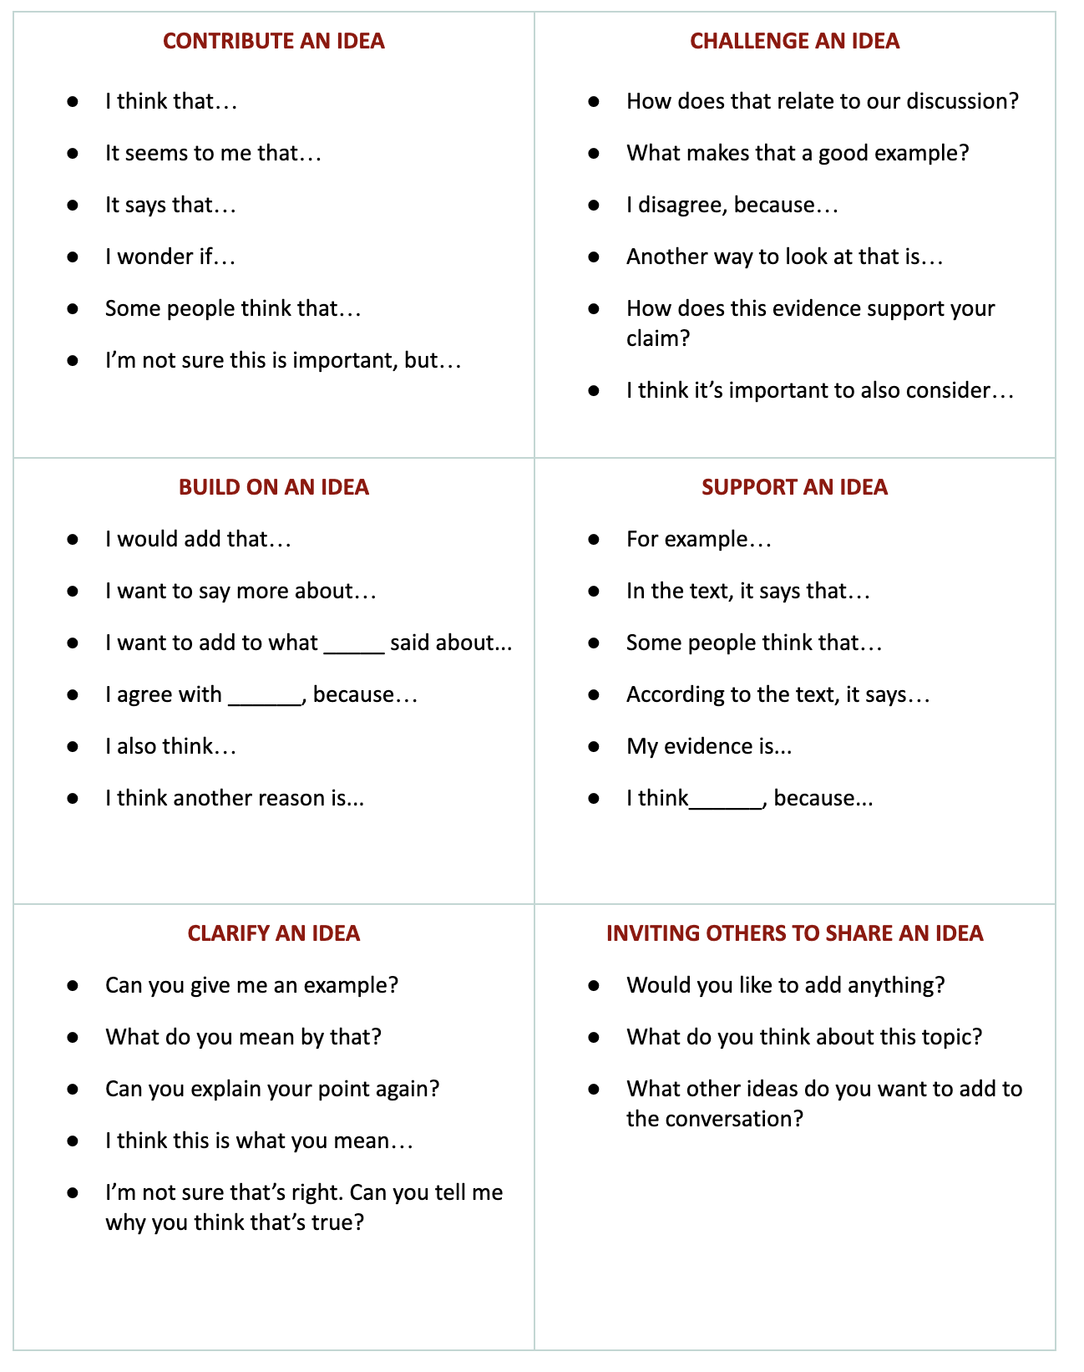
Say Something
Use sentence starters to prompt classroom conversation.
  Using some of the starters below, examine the poem by Langston Hughes on the next slide.

Slide 14
I, TOO [am America] By Langston Hughes
I, too, sing America. I am the darker brother. They send me to eat in the kitchen When company comes, But I laugh, And eat well, And grow strong. | Tomorrow, I’ll be at the table When company comes. Nobody’ll dare Say to me, “Eat in the kitchen," Then. Besides, They’ll see how beautiful I am And be ashamed— I, too, am America.
How can Say Something foster discourse in your classroom?

Slide 15
Reflection
Which of today’s strategies can you implement in your classroom? Why?
How can these strategies be effective in promoting discourse? Explain.
How can you modify these strategies to work with your students? Explain.

