Slide 2
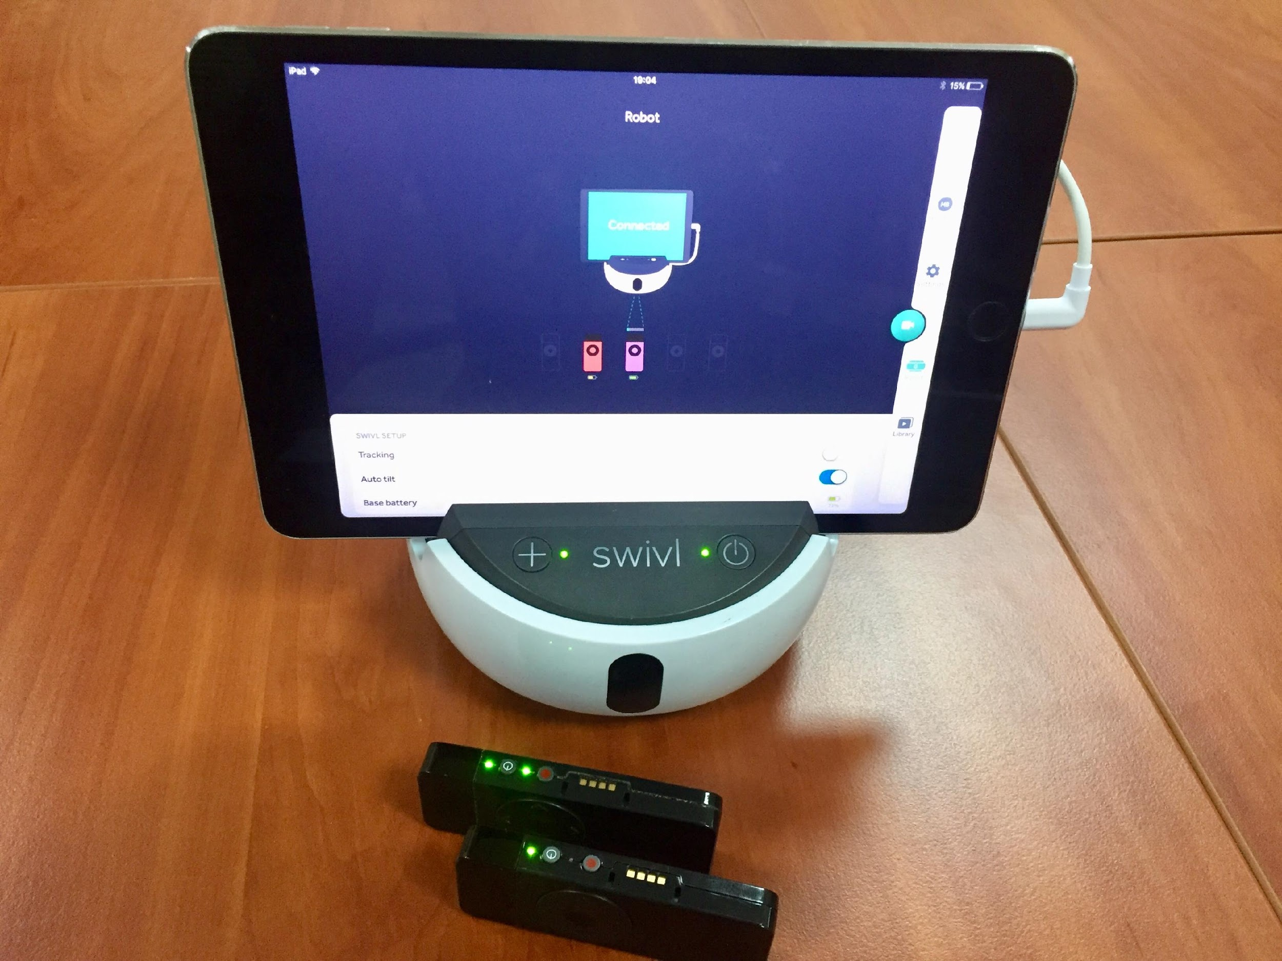
All Around Swivl™ Bots
Notes:
Image source: Swivl Help Center. (n.d.). Swivl™ Robot [Image]. Swivl. https://swivl.zendesk.com/hc/en-us/articles/360003063733-Swivl-Live-Stream-Video

Slide 3
Essential Question
How can technology be used to improve an instructor’s reflective practice?

Slide 4
Getting to Know You
Fist to five: What do you know about Swivl™ bots?
1 = No knowledge
2 = Little knowledge
3 = Some knowledge
4 = Knowledge plus experience
5 = Could teach others how to use them
Notes:
Using Fist-to-Five means no materials are needed and provides a wider range of teacher responses.
Strategy source: K20 Center. (n.d.). Fist to Five. Strategies. https://learn.k20center.ou.edu/strategy/68

Slide 5
Swivl™ Bots in Action
Notes:
Play the video on the slide or go to the following link: https://www.youtube.com/watch?v=QwebkHu8B3U
Source: Great Hearts Academies. (2017, February 7). Swivl in Use [Video]. YouTube. https://www.youtube.com/watch?v=QwebkHu8B3U

Slide 6
Play Time: Preparation
Go to one of the stations. Work with your group to complete the following tasks (they must be done in order):
Task 1A: Do you have a Swivl account?
Yes → Log in. (If you attended ARA this past summer, you have one already.)
No → Go online (swivl.com) and create one by selecting “Sign Up.”
Task 1B: If your device is not preloaded with the Swivl app, download the app to your device.

Slide 7
Play Time: Action
Remember to complete the rest of the tasks in order:
Task 2: Practice setting up your device with the Swivl.
Task 3: Practice recording and uploading video to your Swivl cloud account.
Task 4: Practice accessing your recordings.

Slide 8
What is a Swivl bot?
A Swivl is a robotic “cameraman” for use in classrooms and professional settings. Download the free app and dock your device on a Swivl base.
The robot records as you move and talk, and then it saves the video straight to your Swivl cloud account.

Slide 9
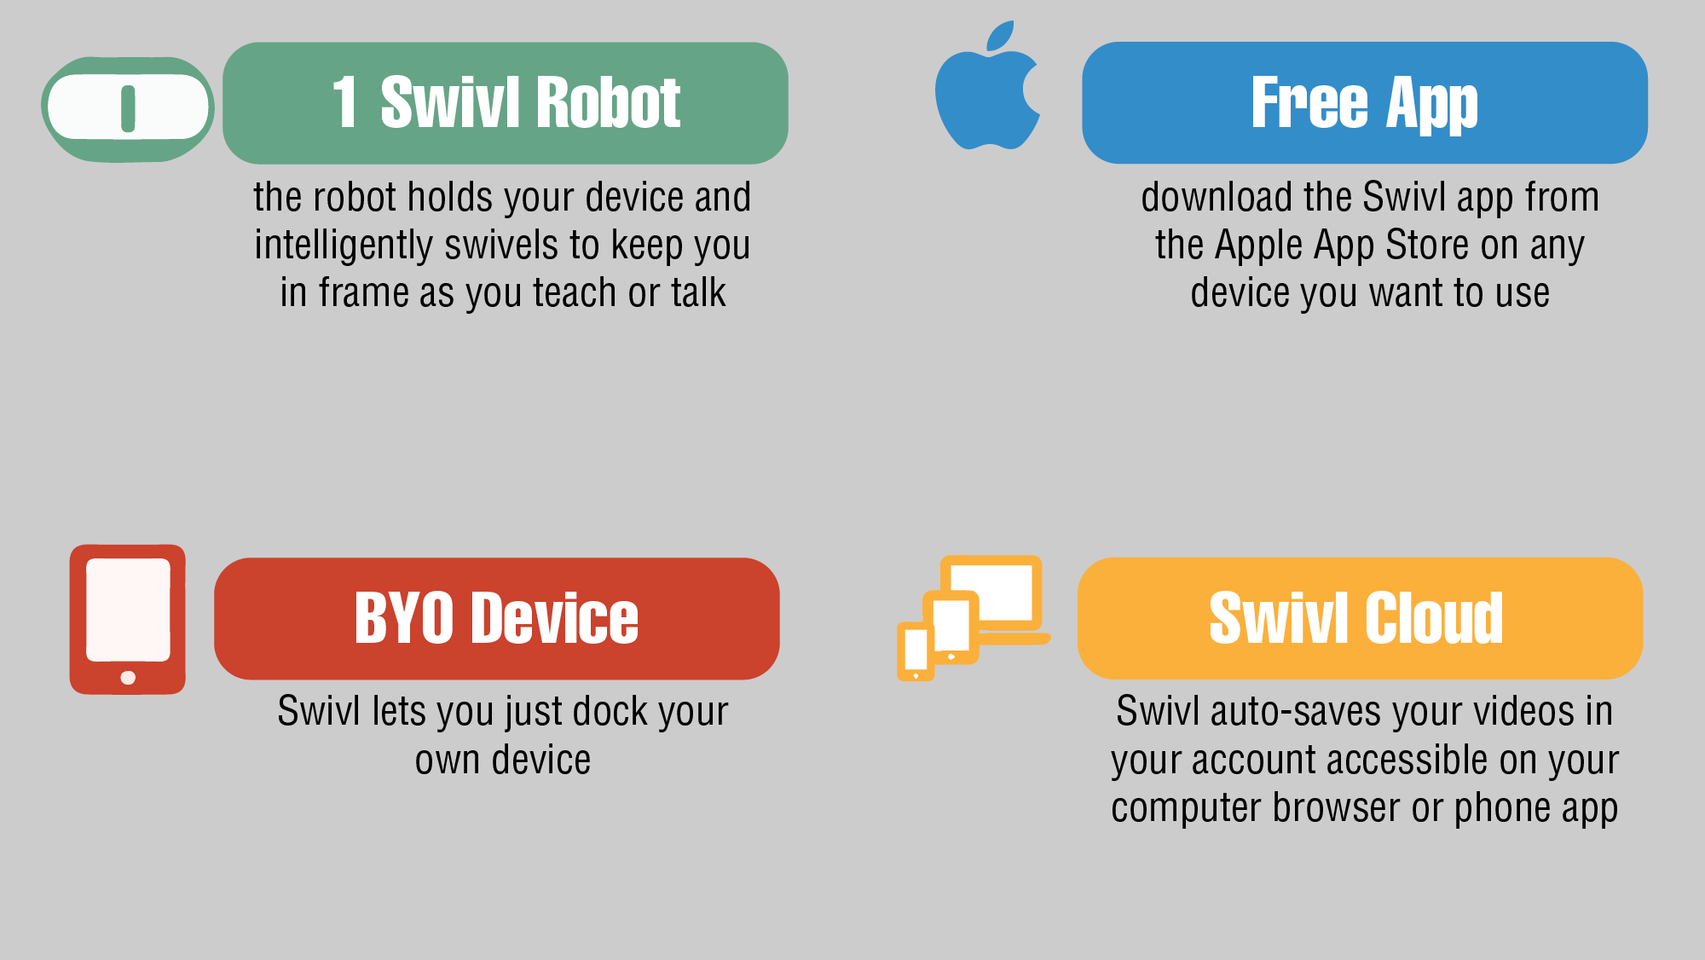
Advantages: Technology Terms
Notes:
Source:

Slide 10
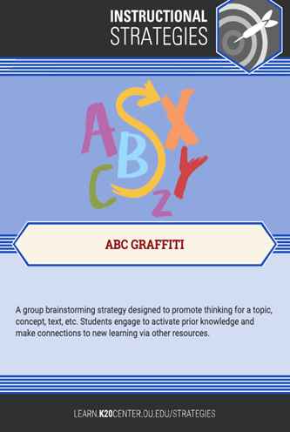
T is for Technology: ABC Graffiti/Chain Notes
Think of ways Swivl can be used in the classroom.
Take 30 seconds to jot down your ideas on the ABC Graffiti handout.
When time is called, pass your sheet to the person on your right.
Repeat.
Notes:
Sources: K20 Center. (n.d.). ABC Graffiti. Strategies. https://learn.k20center.ou.edu/strategy/96
K20 Center. (n.d.). Chain Notes. Strategies. https://learn.k20center.ou.edu/strategy/52

Slide 11
Uses for Swivl Bots
Professional Uses:
Coaching
Peer feedback
Self-reflection
Student-teacher observations
Remote observations
Recording teacher trainings
Building a visual best practices library
Classroom Uses:
Record student projects
Peer (or group) feedback
Student self-reflection
Record lectures and labs
Remote student learning
Capturing student learning
Managing classroom behavior
Notes:
Discuss the Swivl bot as a positive resource, not a punitive one. The K20 Center uses Swivl bots to help coach teachers in using authentic teaching and learning skills in the Action Research in Authenticity (ARA) program. Teachers using the Swivl bot can capture videos of labs or lessons and send to fellow teachers in Oklahoma or in other states and ask for feedback. It is also possible to use the Swivl bot as a tool for teacher evaluations when traveling is a concern.

Slide 12
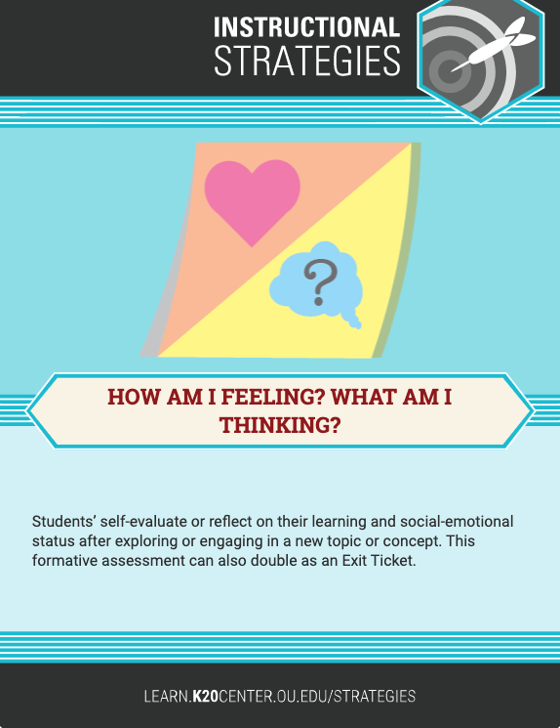
How am I feeling? What am I thinking?
Divide a sticky note in half.
On one half, draw an image of how you feel about Swivl bots.
On the other half, write a sentence about your thoughts on using Swivl.
Place your sticky notes on a wall or whiteboard to share with the group.
Notes:
Source: K20 Center. (n.d.). How am I feeling? What am I thinking? Strategies. https://learn.k20center.ou.edu/strategy/187

Slide 13
Follow us on social media.

