Slide 2
ISTE Standards
& The Exquisite Educator

Slide 3
Essential Question
How can ISTE standards enrich our teaching practice?

Slide 4
Objectives
By the end of this ISTE Educator and Student professional development, cohort teachers will be able to:
Explain the overall importance of the ISTE Standards
Deconstruct each ISTE Standard
Reflect on how the ISTE Standards can transform learning
Construct a plan to incorporate the ISTE Standards into their teaching practice

Slide 5

Exquisite Educator/Student
shorturl.at/bfMNX
Notes:
Use this template to create an exquisite educator and student. Be sure to note what they look like, sound like, etc. Feel free to add words, objects, shapes to the image to show your exquisite educator/student.
The above link should force a copy so every participant has their own to work on.

Slide 6
Exquisite Educator/Student
What do the “Exquisite” Educator and the “Exquisite” Student look like, sound like, ect?
What words, objects, shapes, etc. would represent each?
Notes:
Use this template to create an exquisite educator and student. Be sure to note what they look like, sound like, etc. Feel free to add words, objects, shapes to the image to show your exquisite educator/student.

Slide 7
What do they know?
Think about the “Exquisite” Educator and the “Exquisite” Student.
What do they know?
Add words and images in the “head” section.
Notes:
Remind participants to add words and images on the left for the educator and the right for the student.
After 45 seconds, have participants pass their paper to their right.

Slide 8
What do they feel?
Think about the “Exquisite” Educator and the “Exquisite” Student.
What do they feel?
Add words and images in the “heart” section.
Notes:
Remind participants to add words and images on the left for the educator and the right for the student.
After 45 seconds, have participants pass their paper to their right.

Slide 9
What do they do?
Think about the “Exquisite” Educator and the “Exquisite” Student.
What do they do?
Add words and images in the “hand” section.
Notes:
Remind participants to add words and images on the left for the educator and the right for the student.
After 45 seconds, have participants pass their paper to their right.

Slide 10
Where are they going?
Think about the “Exquisite” Educator and the “Exquisite” Student.
Where are they going instructionally?
Add words and images in the “feet” section.
Notes:
Remind participants to add words and images on the left for the educator and the right for the student.
After 45 seconds, have participants pass their paper to their right.

Slide 11

ISTE Standards & Blackout Poetry
shorturl.at/cyLWX
As you read through your ISTE standard, blackout any unimportant words, thus leaving only words important to that standard.
Notes:
Click the link to access the ISTE Standards for Educators. This will force a copy to your Google Drive.
Select one ISTE standard or the one provided to you. Here is an example of Blackout Poetry. As you read through your ISTE standard, blackout any unimportant words, thus leaving only words important to that standard.

Slide 12


Slide 13


Slide 14

We interrupt this PD for a very important service announcement
Notes:
https://freesvg.org/offline-tv-screen-vector-image

Slide 15

Window Notes
Looking back at your ISTE Standard:
What is the standard?
Who is impacted by the standard?
Why is the standard important?
How is this standard applied in the classroom of an exquisite educator?

Slide 16
ISTE PSA
Create a short PSA which highlights the ISTE standards you selected and why they are important.

Slide 17
ISTE PSA & Exquisite Educator

Slide 18
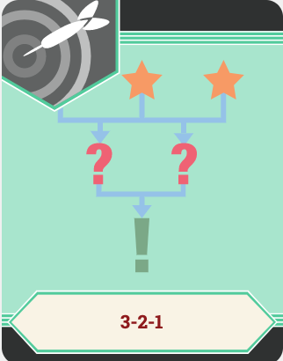
3-2-1
3- ISTE Standards you feel confident you are already implementing
2- ISTE Standards you would like to address more frequently this year
1- goal you have for your classroom this year which will help you improve in those areas

Slide 19
Objectives
By the end of this ISTE Educator and Student professional development, cohort teachers will be able to:
Explain the overall importance of the ISTE Standards
Deconstruct each ISTE Standard
Reflect on how the ISTE Standards can transform learning
Construct a plan to incorporate the ISTE Standards into their teaching practice

