Slide 2
Unlocking Digital Citizenship

Slide 3
Grant Goals
Increase cohort academic performance and preparation for postsecondary education (PSE)
Increase high school graduation and PSE participation
Increase student educational expectations and increase student and family knowledge of PSE options, preparation, and financing

Slide 4
Essential Question
How can embedded digital citizenship skills help our students become productive global digital citizens?

Slide 5
Objectives
By the end of this session, you will be able to:
Evaluate your beliefs and values
Evaluate your digital footprint
Model good digital citizenship
Construct a learning culture where digital citizenship is embedded in the curriculum to promote positive and safe behaviors online

Slide 6
Faux Pas
An embarrassing or tactless act or remark in
a social situation.

Slide 7
What do you Meme?
Select a celebrity faux pas and image
Create a meme to show how to avoid the faux pas

Slide 8
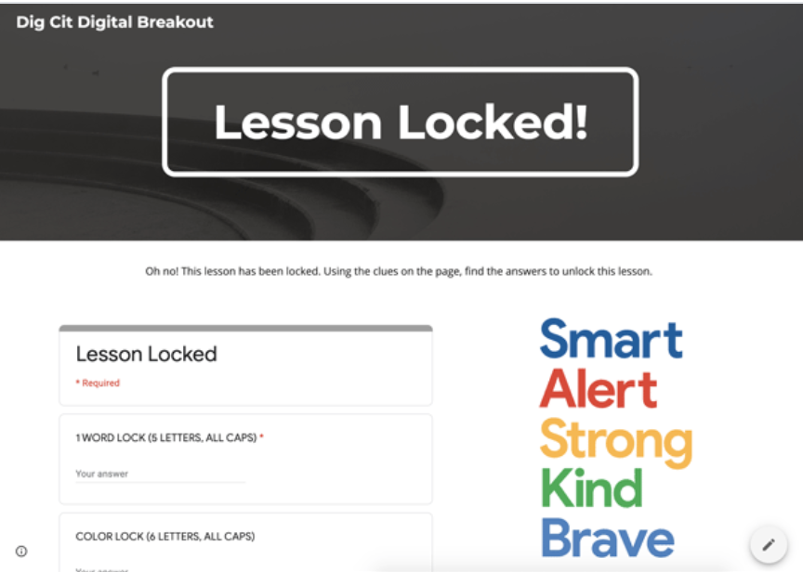
Dig Cit Digital Breakout
https://tinyurl.com/y96l2cwu
Unlock the clues that will help you become a better digital citizen!
Click on the pictures, videos, buttons, and other linked elements
What the videos and read the information to find the answers to each lock

Slide 9
Create Your Own Google Site
Use the resources found in the digital breakout or any other resources that fit your class and students

Slide 10
Digital Footprint
A trail of data you create while using the Internet.
Notes:
https://pixabay.com/illustrations/footprint-footprints-foot-feet-220254/

Slide 11
What’s My Digital Footprint?
Take a moment to Google yourself!
What did you find?
Was there anything surprising?
What did you hope to find?

Slide 12
Two Stars and a Wish
Review at least two other Google Sites.
What did you find that you liked?
What are some other ways content might be organized?

Slide 13
Objectives
By the end of this session, you will be able to:
Evaluate our beliefs and values
Evaluate our digital footprint
Model good digital citizenship
Construct a learning culture where digital citizenship is embedded in the curriculum to promote positive and safe behaviors online

