Slide 2
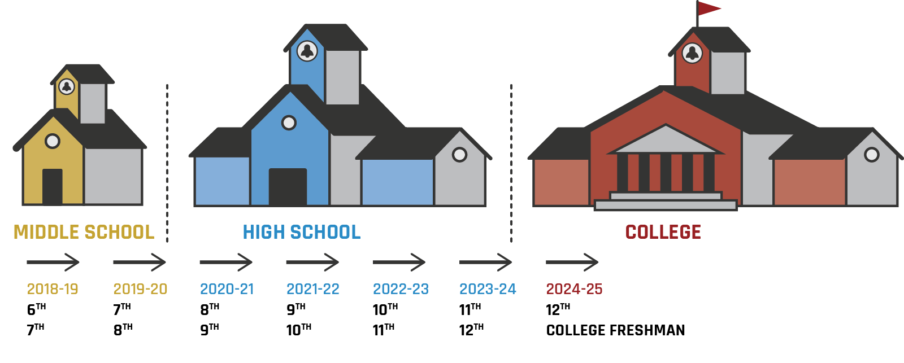
GEAR UP for MY SUCCESS
The High School Years 2020—2025
Notes:
Quick intro that GU has been serving the current 7th and 8th graders for the last two years and we are going to explore what GU is and how you (the staff) can support the partnership between K20 and site.

Slide 3
Preparing for PSE and Careers
What activities and experiences should high schools provide, so students are prepared for postsecondary education (PSE) and careers? [INSERT MENTI.COM CODE]
Notes:
Engage: Using mentimeter, padlet, or another digital platform, allow participants to individually respond to this prompt. The responses generated from this prompt will be revisited again after participants explore the types of GU service opportunities.
Participants will respond. Show their responses and then move to the next slide and have them answer the next question.
Expect answers that are very similar to GU programs such as campus visit, career expo, mentoring, academic rigor, funding, time, etc.

Slide 4
What would you need …
What would you need in order to create these activities and experiences for students?
Notes:
Engage:
We believe they will respond with answers such as time, money, people, parents, campus scheduled, connections and access to these professionals, etc.

Slide 5
Overview Goals
Identify the goals, benefits, and expectations of GEAR UP
Recognize the collaborative partnership between the K20 Center’s GEAR UP grant and your school
Notes:
Participants will… identify the goals, benefits, and expectations of their school's participation in the GU grant. They will also recognize that this is a partnership between us and their school.

Slide 6
What are the goals and benefits of the K20 Center and GEAR UP?
Explore the infogram to learn more.
Record things that you notice or wonder about the goals and benefits of K20’s GEAR UP grant.
http://k20.ou.edu/guoverview20-21
Notes:
Explore
Participants scroll through the provided infogram to learn more about K20 and our past success/impact with other GEAR UP grants. The last portion of this infogram contains the introduction of the three grants. If time allows you could let them read all three, but otherwise steer them to their specific grant. As they scroll through, ask them to look for things they notice and wonder - this is only to scaffold and actively process the information they are briefly searching.
Use the next slide to bring them back together… Ask one to three people to share out what they noticed. If you have time for wonders, you may ask them to share it after they share out the notices.

Slide 7
What did you notice?
Goals?
Benefits?
Notes:
Ask three or less to share out what they noticed and possibly provide time for them to ask questions (wonders). Do not get stuck on this infographic or slides 6 and 7. They are strictly for basic foundational information about our credibility and past success (buy-in).

Slide 8
What services are available?
Use the link to explore 2 to 4 services provided to students, families, and your school.
(insert link for specific grant from notes below)
Notes:
Paste in the short URL for the specific grant this school belongs to:
http://k20.ou.edu/servicesguf
http://k20.ou.edu/servicesokc
http://k20.ou.edu/servicesgums
Spend the meat of your time here. Allow participants to explore this infographic to learn more about the services and opportunities GU offers to the families, students, and school. This connects and brings home the importance of our “partnership” with their site and staff. We cannot do all of this without their commitment to systemic growth/change, continual learning, and support.

Slide 9
Revisit
Based on what you said about needs at the beginning …
What GEAR UP services might help you implement or facilitate those activities and experiences?
Notes:
Bring the whole group back together and ask

Slide 10
It takes a village, and we need your help!
Consider what you are already doing in your classroom and beyond …
What are the expectations of the grant?
How will you support this partnership?
Notes:
Image from <a href="https://www.freepik.com/free-photos-vectors/business">Business vector created by studiogstock - www.freepik.com</a> (I am happy if you create a different image, like this one… using our gears maybe? Shows partnership/teamwork ☺ the gears could also be labeled similar to our larger gears… PD, Fam Eng, Mentoring, CV, etc.)

Slide 11
The impact of GEAR UP for MY SUCCESS
So far (2018 to now) …
#### of 7th graders attended ______ campus
### of 8th graders attended ______ campus
### PD service hours provided to middle school staff
### service hours provided to families
### of hours of mentoring

Slide 12
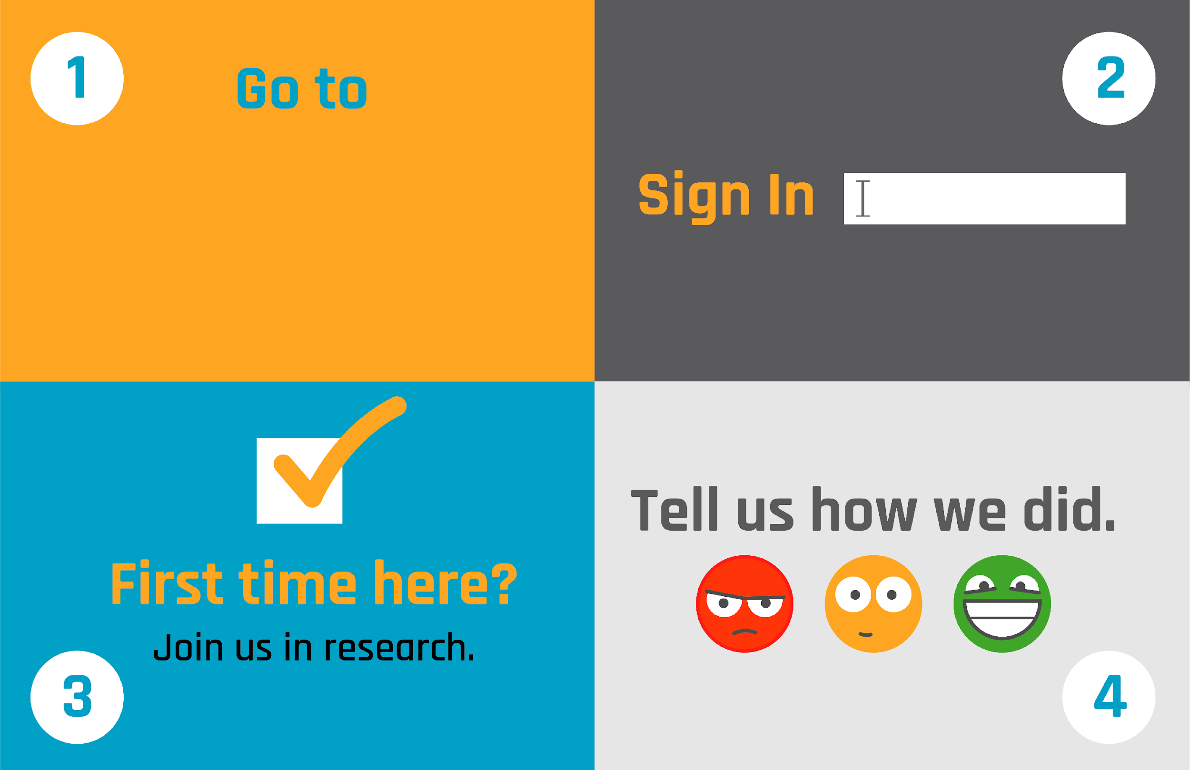
School email
(No Participant ID is required.)
trek.k20center.ou.edu/oe/#####
Notes:
***This slide MUST be edited with the correct TREK web address.***
Click on the link in the orange box to edit the numbers at the end and the QR code.

