Slide 2
Essential Questions-Extend
Overarching and Topical Essential Questions

Slide 3
Essential Questions Card Sort Activity #2
With a partner, sort the cards used earlier into two essential question categories:
Overarching Essential Questions
Topical Essential Questions
Notes:
Have participants sort the characteristics of the types of essential questions into two categories: Overarching and Topical. Ask volunteers to explain their choices.

Slide 4
Overarching Questions—Characteristics
Universal
Life Long
Big Picture
Multiple Units and Cross Disciplines
Show learning and life connections

Slide 5
Topical Questions--Characteristics
Focus on lesson objectives
Promote higher-order thinking
Stimulate discussion
Require evidence and reasoning
Notes:
Pass out second card sort.

Slide 6
Why EQs? Overarching & Topical EQs Promote Inquiry
As you watch the video, complete the table:
Identify the Topical Essential Questions that support the lesson objectives.
Look for ways the teacher in the video encourages inquiry and develops students’ critical thinking.
Essential Questions in an Inquiry-based Classroom
Notes:
Why inquiry?
When we teach students to critically question ideas, we have the first step.
Have participants fill out the table that goes with the video.
The overarching Essential Question is listed.
What are the topical Essential Questions?
How does the teacher facilitate student-centered inquiry to prompt students to think more deeply about the subject matter and how it relates to the essential question?

Slide 7
Subject | Overarching Essential Question | Topical Essential Questions
U.S. History | What is the meaning of freedom? | What does freedom mean to a freed slave in post Civil War era? To a slave owner? What should be done when freedoms are not respected?

Slide 8
Think-Pair-Share
In the video, how does the teacher promote a climate of inquiry and develop students’ critical thinking?
Notes:
K20 Center. (n.d.). Think-Pair-Share. Strategy. https://learn.k20center.ou.edu/strategy/139
Explain that this is more than just having a pre-set of questions. The teacher listens to the student responses and rather than answering the questions, promotes more questions which either leads to further investigations or more responses.

Slide 9
Your Turn for EQs
With lesson objective for your own content area:
Develop one Overarching Essential Question.
Develop 2 to 3 Topical Essential Questions that relate to the content and promote student inquiry.
Notes:
Print cards that have one content objective based upon the needs and size of your group. For example, if you are working with high school teachers, print a few secondary cards. OR
Ask teachers to pick a lesson idea they will TEACH tomorrow or next week and develop the Overarching and Essential Questions.
Pass out the appropriate card, a sheet of chart paper, and markers to participants.
Have participants read the lesson objective and develop the overarching and topical essential questions.
Have participants write their questions on the chart and hang on the wall.
Have participants in the same discipline work together in pairs or as a cross-curricular activity.

Slide 10
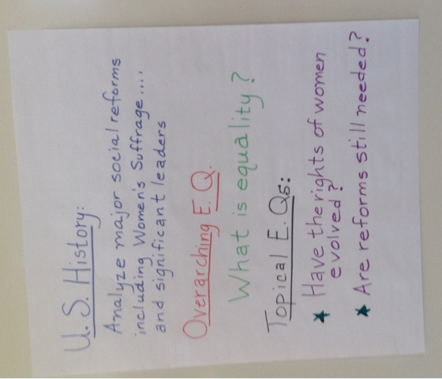
Gallery Walk
Notes:
Direct participants to walk around and look at each others’ essential questions. They may make observations about the essential questions. Use Checklist-Characteristics of Essential Questions.

Slide 11
Session Objectives: How did we do? On a 3x5 note card, briefly tell us how useful this information will be to you in developing and delivering instruction.
Identify the characteristics of Essential Questions.
Recognize the role of Essential Questions in lesson planning.
Develop Essential Questions for a lesson objective.

Slide 12
Research Resources
Keely, P. (2008). Science Formative Assessment: 75 Practical Strategies for Linking Assessment, Instruction, and Learning. Thousand Oaks: Corwin Press.
McTighe, J. & Wiggins, G. (2013) Essential Questions: Opening Doors to Student Understanding, Alexandria: ASCD.

